Slide 1


Redesigning Bandpass filter
Wafeeq Jaleel
Tianxiang He
College of Engineering
The Ohio State University
March 28th, 2022

Slide 2
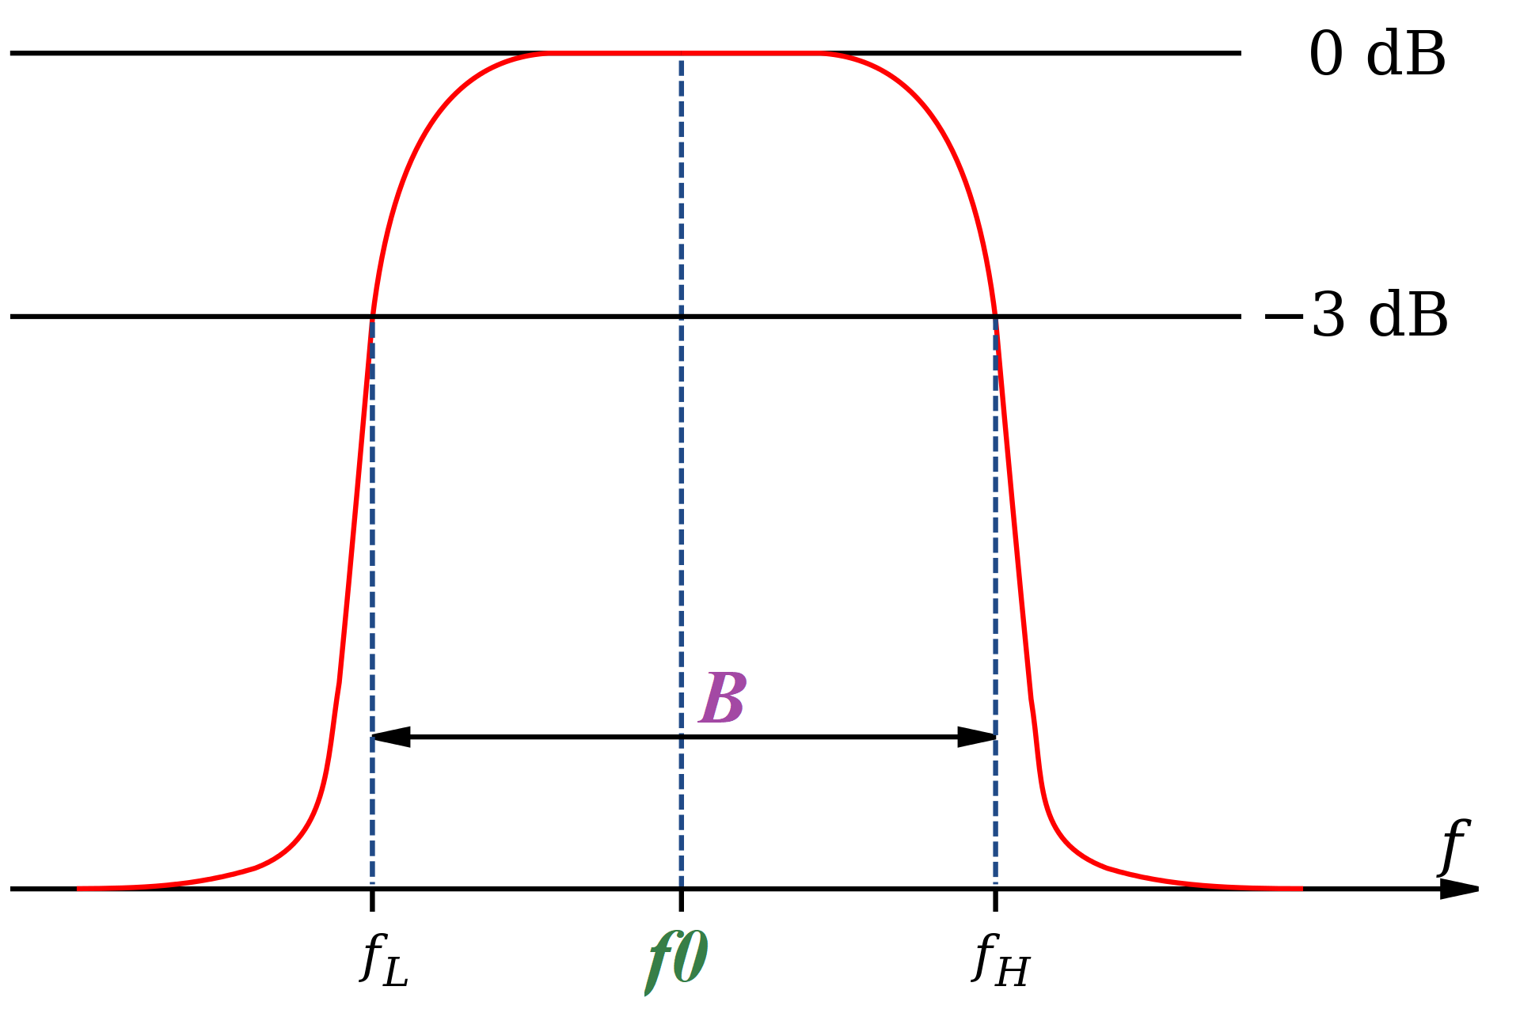
Bandpass filter is a device that only allows frequencies in certain range to pass.
-3db Bandwidth
Center
frequency

Slide 3
The Acme Company proposed a bandpass filter circuit for the team to design.
Center frequency | 200kHz | ±5%
-3db Bandwidth | 50kHz | Maximum
Once the final design is complete, 15000 units of this specific filter will be ordered through Digi-Key.

Slide 4
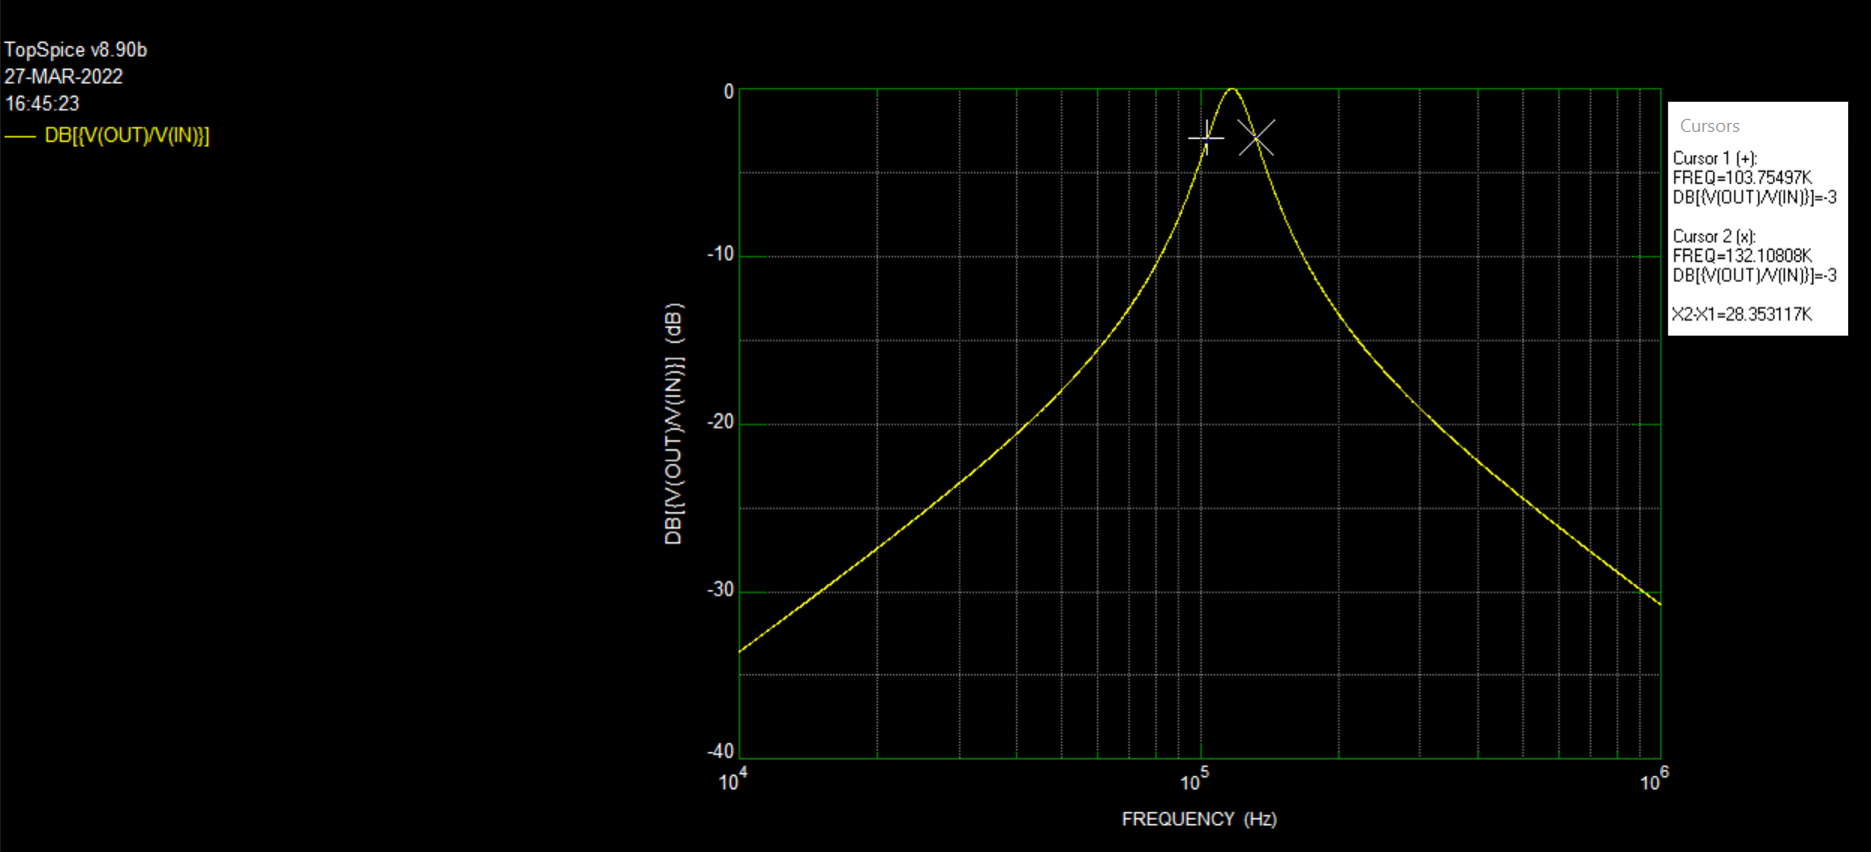
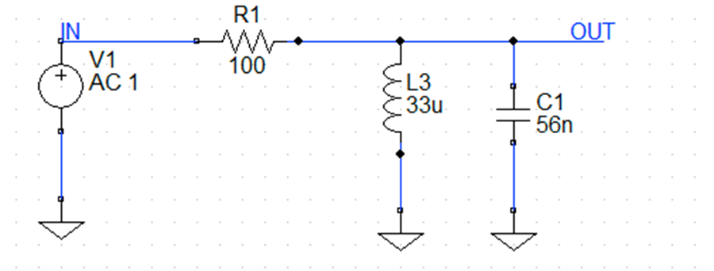
TopSpice was used to simulate bode plot for the circuit and record center frequency and bandwidth
Center Frequency: 117 kHz
Bandwidth: 28kHz

Slide 5
The resistor and capacitor were modified to determine the values that meets the specification
Test number | Capacitor (nF) | Resistor (Ω) | Inductor (µH) | Bandwidth (kHz) | Center Frequency (kHz)
1 | 56 | 50 | 33 | 56.71 | 120.45
2 | 56 | 100 | 33 | 28.35 | 117.93
3 | 56 | 200 | 33 | 14.18 | 117.29
4 | 20 | 50 | 33 | 158.78 | 211
5 | 100 | 50 | 33 | 31.76 | 89.04
6 | 20 | 100 | 33 | 79.39 | 199.89
7 | 20 | 150 | 33 | 52.93 | 197.7
8 | 20 | 200 | 33 | 39.69 | 196.9

Slide 6
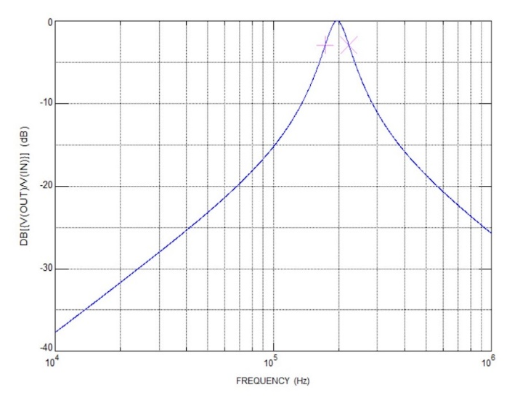
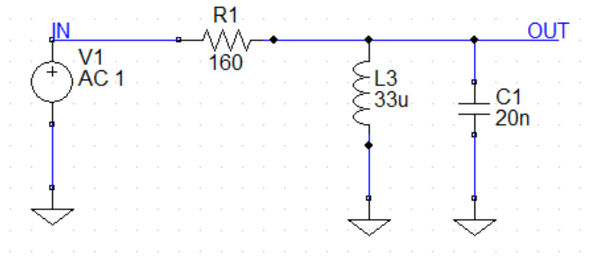
The finalized resistor value is 160Ω, capacitor value is 20nF and inductor value is 33uH

Slide 7
The final design has a center frequency value of 195.906KHz and -3dB bandwidth of 49.6179KHz.
Center frequency | 200kHz | ±5%
-3db Bandwidth | 50kHz | Maximum
Encountered problem: the calculated center frequency value is different using two approaches.

Slide 8
The electronic parts are selected from Digikey
Component | In stock Quantity | unit price | Total price | Shipping cost
160Ω resistor | 37487 | $ 0.01078 | $161.70 | $6.99
20 nF capacitor | 64528 | $ 0.06026 | $903.90 | $6.99
33uH inductor | 17390 | $ 0.03478 | $521.73 | $6.99
Total (Shipping + Price)
$1608.30

Slide 9
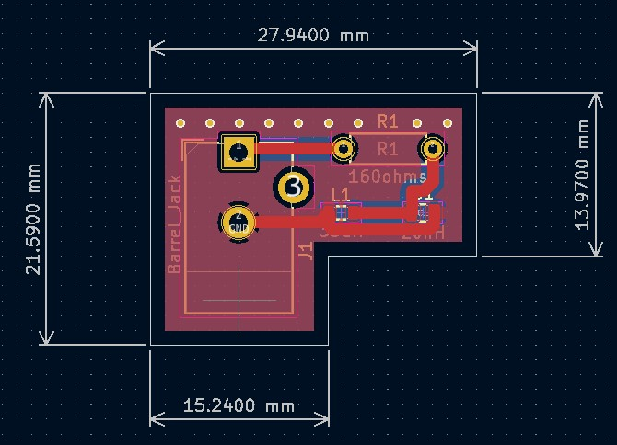
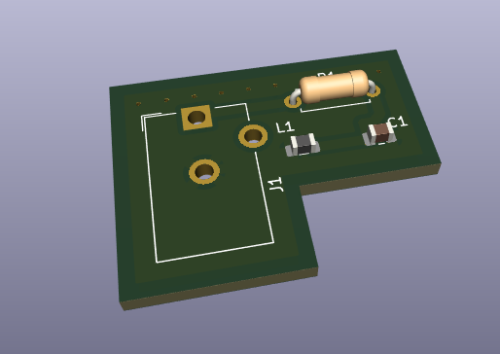
The printed circuit board was designed using KiCad software
Resistor
Power Source
Capacitor
Inductor
Notes:
The

Slide 10
The total cost for 15000 units is $2079.29
The printed circuit board cost for 15000 unit is $450.18 and the shipping cost is $20.19.
The estimated arrival time is two weeks.

Slide 11
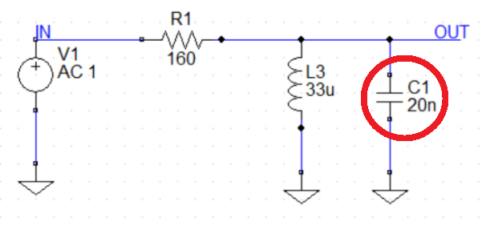
The final design achieves low cost while meeting the company’s requirements
Potential issue:
20nF capacitors are not very common on the market.
Any Question?

Slide 12
https://osu.zoom.us/rec/play/U2z4tW-d0AW06WZquIqr6YKqfkFit3pP8jxYYfHSkypXzh12JP7hr04SdGFCX6JQZDgRTXIhV_FMA5kc.Z-Itta0EKFslCkbi?continueMode=true

