Slide 1

DEVELOPMENT OF AN ONLINE ASSIGNMENT SUBMISSION MANAGEMENT SYSTEM
A CASE STUDY OF DEPARTMENT OF COMPUTER SCIENCE, ADEKUNLE AJASIN UNIVERSITY.
BY
OYELOLA EMMANUEL OLUWAFEMI
MATRIC NO: 140404141
SUPERVISOR:
DR. A.O AKINGBESOTE

Slide 2
BACKGROUND TO THE STUDY
An online assignment system is a system contained within a learning environment. The functionality of the standard assignment handling module has been extended to cater for all the department’s needs in terms of receiving assignments from students and making them available to tutors to mark.
Assignment management involves collecting, marking, and redistributing to students. The process is broken down into four stages, which are: submission, marking, recording and return. Online assignment submission and management (OASM) involves the use of the World-Wide Web, the Internet and computers to aid these processes (Jones, 2003).

Slide 3
BACKGROUND TO THE STUDY (CONTD.)
In view of this, the unrealistic approach(es) considered by the traditional or conventional system in processing assignments; promoted the problems the new system is proposing to unravel. The problems mentioned above may arise due to:
Distance
Format of the assignment (written or printed) etc.
The Centre for Entrepreneurship and Development Study in Adekunle Ajasin University also implored the use of this system during the 2014/2015 school session to facilitate effective grading of the assignments due to the large number of students offering the course.

Slide 4
RELATED WORKS
S/N | AUTHOR | ARTICLE | AIM | STRENGTH | LIMITATIONS
1 | David Jones and Sandy Behrens, (2003) | Online Assignment Management: An Evolutionary Tale | Proposing a model that encapsulates the issues, challenges and opportunities encountered when OASM is adopted by a wider range. | The most obvious advantage offered by the OASM is that it offers faster transportation than traditional and physical methods. | Much of the reported work is limited to small-scale use.
2 | S. Swetha et al, (2017) | Online Assignment Management System | To develop a secure system that provides a platform for submission of assignments. | This system reduced the stress associated with manual marking of large assignments and facilitated a more effective means of submission for students. | The current system could not meet all the real world scenarios.

Slide 5
STATEMENT OF THE PROBLEM
From previous research on this topic, it has been detected that many failures in courses taught in tertiary institutions can be attributed to the following:
Carelessness of the course representative or the teaching assistant who failed to submit an assignment to the lecturer for marking.
The possibility of an assignment going missing or getting damaged, even after submission to the lecturer.
Bulky assignments could discourage a student from submitting due to financial constraints brought about by the high cost of printing such an assignment.

Slide 6
MOTIVATION FOR THE STUDY
The traditional system of submitting assignments in educational institutions can prove to be ineffective at times and can also be overbearing to certain students in the form of financial constraints.
Being a student and having experienced these difficulties before, I proposed to develop this research work in order to fully exploit the present technological advancements to facilitate a better, cheaper and more effective system for submitting assignments.

Slide 7
AIM AND OBJECTIVES
AIM:
The aim of this study is to develop an online system that will promote assignment submission and facilitate better recording and feedback between students and the lecturer.
OBJECTIVES:
The objectives of this project are:
To eradicate the possibility of losing or damaging assignments.
To reduce the cost of submitting assignments.

Slide 8
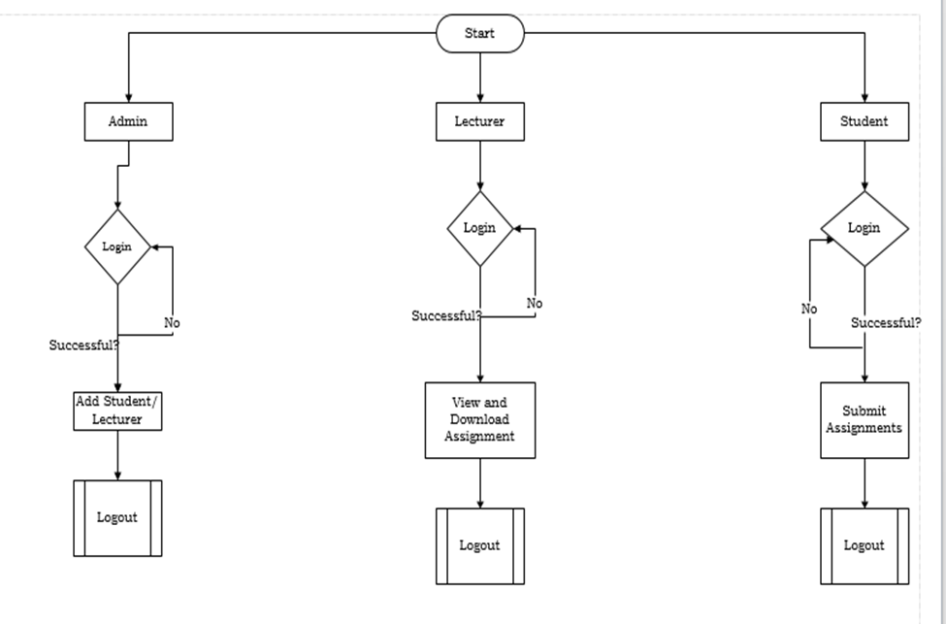
METHODOLOGY
The research methods employed in this project are based on:
Qualitative technique (which takes a look at the system in view)
The observation of the current system.

Slide 9
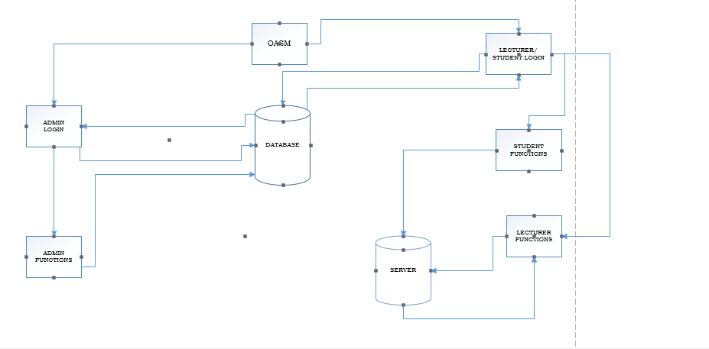
ARCHITECTURAL MODEL

Slide 10
IMPLEMENTATION APPROACH
The implementation approach adopted for this study was a web-based approach. For this, PHP was used for the server side scripting, while MariaDB was used for the database. Other tools for the implementation include HTML, for the application interface, CSS, for the styling and Bootstrap, for the formatting and responsiveness of the webpages.
Software Development Life Cycle (SDLC) Rapid Application development model (RAD) was adopted as the implementation procedure used for this system. The model emphasizes ‘fast/quick’ design approach to solution development, this model emphasizes component-based construction in rapid software development approach.

Slide 11
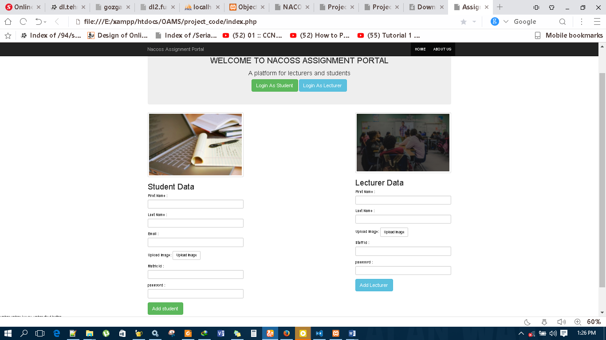
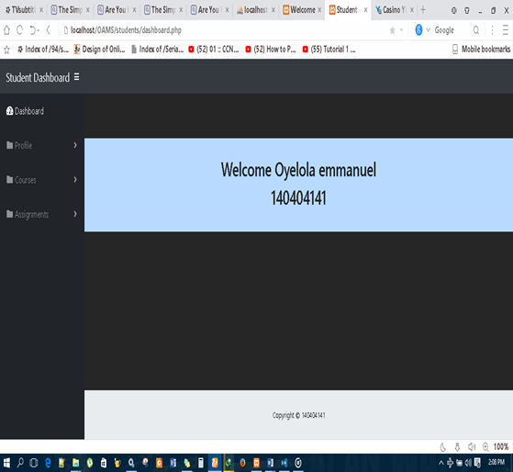
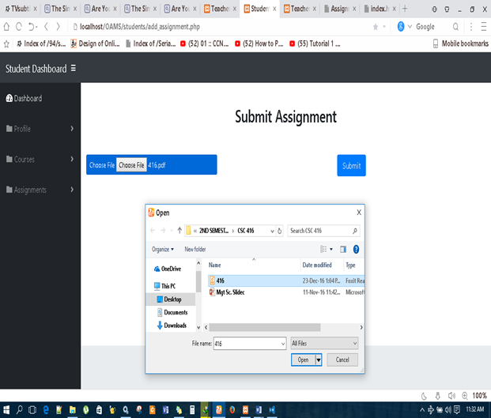
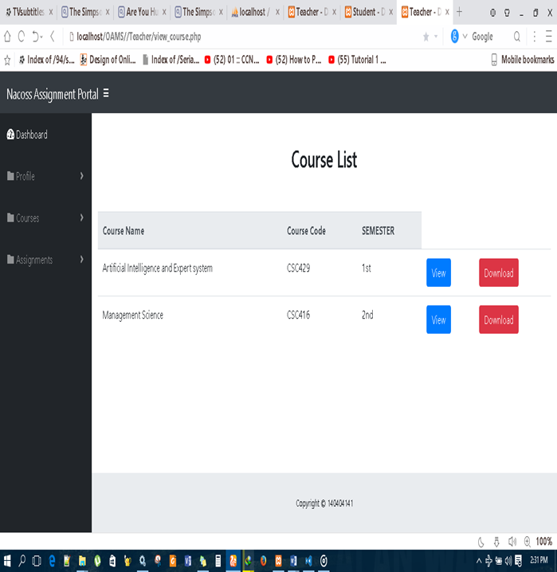
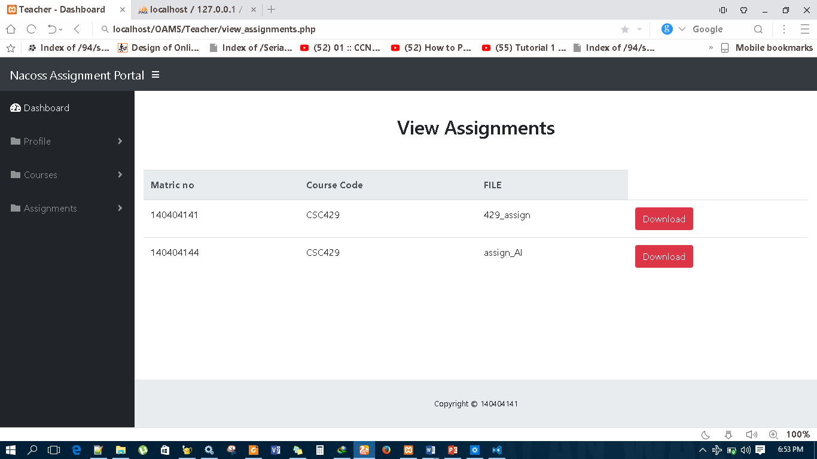
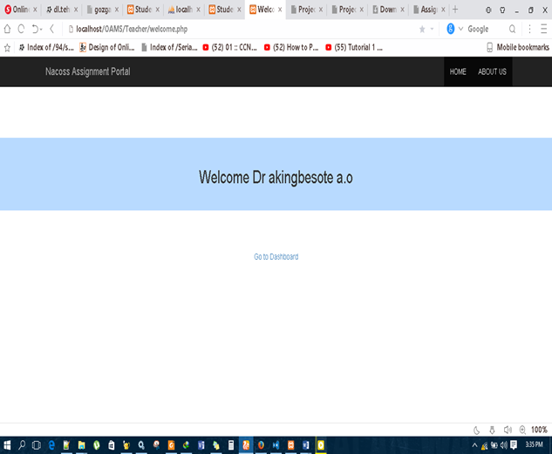
IMPLEMENTATION

Slide 12
CONCLUSION
In deciding what a school management system should look like, it’s important to look closely at systems that have successfully been deployed in challenging environments and any available evaluation data.
This study has been able to emphasize the need to implement and deploy an online assignment submission management system. The researcher, being optimistic about the rationale behind this study, hereby recommends that the proposed system should be fully adopted in the department of Computer Science at the university.

