Slide 1
SELECTED USE CASE / REAL-TIME INTELLIGENCE
Battery Returns Intelligence
HACKATHON USE CASE - REAL-TIME ACTIONS
Turning Customer Real-Time Data into
Real-Time Agentic Actions
PROBLEM STATEMENT
OUR CHOSEN SCENARIO
Disconnected return records hide who initiated a return,
what inspection found, and when a batch needs attention.
Battery-return spike
> detect batch pattern
> investigation notification
Delivered: live detection + Teams alert | Agentic loop: partial, not autonomous
MICROSOFT FABRIC HACKATHON | SYNTHETIC DEMO DATA
01
Notes:
Start with the problem statement, not the dashboard. Disconnected records hide who initiated a return, what inspection actually found, and which batches need investigation. The brief's selected category is Real Time Intelligence; its feature is Real Time Actions, described as Turning Customer Real-Time Data into Real-Time Agentic Actions. Our chosen adaptation is battery-return spike detection followed by an investigation notification. Live detection and a Teams notification were demonstrated. The custom AI is read-only and user-initiated, so do not claim a fully autonomous agentic loop. All source and streaming data are synthetic.

Slide 2
BATTERY RETURNS INTELLIGENCE
Where each use-case section is implemented.
Read the brief as data > intelligence > action; distinguish delivered functions from supporting features and gaps.
USE-CASE SECTION
PROJECT PART
WHAT IS IMPLEMENTED
STATUS
Real-time customer data
Eventstream / Eventhouse
Synthetic live return events ingested
DEMO
Real-time intelligence
KQL BatchSignals
3 distinct batteries / batch / 15 minutes
VERIFIED
Real-time action
Activator + Teams
An investigation notification was delivered
VERIFIED
Agentic actions
AI companion
Read-only, user-initiated; no automatic ticket
PARTIAL
Trusted context (support)
Lakehouse pipeline
Bronze / Silver / Gold; 12,000 historical cases
BUILT
Experience / cost (extra)
Dashboards
Fabric visuals, separate local AI, cost estimates
BUILT
BRIEF'S EXAMPLES - OUR PROJECT ADAPTS THE INVESTIGATION PATTERN
Machine anomaly > maintenance | Inventory drop > replenishment | Shipment delay > operations
Suspicious transaction > investigation | Network issue > service action
MICROSOFT FABRIC HACKATHON | SYNTHETIC DEMO DATA
02
Notes:
Use this slide as the explicit requirement-to-project map. The live flow consumes synthetic real-time events through Eventstream, runs KQL batch-condition detection in Eventhouse, and creates a Teams investigation notification using Activator. The Lakehouse pipeline creates trusted historical context through Bronze, Silver and Gold; it is not the real-time alert feed. The AI companion supports user-initiated, read-only analysis. The Fabric dashboard presents committed Gold. The fully automatic agentic decision-and-action loop is not implemented: no alert-triggered AI investigation, durable ticket creation, or autonomous remediation. The five domain examples are transcribed from the user's brief. They appear to illustrate possible scenarios; we adapt the investigation pattern to battery returns and do not claim that machine maintenance, inventory replenishment, shipment monitoring, fraud detection or network remediation were implemented.

Slide 3
BATTERY RETURNS INTELLIGENCE
Two data paths. One investigation experience.
A repeatable file pipeline builds trusted history; an independent live path supports investigation alerts.
TRUSTED HISTORICAL CONTEXT - SUPPORTS THE USE CASE
4 source files
BRONZE
SILVER
GOLD
EXPLORE
3 CSV + 1 JSON
Products, batteries,
shipments, return events
>
Preserve raw values
and source provenance
>
Clean and validate
Quarantine bad events
Remove exact replays
>
Join dimensions
Latest revision per return
Publish after validation
>
Eventhouse + dashboard
Separate AI companion
REAL-TIME DATA > INTELLIGENCE > AUTOMATED ACTION
Eventstream
Eventhouse
Activator + Teams
>
>
Receives live battery-return events
Queries the live event population
Sends an investigation notification
MICROSOFT FABRIC HACKATHON | SYNTHETIC DEMO DATA
03
Notes:
Architecture (45 seconds): We start with three CSV files and one JSON file stored in the Fabric Lakehouse. Bronze preserves the original inputs. Silver validates and cleans events, removes exact replays, and quarantines invalid events. Gold joins the master data and retains the highest revision for each return ID. The validated Gold publication feeds Eventhouse queries and the dashboard. The custom AI companion queries the same committed Gold data. Separately, our original Eventstream-to-Eventhouse path drives Activator and Teams notifications. Do not say that the historical Gold pipeline itself triggered the live Teams alert.

Slide 4
BATTERY RETURNS INTELLIGENCE
Trusted data, with checks you can explain.
SUPPORTING CONTEXT: a fixed historical snapshot, not the live alert population.
46,442
821
What we verified
SOURCE EVENTS
EXACT REPLAYS REMOVED
45,618 valid, distinct events
11,693 distinct batteries
Legitimate repeat returns retained
Rerun: no duplicate publication
Raw landing events preserved
Duplicate events, not repeat returns
3
12,000
INVALID EVENTS QUARANTINED
GOLD RETURN CASES
Rejected by validation rules
One highest-revision row per return
Reliable numbers first. Visuals and AI second.
MICROSOFT FABRIC HACKATHON | SYNTHETIC DEMO DATA
04
Notes:
Data quality (35 seconds): The JSON contains 46,442 events. We intentionally included three invalid events and 821 exact replays to prove that our cleaning logic works. Silver retains 45,618 valid distinct events. Gold selects the latest revision for each return, producing 12,000 cases across 11,693 batteries. A battery can legitimately have more than one return, so we never deduplicate cases just by battery serial. The pipeline has been run successfully twice, and the second run did not create a duplicate publication.

Slide 5
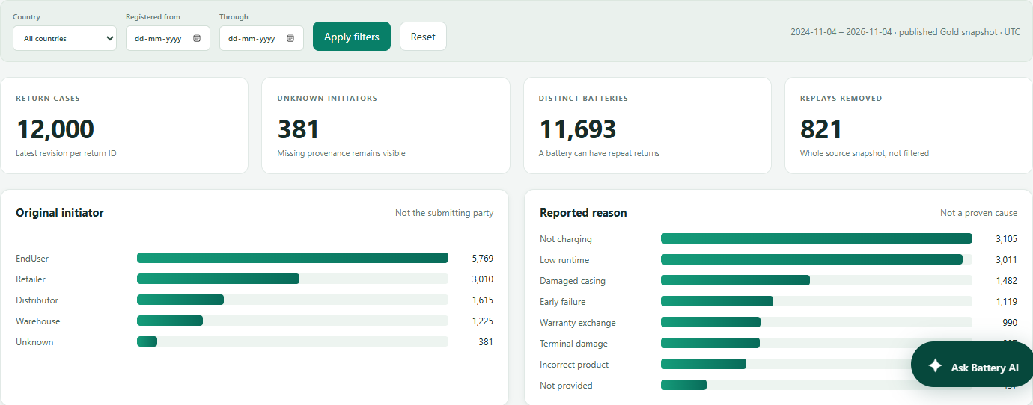
BATTERY RETURNS INTELLIGENCE
Explore the return story in one place.
SUPPORTING VIEWS: local-companion screenshot; the Gold dashboard is historical, not live.
12,000 cases | 381 unknown initiators | Country and date filters
MICROSOFT FABRIC HACKATHON | SYNTHETIC DEMO DATA
05
Notes:
Dashboard (35 seconds): This is an actual screenshot of our local companion, not a mock-up and not an image of the native Fabric page. It queries the same committed Gold population. Point to 12,000 cases, 381 unknown original initiators, and the initiator and complaint charts. The original cloud-hosted Fabric dashboard has also been updated with 14 native tiles and five filter controls. Its styling is similar, but it does not embed the custom chat. Live demo: open the original Fabric dashboard, refresh with Ctrl+F5, and use Country plus Registered (UTC). India from January 1, 2026 through November 4, 2026 gives 1,233 matching cases.

Slide 6
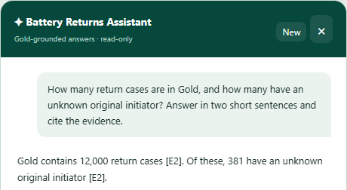

BATTERY RETURNS INTELLIGENCE
Ask naturally. Verify the answer.
AGENTIC ACTIONS - PARTIAL: read-only, user-initiated AI; no autonomous ticket or remediation.
ASK
"How many cases have an unknown original initiator?"
GROUND
The assistant retrieves actual data, rather than inventing a number.
ACTUAL GOLD QUERY RESULT
VERIFY
Open the evidence to inspect the executed query and returned rows.
It does not invent defect rates when the units-sold denominator is missing.
12,000 cases | 381 unknown
MICROSOFT FABRIC HACKATHON | SYNTHETIC DEMO DATA
06
Notes:
AI demonstration (40 seconds): This screenshot contains a fresh, real answer from our signed-in Copilot-backed companion. Ask how many return cases exist and how many have an unknown original initiator. The expected answer is 12,000 and 381. Expand Evidence to show the actual Gold query and results. Then ask a follow-up such as a country breakdown. The assistant uses five allowlisted read-only tools; it cannot change the data through those tools. It has also been tested not to invent a true defect rate when units sold are unavailable. This custom chat runs on the presenter's machine at localhost:8765; it is not embedded native Fabric Copilot and is not publicly hosted.

Slide 7
BATTERY RETURNS INTELLIGENCE
Move from insight to investigation.
REAL-TIME ACTION: delivered Teams notification. Capacity estimates are an extra feature.
investigation alert
Extra: capacity estimate
Live events > Eventhouse > Activator > Teams
Example: F2 / USD / 24 charged hours per day
1 DAY
1 WEEK
Demo rule: 3 distinct batteries
from the same batch within 15 minutes.
$9.60
$67.20
30 DAYS
365 DAYS
$288.00
$3,504.00
Teams notification received in the demo.
This threshold is not a validated business policy.
Current workspace: FT1 trial. These are estimates, not actual bills.
West Central US retail snapshot, Nov 4, 2026. Capacity only; excludes storage, licenses, taxes, bandwidth and other services.
MICROSOFT FABRIC HACKATHON | SYNTHETIC DEMO DATA
07
Notes:
Alerts and cost (35 seconds): We already demonstrated an actual Teams notification using the live streaming path. The investigation rule is three distinct batteries from a batch in fifteen minutes; this is a demo threshold, not a validated production rule. Separately, the dashboard shows one-day, one-week, thirty-day, and 365-day capacity-only retail estimates. For F2, USD, and twenty-four provisioned hours per day, those are 9.60, 67.20, 288, and 3,504 dollars. These are whole-capacity examples, not account invoices. The actual workspace is on an FT1 trial. Native dashboard rates are a dated snapshot and do not automatically refresh. Changing a cost control does not provision or pause a resource.

Slide 8
BATTERY RETURNS INTELLIGENCE
Demonstrate the use-case coverage honestly.
Show the live alert path separately from historical Gold and read-only AI.
1
Show live-path evidence
event ingestion, batch rule and received Teams notification.
2
Trace historical cases
Gold + Fabric dashboard: filters and case evidence.
3
Ask the AI companion
read-only analysis; verify the query and returned rows.
4
State the remaining gap
No automatic AI investigation, ticket creation or remediation yet.
Open original Fabric dashboard
Open local AI companion (this PC)
MICROSOFT FABRIC HACKATHON | SYNTHETIC DEMO DATA
08
Notes:
Demonstration sequence: First show the verified The live flow live event-to-notification evidence, including the actual Teams delivery. Do not imply that a past alert is newly triggered. Next open the original Fabric dashboard, refresh with Ctrl+F5 if cached, and explore the historical Gold population. Country India with registration dates January 1 through November 4, 2026 was verified at 1,233 cases. Then open the local AI companion on this presenter PC and ask about unknown initiators; expand evidence. Explain that The Lakehouse pipeline creates trusted history, The AI companion provides read-only AI analysis, and The Fabric dashboard presents Gold in Fabric. Clearly state the remaining gap: there is no alert-driven autonomous AI investigation, durable ticket creation, or remediation. The localhost link only works on this presenter machine. All data are synthetic, and no production benefit or defect rate has been measured.

