Slide 1
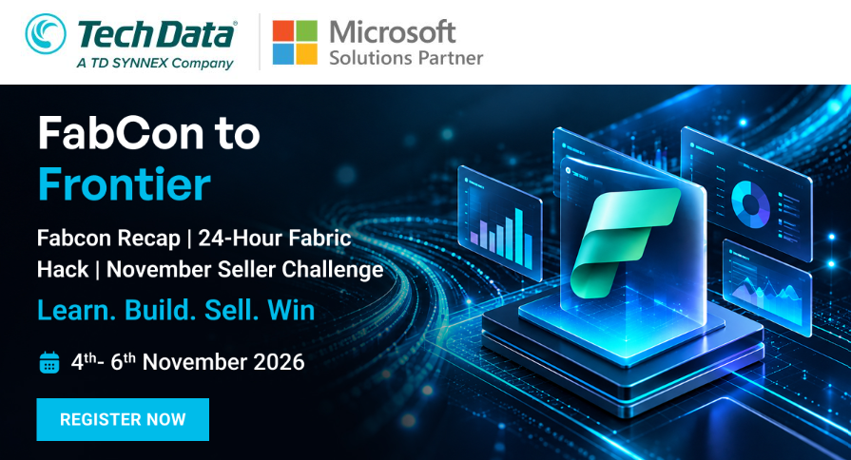

Slide 2
Use Cases
Feature | What is this feature | Solution / Offer
Copilot in Fabric | Enable customers for agent driven development adoption and use of Fabric Copilot for Analytics development | Solution Offer - Self Service - Agent driven Analytics 4 weeks workshop create end to end analytics demo using copilot - use it as labs for customer
PowerBI in Fabric | Modernize enterprise BI using OneLake + Direct Lake + semantic models + Power BI, with Copilot helping users consume insights | Legacy BI → Fabric; semantic model modernization; Direct Lake adoption; DAX/model optimization; executive dashboards
Fabric IQ in Copilot | Fabric IQ now availabel with Microsoft Copilot, Access business context from Fabric IQ in Chat and Cowork | Enabling Chat with your report functionality
Planning | You can now do planning within Fabric itself - no need of external third party tools | AI Powered Buisness Planning Offer 🛒 Retail → Demand & inventory planning 🏭 Manufacturing → Production & supply planning 💰 Finance → Budget & financial planning 📈 Sales → Revenue & quota planning 👥 HR → Workforce planning
Real Time Intelligence | Feature – Real Time Actions Turning Customer Real-Time Data into Real-Time Agentic Actions | Build Real time Intelligence Solution 🏭 Machine anomaly → trigger maintenance 🛒 Inventory drop → trigger replenishment 🚚 Shipment delay → alert operations 💳 Suspicious transaction → trigger investigation 📡 Network issue → trigger service action
Google Big Query integration with Fabric | Turning their Google Big-Query Data Data into Agentic BI Google Analytics heavy Customers Retail , Ecommerce , Media Entertainment, Travel Hospitality | Google Big Query- Fabric Data Agent
Fabric Capacity Billing Optimization | Package these together as recurring service Capacity Surge Protection Real-Time Capacity Event Monitoring Resiliency / Peak Management Periodic Capacity Utilization Review & Optimization Recommendations | Build Managed Service Offering
1
2
3
4
5
6
7

Slide 3
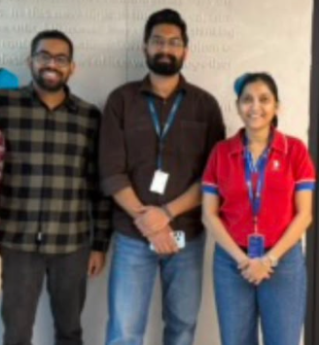
1
Select your Team | Select Use case
2
Define Generic , Industry Specific, Target Users
3
Define end to end working scenario
4
Submit your deliverables in TD Synnex Repository
Customer
Demo
HTML
Customer Elevator Pitch
Solution Accelerator
+ github Repo
Solution Offer Template

Slide 4


Building Fabric-Frontier solution
In 24 HRS..

Slide 5


Slide 6


Slide 7




Feature | What is this feature | Solution / Offer
Planning | Demonstrate You can now do planning within Fabric itself - no need of external third party tools | 🏭 Manufacturing Production & supply planning Solution Name - AI Powered Business Planning My Solution will have Capacity Crunch Dashboard Features – scenario , Comparison, Recovery Plan etc Copilot for chat functionality

Slide 8

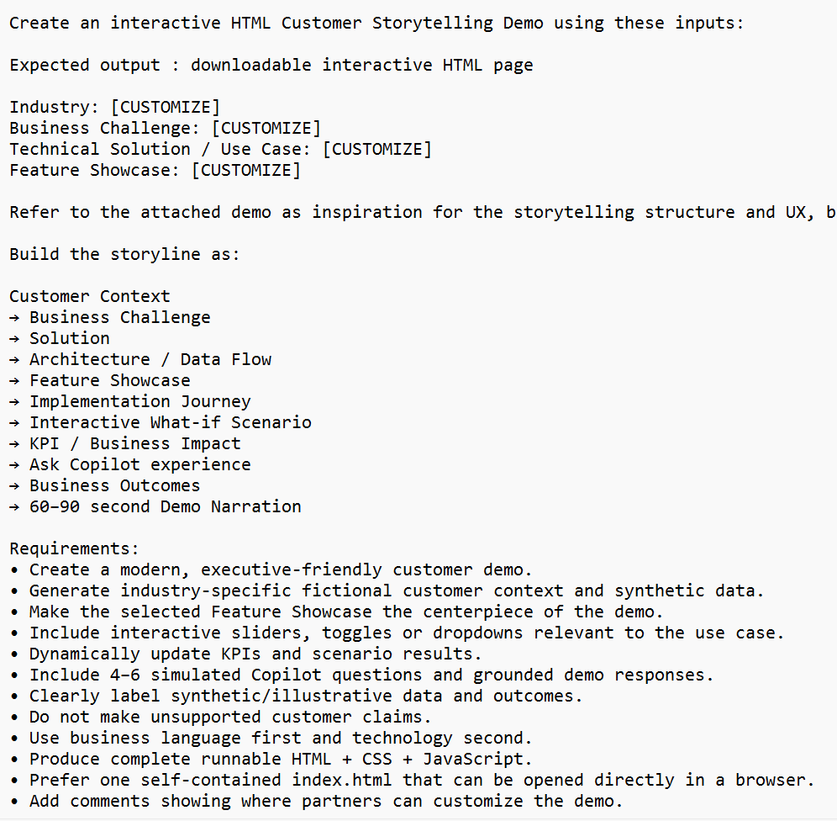
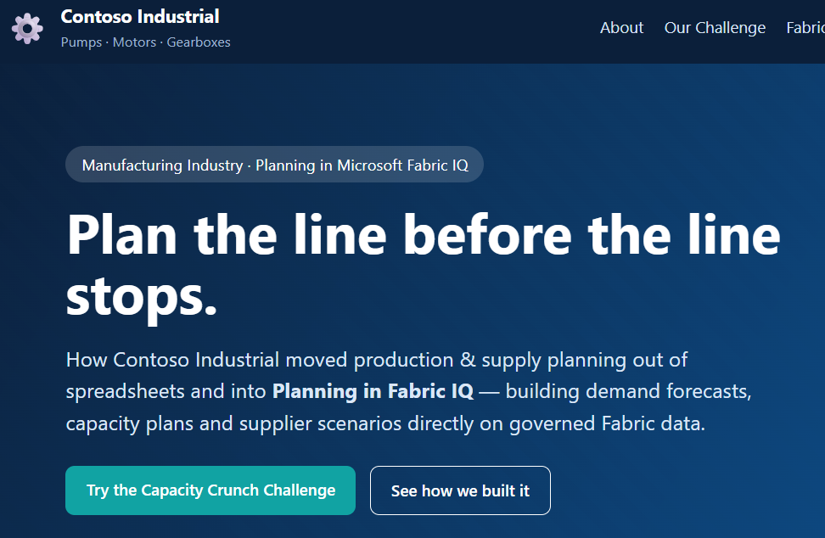
Customer Frontier Demo
Contoso Industrial | Production & Supply Planning with Planning in Fabric IQ

Slide 9
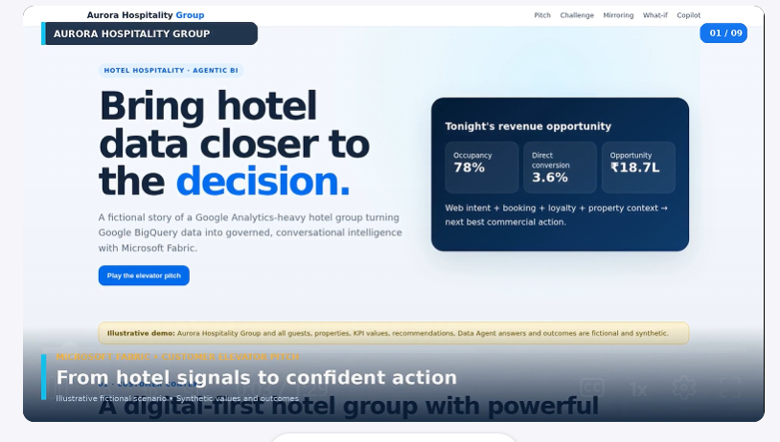
Customer Elevator Pitch
Prompt 1 for creating narration script
Create ≈90 sec Narration script for attached customer demo
attach your HTMP Page
Prompt 2 for creating elevator pitch video
Create ≈90 sec Narration script for attached customer demo
attach your HTMP Page
create downloadable mp4 video​‌ for below narration script

Slide 10

Microsoft Learning Documentation Tutorials
Fabric Planning Tutorial: Introduction and Environment Setup [learn.microsoft.com]
Get Started with Planning Sheets [learn.microsoft.com]
Github accelerators fabric-docs/docs/iq/plan/planning-how-to-get-started.md at main · MicrosoftDocs/fabric-docs · GitHub
Building on your own
Create Sample Dataset / pbix using Copilot
Package your solution in github repo
Solution Accelerator build

Slide 11
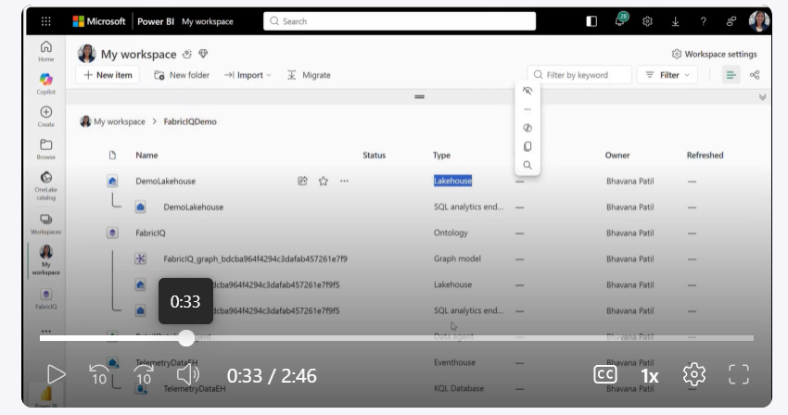
Solution Demonstration video

Slide 12




Microsoft
Planning in Fabric IQ
Contact:
TBD
Business Challenge
Demand, capacity and material plans sit in disconnected spreadsheets while actuals remain in ERP/MES. Conflicting versions, late capacity warnings and hidden supplier risks create manual work across the monthly S&OP cycle.
Technical Solution – Production & Supply Planning
Build connected demand forecasts, production plans and supply scenarios on governed Fabric data and shared semantics. Combine collaborative planning, secure plan writeback and plan-versus-actual reporting.
Industry | Target Users
Technical Components
Assumed Workload
Azure Cost
Industrial manufacturing
Demand & production planners
Plant operations managers
Supply chain & procurement leads
S&OP leads and finance leads
Microsoft Fabric , OneLake / Lakehouse
Fabric SQL database:
plan writeback ,
Power BI semantic model &reports
Fabric IQ planning, Copilot / Data Agent
2 planners, 8 stakeholders, 40 viewers
Data footprint: ~100 GB initial, ~10 GB monthly growth
Operations: Daily ERP/MES refresh, monthly S&OP planning, light Power BI and Copilot usage
starting SKU – F8
1-year RI - $ 625/month | $ 7.5K /year
PAYG equivalent if continuously active: ~$ 1K /month | $ 12,700/year| Calculator link
Reference Architecture
How it works
Customer Deployments
ERP orders & BOMs · MES production
Supplier portal · CSV uploads
1
Connect ERP, MES and supplier data to a governed Lakehouse.
Define shared KPIs: fill rate, utilization, forecast accuracy and revenue at risk.
Contoso Industrial
Plants: Pune · Monterrey · Stuttgart
OneLake / Lakehouse
Plant, product, supplier & fact tables
2
Use case:
Align demand, plant capacity and material availability across a shared product portfolio.
Power BI semantic model + Fabric IQ ontology
3
Build demand, production and material plans; test demand spikes and supplier delays.
Demand, capacity & supply planning
Submit, review and approve plans with role-based access and audit trails.
Expected value:
Earlier bottleneck visibility, faster scenario evaluation and less spreadsheet reconciliation.
4
Plan writeback → Fabric SQL database
Reports & Copilot → decision support
5
Write back approved versions and monitor plan versus actual.
Live customer references & measured outcomes:
TBD
Based on the supplied HTML scenario. Product capabilities, licensing and availability require validation.
Notes:
Planning in Fabric IQ – editable one-pager (worked example). Contoso Industrial is an illustrative company, not a verified customer deployment. Every text block is its own editable box; the three lower column header bars are blue-to-teal pictures that can be stretched or replaced. Slide 2 is the same layout with placeholder prompts for a new scenario.

Slide 13

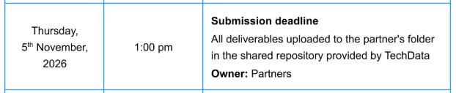
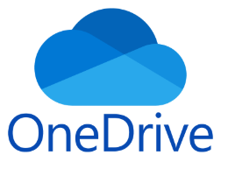
Hackathon Submission
    1) Updated Partner Hack Kit
    2) Customer Demo (HTML) folder
    3) Elevator Pitch Video m4 file
    4) Solution Accelerator – Githhub code folder
    5) solution demonstration video mp4
Please make sure to place all the deliverables in
a SharePoint folder provided by Techdata Team

Slide 14
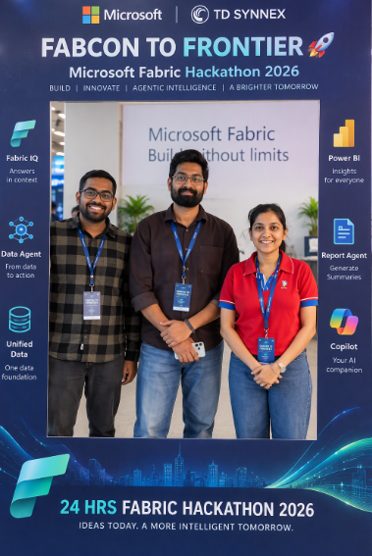
Selfie Booth
  Use the uploaded participant photo(s) as visual references for the people shown in the final image. Keep each participant’s recognizable appearance, hairstyle, clothing, accessories, and overall visual characteristics consistent with the corresponding reference photo. Maintain each participant as a separate, naturally represented person and do not combine or interchange characteristics between people.
Create a realistic professional event photograph showing the referenced participant(s) standing naturally inside a FABCON TO FRONTIER 🚀 Microsoft Fabric Hackathon 2026 photo frame.
The composition should automatically adapt to the number of people in the uploaded reference:
For one participant, create a natural individual event portrait.
For multiple participants, create a balanced group photograph with everyone clearly visible.
Keep realistic spacing, height differences, body proportions, poses, and perspective.
Design the event frame using a premium Microsoft Fabric Hackathon aesthetic with deep navy, Microsoft blue, cyan, teal, and subtle Fabric gradient accents.
Prominently feature:
FABCON TO FRONTIER 🚀
Microsoft Fabric
24 HRS FABRIC HACKATHON 2026
Microsoft | TD SYNNEX
Add subtle Fabric-inspired technology elements around the outer frame referencing Fabric IQ, Data Agent, Unified Data, Power BI, Report Agent, and Copilot, while keeping the center photography area clean and uncluttered.
Make the final result look like a genuine photograph captured at a professional Microsoft technology event rather than an illustration or synthetic poster. Use natural photographic lighting, realistic perspective, authentic body proportions, clear facial detail, balanced composition, sharp focus, subtle depth of field, and premium corporate event photography.
Do not add extra participants. Do not replace participants with fictional people. Do not duplicate people. Do not combine characteristics between participants. Keep the referenced participants visually consistent with their uploaded photographs while naturally integrating everyone into the FABCON TO FRONTIER event environment.

Slide 15

Claim your Badge
  Thank you for participation in TD Synnex Hackathon, sponsored by Microsoft.
  We wish you all the very Best and looking forward to see you tomorrow for Award Ceremony

Slide 17
Partner Name - Waferwire
Battery Returns Intelligence
Real Time Intelligence - Real Time Actions
Hackathon Team
Raj Kumar
Srikant Karimajji
Notes:
Partner: Waferwire. Participants: Raj Kumar and Srikant Karimajji. No separate team name was supplied.

Slide 18
Feature | What is this feature | Solution / Offer
Real Time Intelligence | Real Time Actions Turning Customer Real-Time Data into Real-Time Agentic Actions Battery-return spike > batch detection > Teams investigation alert AI is read-only and user-initiated; no autonomous remediation. | Battery Returns Intelligence Industry: battery manufacturing / returns Users: quality and returns-investigation teams Real-time batch detection and Teams alerts CSV + JSON > Bronze > Silver > Gold Gold dashboards, traceability and separate read-only AI chat Synthetic demo; automated alerts, not autonomous remediation
Notes:
The selected track is Real Time Intelligence / Real Time Actions. Live detection and a Teams notification were demonstrated. AI is read-only and user-initiated, not an autonomous investigation/remediation agent.

Slide 19
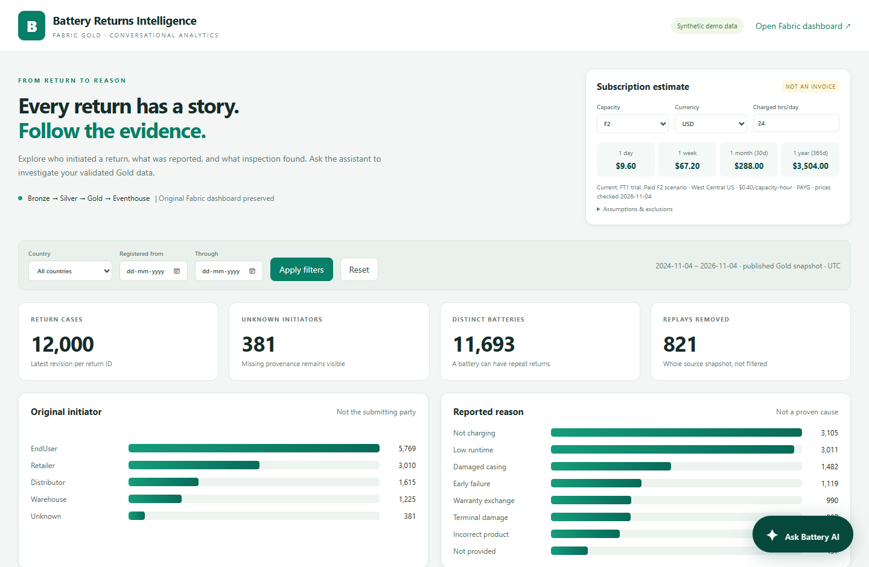
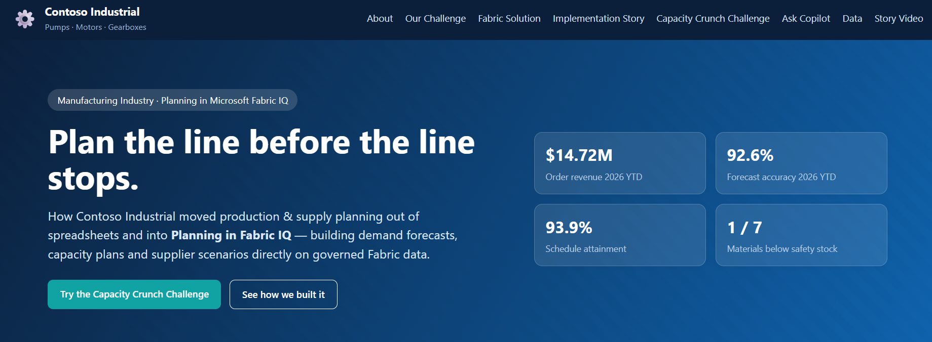
Customer Frontier Demo
Battery Returns Intelligence - actual local HTML dashboard and AI companion
12,000 Gold cases | 381 unknown initiators | traceability | read-only AI | cost estimates
Local access: localhost:8765 (same PC). Code: app\companion\public\index.html + server.
Server-backed HTML application; customer-story packaging and SharePoint upload remain to be completed.
Notes:
Actual local HTML companion screenshot. The app uses committed Gold and a separate Copilot-backed AI engine. It runs locally, not on a public website. Full customer-storytelling packaging and upload remain pending.

Slide 20
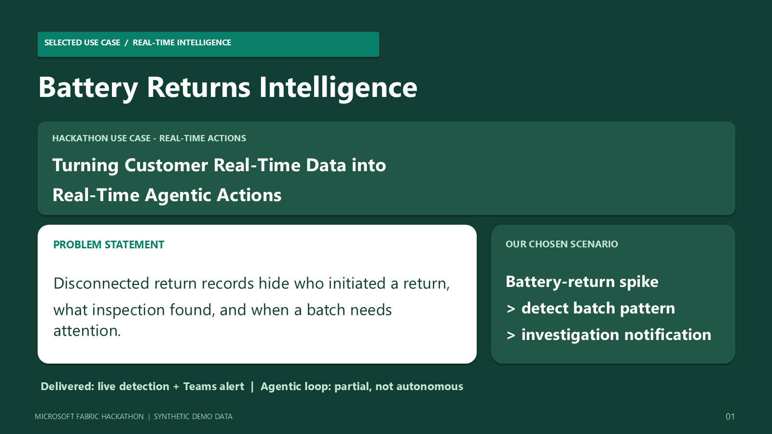
Customer Elevator pitch video
Available use-case explainer: under 3 minutes. Dedicated approximately 90-second customer pitch: PENDING.
Existing MP4 is embedded for review; a shorter pitch version and separate SharePoint upload are still required.
Notes:
The available use-case video is 159.09 seconds, not the approximately 90-second pitch suggested by the kit. It is embedded as an existing review artifact, not presented as a finished length-matched pitch.

Slide 21
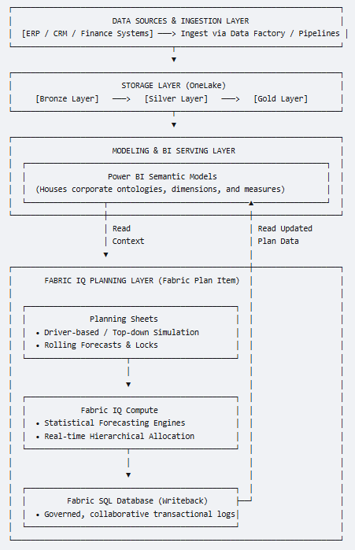
Reference Architecture
One workspace: Waferwire_hackathon | Lakehouse: BatteryReturnsMedallion | KQL database: BatteryReturnsEH
HISTORICAL GOLD: the four-activity pipeline
3 CSV + 1 JSON
Bronze
Silver
Gold
Eventhouse
Insights
Products / batteries
Shipments / returns
Raw strings
File + run provenance
Type / validate
Quarantine / dedup
Join + warranty
Latest revision per case
Validate + commit
ReturnsGoldLatest()
Native dashboard
Separate read-only AI
46,442 raw events > 45,618 valid events > 12,000 cases | 3 quarantined | 821 replays removed
Publication is retry-safe; partial loads stay out of the dashboard. Verified rerun reused the publication.
Serving contract: ReturnsGoldRaw has 35 columns; ReturnsGoldCommits marks a validated publication.
SEPARATE LIVE PATH: automated investigation notification
Eventstream
Eventhouse
Batch detection
Activator
Teams
Live battery-return
signals
Live events
KQL processing
3 distinct batteries
Same batch / 15 minutes
Condition triggers
notification
Investigation alert
Human follow-up
Demo rule, not a validated business policy. Live alerts and historical Gold are different populations.
AI responds to user questions against Gold. Automatic alert-driven AI investigation, ticket creation
and autonomous remediation are not implemented.
Notes:
The historical pipeline preserves valid lifecycle revisions and repeated returns; latest selection is per return_id. Publication writes a commit only after validation. The live Eventstream is a separate population. The 3-batteries/15-minutes condition is a demonstration rule, not a validated operational policy.

Slide 22
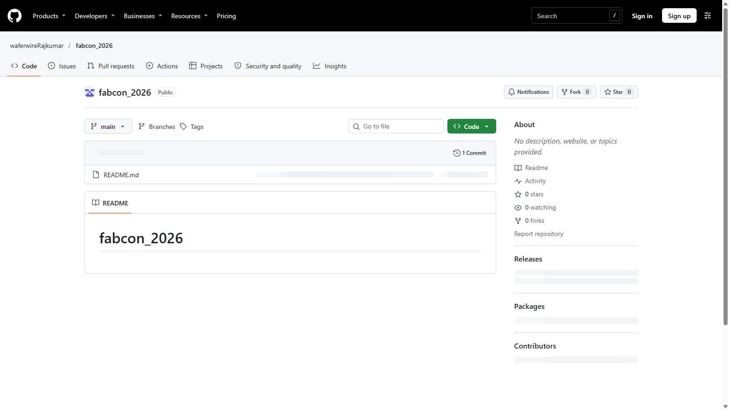
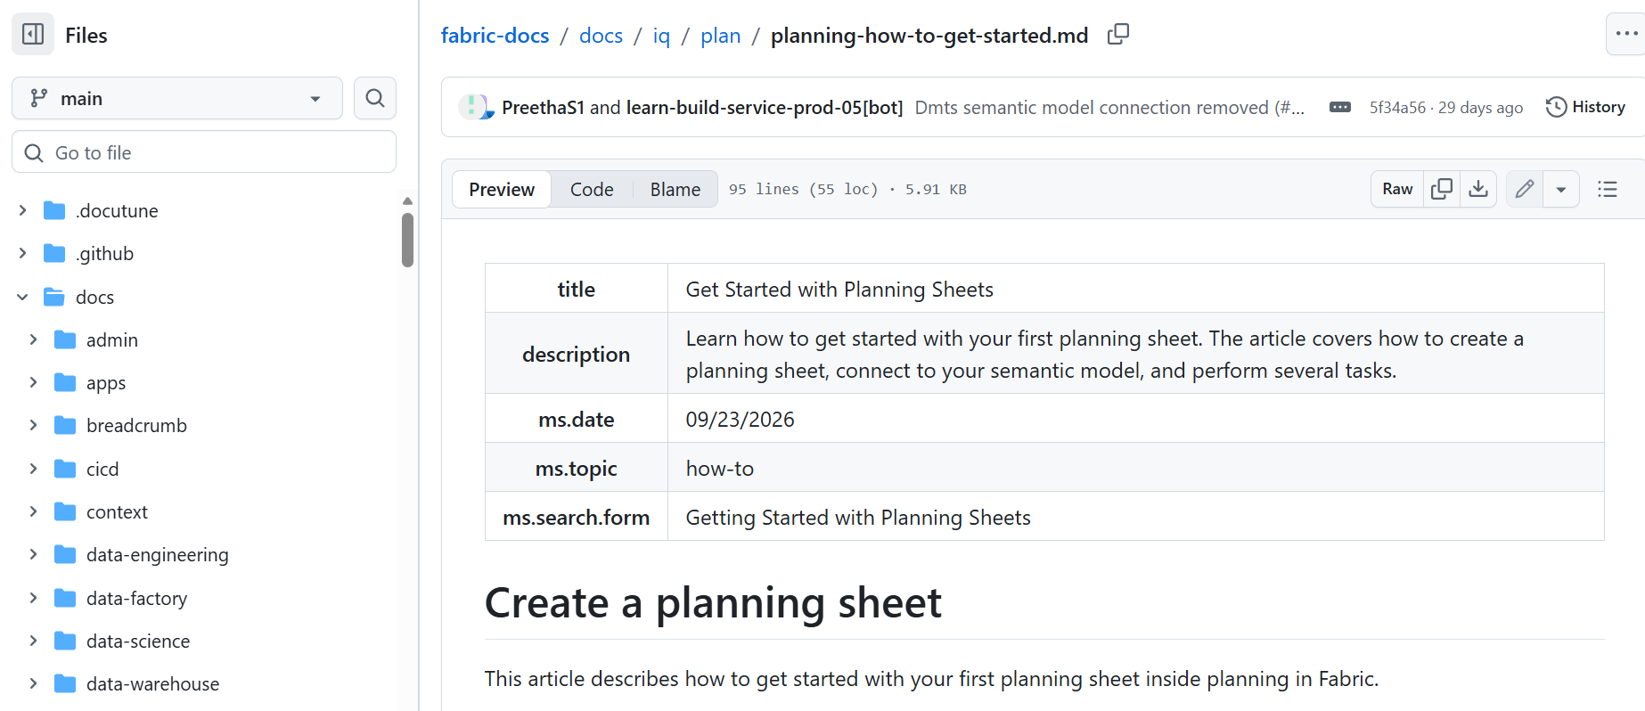
Solution Accelerator
GitHub: waferwireRajkumar/fabcon_2026
PUBLIC REPOSITORY VERIFIED
Default branch: main
At verification, the repository contained
README.md only.
Solution code publication: PENDING.
The downloadable project package contains
the local source, data, Fabric definitions,
HTML companion and existing media.
Actual public GitHub screenshot. Repository link is verified; project-source publication and
separate code-package upload to Techdata SharePoint remain to be completed.
Notes:
Public GitHub repository waferwireRajkumar/fabcon_2026 was verified through GitHub. Default branch: main. At verification the root contained README.md only. The repository link is provided, but project-source publication remains pending. Local source/definition files are included in the project package.

Slide 23
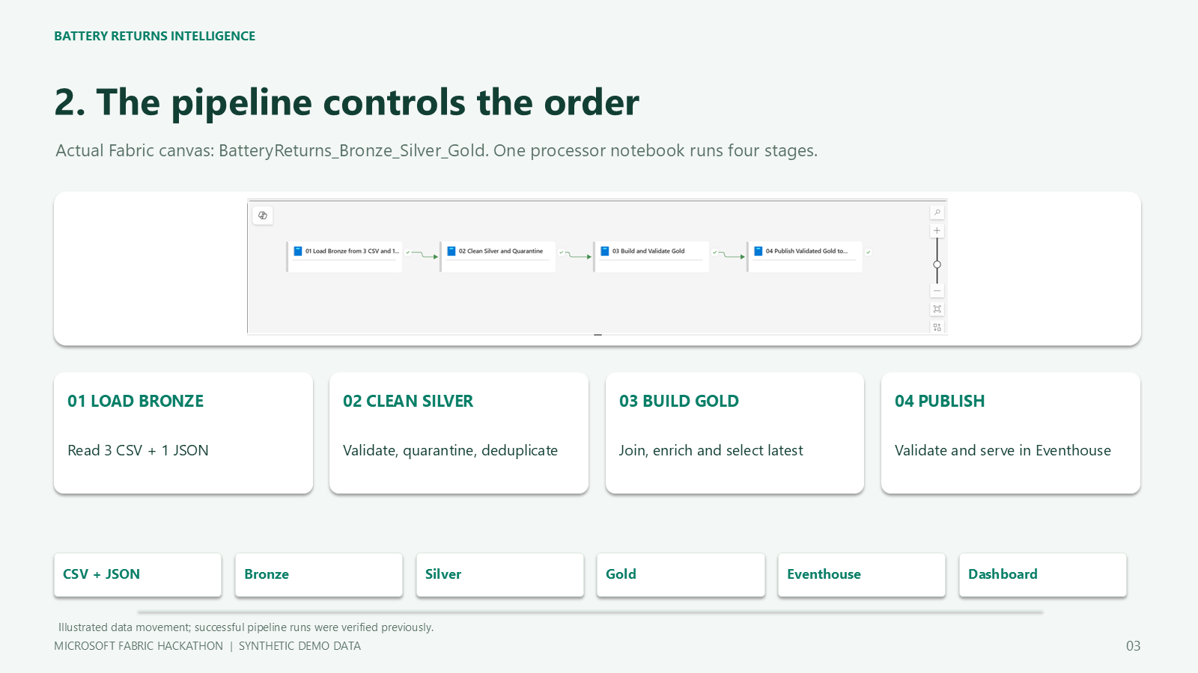
Solution Demonstration video
Verified solution walkthrough: 2:42 | actual Fabric screens | illustrated flow | English narration + captions.
Click the embedded video to play in PowerPoint. Upload the standalone MP4 separately with the submission.
Notes:
The walkthrough is 161.65 seconds, 1080p H.264/AAC. Full audio/video decode, audible narration, actual marker movement and visual review passed. Animation illustrates movement; it does not show a new pipeline run.

Slide 24
Microsoft
Battery Returns Intelligence
Contact:
Raj Kumar
Srikant Karimajji
Business Challenge
Disconnected battery-return records hide who initiated a return, what inspection found, and when a batch needs attention.
Technical Solution - Real Time Intelligence / Real Time Actions
Microsoft Fabric combines automated live batch alerts with validated Bronze / Silver / Gold history, case traceability and a separate read-only AI companion.
Industry | Target Users
Technical Components
Workloads
Azure Cost
Battery manufacturing / returns
Quality and service teams
Batch-investigation users
Illustrative synthetic scenario
Eventstream + Eventhouse
Lakehouse + notebook pipeline
Activator + Teams
KQL dashboards + AI companion
12,000 cases / 11,693 batteries
46,442 raw lifecycle events
45,618 valid distinct events
Production scale: to be sized
Demo ran on FT1 trial
F2 illustration: USD 288 / 30 days
24 h/day; rates: 2026-11-04
Sizing / ACR: pending; calculator
Reference Architecture
How it works
Customer Deployments
3 CSV + 1 JSON / live signals
Products, batteries, shipments, returns
1
Land files in Bronze; ingest live signals.
Illustrative scenario - synthetic demo
Clean Silver: quarantine 3; remove 821 replays.
Illustrative battery manufacturer
Workspace: Waferwire_hackathon
OneLake / Lakehouse tables
Bronze > Silver > Gold
2
Use case:
Investigate batch spikes and trace each return.
Eventhouse: committed Gold / live events
3
Build 12,000 Gold cases; validate and publish.
Batch detection + dashboards / read-only AI
Serve committed Gold to dashboards and AI.
Expected value:
Earlier batch visibility and easier case tracing.
Customer business impact not measured.
4
Teams investigation notifications
Case traceability and decision support
5
Detect batch spikes; Activator notifies Teams.
Live customer references: none approved.
Demo: 12,000 cases; 381 unknown initiators.
Verified synthetic demo; AI is user-initiated, not autonomous. F2 is a dated illustration, not sizing advice or an invoice; extra charges excluded.
Notes:
Synthetic illustrative scenario, not an approved customer deployment. Data-quality counts are verified demo metrics; business ROI is not measured. USD 288/30 days is the F2 West Central US capacity-only PAYG scenario at 24 provisioned hours/day and USD 0.20/CU-hour, from the 2026-11-04 Azure Retail Prices API snapshot. Exclude storage/transactions, bandwidth, licenses, taxes, overage and optional services. F2 is not validated production sizing. Reference retail-pricing-basis.json. Calculator link is an official Microsoft Azure link.

Slide 25
Waferwire Team - Optional Photo
Raj Kumar | Srikant Karimajji
Team photograph not provided.
Optional marketing item. No unrelated participant photo has been used as this team's photo.
Notes:
Optional marketing photo. No photo for this team has been provided; the unrelated sample photo was removed.

