Slide 1
Classifying Political Bias in News Articles
Gabriel Iturriaga
Ben Kelly
Rhys Mackenzie
Courtney Pick

Slide 2

Notes:
Rising distrust in the media
Polarization in the presentation of facts
Image source: https://depauliaonline.com/wp-content/uploads/2016/10/Phones-01.png

Slide 3

Solution Overview
Text classification problem
Binay Classification: 0 for Liberal (left) and 1 for Conservative (right)
Create dataset of news articles
Implemented various classifiers
Linear Model
BERT
RoBERTa
DistilBERT
Successfully classified news bias

Slide 4


Creating Dataset
Retrieved news articles posted in political subreddits using Reddit API
conservative, progressive, demsocialist, liberal, politics*
Articles scraped using News Please web scraper
Articles classified as left or right leaning based on the subreddit they were posted
Final dataset containing ~880 scraped articles

Slide 5
Hyperpartisan Dataset
Contains 1.2 million articles total
Articles belong to one of five categories of partisanship
Right, center-right, neutral, center-left, left
Adapted these to simply right and left
Articles labelled using MediaBiasFactCheck.com
Reduced dataset to 100,000 articles
Notes:
In addition to using our homemade dataset, we experimented with using the Hyperpartisan dataset. This dataset contains 1.2 million articles, with each article labelled as one of right, center-right, neutral, center-left, and left. The articles were labelled based on the websites they appeared on. For our purposes, we ignored any articles that were classified as neutral and simplified the remaining labels to be simply left or right. We also had to remove most articles due to memory limitations in Google colab, so when we were done we had a total of 100,000 articles. Our initial models performed really poorly with this dataset, so we decided it was not to pursue it.

Slide 6

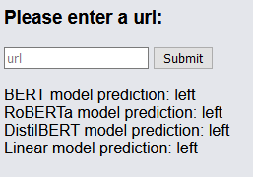

Slide 7

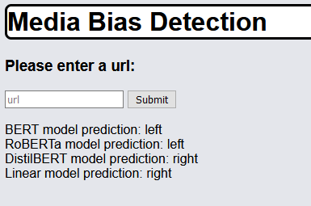

Slide 8
Discussion of Results
No models performed well on the Hyperpartisan dataset
Max test accuracy: 51%
Labelled with MediaBiasFactCheck.com
All models performed well on the Reddit dataset.
Linear model performed best with 97% test accuracy
Possibly due to the linear model accepting entire articles as input
Notes:
No models performed well on the Hyperpartisan dataset; the best accuracy we saw was 51%. We believe that one of the reasons for this is that the Hyperpartisan dataset is noisy. The dataset contains many different kinds of articles, not just political ones. This makes it difficult to classify articles as politically biased. Additionally, we believe that the way in which articles were labelled is flawed. The Hyperpartisan dataset labels articles by publisher, but in our Reddit dataset, articles are labelled based on the subreddit in which they were posted, meaning that people read those articles and shared them with a group that shares their political bias.
On the other hand, all of our models performed well with our Reddit dataset. The linear model performed best with a test accuracy of 97%. We expect that this is because of a limitation with the pre-trained models which is that they only accept the first 512 characters of an article as input. Obviously this is not enough to capture the full sentiment of the article. Our linear model accepts the entire article, meaning it can better understand the sentiment.

Slide 9
Recommendations
Find more diverse sources of data (rather than simply Reddit)
Use a larger dataset
Use models that permit entire article as input
Notes:
We have a few recommendations for future research. The first recommendation is to use a more diverse source of data. It would probably be beneficial to grab articles from websites other than Reddit. Within Reddit, we only considered four subreddits as sources of articles. One of these was classified as right-leaning and three were left-leaning, so we had some imbalance on our sources. Our next recommendation is to use a larger dataset. As we mentioned before, our dataset contained 880 articles. More articles would always be better. Finally, we recommend that you classify text using custom-made models rather than pre-built ones so that you can accept entire articles as input. As we saw with our linear model, this improved performance.

Slide 10
Questions?

