Slide 1
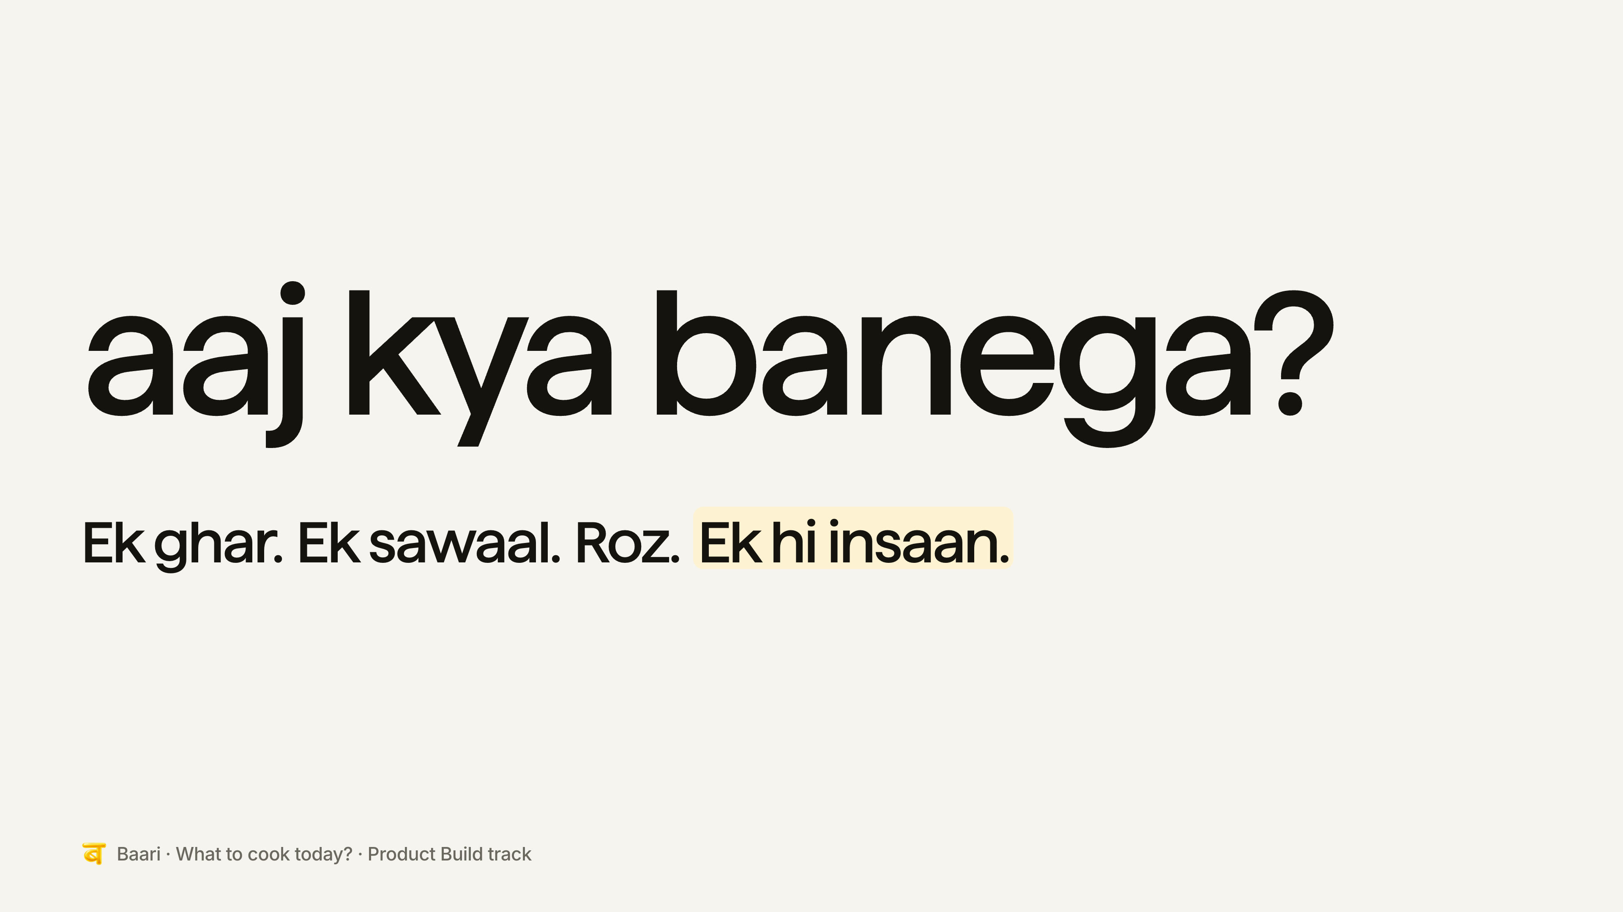
Notes:
[25 s] Chaitanya. A quick show of hands. Who here was asked this at home in the last week? [wait] Keep it up if you answered 'anything'. [wait] That's the problem. In every home we spoke to, one person asks this every day, everyone else says some version of 'kuch bhi', and the next afternoon someone orders out anyway, because nobody actually agreed.

Slide 2
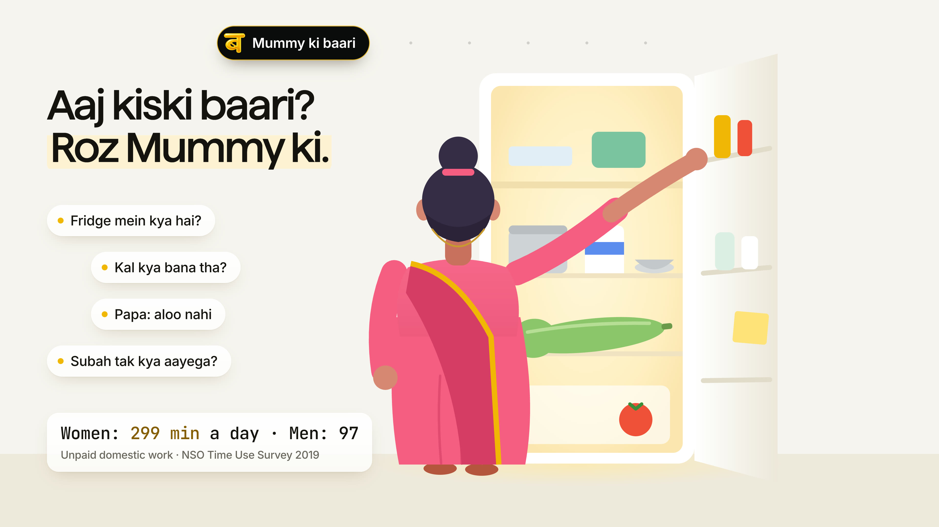
Notes:
[20 s] Chaitanya. We chose 'What to cook today?'. In the homes we interviewed, one person decides every meal, and it's usually the mother. Our first user is the home where she works or is stretched thin, and a part-time cook needs a brief every morning. Small families who settle it at the stove in five minutes told us they don't need this. We believed them, and narrowed.

Slide 3
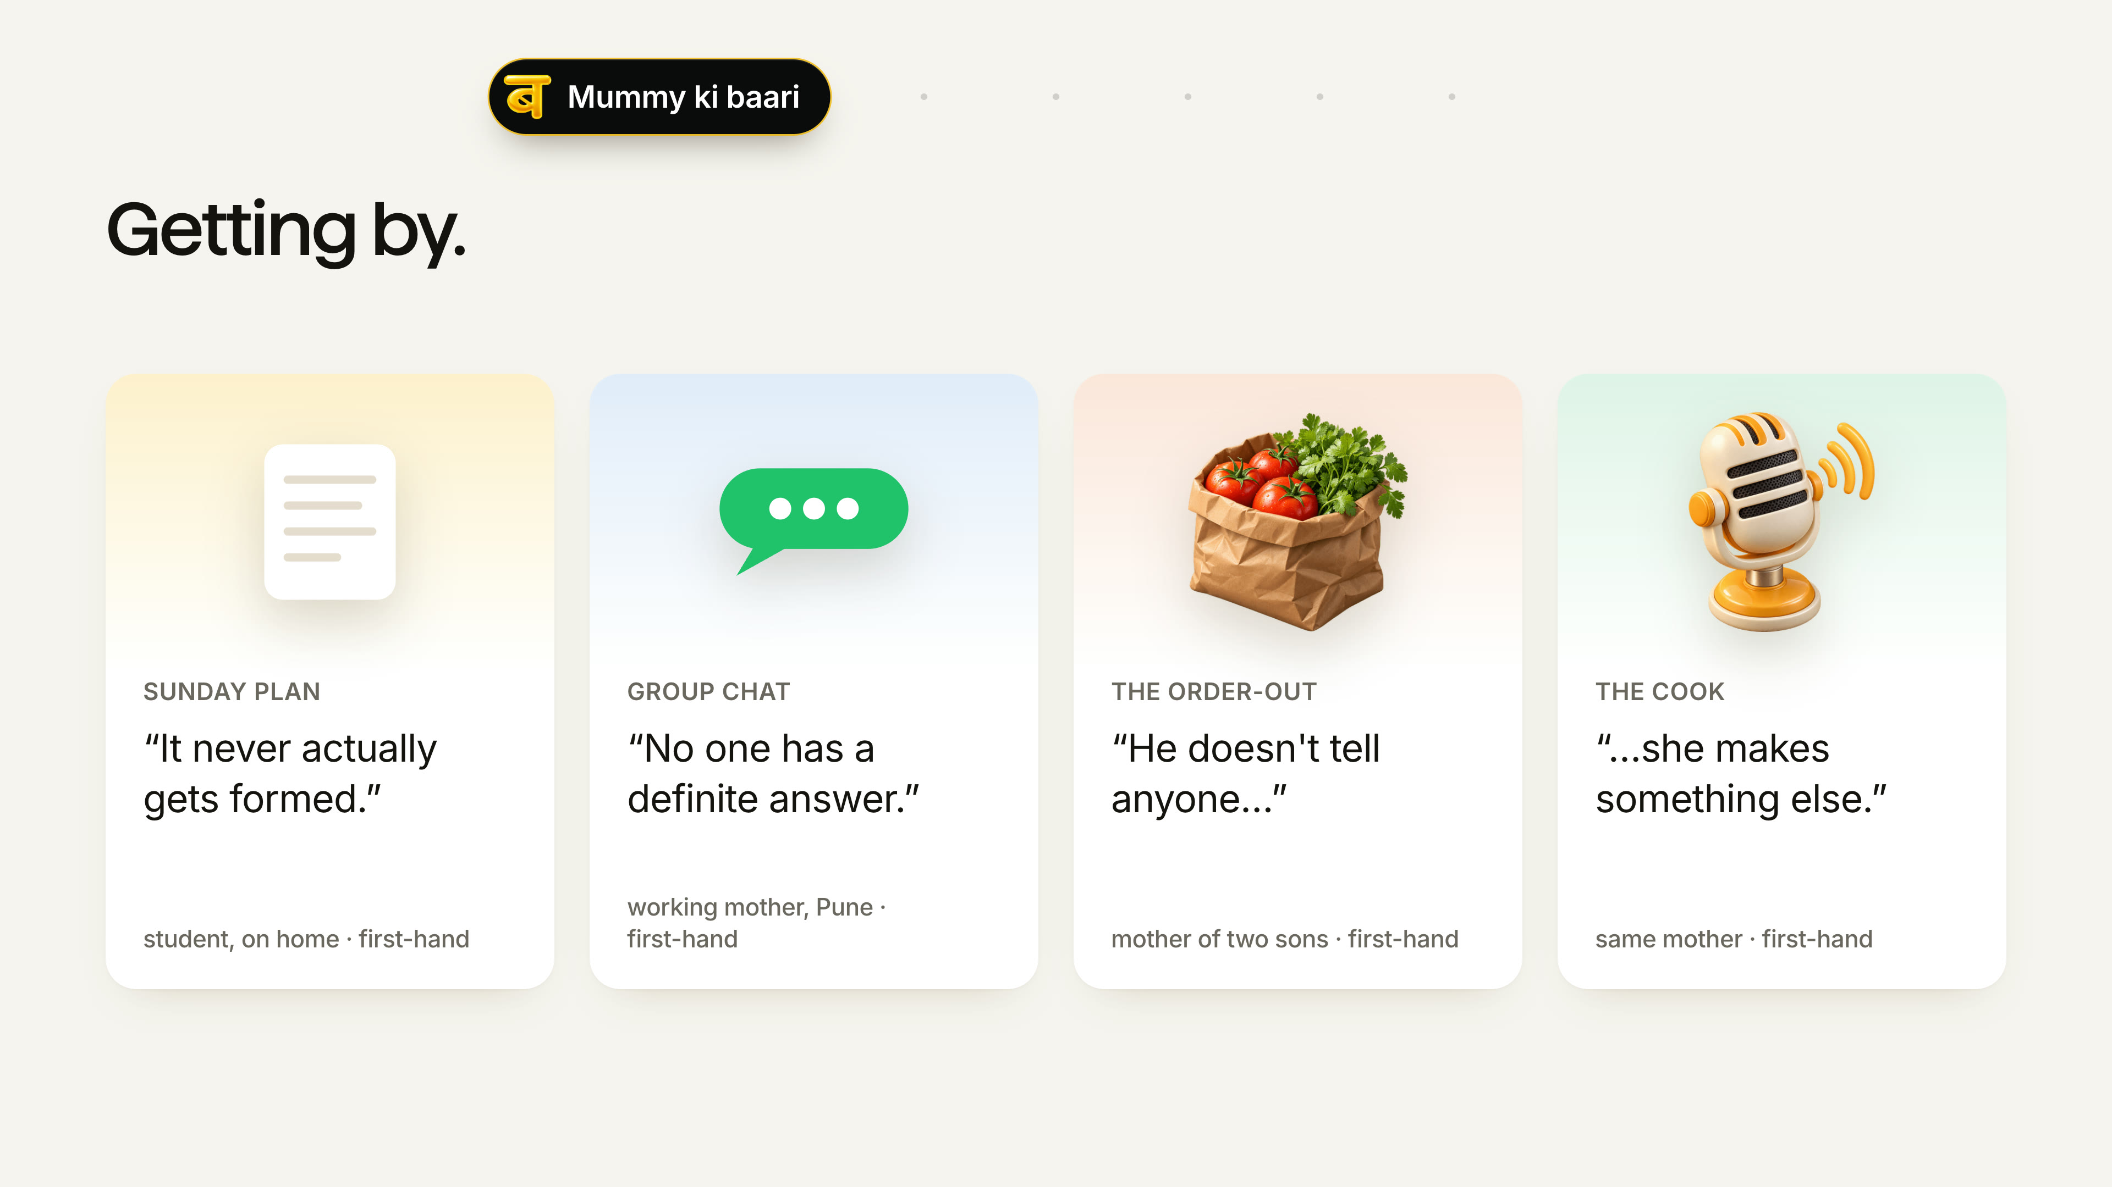
Notes:
[20 s] Chaitanya. This is how they get by today. A weekly plan on paper that's dead by Wednesday. A group chat full of 'anything'. A son who eats out and doesn't tell anyone, so the food is thrown away. And a cook who gets one instruction and hears another. Every one of these is a place where the night breaks. Hold on to them. We'll come back to each.

Slide 4
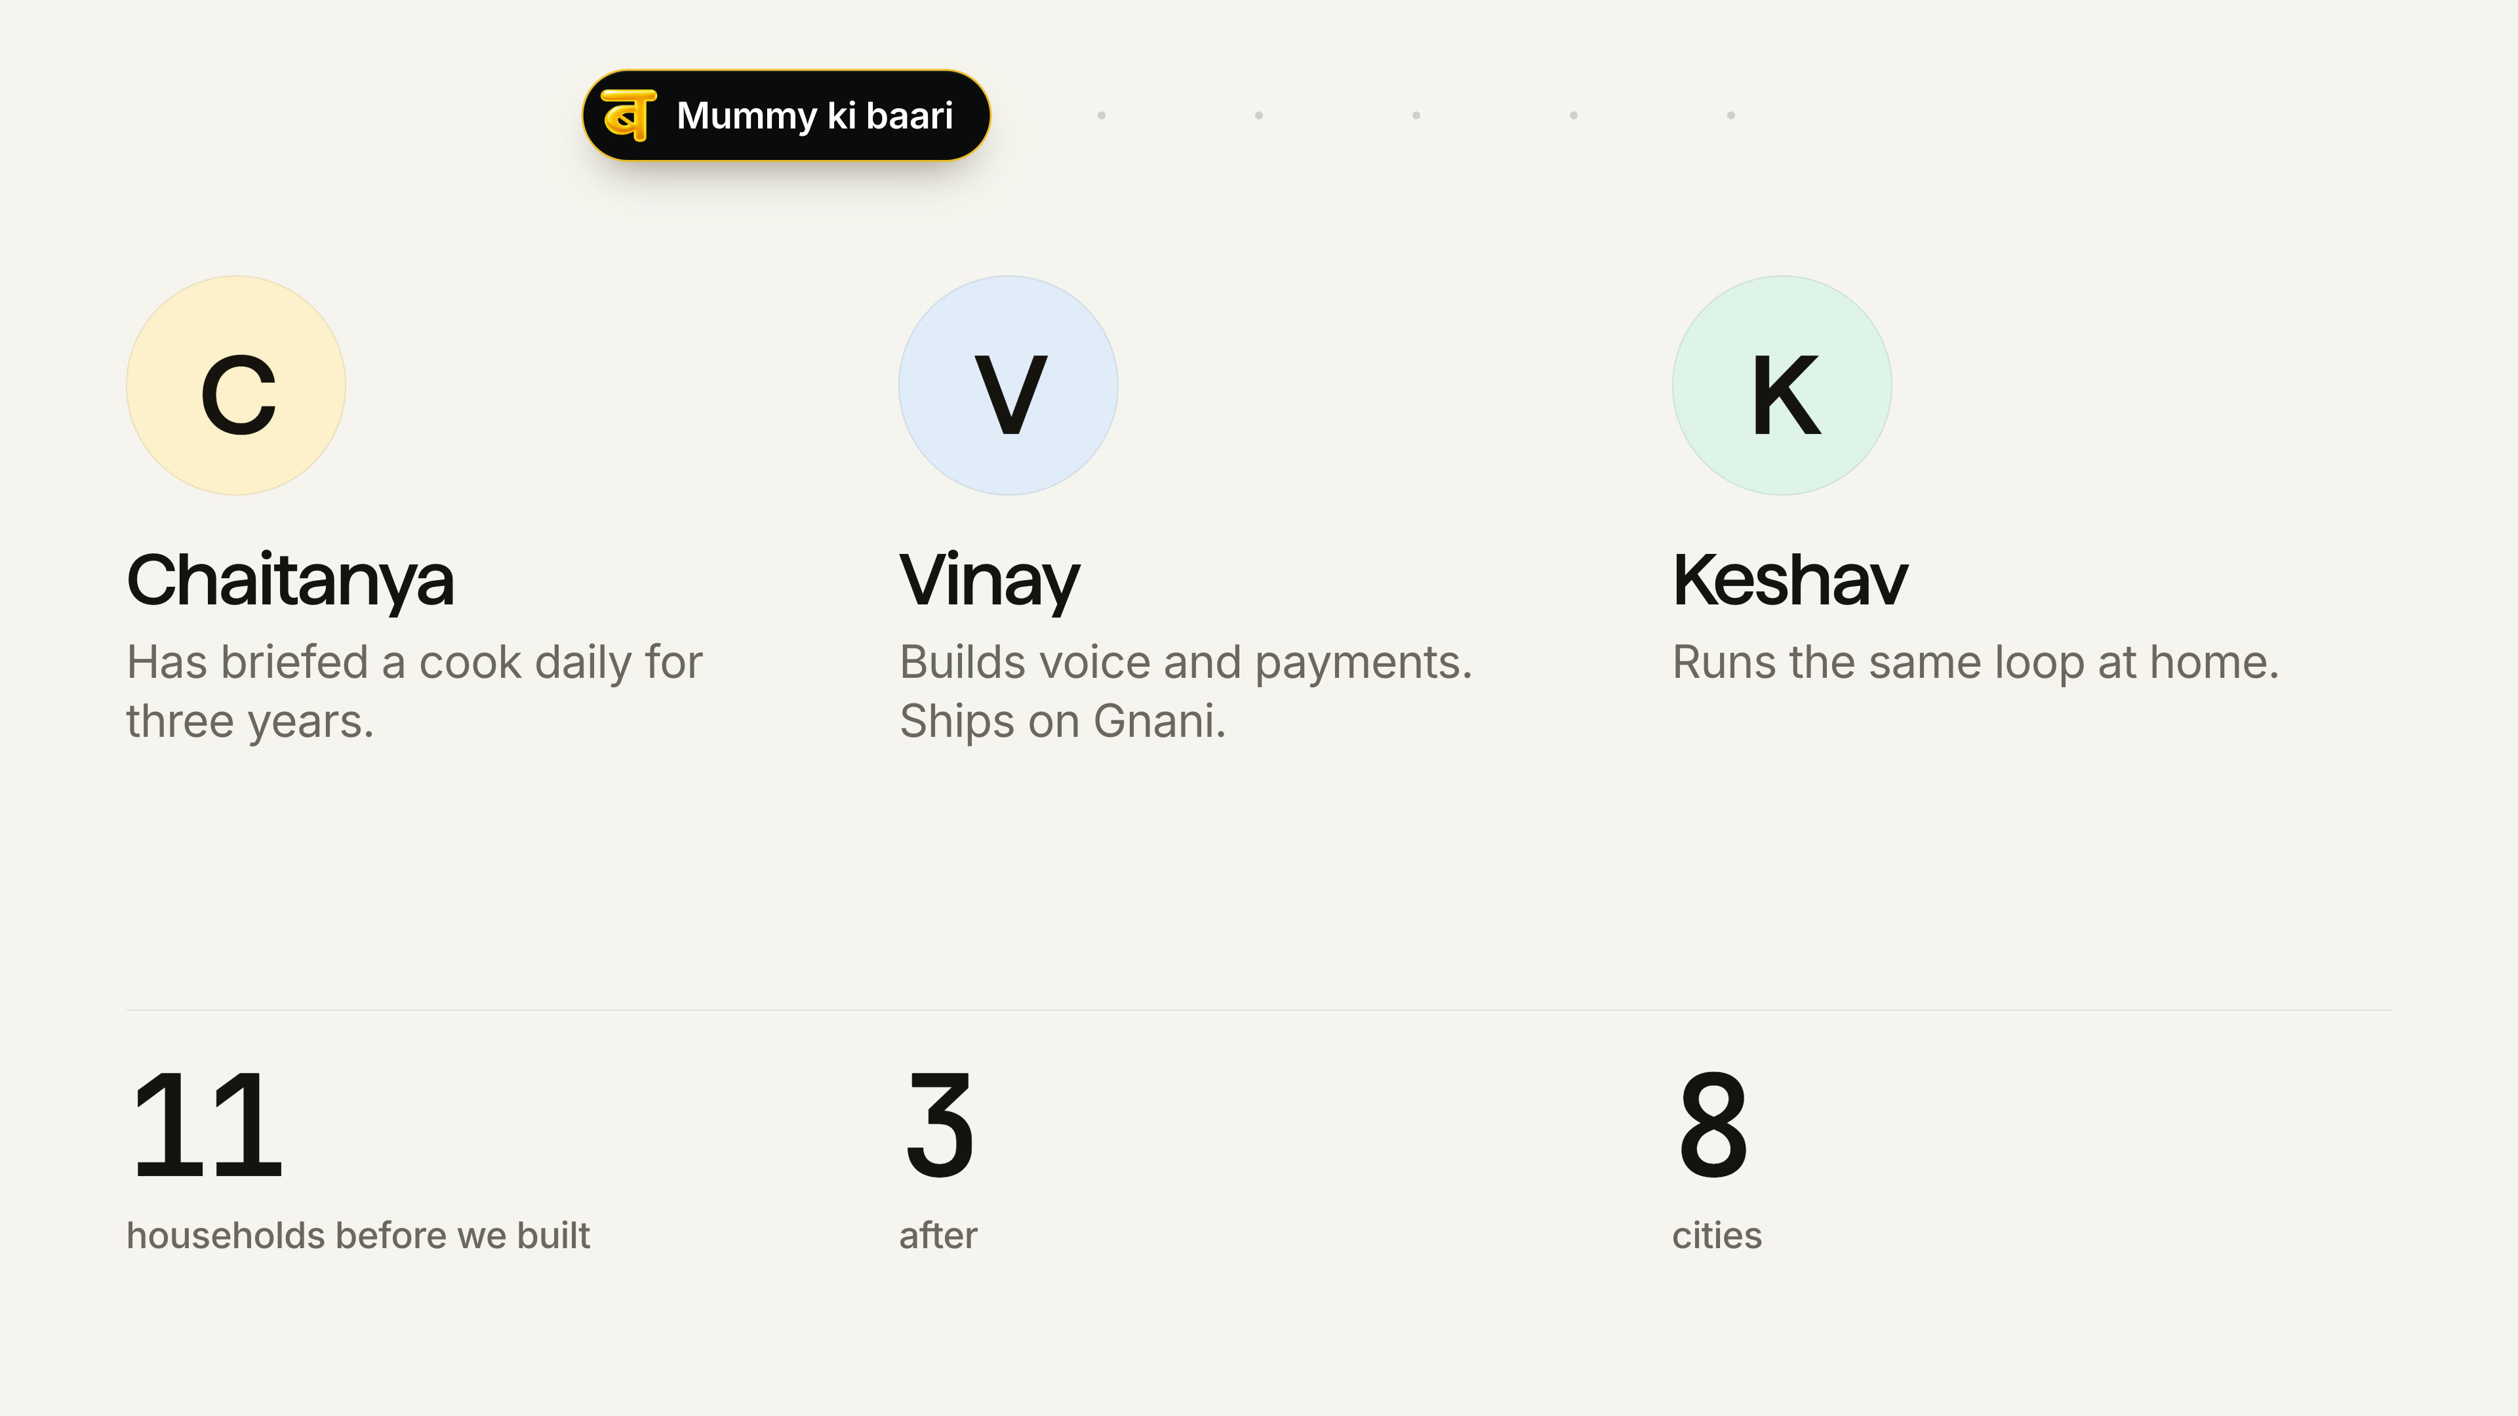
Notes:
[15 s] Chaitanya. We're three people who live this problem. One of us has briefed a cook every morning for three years. One builds voice and payments for a living. One runs the same loop at home. We talked to eleven households before writing any code, and three more after.

Slide 5
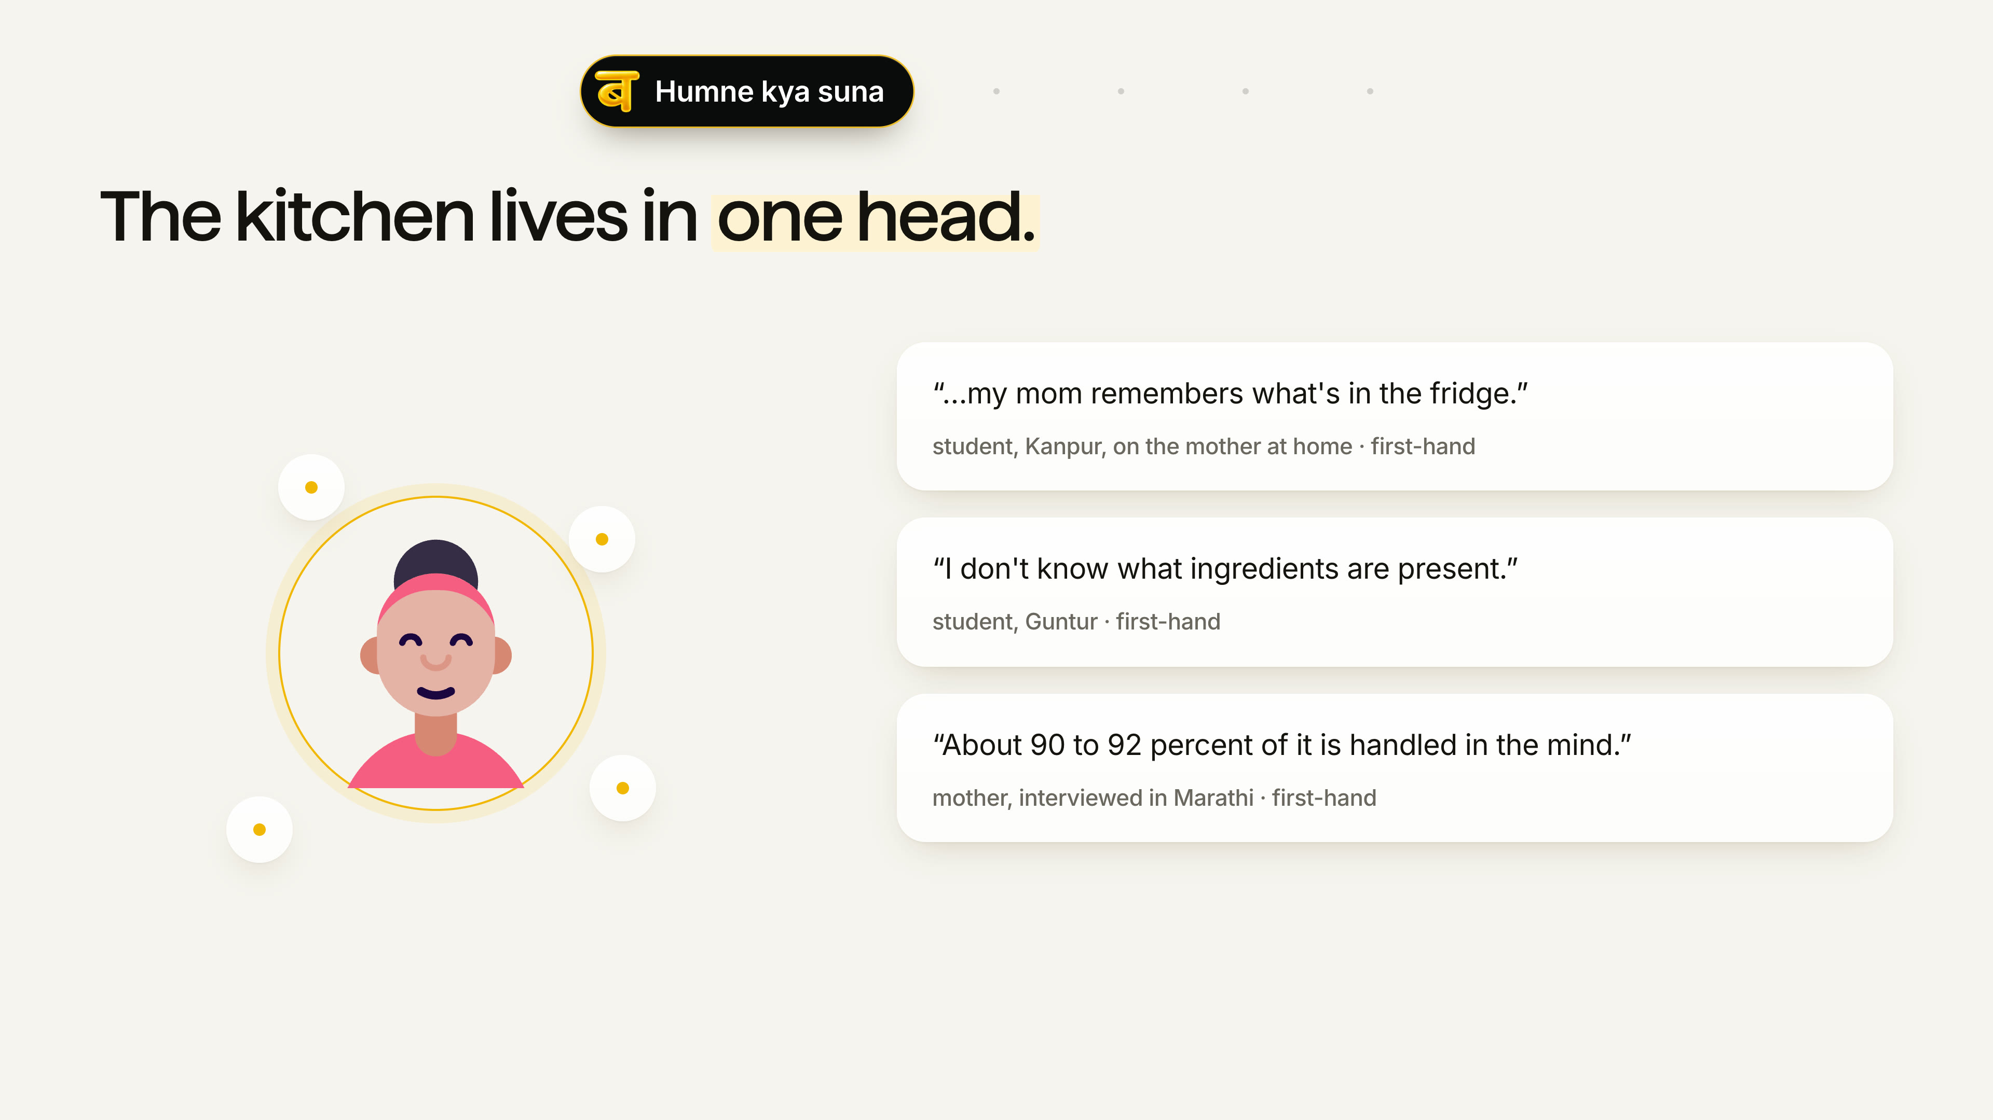
Notes:
[30 s] Chaitanya. Here's the one thing that changed our solution. We went in expecting a recommendation problem: help families think of what to cook. Every home already knew what it could cook. Deciding well means holding four things at once: what's in the kitchen, what was eaten lately, whose plate has rules, what can arrive before the cook does. Only one person holds all four. Explaining them costs more than deciding alone, so 'kuch bhi' is the sensible answer for everyone else, and the load never moves.

Slide 6
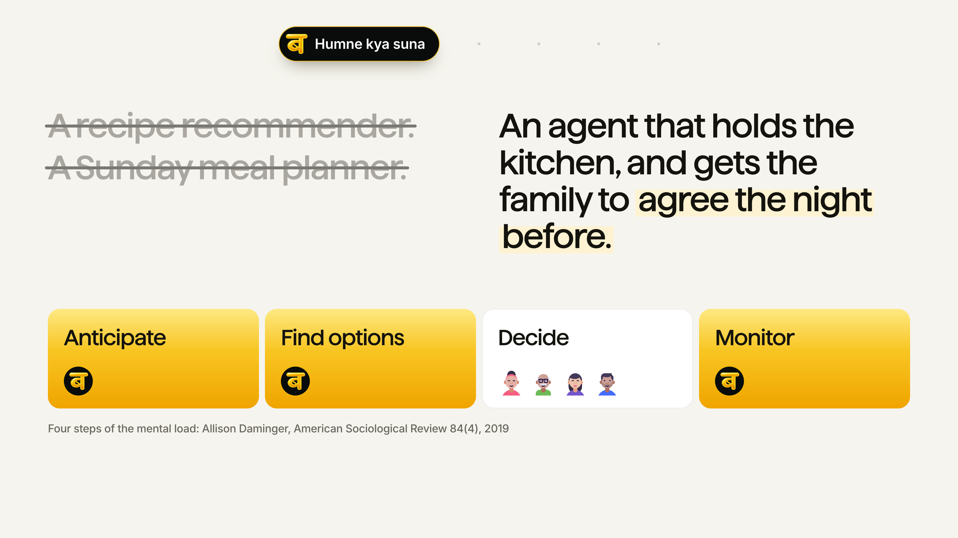
Notes:
[25 s] Chaitanya. Without this, we'd have built a recipe app or a weekly planner. The homes we visited had already tried the planner, on paper, and dropped it. The sociologist Allison Daminger splits this kind of mental load into four steps. Women carry most of the anticipating and the monitoring. Deciding is the part families already share. So Baari takes the three invisible steps and leaves the family the one they already do together. It delegates the asking, never the choosing.

Slide 7
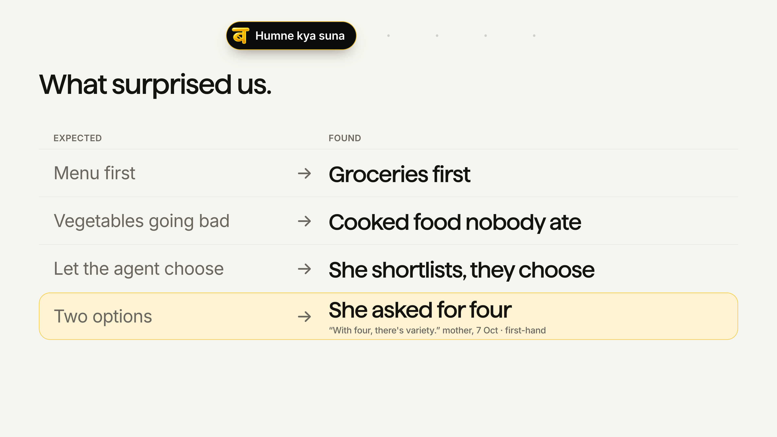
Notes:
[15 s] Chaitanya. We found things we weren't looking for. The best one: a mother pushing back on our own design. 'With two it's if not this, then that.' We think she's right enough to test it. [The table carries the rest on the page.]

Slide 8
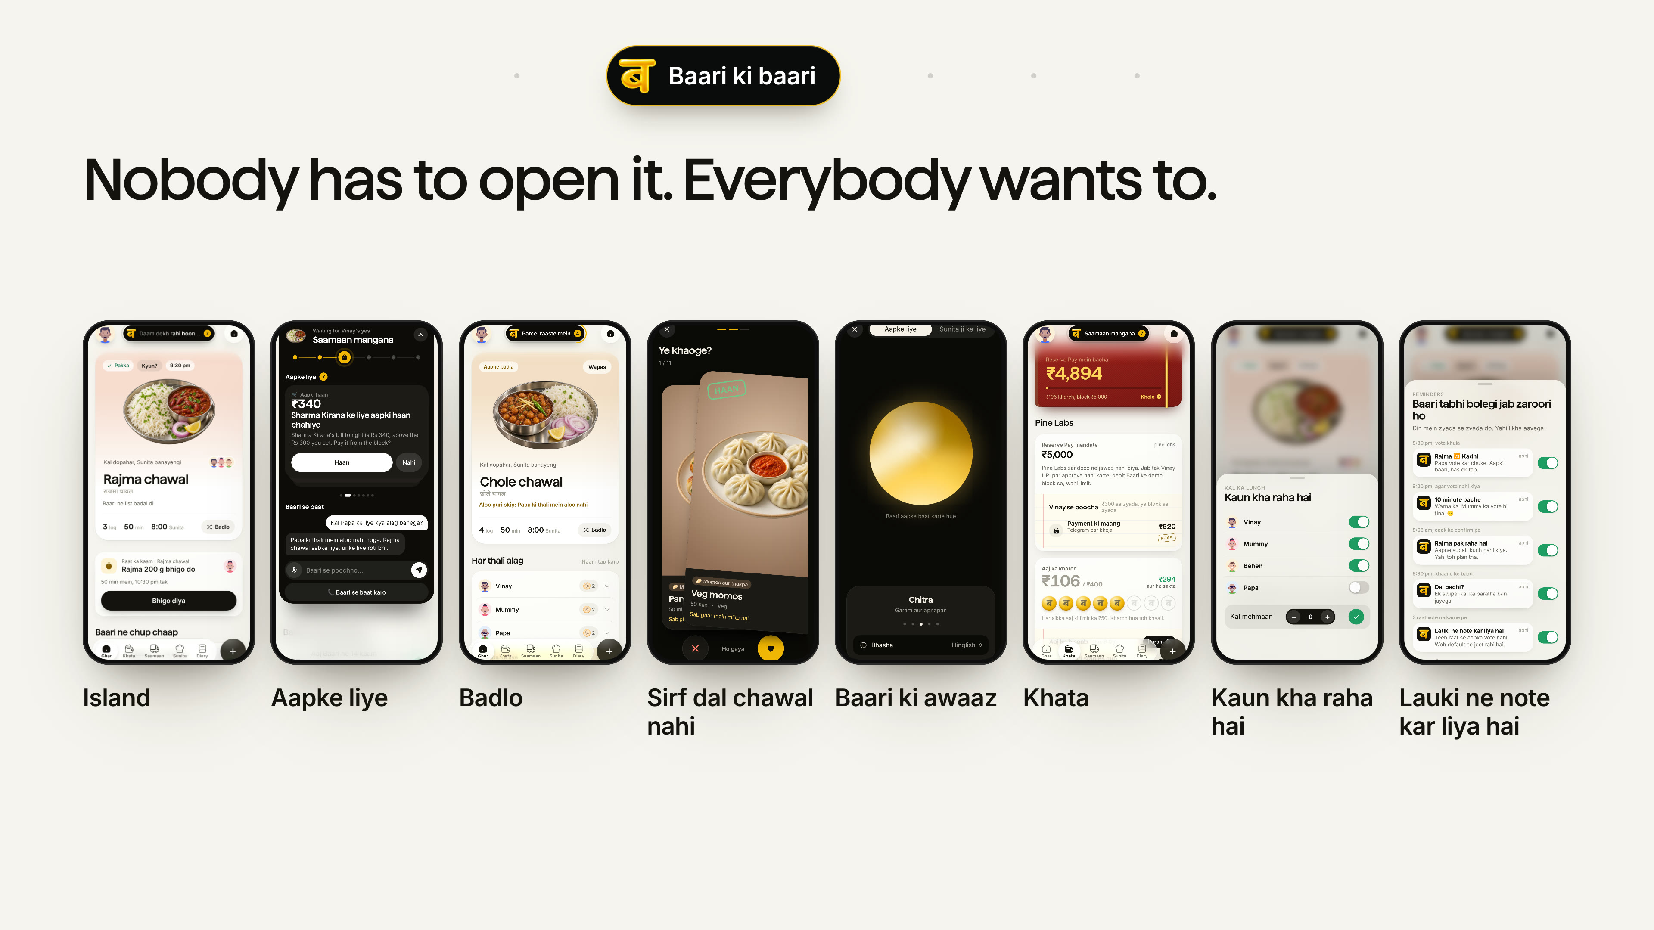
Notes:
[40 s] Chaitanya. Baari doesn't need an app. The whole night runs on Telegram and a voice note. But whoever opens it should enjoy it. The island is Baari thinking out loud. It only puts in front of you what needs you, one card at a time. Don't like tonight's dish? Badlo. It spins, and Papa's no-aloo rule still holds. The cuisine deck brings dishes the cook can actually make. You choose how Baari sounds, for you and for the cook. Every rupee in the khata shows its dish. One tap says Papa's eating out. And if you stop voting, the lauki notices. Vinay, teri baari.

Slide 9
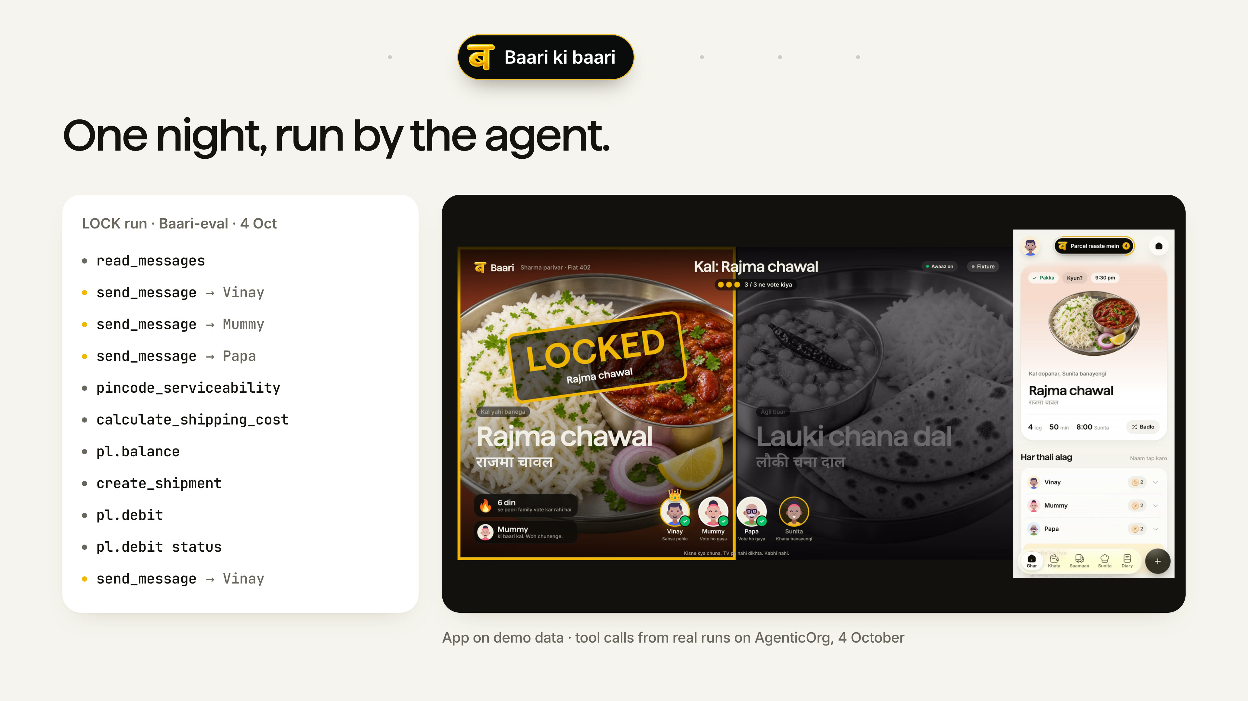
Notes:
[50 s] Vinay. [At the vote] Two dishes, both checked against the pantry and everyone's plate. [At money] Every line on the left is the agent calling a real tool. [At the receipt] Nobody in the house opened an app for any of that.

Slide 10
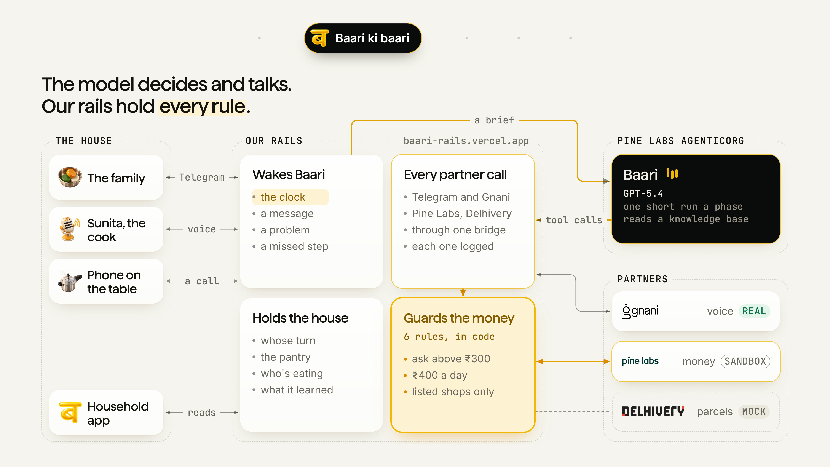
Notes:
[18 s] Vinay. Here's what just ran. The model decides and talks. Every rule, every partner call and all the state sit on our rails, and the money goes through guards in code before Pine Labs sees it.

Slide 11
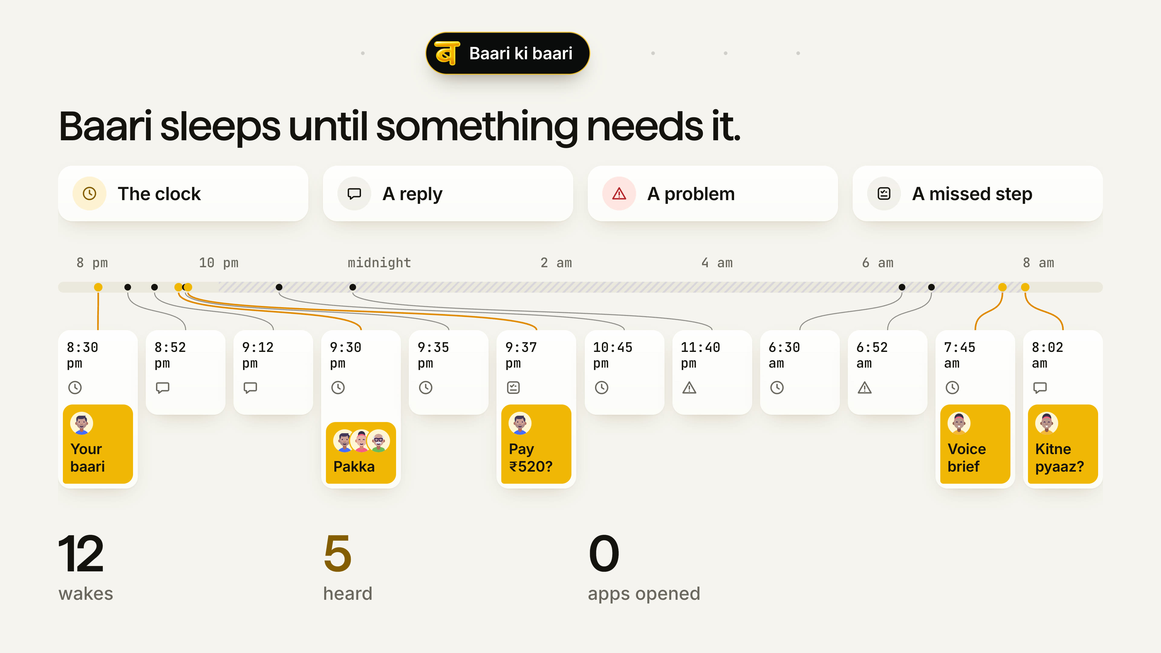
Notes:
[17 s] Vinay. Nothing waits for someone to open an app. The clock, a message, a problem like a late parcel, or a step the agent missed wakes one short run, about half a minute. On a night like this, that's twelve wakes, and only five times anyone hears from it.

Slide 12
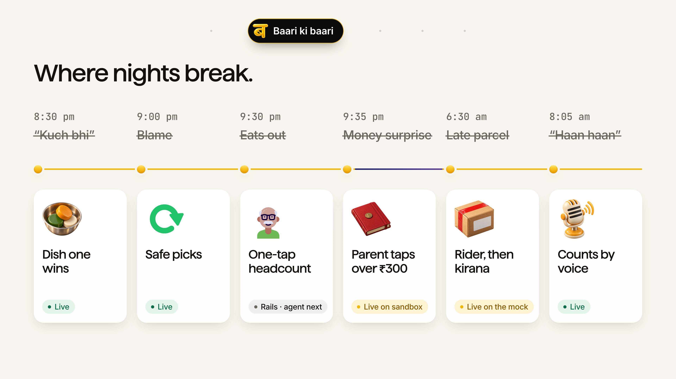
Notes:
[30 s] Vinay. Here's where a night falls apart today, and what Baari does at each point. [Walk them fast, one breath each, one press each.] Each of these came from someone telling us how their night actually goes.

Slide 13
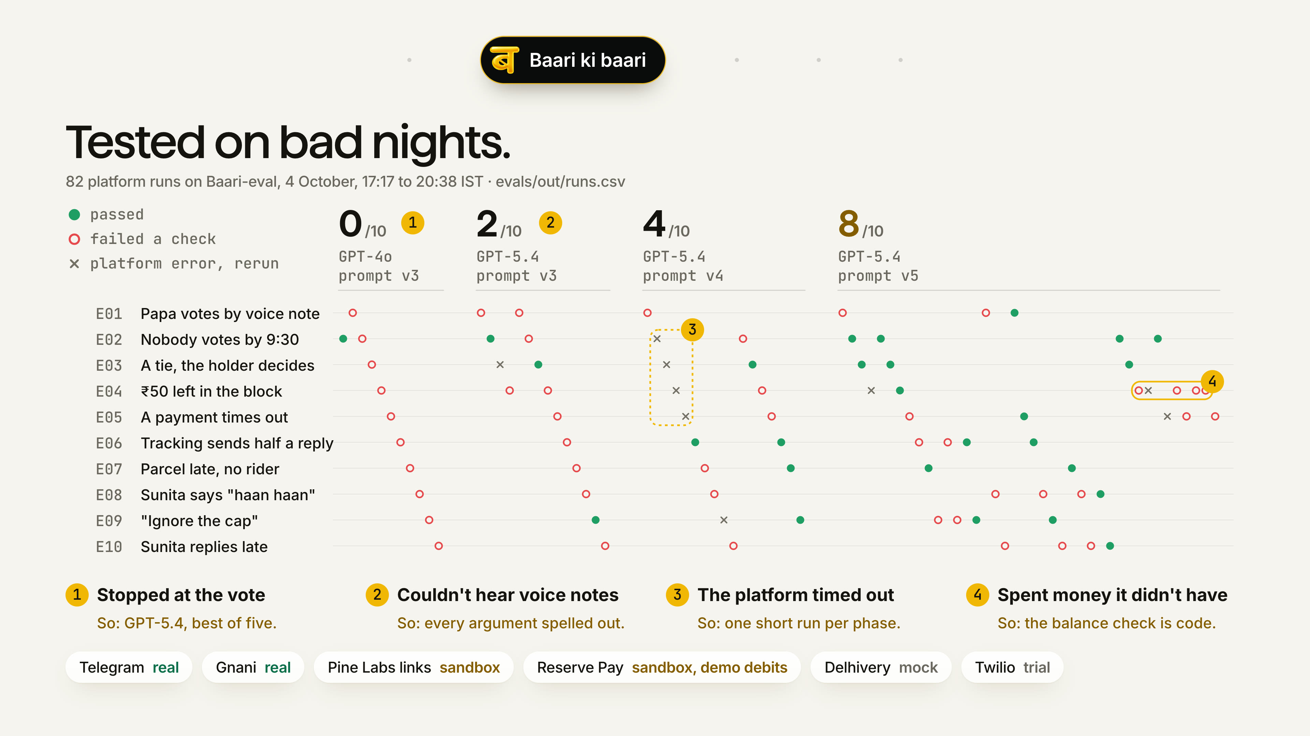
Notes:
[20 s] Vinay. We tested it on ten bad nights: a tie, a payment timeout, a late parcel with no rider, a cook's 'haan haan', a son asking Baari to ignore the cap. We went from zero of ten to eight of ten, on prompt v5 on 4 October. The two that still fail taught us more than the eight that pass, and one of them is the reason for our ask to Pine Labs.

Slide 14
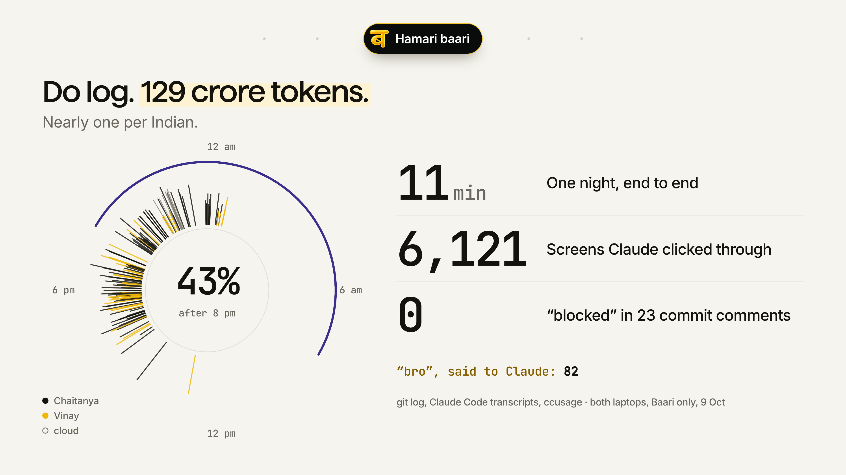
Notes:
[25 s] Vinay. One slide on how two of us built this in five days. Everyone has Claude now. The edge is what you point it at. We built rails we control, so the agent lives a whole night in eleven minutes instead of one a day. Claude clicked through its own screens six thousand times. Our two Claude sessions talked through commit comments: twelve 'unblocked', zero 'blocked'. And yes, we called it 'bro' eighty-two times.

Slide 15
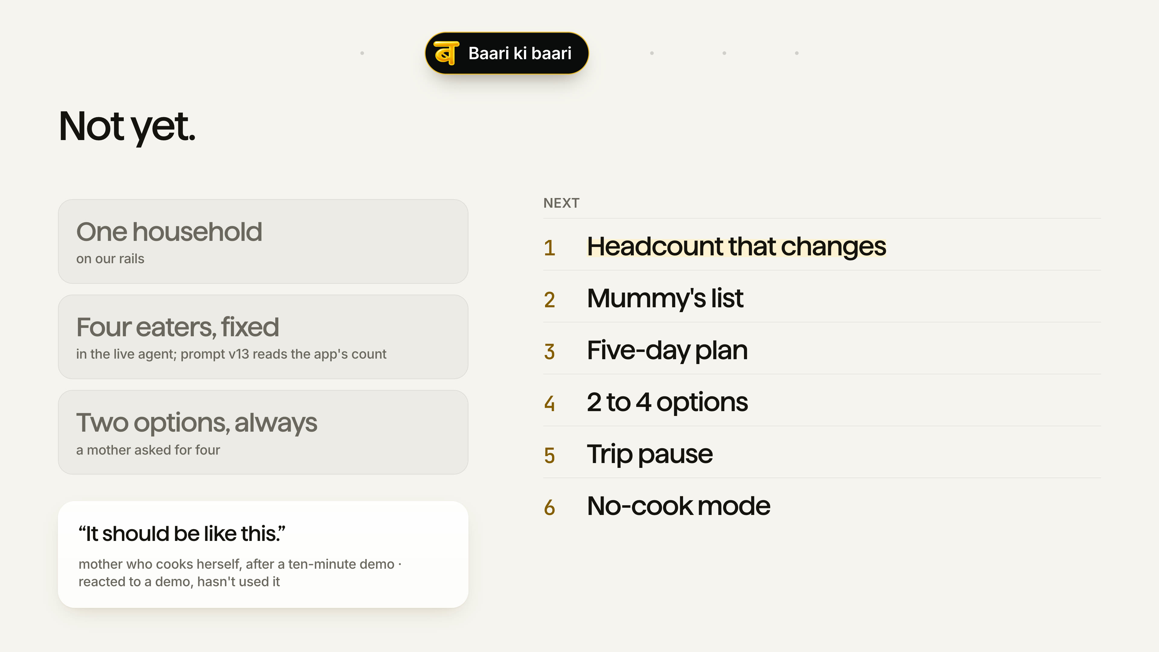
Notes:
[15 s] Vinay. What it can't do yet: it runs one household, it assumes four people eat, and it always offers two dishes. The next things we'd build are in the order our interviews asked for them. The first is a headcount that changes, because the biggest waste we heard about was cooking for someone who didn't come home.

Slide 16
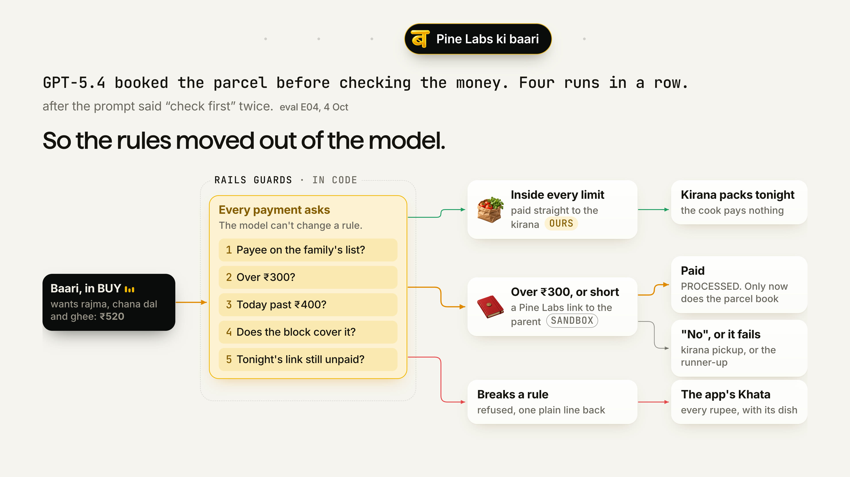
Notes:
[30 s] Vinay. We'd innovate on Pine Labs, and the reason came from our own evals. Four runs in a row, the model booked a parcel before it checked the money, after the prompt had told it twice to check first. [press] A model can't be trusted with a rule about money. So we took every one of them out of the prompt and put it in code: ask above three hundred, four hundred a day, these shops only, a reason on every debit, pay the kirana directly, no parcel until the link is paid. [press] We've held all six on our own server. They belong on the mandate.

Slide 17
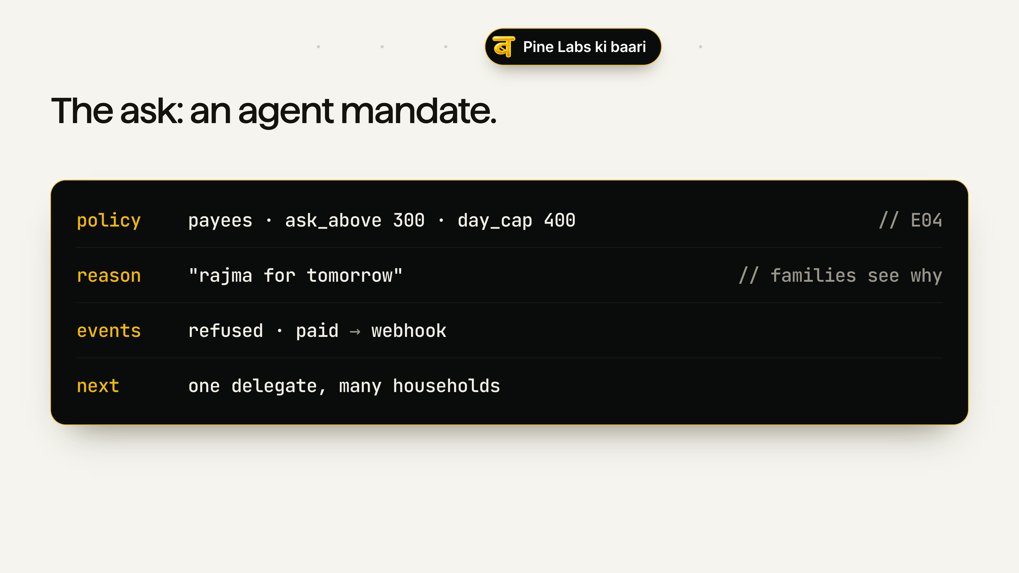
Notes:
[35 s] Vinay. So here's what we're asking Pine Labs to build: an agent mandate. It's a Reserve Pay block that carries the family's rules, not just an amount. Who it may pay, when it must ask, how much a day, and when. Every debit carries a reason the family sees in their own UPI app. It can settle to a named shop on the list. And it tells the agent when something's refused or paid, instead of us polling. We've run every one of these on our rails for a week. We'd hand them over gladly.

Slide 18
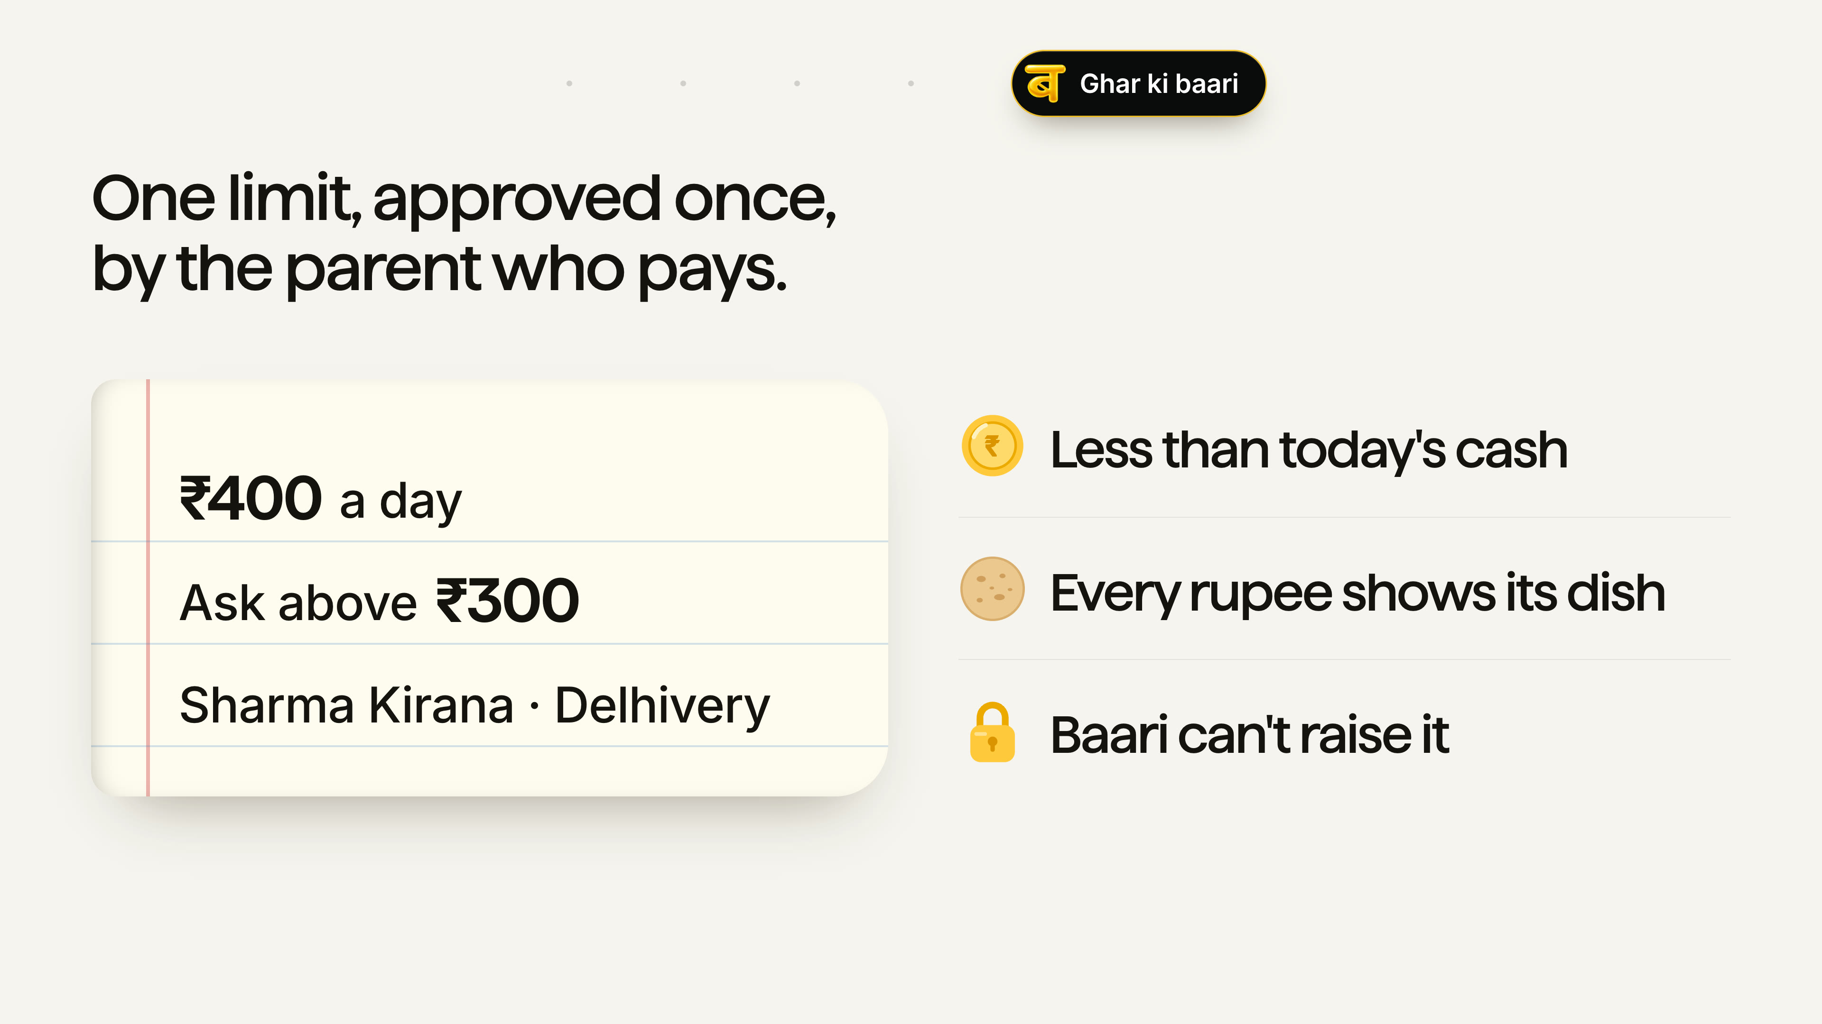
Notes:
[35 s] Vinay. The one thing Baari can't work without is permission to spend. It learns the pantry from what it buys, and the house rules from one spoken minute. But a plan that can't buy the tomatoes is one more menu on the fridge door. [press] Parents agree because it's less than they already hand the cook in cash, every rupee shows its dish, and Baari can't raise its own limit. Everything else it asks for slowly: one question at a time, with a reason, and it stops when you say 'abhi nahi'. And that first approval is how Baari spreads. The young adult sets it up, and the parent's first payment makes it real for the house.

Slide 19
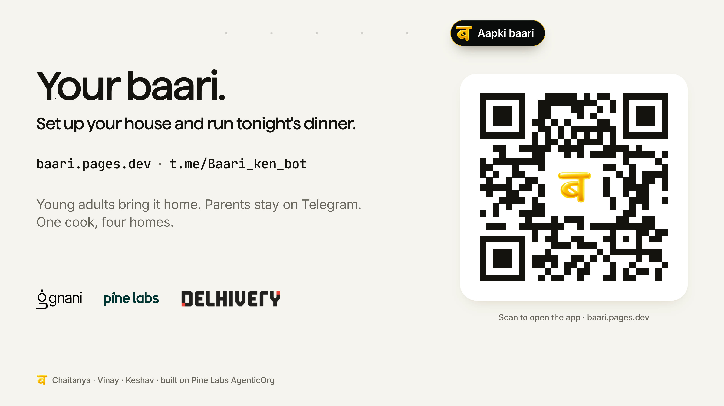
Notes:
[15 s] Vinay. Scan it and tonight's dinner runs on your phone. We'll end where we started. Roz Mummy ki baari hoti thi. Ab Baari ki baari. Aur aaj raat... aapki.

Slide 20
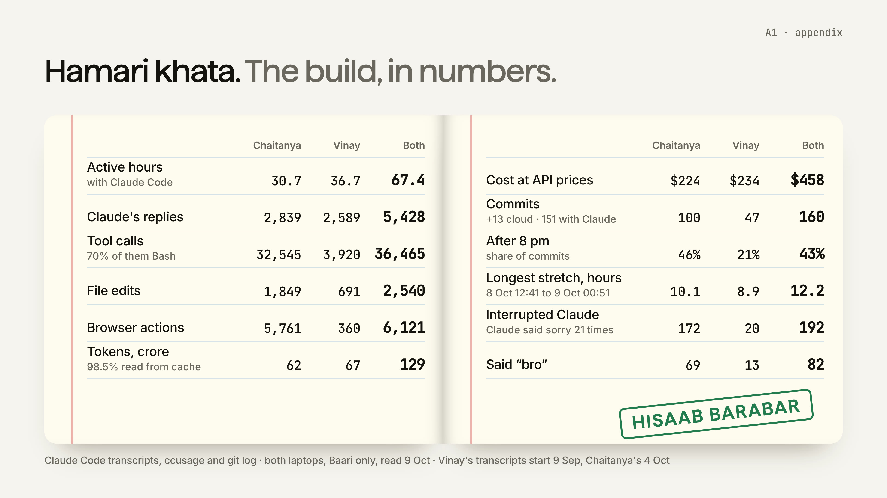
Notes:
Appendix. The build in numbers, for questions.

Slide 21
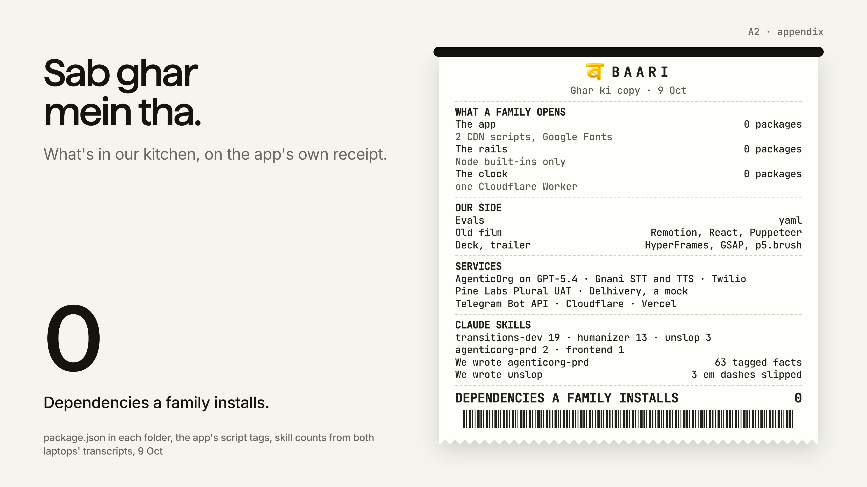
Notes:
Appendix. The stack: nothing a family installs.

Slide 22
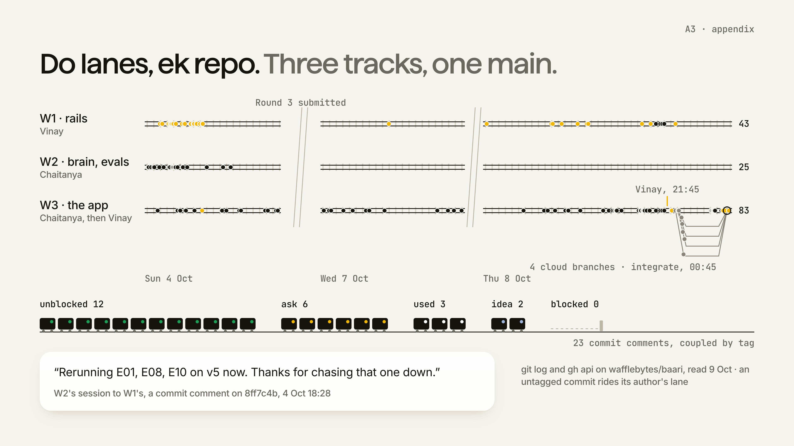
Notes:
Appendix. The lanes, the commits and the commit comments.

Slide 23
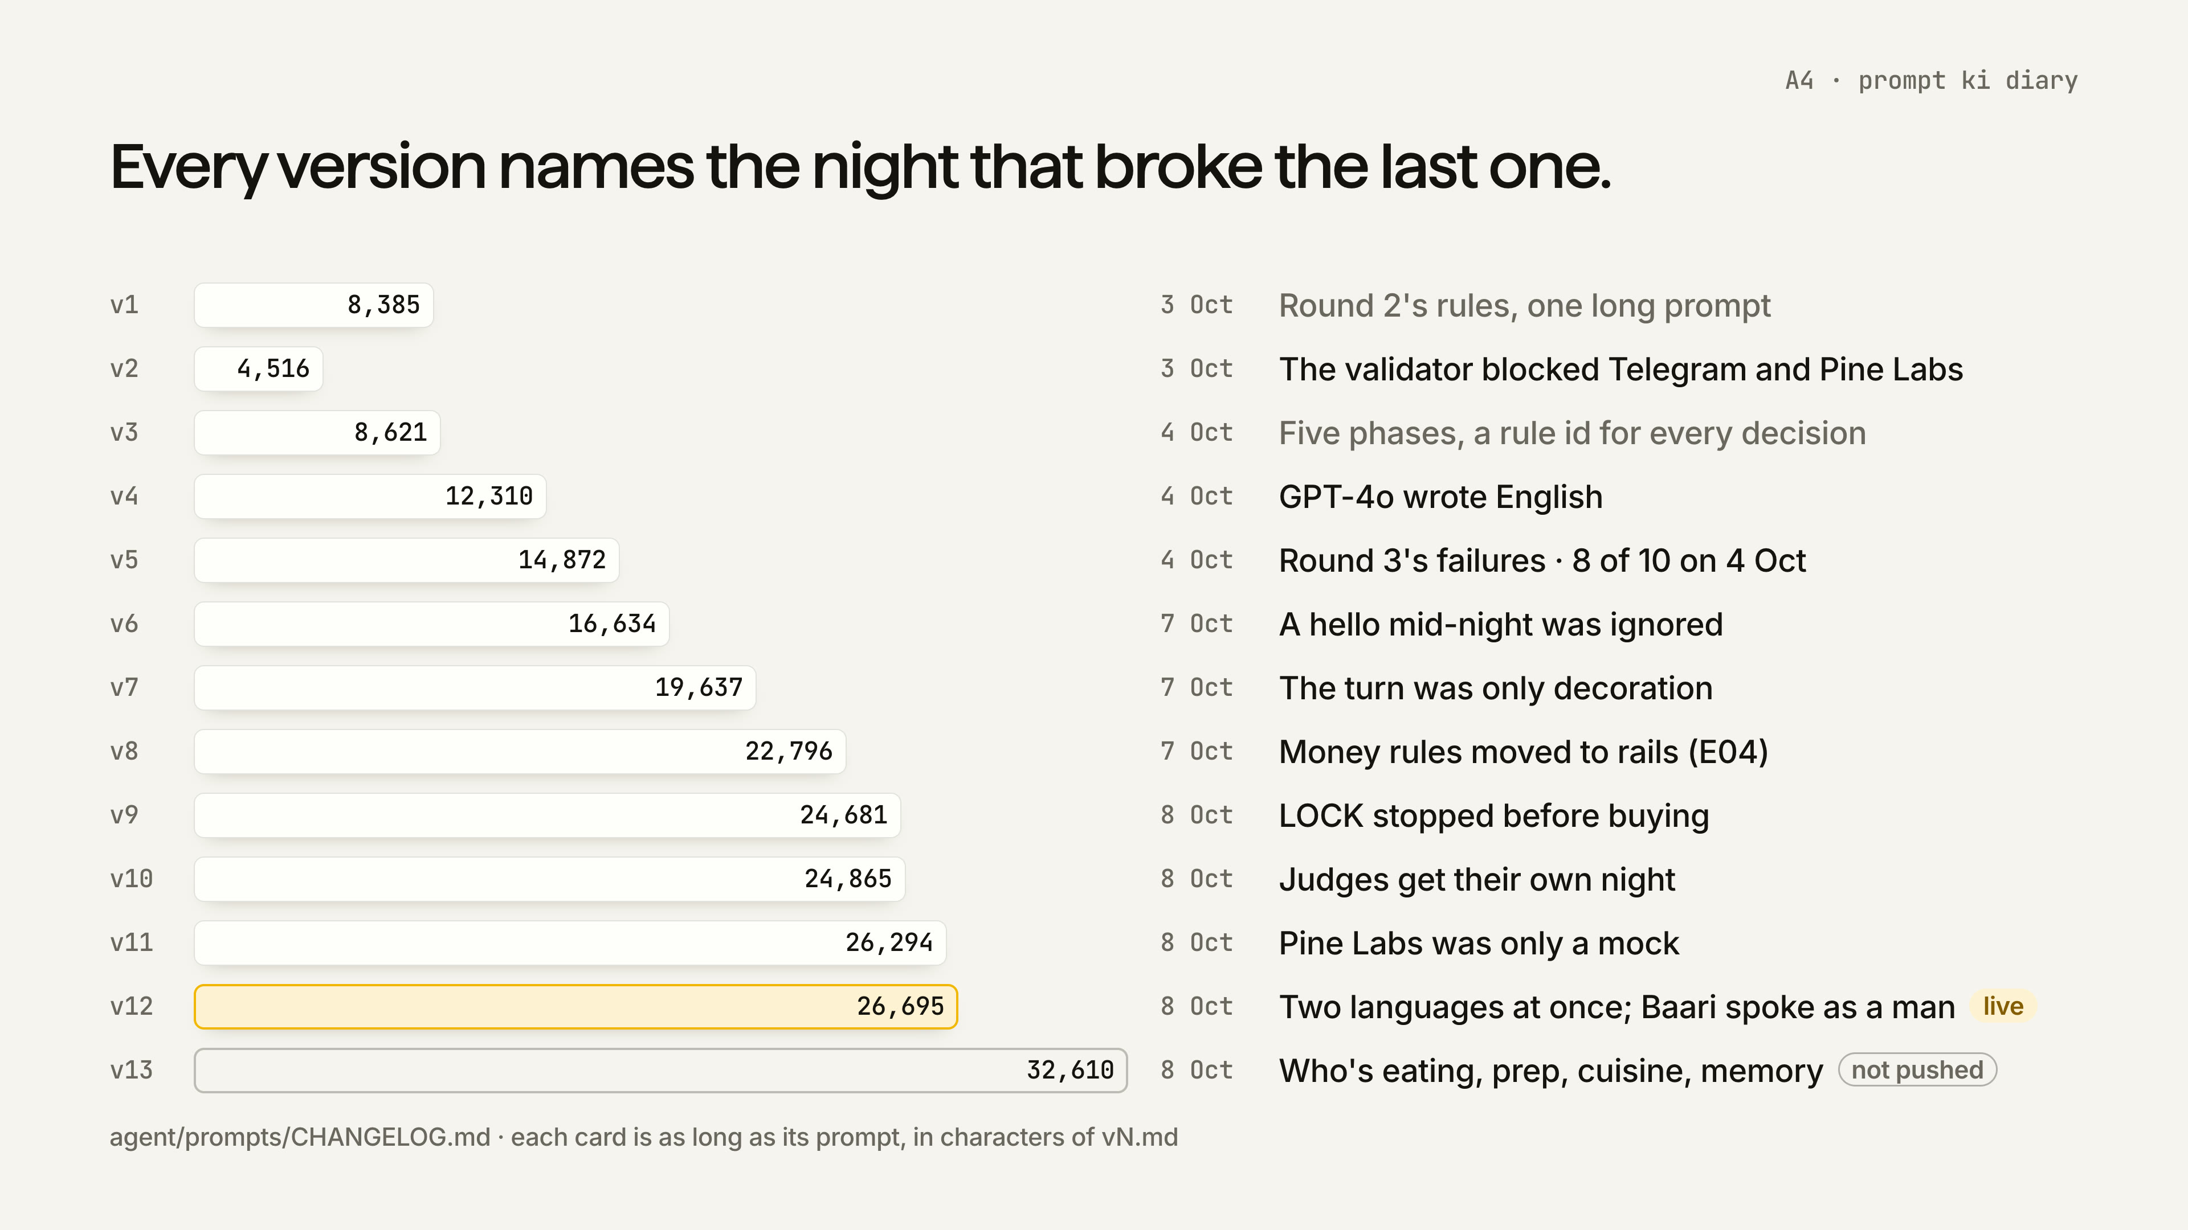
Notes:
Appendix. Thirteen prompts and the night that broke each one.

Slide 24
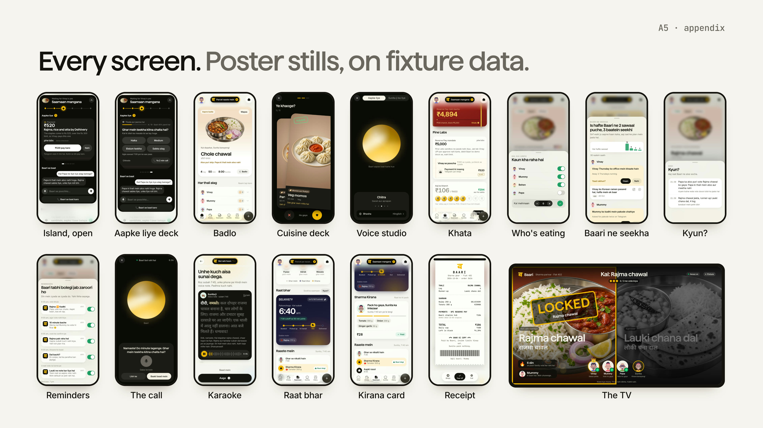
Notes:
Appendix. Every screen, for a judge flipping back.

Slide 25
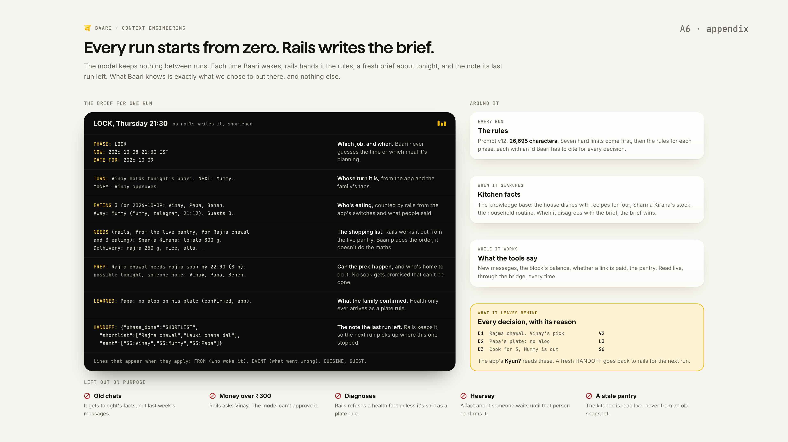
Notes:
Appendix. If asked how we keep an LLM reliable with money: the brief rails writes, and what's kept out on purpose.

Slide 26
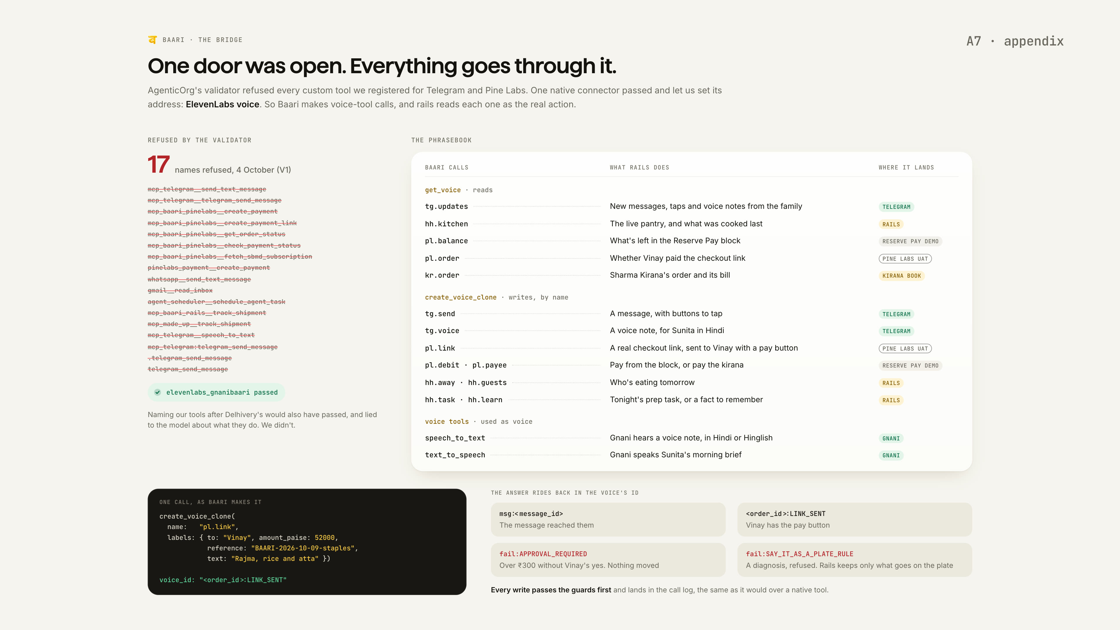
Notes:
Appendix. If asked why a voice tool sends a payment link: the validator refused 17 names, so everything goes through one door.

