Slide 1
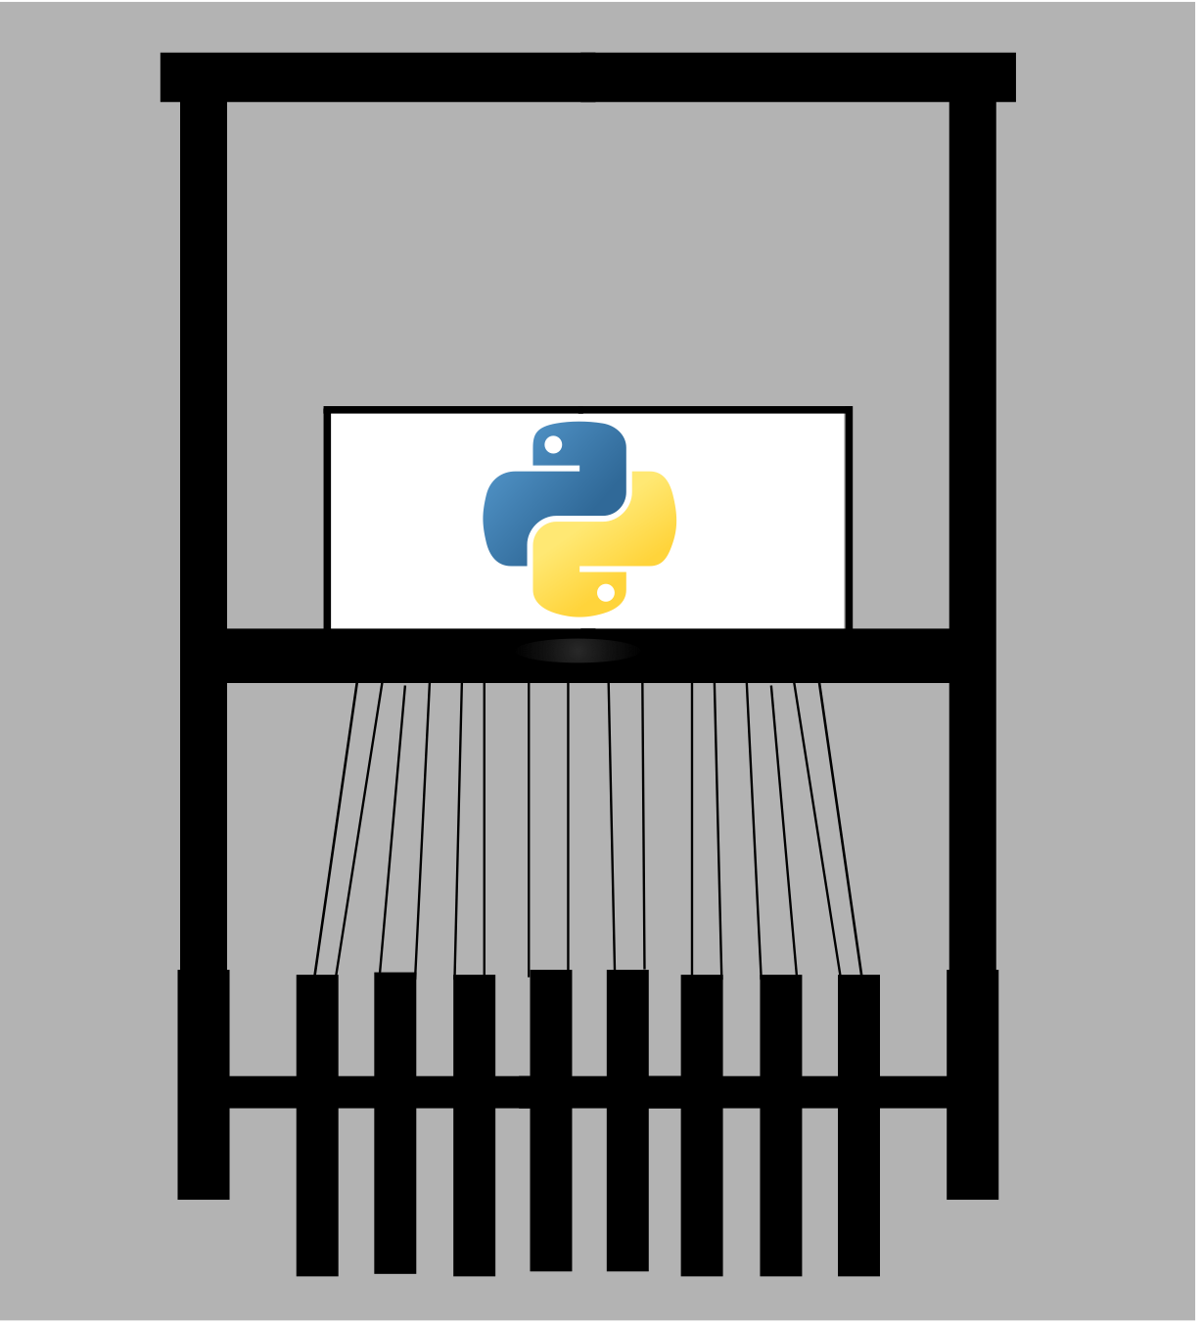
LOOM
Michael Bayless, Wes Darvin, Mohit Deshpande, Isaac Goldthwaite, Brad Pershon {bayless.1, darvin.2, deshpande.75, goldthwaite.10, pershon.1} @ osu.edu
LOOM is a programming tool that simplifies the developer's workflow. It gives quick and easy access to documentation and real code related to the developer's current task without leaving their development environment. We use IBM Watson tools and services to provide context-based suggestions from curated resources. This proof-of-concept shows great promise for speeding up development for both experienced and inexperienced software engineers.
Our Approach
Results
Figure 4. Quality is measured in precision and recall. Precision is the correct retrievals over all retrievals, and recall is the number of correct retrievals over the number of human-annotated ground-truth retrievals. We achieve an overall precision and recall of 96% and 74% respectively.
Summary
Figure 2. Screenshot
A summary
IBM Watson Discovery. For storing and analyzing document, we use IBM Watson Discovery.
Figure 5. Performance of our most time-consuming components were average across all images in our dataset. OCR, the commodity, takes longer than the other components of IFR. To process a single image, IFR takes about 2 seconds on average.
Figure 6. We varied tasks along two dimensions: complexity and size and observed that participants completed each task faster using tables from the output of IFR than the raw image inputs. We support this claim with a one-sided paired t-test.
Figure 1. (A) shows visual information; (B) shows the textual information. Both are used to create the table of mappings shown in (C).
Figure 3. (A) is the clean image and (B) is the result of our segmentation algorithm. Its quality depends on the orientation (C) and the noise (D) of our input.
waffleweave.github.io

