Slide 1
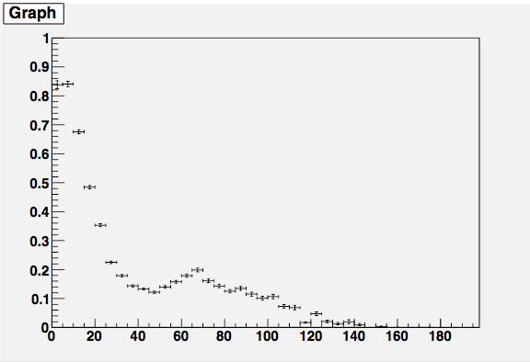
Detection efficiency
Muon’s true angle [deg.]

