Slide 1
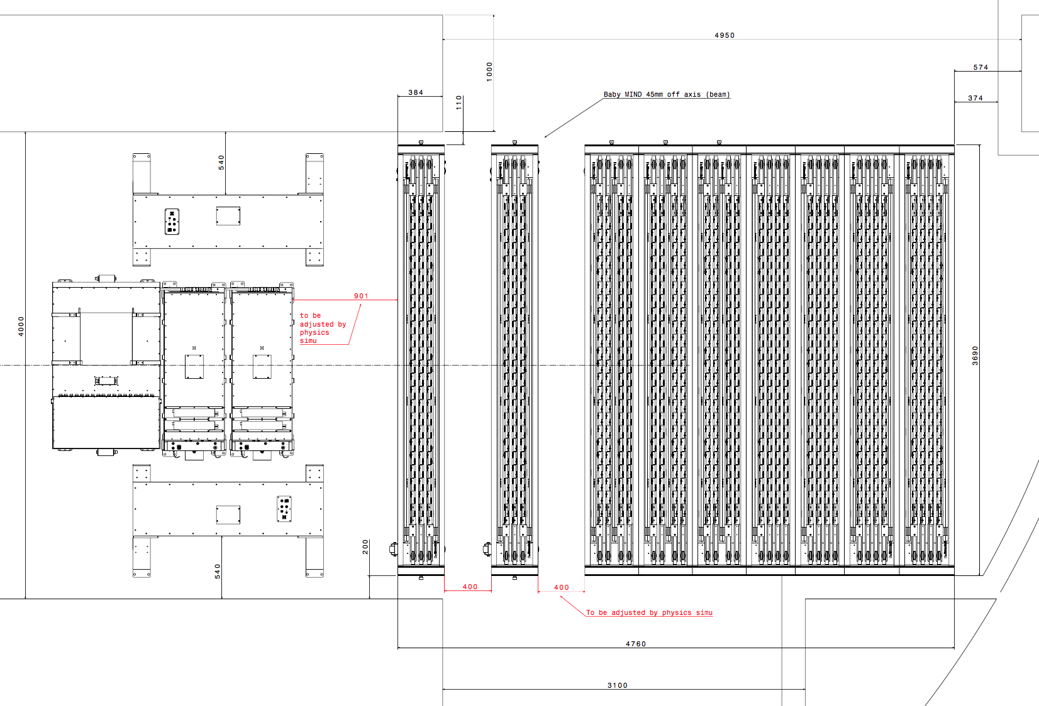
INGRID proton module
Top view
water-out WAGASCI
water-in WAGASCI
Baby-MIND
Side-MRD modules

