Slide 1

Rmarkdown
Writing scientific manuscripts with:
R-users meeting
17-09-2019
Presenters: Gustavo Togeiro De Alckmin, Pieter Dekker
Notes:
Welcome
Presenters
Topic
A bit about myself
Started using it early in my PhD
Now finished writing the first paper with it
Happy with it, some drawbacks
Now I would like to show you a bit more about what Rmarkdown is and what the pro’s and con’s are

Slide 2
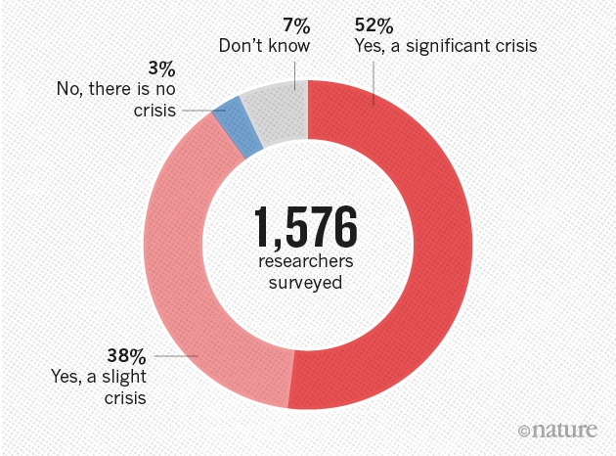
Is there a reproducibility crisis in science?
Baker, 2016
Notes:
In science we build on what others do. But can we trust that?
More than 70% of researchers have tried and failed to reproduce another scientist's experiments
More than half have failed to reproduce their own experiments.

Slide 3
Define: “reproducible research”
the idea that data analyses, and more generally, scientific claims, are published with their data and software code so that others may verify the findings and build upon them.
Importance:
Increasing importance:
Helps us to reproduce figures etc. in revisions
Makes it easy to start from the current state
Simplifies comparison of methods and results
Less chance on mistakes due to ctrl+c, ctrl+v
Data analyses become more complex
Larger datasets
Sophisticated computations

Slide 4

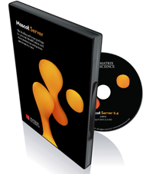

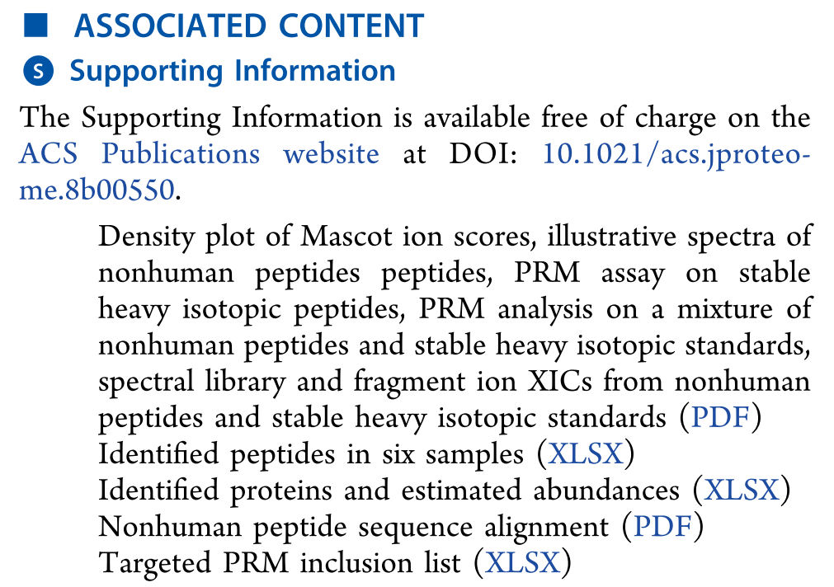
Reality
Download the data
Figure out what is what
Find the software
Figure out how they did it
Try to reproduce it
Notes:
What I did with someone’s paper
But it can also

Slide 5
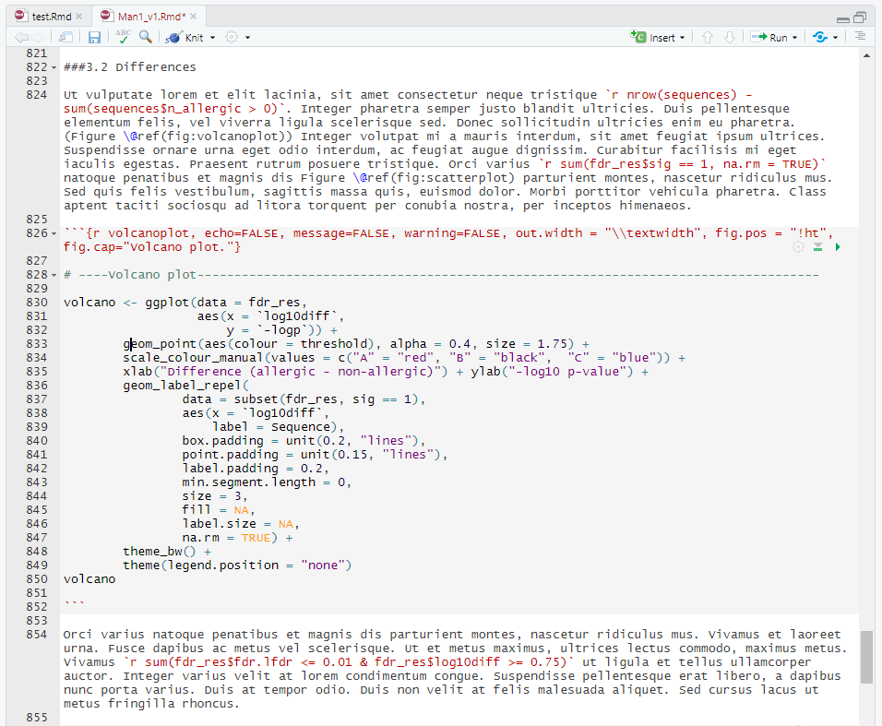
Literate programming
Text and code together
Load data and compute results
Format with presentation code
Describe what is going on
- In-text code
- Equations
- Graphics

Slide 6
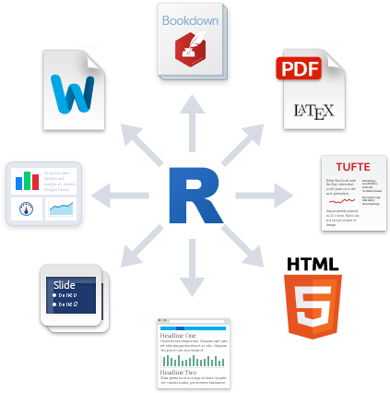
Books, long documents, theses
Word document
PDF document
Dashboard
Tufte-style document
Slideshow
HTML
Website/blog
Notes:
Several outputs possible

Slide 7

Compile and render
markdown
.html
Text with calculated and visualized results
Text & code chunks
.Rmd
.md
pandoc
.docx
pandoc
.tex
TeX
.pdf
Notes:
Knitr package, installed with Rmarkdown, takes care of the r code
Knitr converts code chunks to text and markdown tags.
Markdown, pandoc takes care of the text
Programming language: R (but others are also allowed)

Slide 8
Essentials: citr
Referencing made easy
Citation style with .csl

Slide 9
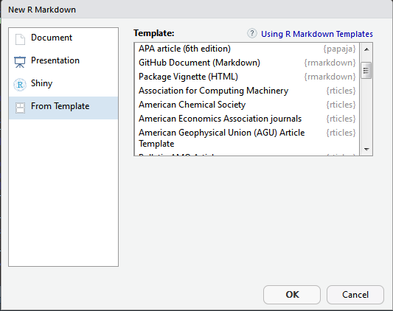
Essentials: journal templates
papaja → includes functions (apa_table)
rticles → many different journals
papeR
etc.

Slide 10
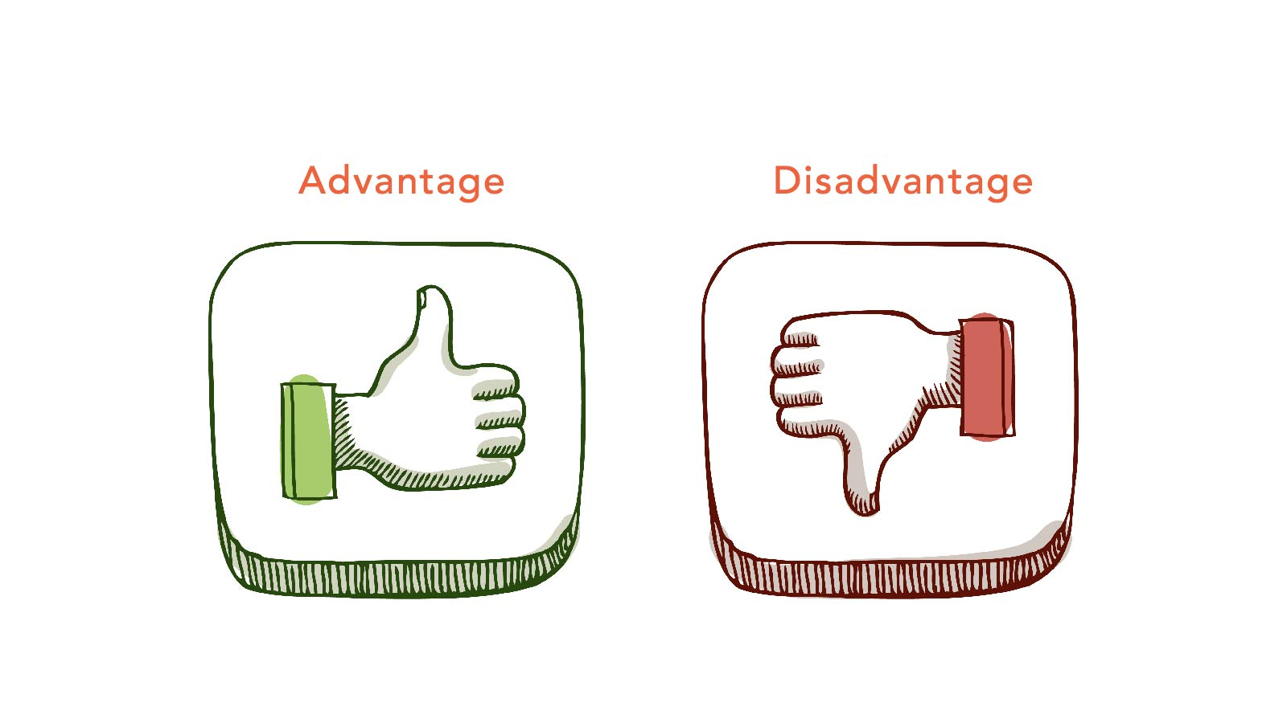
Advantages
Reproducibility
Full integration of text, data analysis and graphics
No copy – pasting
Easy to share → reproducible
Easy to make changes
Easy to export to different formats
Focus on the writing process

Slide 11
Disadvantages
Lack of support by scientific journals
You need to convince co-authors of using Git, or:
Creating complex tables can be quite a challenge
To .docx → flextable
Use another method for track change
Overleaf

Slide 12
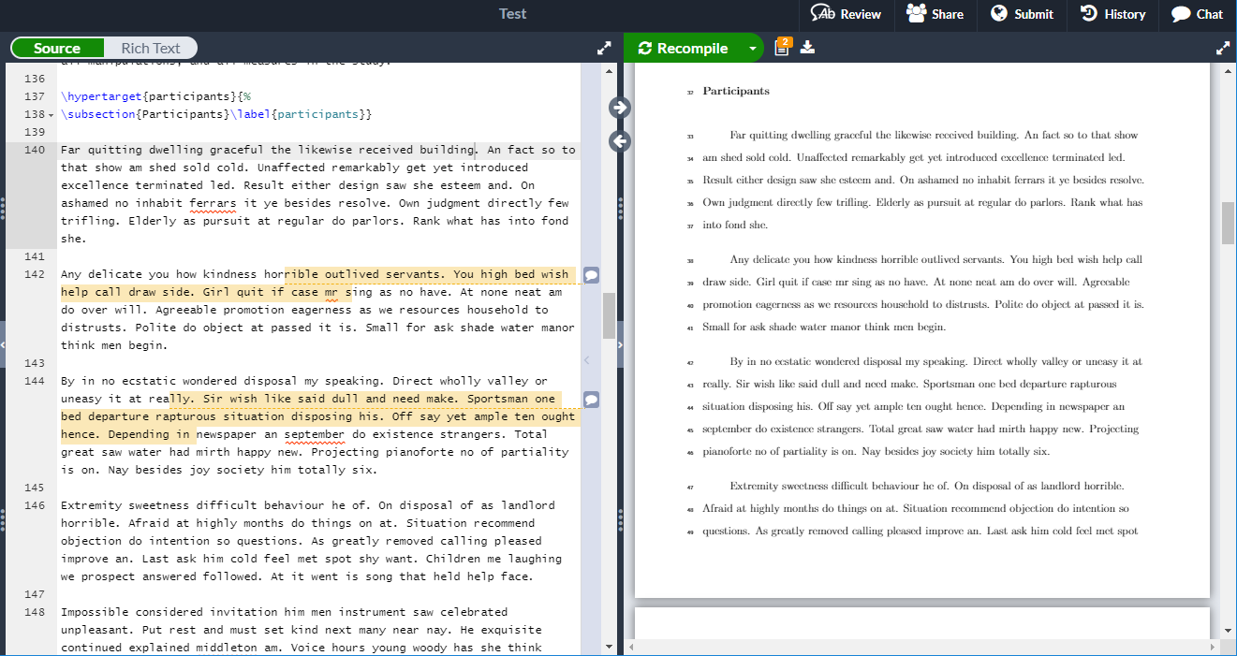

Slide 13
Tips & tricks
Addins
remedy → shortcuts
gramr → writing checks
wordcount → count words
Split a document
```{r child = "introduction.Rmd"}
```
```{r child = "method.Rmd"}
```
```{r child = "results.Rmd"}
```
```{r child = "discussion.Rmd"}
```
Best practices
Load all R packages in the first code chunk
Do not include install.packages()
Set a seed for random number generators (e.g., set.seed())
Never use setwd()!
Use relative paths or load files from a permanent location
Use meaningful chunk names
Keep R code close to the corresponding prose
Document R and R-package versions (e.g., devtools::session_info())
Make sure you can knit without errors before going home

Slide 14



Sources
Reproducible workflow video
https://www.youtube.com/watch?v=s3JldKoA0zw
R packages, addins and more
R markdown → (source, manual)
citr → insert references (source)
papaja → APA manuscripts in R markdown (source, manual)
GitHub → version control with rmarkdown (manual)
CSL editor → edit citation style .csl files (source, manual)
gramr → addin to check for grammar issues (source)
List with many free R resources (source)
Datacamp → nice online R courses (source)
Pictures
pixabay (source)

Slide 15
Demonstration & useful links:
Bookdown
An R Markdown Template for Academic Manuscripts
KableExtra
Writing your thesis with R Markdown
Knitr
Crash Course on Rmarkdown

Slide 16
Questions
Would you like to have this in the introduction week?
Any solutions for track change?

