Slide 1
LLM Encapsulation in Sage

Slide 2
Overview
Background Information
Coding
My experience in setting up and deploy an LLM on the Sage Node
Going over, what I assume to be, the important aspects
ECR Deployment
Quick Start for Deploying Moondream 2 on ECR

Slide 3
Background Information
What is Moondream
Moondream is a tiny vision language model typically meant for low resource availability devices like edge devices
Inputs typically are image + prompt and output can be a natural language response, point detection, and object detection
https://moondream.ai/
What is Moondream in Sage?
Moondream in Sage is basically having taken the moondream model and wrapping it in a container that is deployable on Sage Nodes.
https://github.com/cleeuh/moondream-for-sage-node

Slide 4
LLM Encapsulation in Sage
Coding

Slide 5
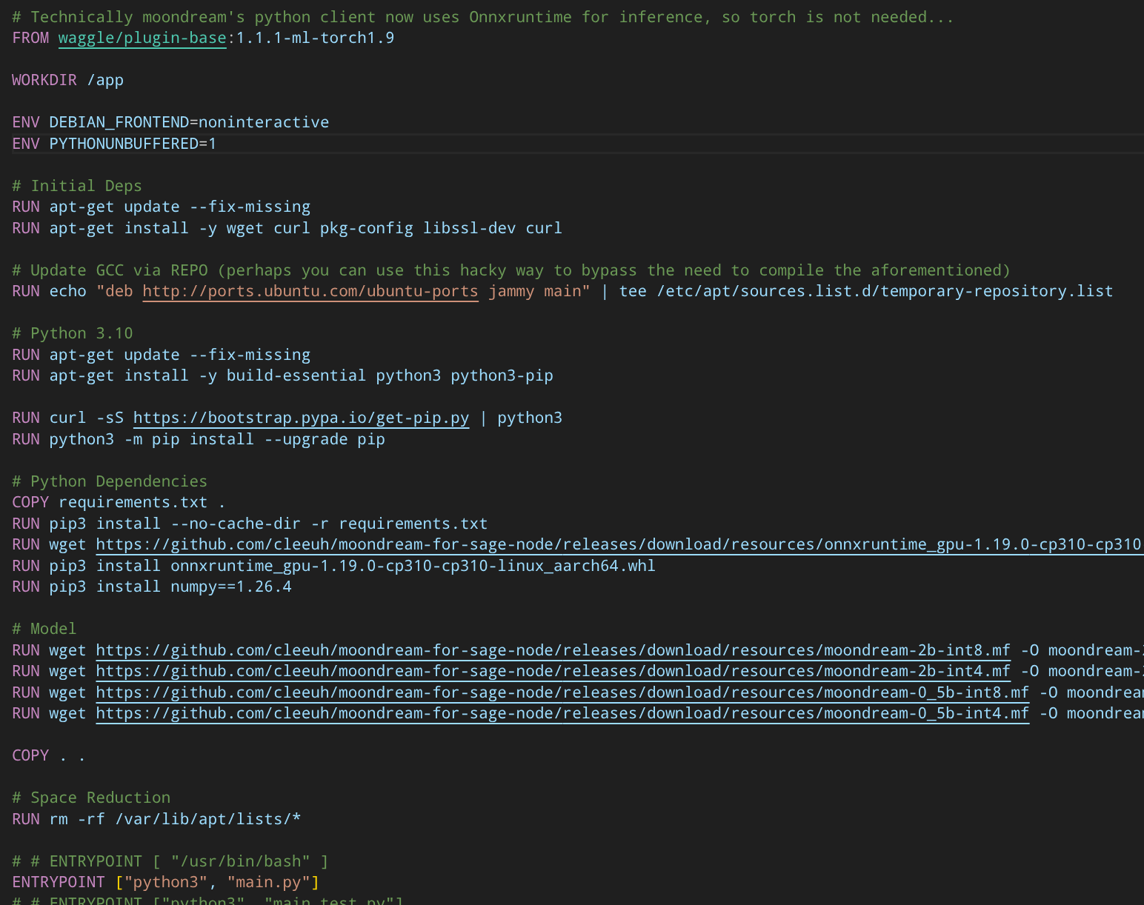
Dockerfile
Dockerfile
Base Image: waggle/plugin-base:1.1.1-ml-torch1.9
Updating to newer python version by referencing newer repository or compiling.
For less headaches, I recommend trying to either reference a newer repo or installing from local (.deb files) before trying to compile from source.
Newer python versions will support more up to date packages (pytorch 2.x, onnxruntime, etc.)
Be cognizant of ARM vs x86 repos

Slide 6
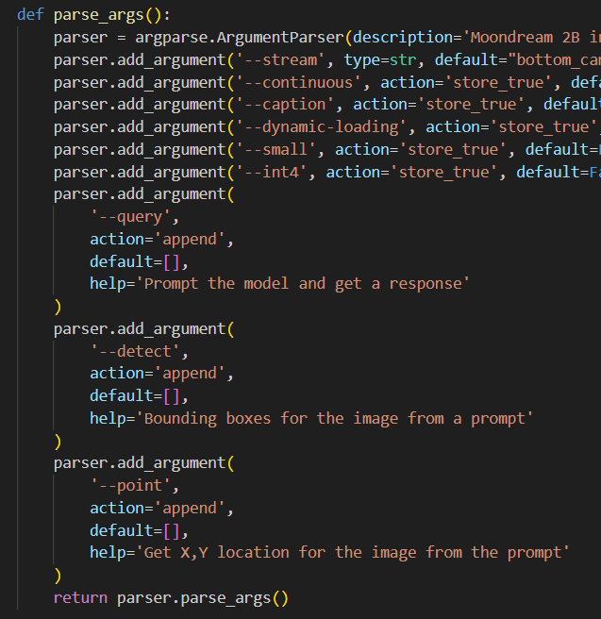
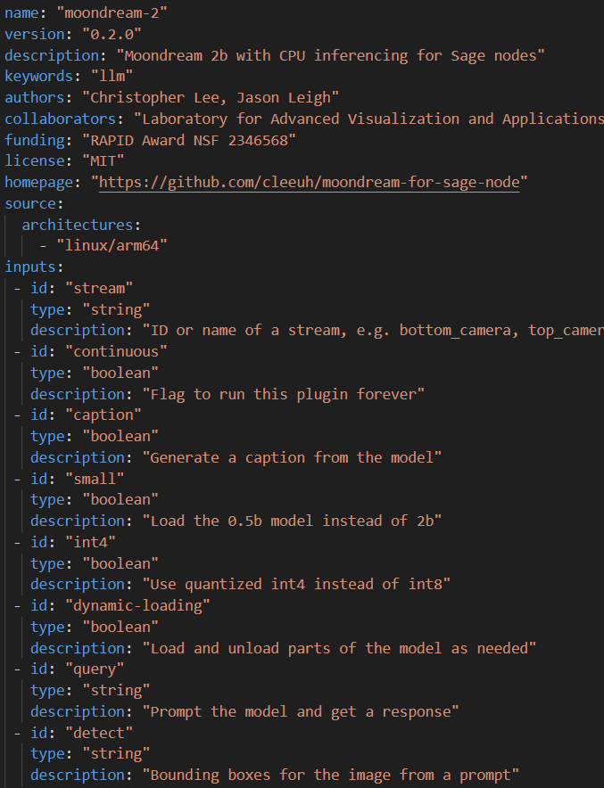
Arguments
main.py
sage.yaml
Use argparse library
import argparse
Make sure arguments are also noted in sage.yaml

Slide 7
Additional Remarks
When build on local system, make sure to build and test for the arm platform
https://docs.docker.com/build/building/multi-platform/
There maybe compatibility issues where GPU remains unutilized
Use resource selector gpu
sudo pluginctl run --name plugin-objectcounter --resource request.cpu=1,limit.cpu=2,request.memory=2Gi,limit.memory=3Gi --selector resource.gpu=true 10.31.81.1:5000/local/plugin-objectcounter -- -stream bottom_camera -all-objects
Outdated firmware on older nodes
newer orin nodes with latest jetpack should streamline the process

Slide 8
LLM Encapsulation in Sage
ECR Deployment

Slide 9
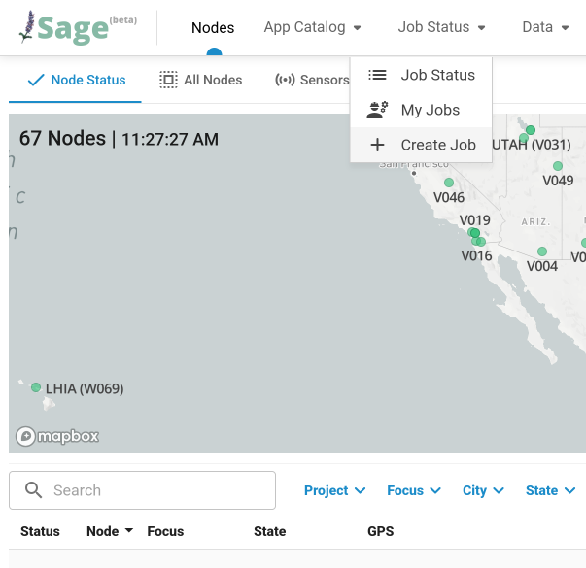
Quick Start for Deploying Moondream on ECR
Go to: https://portal.sagecontinuum.org
Make sure you are logged in
Click [Job Status] then [Create Job]

Slide 10
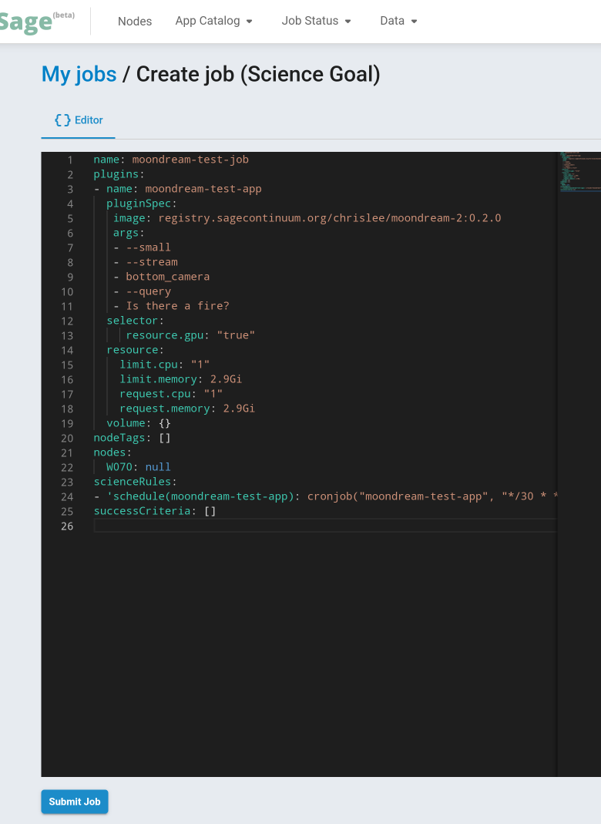
Arguments (Args):
description: ID or name of a stream, e.g. bottom_camera, top_camera, left_camera
id: stream
type: string
description: Flag to run this plugin forever
id: continuous
type: boolean
description: Generate a caption from the model
id: caption
type: boolean
description: Load the 0.5b model instead of 2b
id: small
type: boolean
description: Use quantized int4 instead of int8
id: int4
type: boolean
description: Load and unload parts of the model as needed
id: dynamic-loading
type: boolean
description: Prompt the model and get a response
id: query
type: string
description: Bounding boxes for the image from a prompt
id: detect
type: string
description: Get X,Y location for the image from the prompt
id: point
type: string
Node to run on
Submit when done

Slide 11
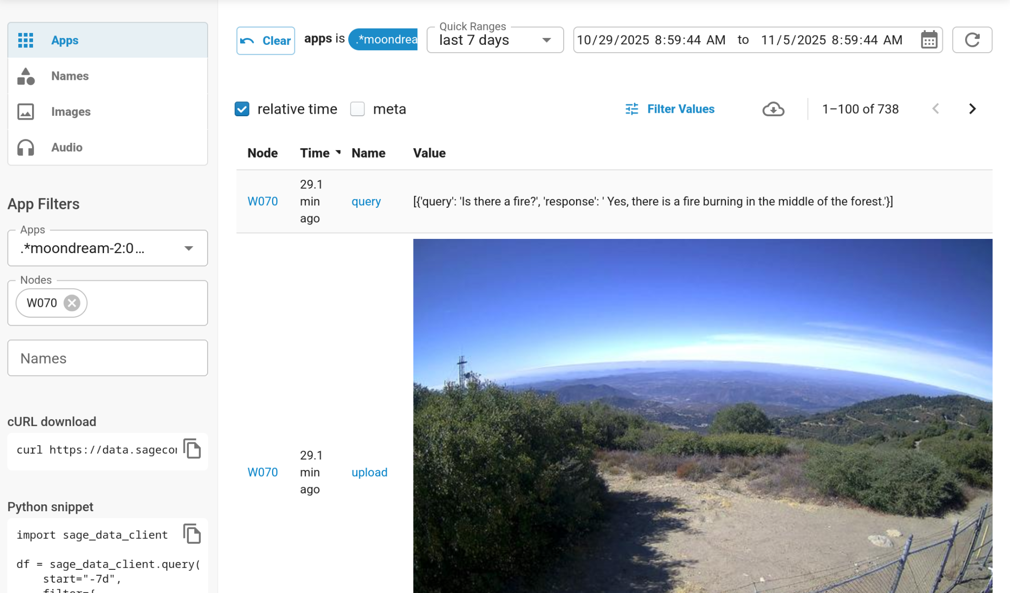
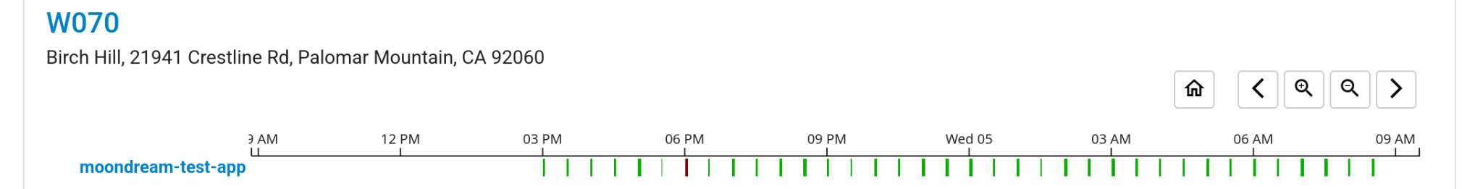
You can verify that it is running in [Job Status] -> [My Jobs]
Note that smaller models, tend to hallucinate more when prompted.

Slide 12
Examples
name: moondream-test-job
plugins:
- name: moondream-test-app
pluginSpec:
image: registry.sagecontinuum.org/chrislee/moondream-2:0.2.0
args:
- --small
- --stream
- bottom_camera
- --query
- Is there a fire?
selector:
resource.gpu: "true"
resource:
limit.cpu: "1"
limit.memory: 2.9Gi
request.cpu: "1"
request.memory: 2.9Gi
volume: {}
nodeTags: []
nodes:
W070: null
scienceRules:
- 'schedule(moondream-test-app): cronjob("moondream-test-app", "*/30 * * * *")'
successCriteria: []
name: moondream-test-job
plugins:
- name: moondream-test-app
pluginSpec:
image: registry.sagecontinuum.org/chrislee/moondream-2:0.1.5
args:
- --dynamic-loading
- --stream
- bottom_camera
- --caption
- --point
- smoke
- --point
- fire
- --point
- hazard
- --query
- Is there a fire?
selector:
resource.gpu: "true"
resource:
limit.cpu: "3"
limit.memory: 7Gi
request.cpu: "3"
request.memory: 7Gi
volume: {}
nodeTags: []
nodes:
W070: null
scienceRules:
- 'schedule(moondream-test-app): cronjob("moondream-test-app", "*/30 * * * *")'
successCriteria: []

Slide 13
Other Notes
Job may not run immediately after submission as the node must download the container.
Enabling the GPU in the resource selector as the code doesn’t work reliably on Raspberry Pi Compute Units.
Moondream 2, as of now runs on CPU only
Dynamic Loading is meant to reduce the RAM usage slightly with trade off for longer compute time.
Moondream 2 model used is the 2024 variant
Smaller model constraints
Point and Object Detect wont work
Sophisticated prompts may not work reliably, keep prompts short and concise for best results

