Slide 1
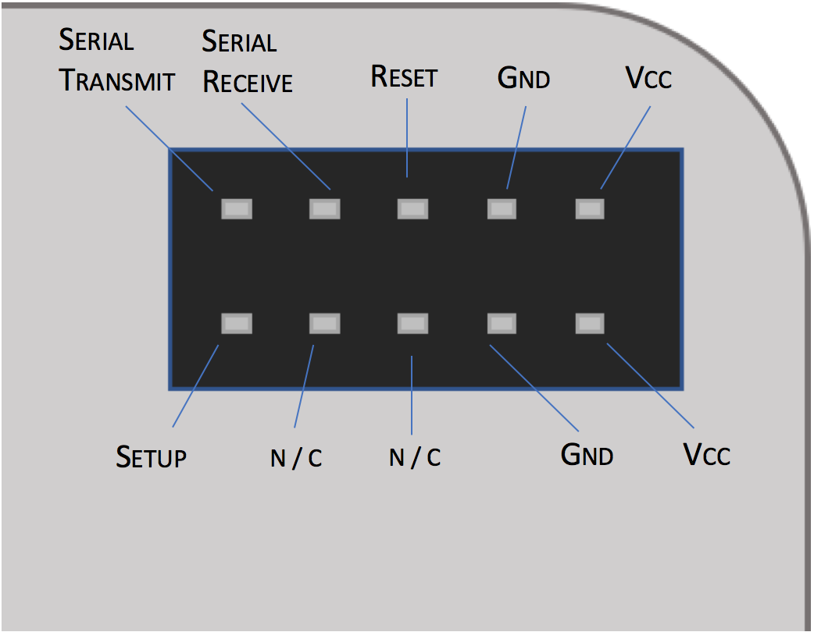

Slide 2
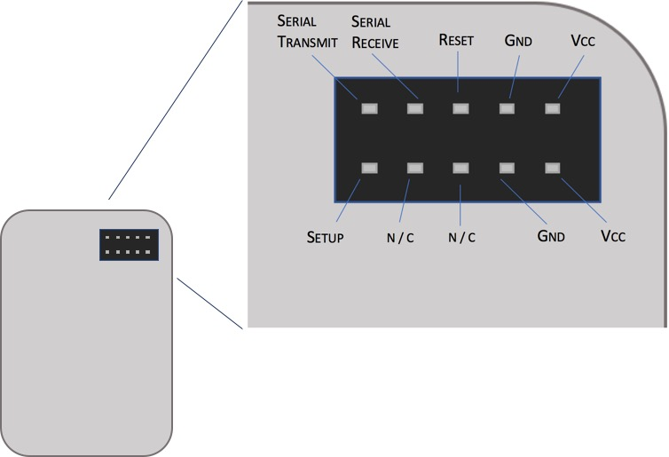

Slide 3
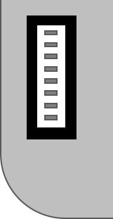
N / C
N / C
RESET
SERIAL TRANSMIT
SERIAL RECEIVE
SETUP
GND
VCC

Slide 4
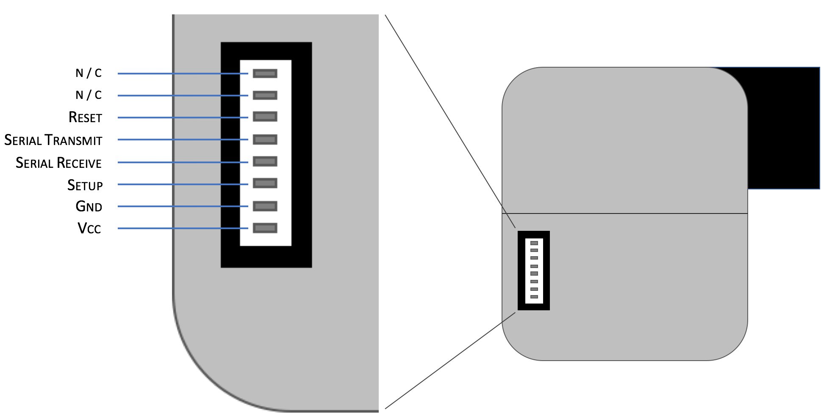

Slide 6
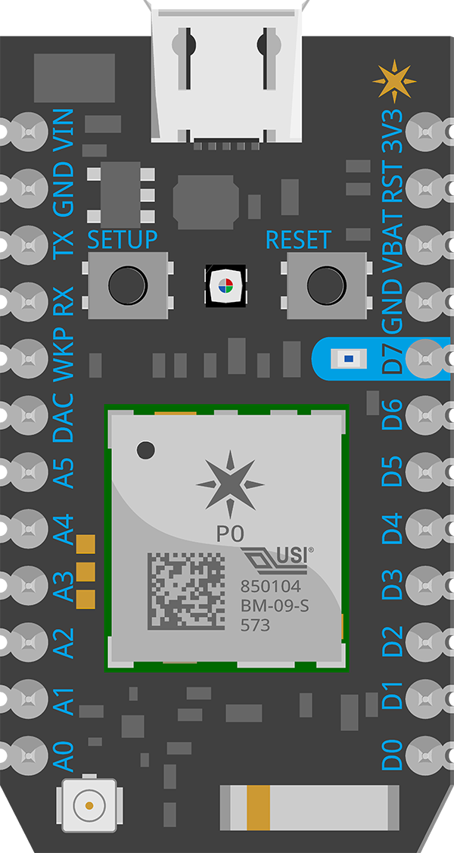
N / C
N / C
RESET
SERIAL TRANSMIT
SERIAL RECEIVE
SETUP
GND
VCC

Slide 7
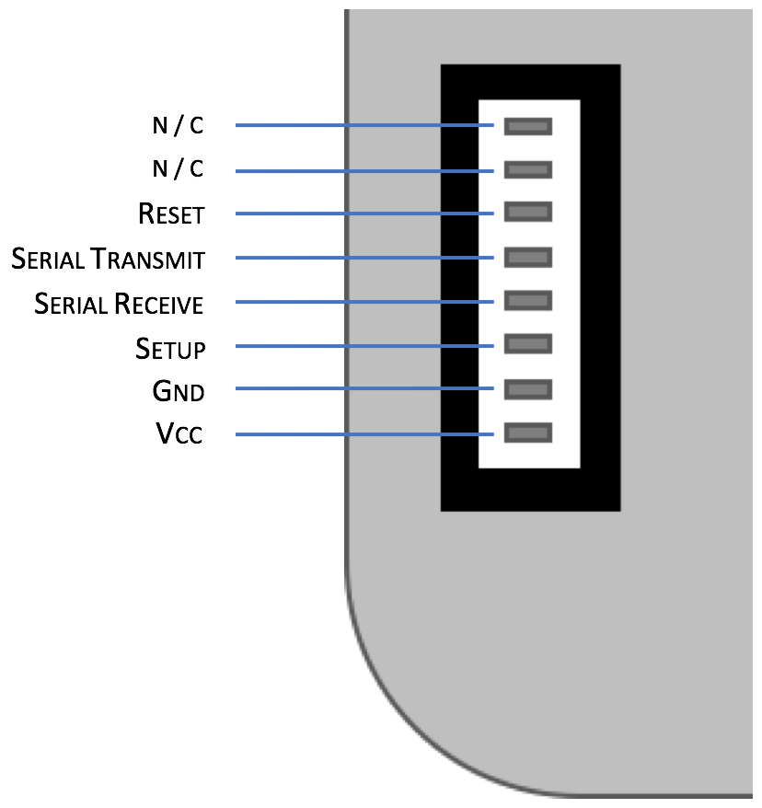
10 K
PROVIDE SEPARATE 5V POWER SUPPLY
5 V

Slide 8
CR 3110

Slide 9
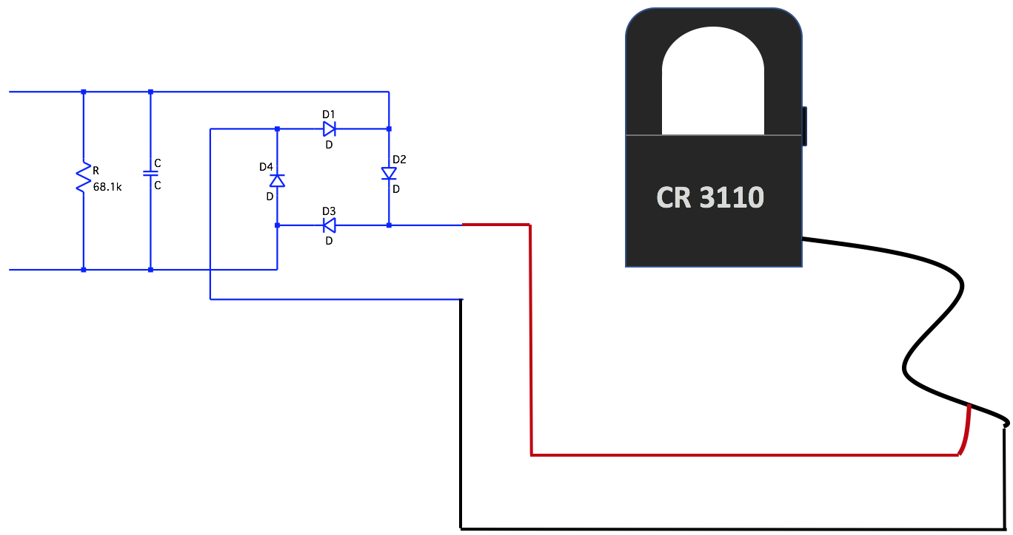

Slide 11
OUT
VCC
GND

Slide 12
https://www.sainsmart.com/water-level-sensor-depth-of-detection-water-sensor-for-arduino.html

