Slide 1
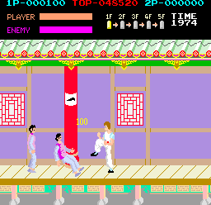
BUILDING AN RL AGENT: KUNGFU MASTER
SOC’25 PROJECT
Presented by: Aaishwarya Wagh

Slide 2
Problem Statement
Goal:
Build an agent that learns to play Kung Fu Master from scratch - using only visual input from the game.
Agent must learn to defeat enemies and survive in the game using trial-and-error.
Why this is interesting:
Agent starts with zero understanding of the game - no prior rules or strategy.
Game rewards are sparse - agent only receives feedback when defeating enemies.
Observations are raw pixel images, not structured data - which makes learning more difficult.

Slide 3
Proposed Solution
Model:
Used a Deep Q-Network (DQN) : a CNN-based model that maps game frames to Q-values for actions.
Input: 84×84 grayscale frames (stacked 4 at a time to give context of movement).
Output: Q-values for each action the agent can take.
Key Techniques:
Experience Replay: to reuse past experience for learning.
Epsilon-Greedy Policy: for a balance of exploration and exploitation.
Model trained on ALE/KungFuMaster-v5 using Gymnasium.

Slide 4



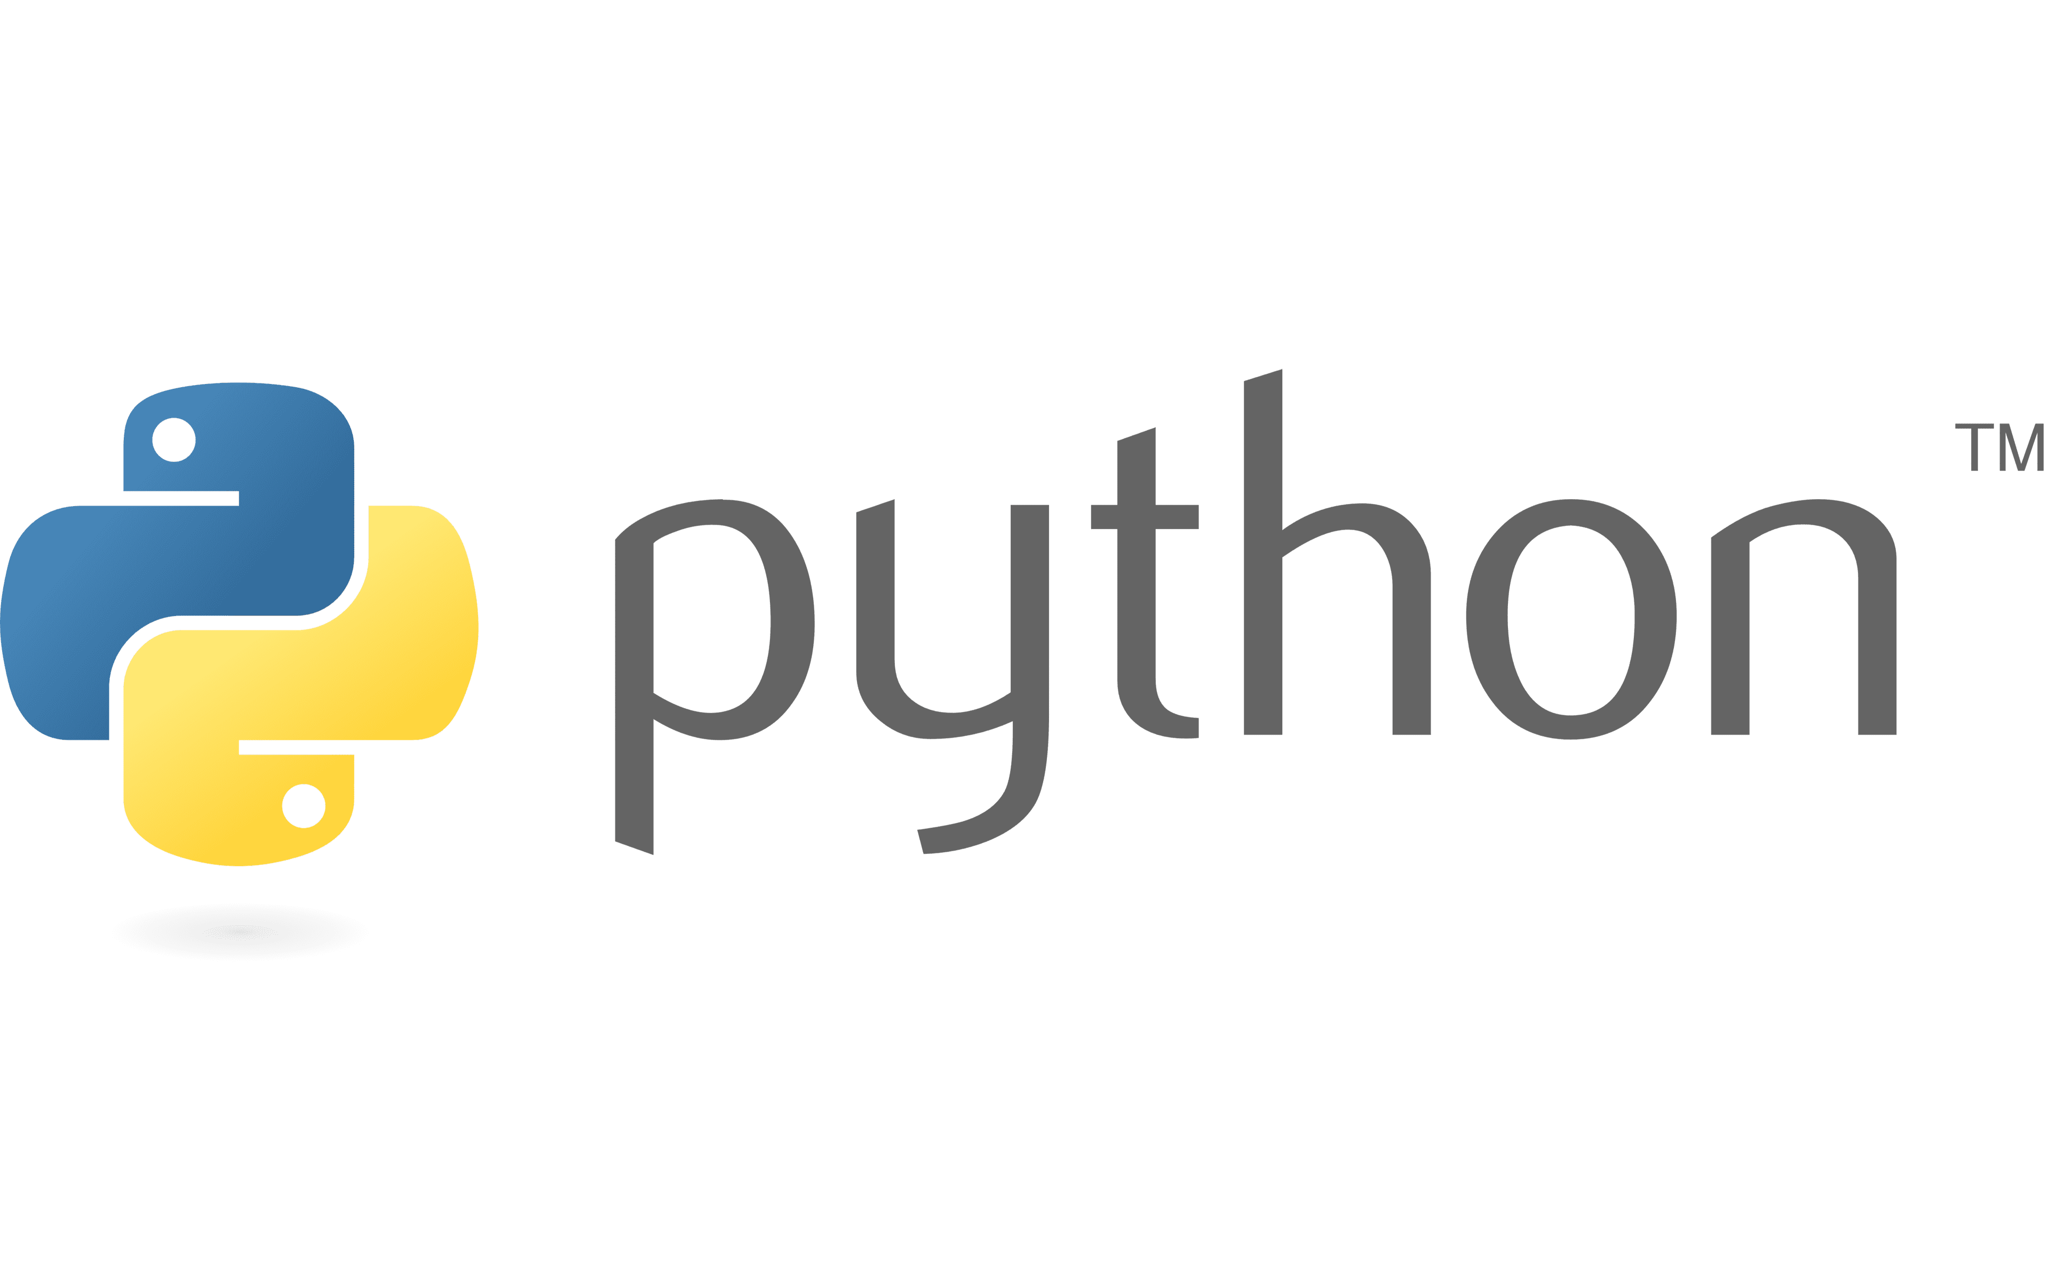


Tech Stack
Environment: Gymnasium (ALE/KungFuMaster-v5), ALE-py
Model: TensorFlow, Keras
Video Recording: OpenCV
Plotting: Matplotlib
Language: Python

Slide 5
Results
Training Run 1 (10 episodes)
Fixed epsilon = 0.1
Agent mostly got 0 reward
No visible learning or improvement
Training Run 2 (20 episodes)
Same epsilon (0.1), but trained longer
Agent started to learn: total rewards increased
Best episode reward: 1500
Agent could consistently defeat 2–3 enemies
Output:
Saved model weights after training
Recorded final gameplay (agent_play.mp4) using OpenCV

Slide 6
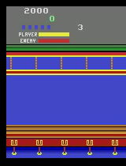

Slide 7
Conclusion & learnings
What Worked:
The DQN model was able to learn from raw pixel input
Training for longer episodes led to noticeable improvement
Modular structure made it easier to test and record results
What Didn’t Work:
Fixed epsilon (0.1) limited exploration in early episodes
20 episodes were not enough for the agent to reach higher game levels
Some inconsistencies due to version mismatch (v4 vs v5) initially
Learnings:
Hands-on experience with reinforcement learning and DQN
Importance of exploration rate, training time, and hyperparameters
How to debug RL environments, save models, and evaluate agent performance

