Slide 1
Qspin
SmartPal
by
Smarter yet not an Alien assistant for the Veteran Bharat

Slide 2
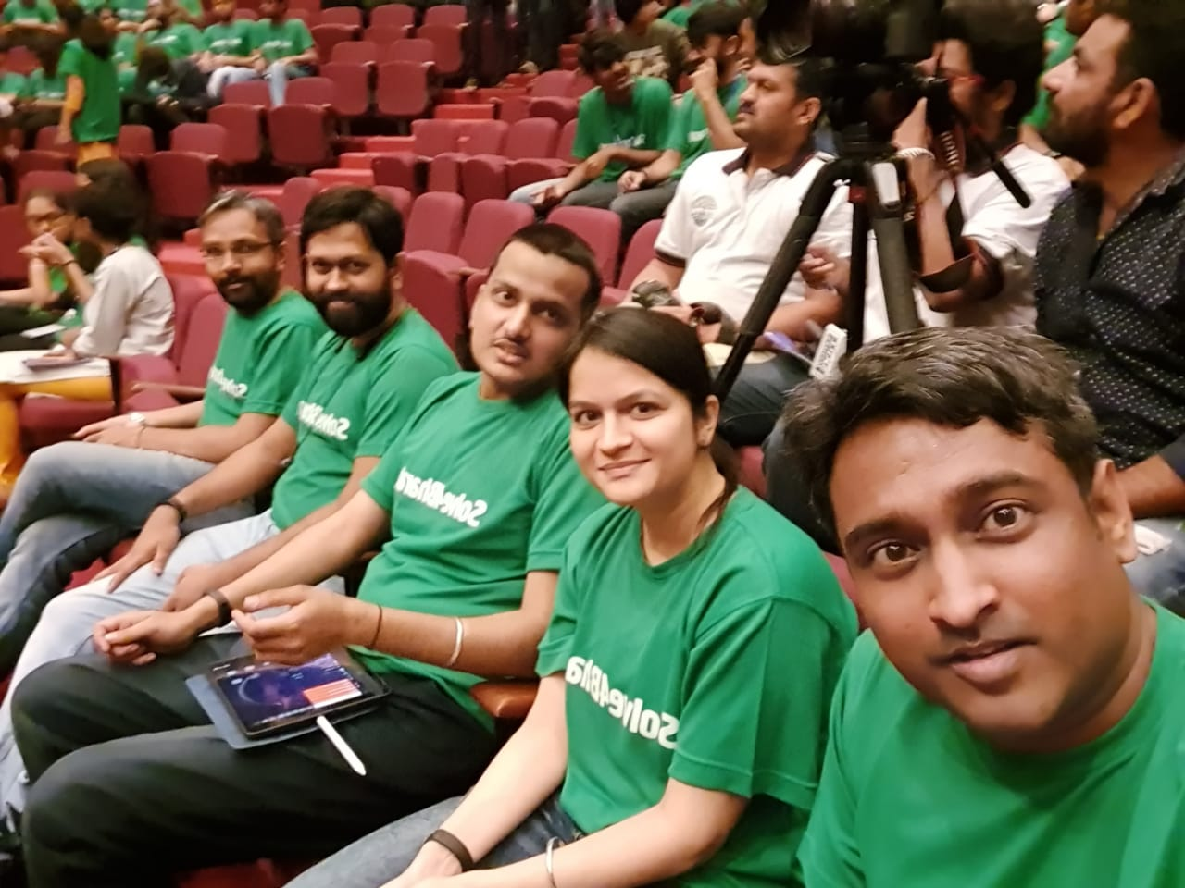


Team
Perfect blend of researchers, engineers and Entrepreneurs

Slide 3
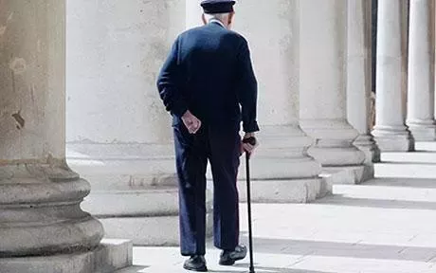
Problem
Veterans/disabled people struggle to do basic actions - the action could be as simple as turning ON/OFF the Switch while going to washroom during the night.
Sending updates about health to doctors or loved ones without much hassle
Sharing location with family members without a need of carrying a smartphone

Slide 4
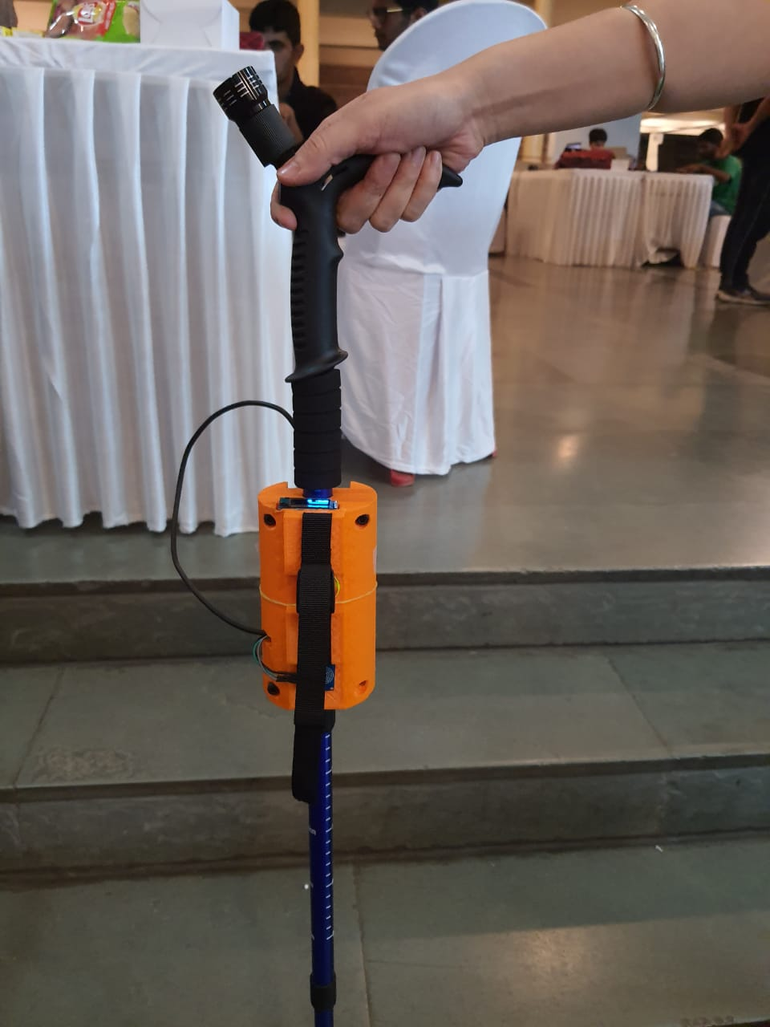
Solution - SmartPal
Live life without the hassle of using Smartphones
Tech embedded in daily use gadget
Control simple actions
Turn ON/OFF Switches
Communicate Heartrate
Update locations
Call for help with minimal effort

Slide 5
Why it makes sense -
It has no dependency on the mobile
It connects with the existing tool which is has been trusted for generations - The Stick!
It means carrying no extra responsibility
Doesn’t need two hands - which is a major drawback of all the smartphones

Slide 6
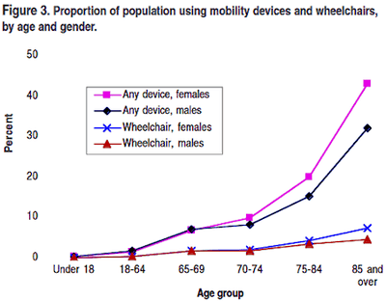
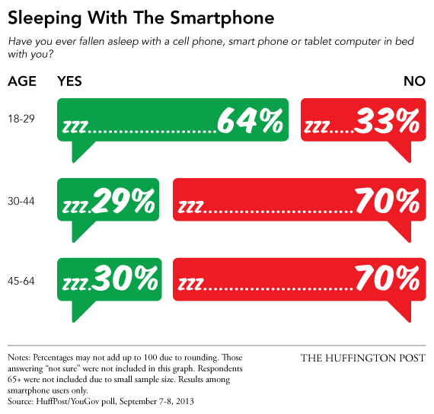
Why it makes sense -

Slide 7
Components of the system
Raspberry Pi
ESP module - (ESP8266)
Heart rate sensor
Gyro/Accelerometer - (MPU6050)
Capacitive sensor

Slide 8
Likely pricing
Module | Cost | Installation | Final cost | Gain
Location | 5000.00 | - | 5000 | You can forget the way back home :)
Gesture control (1 Switch) | 8000.00 | 500.00 | 8500 | Reducing risk of accidents
Heart Rate | 8000.00 | - | 8000 | No need to go to doctor every week
Entire module | 15000.00 | 500.00 | 15500

Slide 9
Value proposition
Action | Component | Component | Component | Component | Gain
Switch ON/OFF | Gyro module (300) | Server (3000) | Wifi Switch (1000) | Battery (600) | Reducing risk of accidents
Heart rate | Heart rate sensor (1000) | Server (3000) | - | Battery (600) | No need to go to doctor every week
Location | GPS + GSM module (2000) | Mobile SIM (100) | - | Battery (600) | You can forget the way back home :)

