Slide 1
Microsoft Research
CVPR, pp. 157–165 (2003)
Face Relighting with Radiance Environment Maps
Technical Report MSR-TR-2002-111
Wang, Y., Liu, Z., Hua, G., Wen, Z., Zhang, Z., Samaras, D.: Face Re-Lighting from a Single Image Under Harsh Lighting Conditions. In: Proceedings of IEEE CVPR (2007)
The Robotics Institute, Carnegie Mellon University, wangy@cs.cmu.edu 2Microsoft Research, {zliu,zhang}@microsoft.com 3Microsoft Live Labs Research, ganghua@microsoft.com 4IBM T.J.Watson Research Center, zhenwen@us.ibm.com 5 Computer Science Department, Stony Brook University, samaras@cs.sunysb.edu

Slide 2
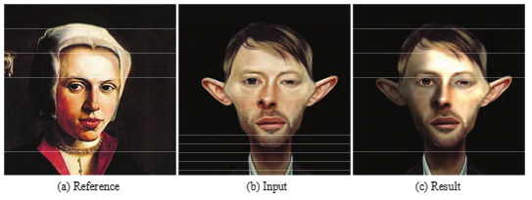
Artistic Illumination Transfer for Portraits
Xiaowu Chen,
Xin Jin*,
Qinping Zhao*and
Hongyu Wu
Computer Graphics Forum, 2012
State Key Laboratory of Virtual Reality Technology and Systems School of Computer Science and Engineering, Beihang University, Beijing, China
Abstract
Relighting a portrait in a single image is still a challenging problem, particularly when only a single artistic reference photograph or painting is provided. In this paper, we propose an artistic illumination transfer system for portraits based on a database of portrait images (photographs and paintings) associated with hand-drawn illumination templates (276) by artists. Users can select a reference portrait image in the database, and the corresponding illumination template is transferred to an input portrait using image warping. Users can also provide reference portrait images those are not in the database. Based on the Face Illumination Descriptor (FID), the system selects from the database the reference image with the closest illumination to that of the user-provided reference image and adjusts the corresponding illumination template to match the contrast of the user-provided reference image. Experiments on not only paintings but also photographs, paper-cuts and sketches demonstrate that convincing illumination transferred results can be rendered by our system.

Slide 3
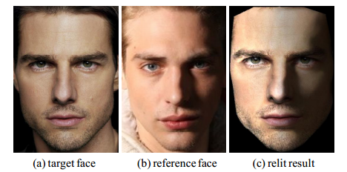
Face illumination transfer through edge-preserving filters
(CVPR), 2011
Xiaowu Chen ; State Key Lab. of Virtual Reality Technol. & Syst., Beihang Univ., Beijing, China ; Mengmeng Chen ; Xin Jin ; Qinping Zhao

Slide 4
Face Illumination Manipulation Using a Single Reference Image by Adaptive Layer Decomposition
Image Processing, IEEE Transactions on , 2013
Xiaowu Chen ; State Key Lab. of Virtual Reality Technol. & Syst., Beihang Univ., Beijing, China ; Hongyu Wu ; Xin Jin ; Qinping Zhao
ABSTRACT
This paper proposes a novel image-based framework to manipulate the illumination of human face through adaptive layer decomposition. According to our framework, only a single reference image, without any knowledge of the 3D geometry or material information of the input face, is needed. To transfer the illumination effects of a reference face image to a normal lighting face, we first decompose the lightness layers of the reference and the input images into large-scale and detail layers through weighted least squares (WLS) filter with adaptive smoothing parameters according to the gradient values of the face images. The large-scale layer of the reference image is filtered with the guidance of the input image by guided filter with adaptive smoothing parameters according to the face structures. The relit result is obtained by replacing the largescale layer of the input image with that of the reference image. To normalize the illumination effects of a non-normal lighting face (i.e., face delighting), we introduce similar reflectance prior to the layer decomposition stage by WLS filter, which make the normalized result less affected by the high contrast light and shadow effects of the input face. Through these two procedures, we can change the illumination effects of a non-normal lighting face by first normalizing the illumination and then transferring the illumination of another reference face to it. We acquire convincing relit results of both face relighting and delighting on numerous input and reference face images with various illumination effects and genders. Comparisons with previous papers show that our framework is less affected by geometry differences and can preserve better the identification structure and skin color of the input face.

Slide 5
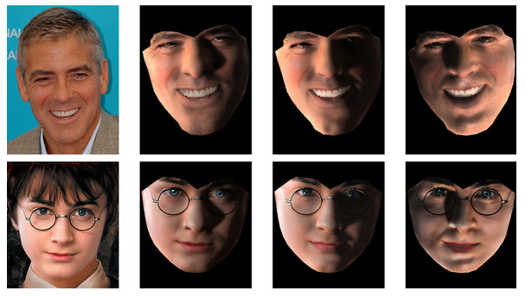
Face Image Relighting Using Locally Constrained Global Optimization
ECCV 2010
Jiansheng Chen, Guangda Su, Jinping He, and Shenglan Ben
Department of Electronic Engineering, Tsinghua University
http://jschenthu.weebly.com/projects.html

Slide 6
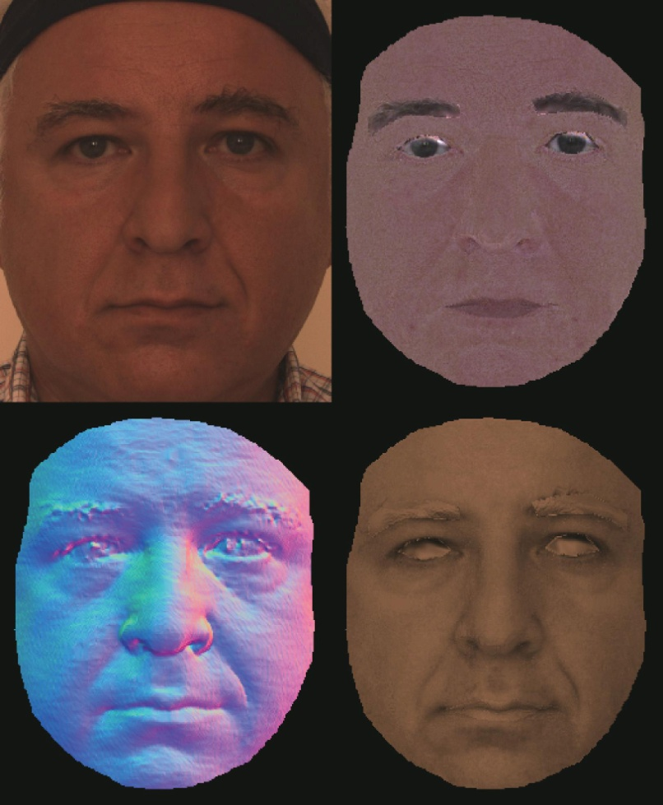
Intrinsic Face Image Decomposition with Human Face Priors
ECCV, 2014
Chen Li , Kun Zhou , and Stephen Lin
State Key Lab of CAD&CG, Zhejiang University Microsoft Research

Slide 7
The CAS-PEAL Large-Scale Chinese Face Database and Baseline Evaluations
Wen Gao, Bo Cao, Shiguang Shan, Xilin Chen , Delong Zhou, Xiaohua Zhang, and Debin Zhao
Institute of Computing Technology, Chinese Academy of Sciences, Beijing

