Slide 1
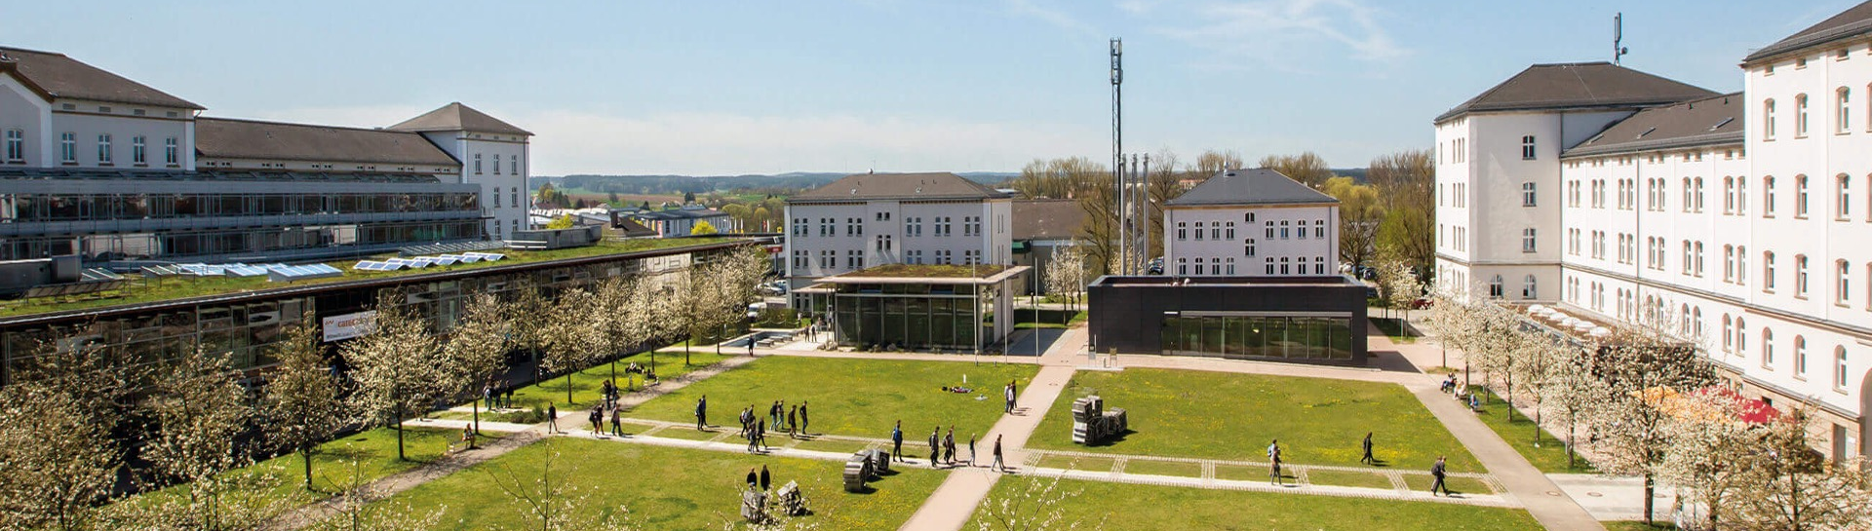
Comparative Study of VGG16-BN and ResNet34 Encoders in U-Net for Semantic Segmentation on the CamVid Dataset
Computer Vision and AI Gauri Nitin Wagholikar

Slide 2
Problem Statement
Project Goal: How does the choice of encoder backbone (VGG16-BN vs. ResNet34) affect a U-Net’s segmentation accuracy and computational efficiency on urban driving scenes?
Project Pipeline: Built a full segmentation pipeline on CamVid, data preprocessing, two U-Net variants, Optuna hyperparameter search, training with a combined CE + Dice loss, and a comprehensive quantitative + qualitative evaluation.

Slide 3
Dataset Details
CamVid - Cambridge-driving Labelled Video Database
Urban driving video dataset with pixel-level semantic labels, captured from a driving vehicle in Cambridge, UK.
Original masks are RGB-coded 256 X 3 lookup table maps each color to one of 11 consolidated classes (void pixels = ignore index 255).
Standard train / val / test folder split, images resized to 256×256 for training and evaluation.
Training augmentation: horizontal flip, ±10° rotation, random scale + crop, colour jitter, gamma blur and Gaussian noise.
Validation and test: resize + normalize only.
 | Class
1 | Sky
2 | Building
3 | ColumnPole
4 | Road
5 | Sidewalk
6 | Tree
7 | SignSymbol
8 | Fence
9 | Car
10 | Pedestrian
11 | Bicyclist

Slide 4
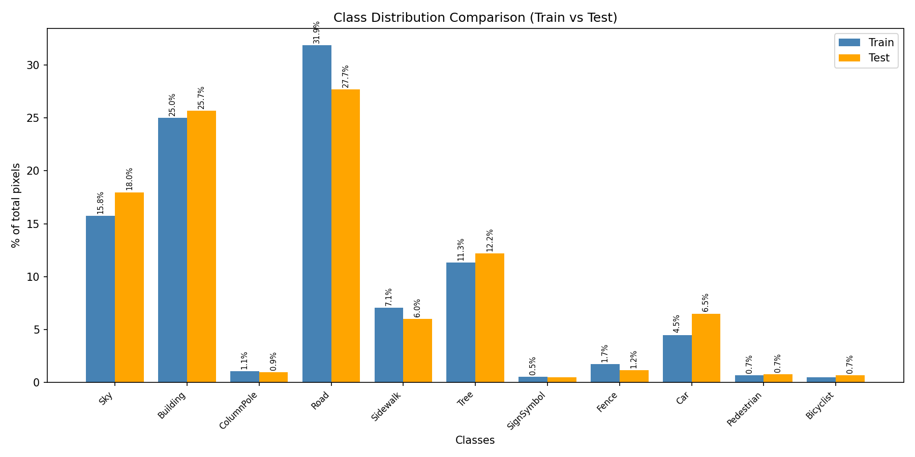
Dataset Exploration
Severe class imbalance
Road (31.9%) and Building (25.0%) dominate the training pixels.
ColumnPole (1.1%), Pedestrian (0.7%), and Bicyclist (0.5%) are extremely rare.
Train and test distributions are closely matched, so the imbalance is a dataset property, not a split artifact.
The reason why combined CE + Dice loss is used during training.

Slide 5
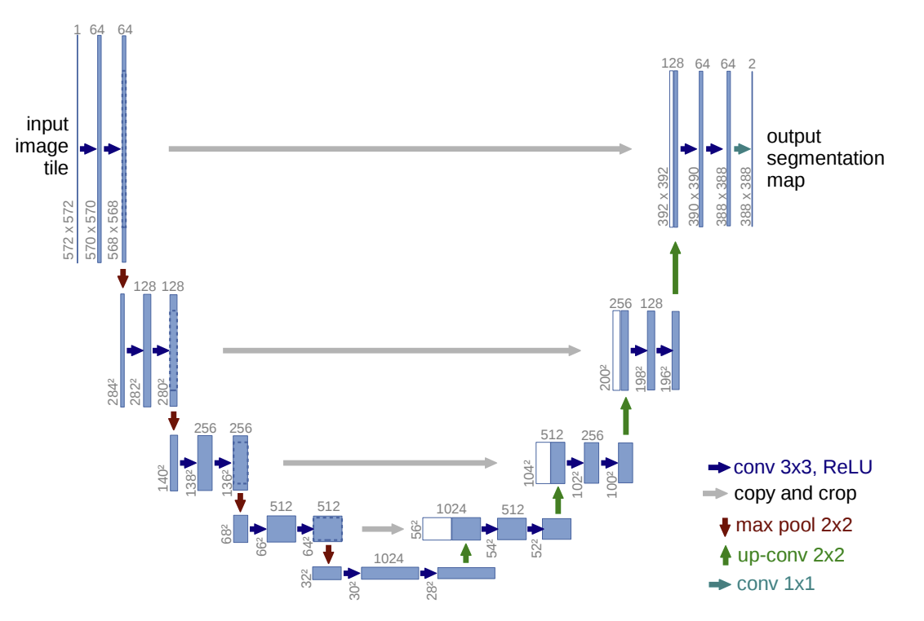
Model Architecture
Vgg16_BN with Unet
Stage | Components | Resolution | Channels
1 | Conv-BN-ReLU x2 | 256 x 256 | 64
2 | Conv-BN-ReLU x2 | 128 x 128 | 128
3 | Conv-BN-ReLU x3 | 64 x 64 | 256
4 | Conv-BN-ReLU x3 | 32 x 32 | 512
5 | Conv-BN-ReLU x3 (bottleneck) | 16 x 16 | 512
Pretrained on ImageNet. Stage 1 keeps full 256×256 resolution before any downsampling: the decoder receives a full-resolution skip connection.

Slide 6
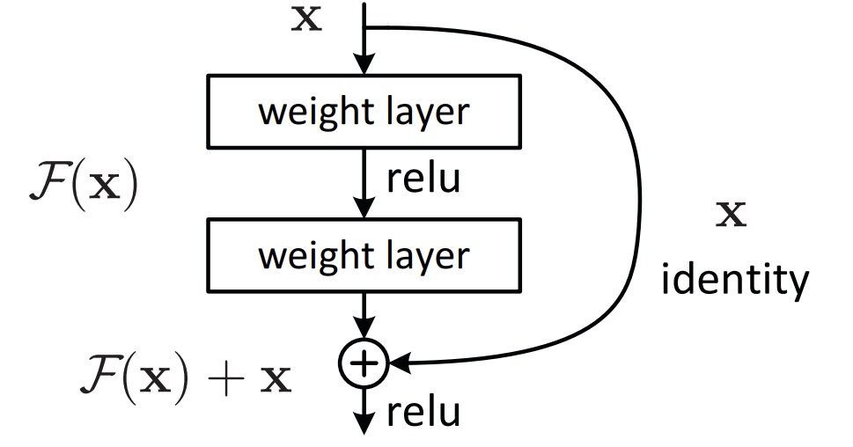
Model Architecture
resnet34 with Unet
Level | Components | Resolution | Channels
0 | conv1 + BN + ReLU | 128 x 128 | 64
1 | MaxPool + layer1 (x3 residual) | 64 x 64 | 64
2 | layer2 (x4 residual) | 32 x 32 | 128
3 | layer3 (x6 residual) | 16 x 16 | 256
4 | layer4 (x3 residual, bottleneck) | 8 x 8 | 512
The stem already downsamples 2x before the first residual block, and the shallowest skip is 128×128, not 256×256 as in VGG16-BN.

Slide 7
Hyper parameter tunning by Optuna
Search Strategy
Tree-structured Parzen Estimator (TPE), 20 trials per encoder,
each trained for 20 epochs, maximising validation mIoU.
MedianPruner with 2 warm-up steps terminates weak trials early.
Search space
Learning rate: log-uniform [1e-5, 1e-3]
Batch size: {2, 4}
Optimizer: Adam / AdamW
Weight decay: log-uniform [1e-6, 1e-2]
CE loss weight: uniform [0.2, 0.8] (Dice weight = 1 − CE weight)
Best Setting | UNet-VGG16 | UNet-ResNet34
Best val mIoU | 0.748 | 0.720
CE weight | 0.623 | 0.557
Dice weight | 0.377 | 0.443
Learning rate | 1.10e-4 | 1.84e-4
Batch size | 2 | 2
Optimizer | AdamW | Adam
Weight decay | 5.43e-5 | 3.19e-6

Slide 8
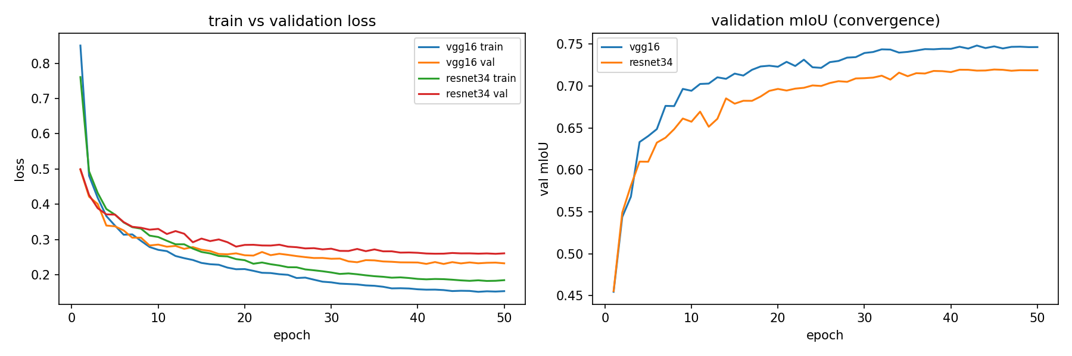
Training
50 epochs · combined CE + Dice loss · cosine-annealing LR · gradient clipping (max norm 1.0) · AMP (mixed precision) · early stopping (patience 10, never triggered) · seed 42

Slide 9
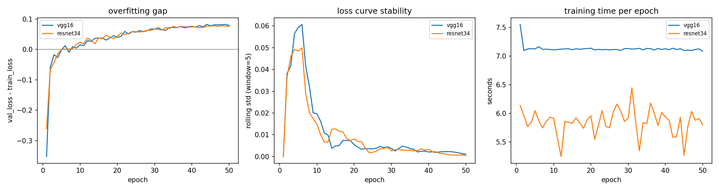
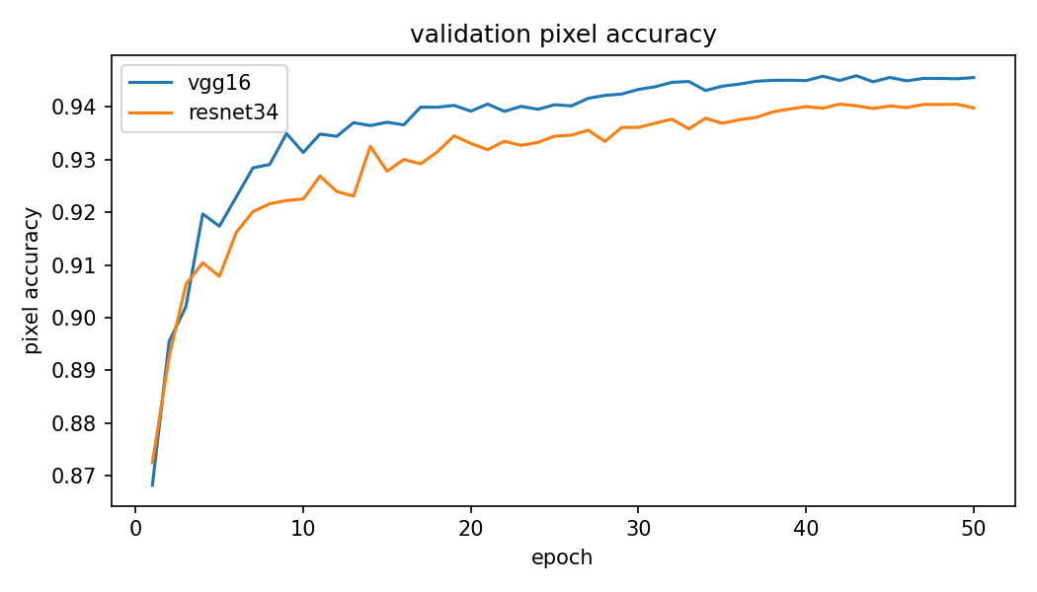
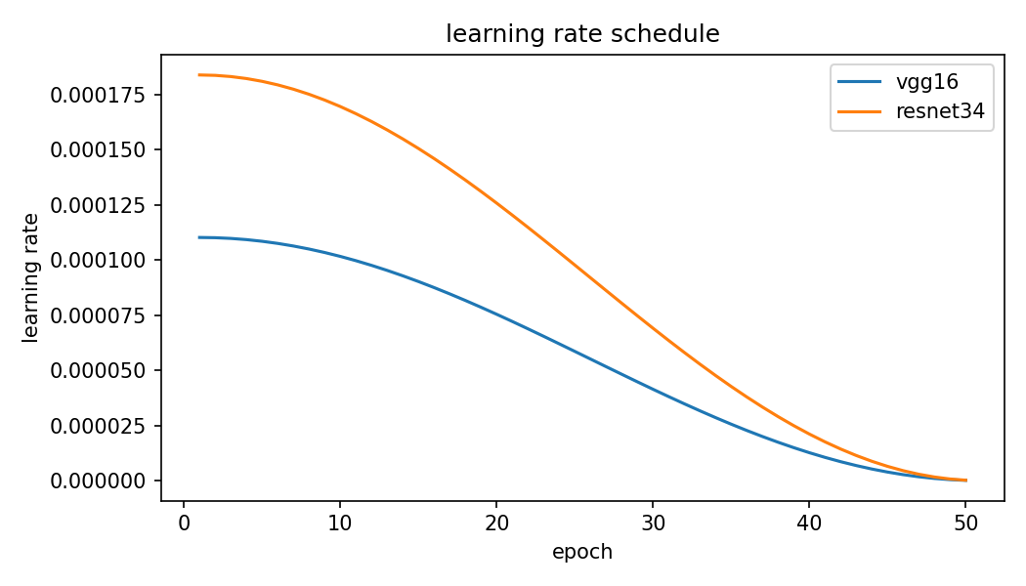
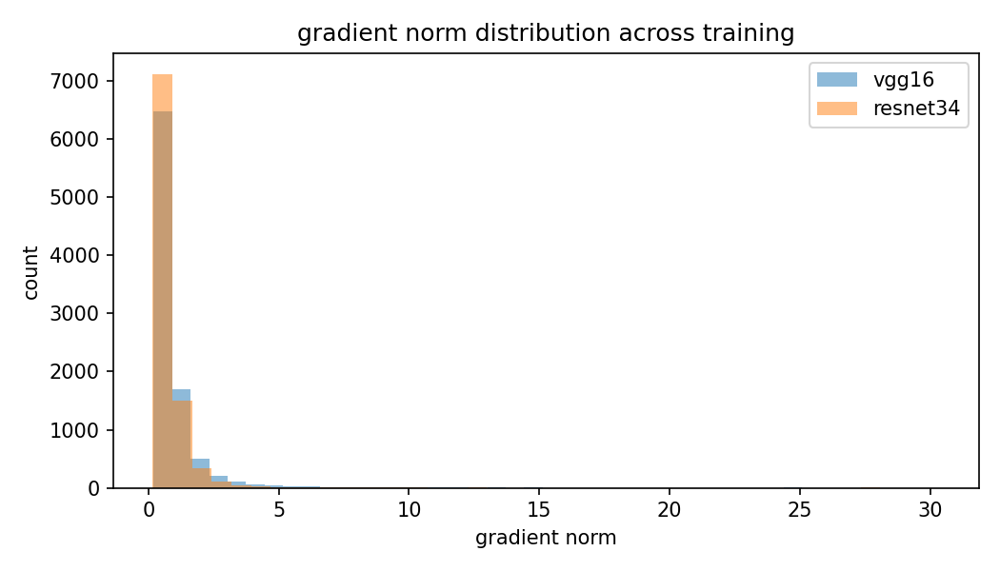
Training Diagnostics

Slide 10
Test Results - Quantitative Metrics
Segmentation Quality | VGG16 | ResNet34
mIoU | 0.7123 | 0.6729
Pixel Accuracy | 0.933 | 0.923
Mean Dice | 0.814 | 0.781
Macro Precision | 0.844 | 0.811
Macro Recall | 0.791 | 0.760
Mean Boundary F1 | 0.662 | 0.608
Efficiency | VGG16 | ResNet34
Parameters | 25.79M | 31.57M
Model Size | 98.4 MB | 120.4 MB
GFLOPs | 76.42 | 17.75
GPU Peak Memory | 199.3 MB | 178.6 MB
Avg. Latency | 8.89 ms | 5.37 ms
FPS | 112.5 | 186.2
VGG16-BN wins on every quality metric, ResNet34 wins on every efficiency metric, with a 3.9-point mIoU gap against a 4.3 times compute-cost reduction.

Slide 11
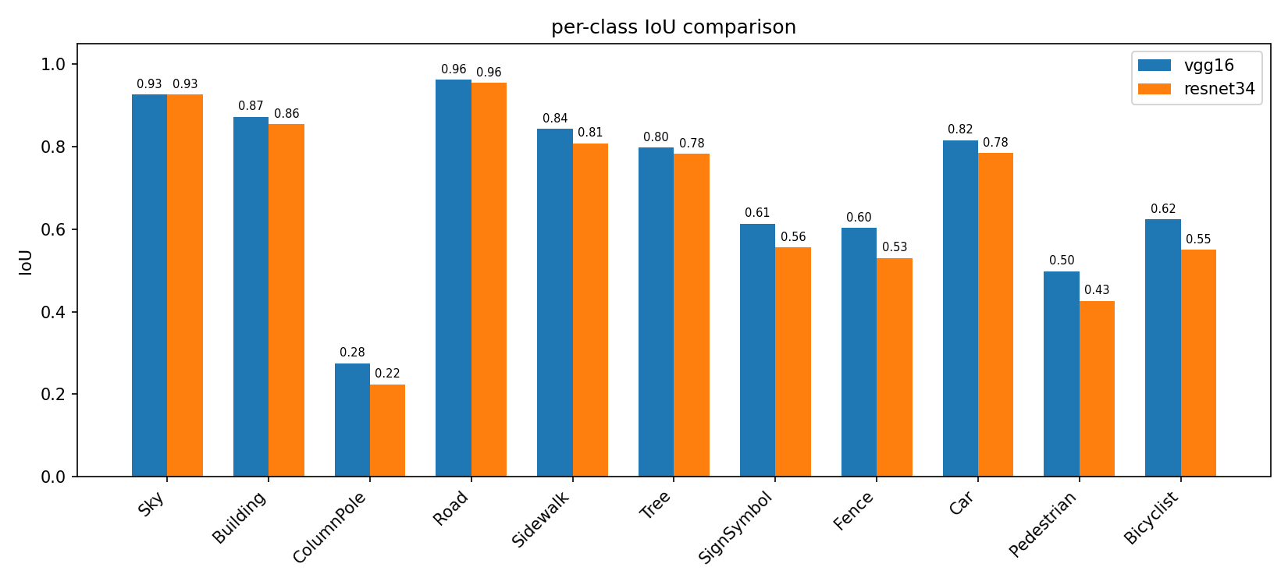
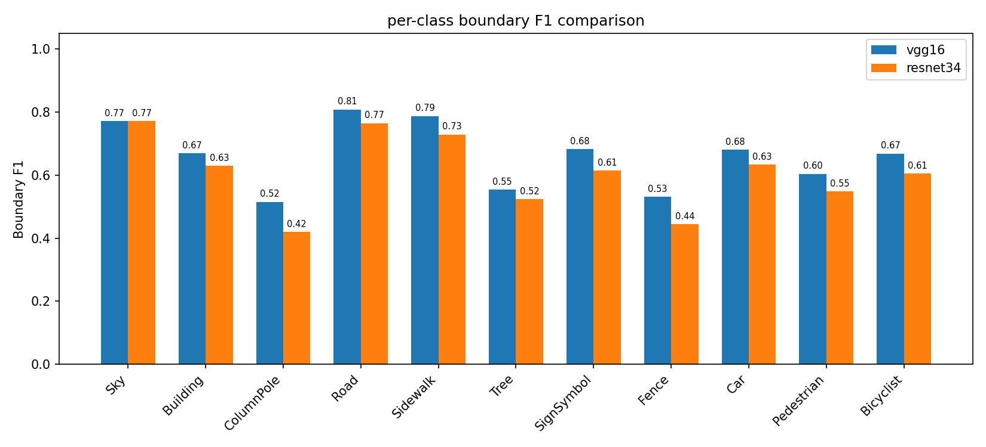
Test Results - Per-Class Performance

Slide 12
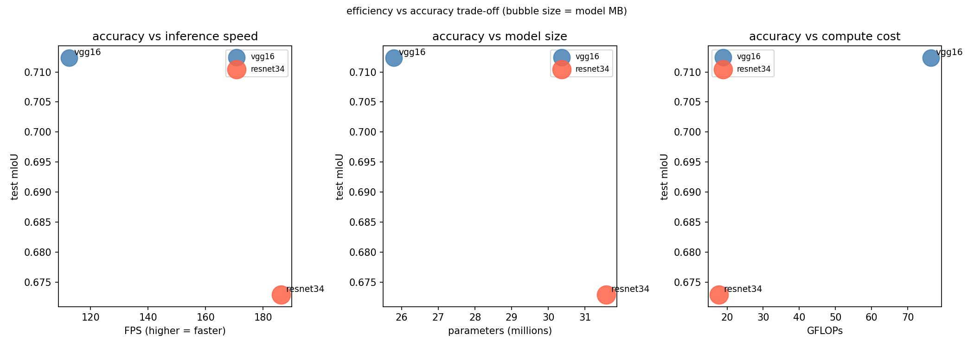
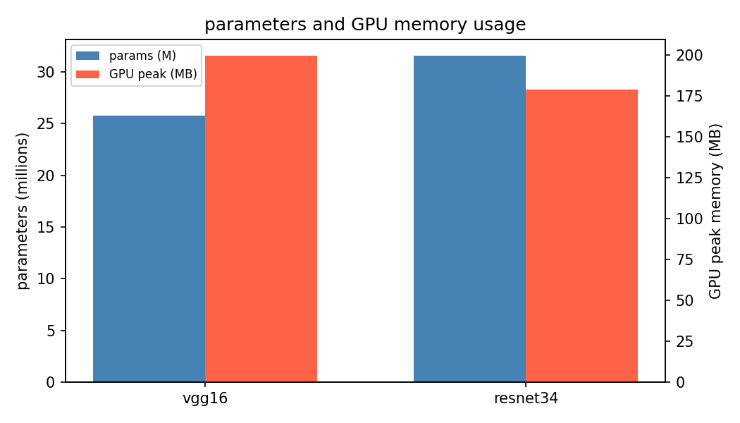
Test Results - Efficiency Trade-off

Slide 13
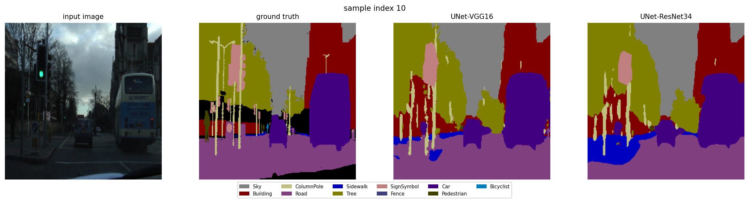
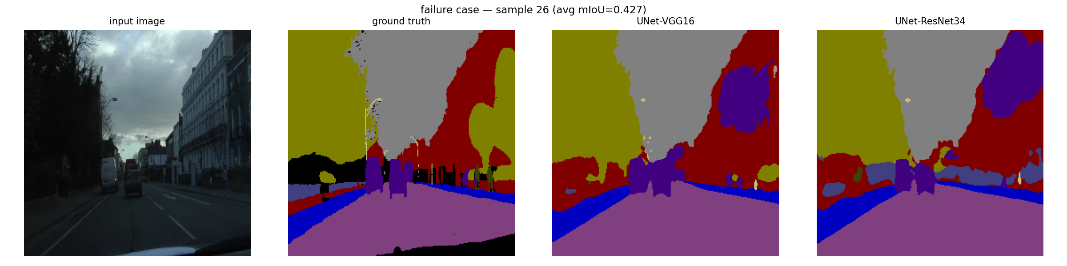
Qualitative Results
Prediction Sample
Failure case (avg mIoU 0.427) - dark scene with thin structures (lamp posts, sign poles)

Slide 14
Final Analysis & Conclusion
 | UNet-VGG16-BN | UNet-ResNet34
mIoU | 0.7123 | 0.6729
Boundary F1 | 0.662 | 0.608
FPS | 112.5 | 186.2
GFLOPs | 76.42 | 17.75
Best for | Boundary precision | Real-time / constrained hardware
VGG16-BN’s full-resolution first skip (256×256) preserves fine spatial detail that ResNet34’s downsampled stem discards this is the main driver of its boundary-F1 and mIoU advantage.
ResNet34 is not weak it is a genuine efficiency trade-off: both models clear the 60 FPS real-time threshold, but ResNet34 does so at ~4.3x lower compute cost.
Neither architecture solves the thin, infrequent classes (ColumnPole, Pedestrian) that gap is a class-imbalance problem in CamVid, not an encoder problem.
If boundary precision matters → UNet-VGG16-BN. If the deployment target needs speed on constrained hardware → UNet-ResNet34.

Slide 15
Limitations & Future Work
Limitations
Trained/evaluated only on CamVid results may not generalize to other datasets.
Fixed 256×256 input resolution suppresses fine boundary detail.
Class imbalance is only partially addressed by the combined loss, rare classes remain hard.
Optuna search limited to 20 trials per encoder configurations may not be globally optimal.
Future Work
Study the same two encoders inside a SegNet architecture to see whether its asymmetric decoder handles boundaries differently.
Evaluate on a larger dataset at higher input resolution.

