Slide 1



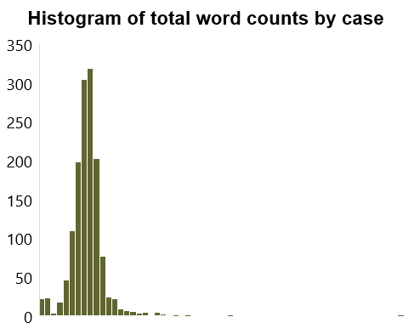
Predicting recent Supreme Court outcomes
Jonas Heim, Matt Kaufmann, Michael Wagner, Núria Adell Raventós, Sergio Olalla Ubierna
Introduction
Data and preprocessing
Context: The Supreme Court is one of the most important institutions in public policy, influencing the civil fabric of society. Recent advances in machine learning provide an innovative lens through which to predict the outcomes of Supreme Court cases and the voting behaviors of judges.
Objectives: (1) to predict case outcomes in favor of either the petitioner or the respondent, and (2) to predict the voting patterns of a subset of judges.
Significance: Based on how well our models predict a given judges vote, we can potentially understand how much predictive power utterances have on judges' decisions, or the impact of oral arguments on the judges’ perspective of a case.
Data pipeline
Data summary information
Extract data
2000-2019 chosen for recency
Sourced from Cornell Supreme Court ConvoKit
Clean and preprocess data
Remove irrelevant feature columns
Combine all utterances into a single text formatted as “person X says Y to person Z”
Pass into specific models
For entire case prediction, extract win side
Group by case
For justice prediction, analyze only their cases
5k | 10k | 15k | 20K | 25K | 30K | 35K | 40K
Model comparison
Results and conclusions
 | Token limit | Depen-dencies | Benefits | Considerations
Continuous Bag of Words | N/A | None | Simplicity Efficient representation | Limited contextual understanding
BERT |  | Short | Bidirectional context Pre-trained | Complexity Short attention window
RoBERTa |  | Medium | Generalizability Enhanced relative to BERT | Relatively shorter attention window Fine-tuning challenges
RoBERTa (randomized) |  | Medium | More robust training | Same as above
BigBird |  | Long | Longer depend. Computationally efficient | Substantial memory
LongFormer |  | Short + Long | Long strings Fine-grained attention | Training time Limited context at boundaries of doc.
Key conclusions
Next steps
RoBERTa and BigBird perform the best, underscoring the significance of structural information retained by more advanced architectures
RoBERTa (68.57%) predicts case outcomes at 3.04% higher than baseline
BigBird outperforms 12/15 justices on baseline
Improve data nuance: Refine models to capture courtroom speaker dynamics
Hyperparameter optimization: Conduct grid search for performance improvement
Train legal context embeddings: Develop or use legal-specific embeddings for better language comprehension
More tokens
Note: Also ran sentiment analysis on justices to try and predict vote side, but results were inconclusive.

