Slide 1
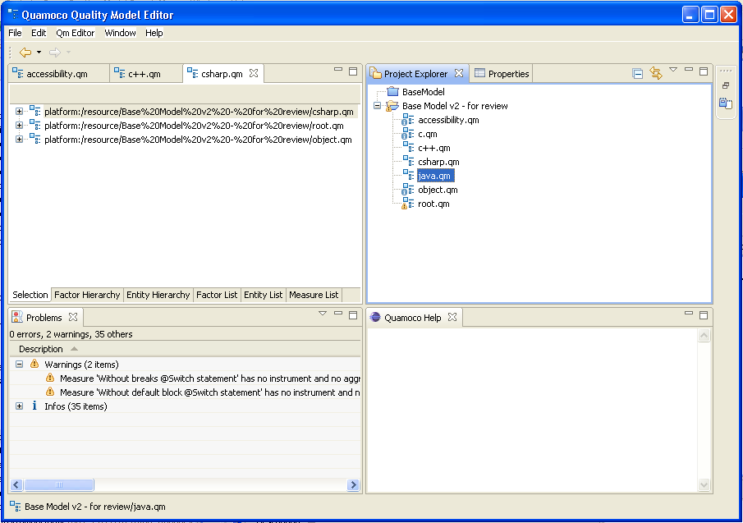
Do not click each file!

Slide 2
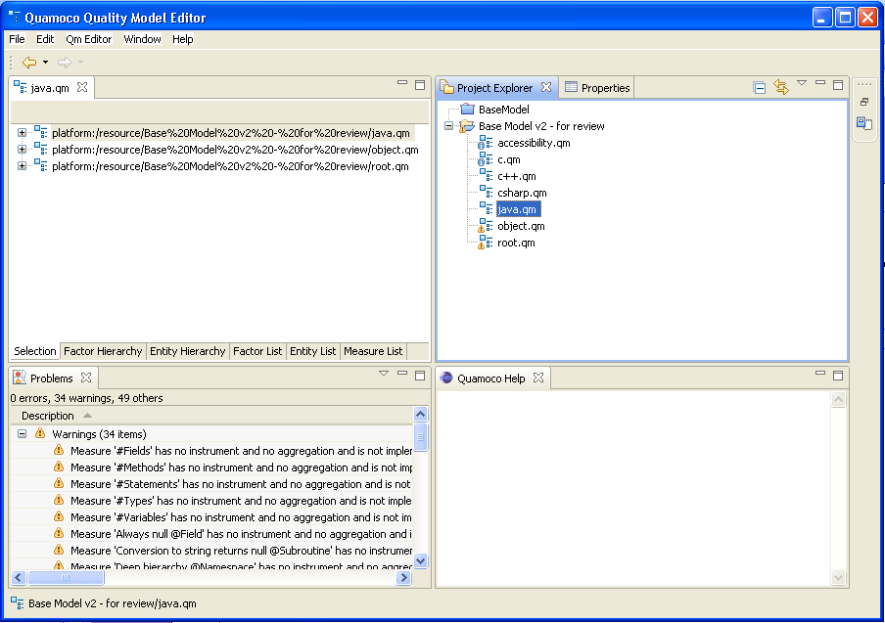
Open one file.

Slide 3
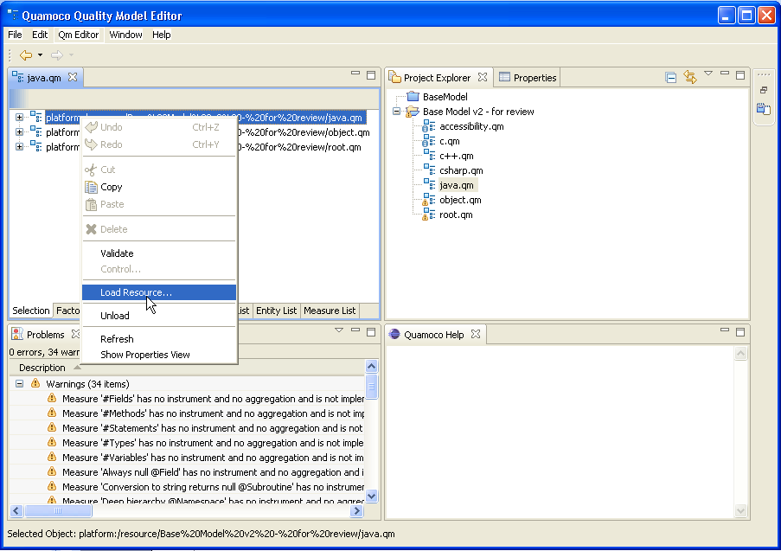
Click “Load Resource…”.

Slide 4
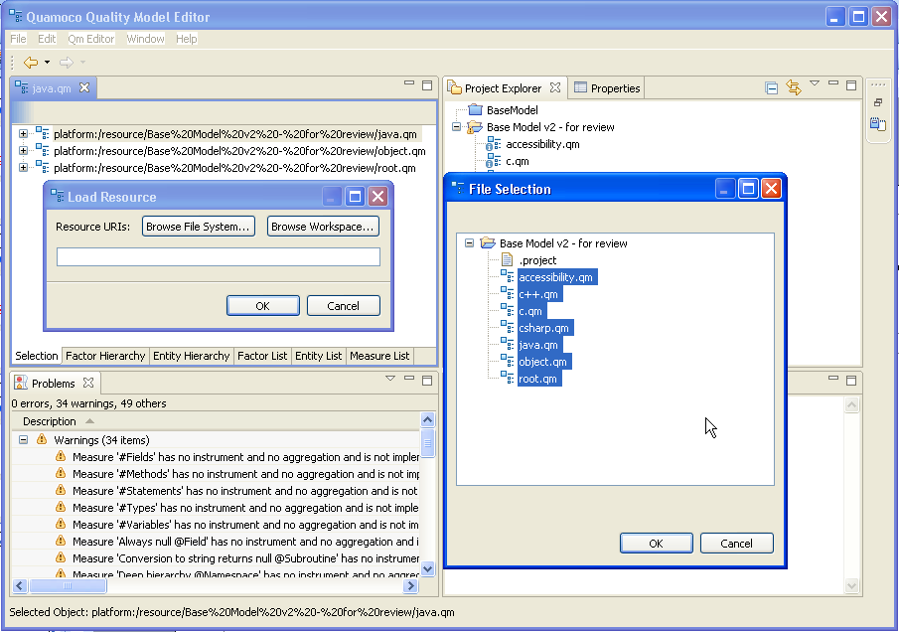
Select all files
of the base model…”.

Slide 5
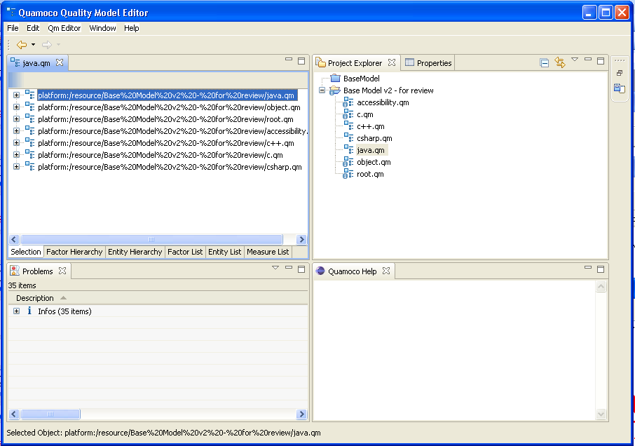
All files have been loaded.

Slide 6
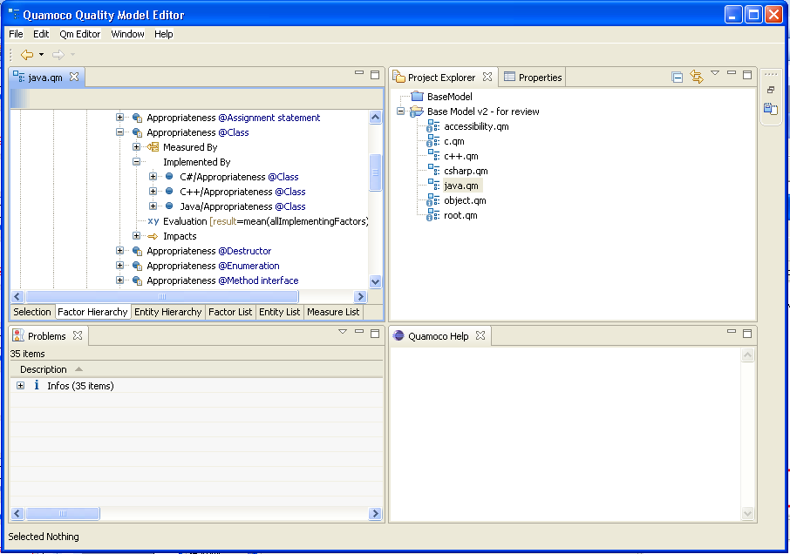
Also in the factor hierarchy,
all modules are shown
combined.

