Slide 1
A glimpse into Text Mining

Slide 2
Text mining attempts to extract meaningful information from natural language text.
Document Retrieval:
Given a large group of documents and a query, identify and return the most relevant documents
Document Classification:
Assign natural language documents to predefined categories according to their content
Document clustering:
“Unsupervised” learning in which there is no predefined category or class, but groups of documents that belong together are sought
Text summarization:
Produces a condensed representation of the input (one or a group of documents)

Slide 3
Text mining attempts to extract meaningful information from natural language text.
Document Retrieval:
Given a large group of documents and a query, identify and return the most relevant documents
Document Classification:
Assign natural language documents to predefined categories according to their content
Document clustering:
“Unsupervised” learning in which there is no predefined category or class, but groups of documents that belong together are sought
Text summarization:
Produces a condensed representation of the input (one or a group of documents)

Slide 4
Text mining attempts to extract meaningful information from natural language text.
Document Retrieval:
Given a large group of documents and a query, identify and return the most relevant documents
Document Classification:
Assign natural language documents to predefined categories according to their content
Document clustering:
“Unsupervised” learning in which there is no predefined category or class, but groups of documents that belong together are sought
Text summarization:
Produces a condensed representation of the input (one or a group of documents)

Slide 5
Text mining attempts to extract meaningful information from natural language text.
Document Retrieval:
Given a large group of documents and a query, identify and return the most relevant documents
Document Classification:
Assign natural language documents to predefined categories according to their content
Document clustering:
“Unsupervised” learning in which there is no predefined category or class, but groups of documents that belong together are sought
Text summarization:
Produces a condensed representation of the input (one or a group of documents)

Slide 6
Text mining attempts to extract meaningful information from natural language text.
Document Retrieval:
Given a large group of documents and a query, identify and return the most relevant documents
Document Classification:
Assign natural language documents to predefined categories according to their content
Document clustering:
“Unsupervised” learning in which there is no predefined category or class, but groups of documents that belong together are sought
Text summarization:
Produces a condensed representation of the input (one or a group of documents)

Slide 7
Basic Concepts and Notations in Text Mining
A set of all documents is called a corpus
Document is broken into tokens (words) and is represented by a set of tokens
A set of all tokens in a corpus is called a vocabulary

Slide 8

Text Representation
Docs are represented as vectors in high-dimentional space
Dimension of the space is equal to the vocabulary size
Each dimension corresponds to a word in the corpus
Documents are represented as a 0-1 vectors
$$\begin{matrix}\left.d_{1}=(1,1,1,0,1\right) \\ \left.d_{2}=(1,1,1,1,0\right) \\ \left.d_{3}=(0,1,1,0,0\right)\end{matrix}$$

Slide 9
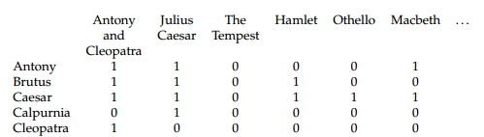
Example

Slide 10
Example of Boolean Retrieval
Determine which plays of Shakespeare contain the words:
Brutus AND Ceasar AND NOT Calpurinia

Slide 11
Boolean Information Retrieval
To answer the query we take the vectors for Brutus, Caesar and Calpurnia and do a bitwise AND:
110100 AND 110111 AND 101111 = 100100
The answers for this query are thus ‘Antony and Cleopatra” and “Hamlet”

Slide 12
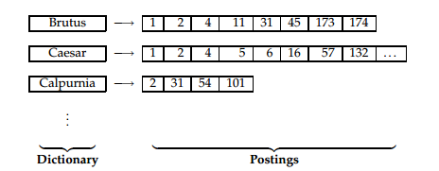
Building an Inverted Index

Slide 13
Non Binary Term Weights
car
d1
q
d2
d3
0
insurance

Slide 14
Vector-Space Model
car
d1
q
d2
d3
0
insurance

Slide 15
Term Frequency (TF) and Inverted Document Frequency(IDF)
Term Frequency (TF) of term i in document j is defined as the number of times the term occurs in the documents
Document frequency is the number of documents that contain term i. Inverted DF measures the informativeness of the term.

Slide 16
TF-IDF weighting

Slide 17
Identifying drug-drug interactions (DDIs) from biomedical literature

Slide 18
Definition
The drug-drug interaction (DDI) is defined as a change in the effects of one drug by the presence of another drug
another drug prevents the first drug from performing as expected
This drug-drug interaction may cause you to experience an unexpected side effect.
Mixing a drug you take to help you sleep (a sedative) and a drug you take for allergies (an antihistamine) can slow your reactions and make driving a car or operating machinery dangerous.

Slide 19
More about drug interactions
Drugs interact when there is an increase or decrease in:
the absorption of a drug into the body;
distribution of the drug within the body;
alterations made to the drug by the body (metabolism);
elimination of the drug from the body
http://www.rxlist.com/drug-interaction-checker.htm

Slide 20
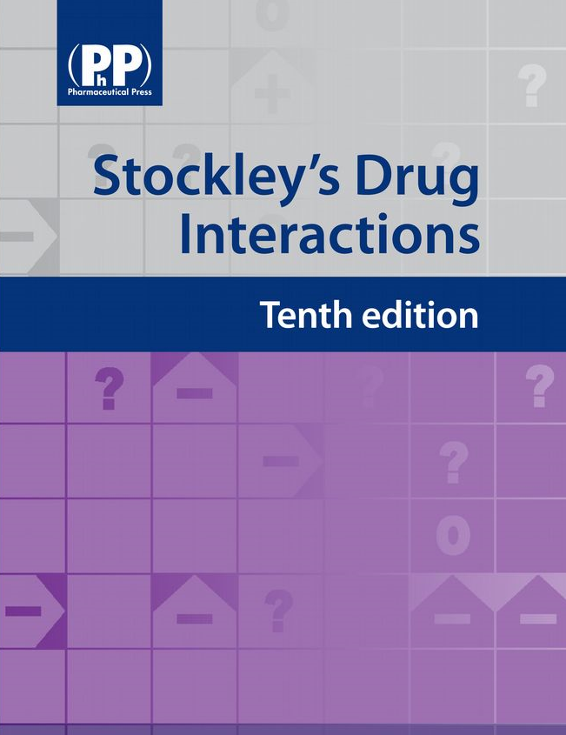
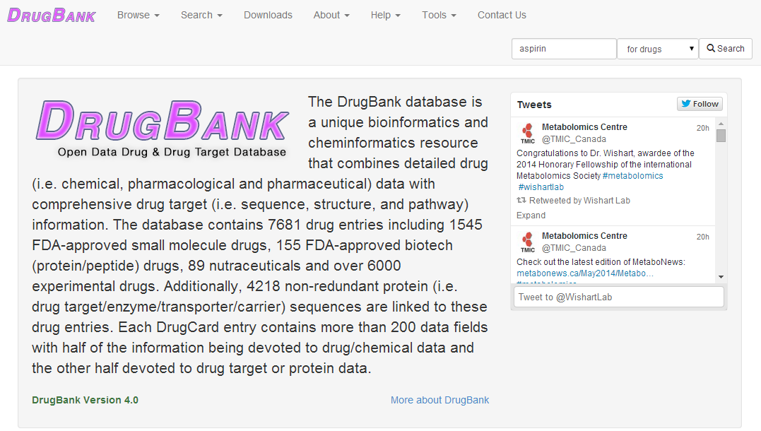
Drug-Drug Interaction Resources

Slide 21
However..
A large amount of up-to-date information is hidden in:
Text of journal articles
Technical reports
Other unstructured published text
Goal: Automatically identify sentences that describe drug interactions

Slide 22
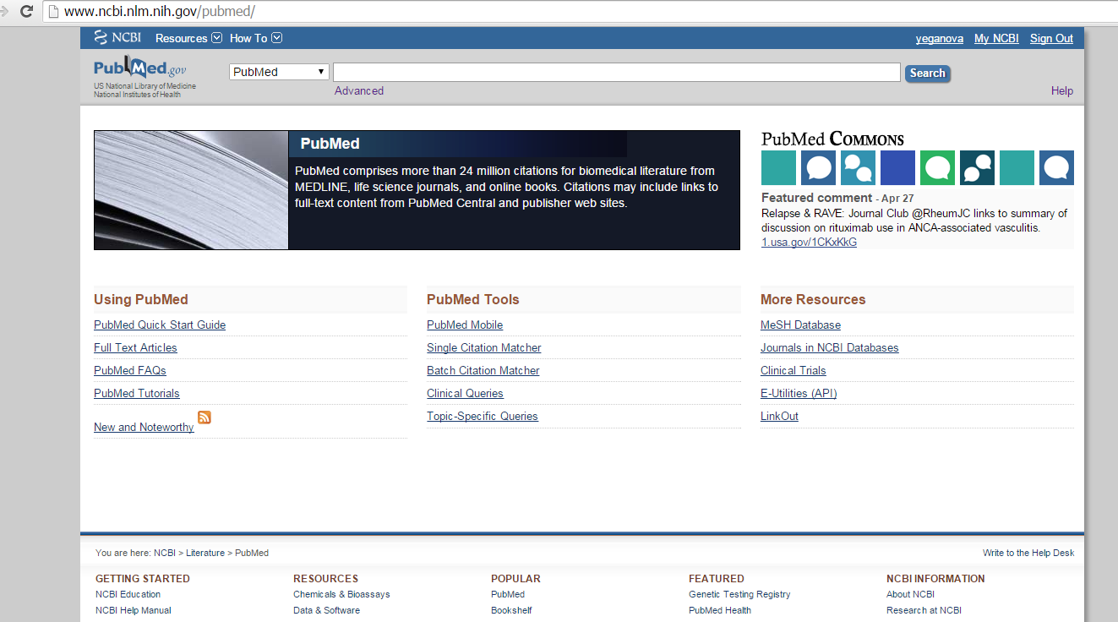

Slide 23
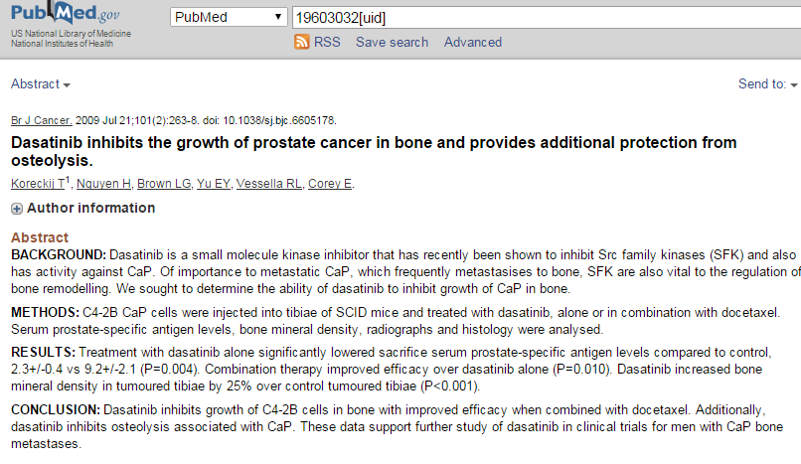
Notes:
Abstract of a scientific paper is like a required summary session that proceeds every paper.

Slide 25
Phenobarbital decreases aspirin effectiveness by enzyme induction.
Alcohol has a synergistic effect with aspirin in causing gastrointestinal bleeding.
Caution should be used if ibuprofen is administered concomitantly with methotrexate.
Linezolid has the potential for interaction with adrenergic and serotonergic agents.

Slide 26
Introductory Task Annotating Drug-Drug Interactions
Every group is provided with
A set of 50 sentences
2 drug names in each sentence – we will call them target drugs
Goal
Identify whether or not the sentence describes an interaction between the two target drugs
Annotate
Record your decision through the website

Slide 27
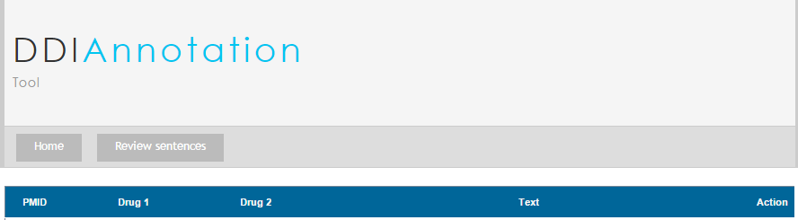
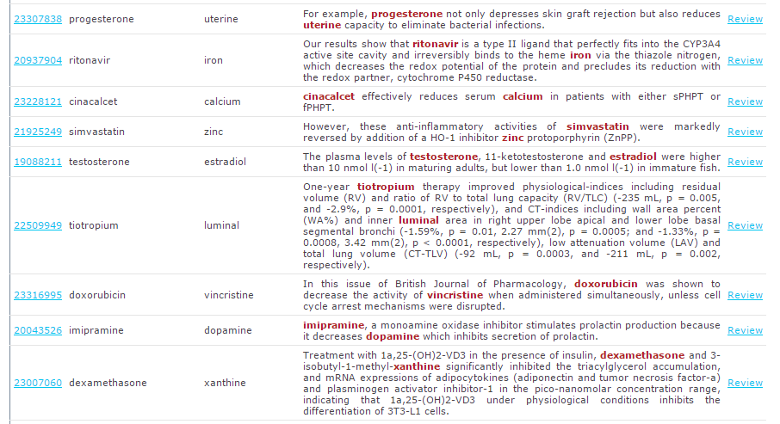
Link to the Tool

Slide 28
Introductory Task Annotating Drug-Drug Interactions
As you annotate every sentence, pay attention to how drug interactions are expressed in the sentences
What words indicate drug-drug interactions (we call them trigger words)
Pairs of words indicating drug-drug interactions
Position of these words relative to the target drugs
Any other information that will help your classifier distinguish between the positive and negative instances

Slide 29
Main Task - Text Classification Task
Set up a model which given a sentence and a pair of target drugs will classify the instance as positive or negative
Positive means that there is an interaction between the two drugs
Phenobarbital decreases aspirin effectiveness by enzyme induction.
Negative means that there is not interaction between the two drugs, or sentence does not discuss drug interactions.
The efficacy of weekly docetaxel is not improved by concurrent administration of imatinib as a PDGFR inhibitor.
However, sufentanil was superior to fentanyl in the quality of the spinal block produced.

Slide 30
Datasets
We have provided positive and negative sentences for training and test sets
Data Preprocessing
Sentences have been tokenized and lemmatized
Position information has been included
Features have been transformed into numeric format
Features
Words
Pairs of Adjacent Words

Slide 31
Thank You!

