Slide 1

ESP32
←
←
Reset
↑

Slide 2
ESP32
←
←
Reset
↑

Slide 3
ESP32
←
←
Reset
↑

Slide 4
ESP32
←
←
Reset
↑

Slide 5
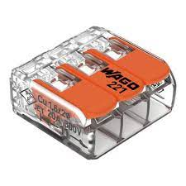
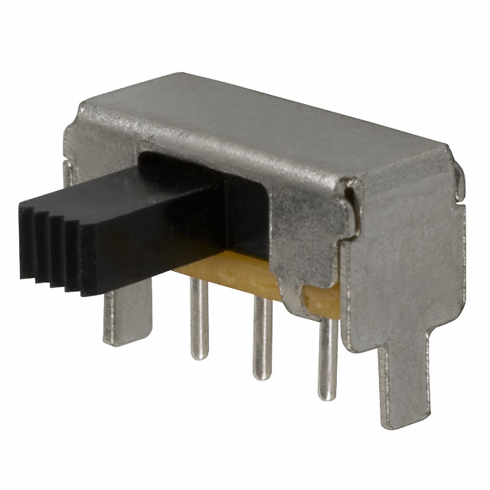

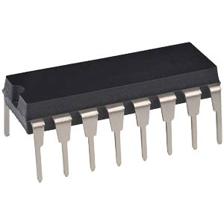
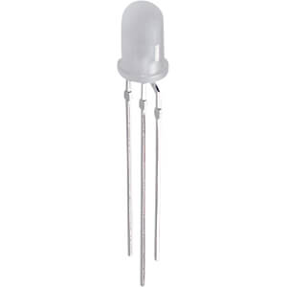
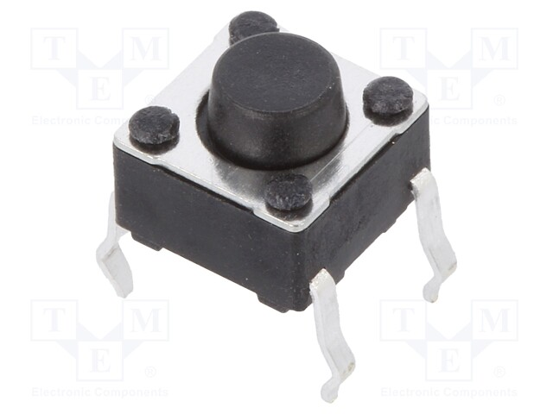
ESP32
6 x 5 LED-Matrix

Slide 8
WAGO 221
WAGO 221

