Slide 1
Workshop I
Introduction to Linux
Professional Training Academy Linux Series

Slide 2
What is Linux?
Linux is an operating system. Specifically, Linux is the kernel or
the core of the system
Originally developed by Linus Torvalds at the University of
Helsinki, Finland
Today, the Linux kernel is more commonly deployed with a set of
tools
Various distributions of Linux exist which package different sets of
tools and environments for the various types of users. For example:
  Red Hat: for system administrators
  Ubuntu, Fedora: for desktop users
  Others include: SuSE, Debian, Knoppix, Slackware, Mandriva,
  Gentoo, etc.

Slide 3
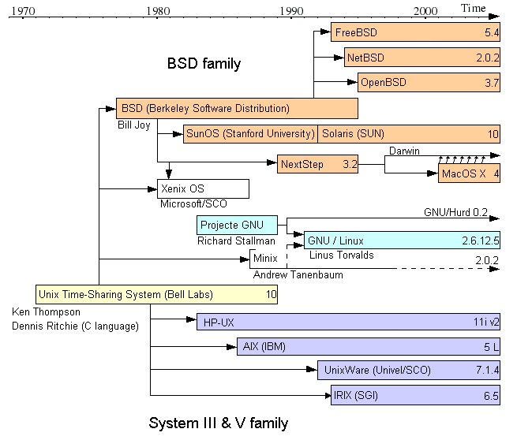
Linux History
Source: http://en.wikipedia.org/wiki/Linux

Slide 4
Linux History
By the early 1990s, PCs became powerful enough to start running
UNIX
Linus started to develop a freely available academic version of
UNIX for PC machines (UNIX was developed at AT&T's Bell
Laboratories in the early 1970s)
Minix (by Andrew Tanenbaum at the Vrije Universiteit,
Amsterdam) existed at the time and was a smaller academic
version of UNIX for teaching, but new features were not allowed
to be added
Consequently, Linus started his own project

Slide 5
Linux Popularity
In late 1991, first version of Linux was released
Two years after beginning, Linus had 12000 users
Today, Linux is well known for its stability and reliability
Linux powers the majority of web servers in the world (Apache)
The Linux counter project roughly estimates that there are 29
million Linux users (Source: http://counter.li.org/estimates.php)

Slide 6
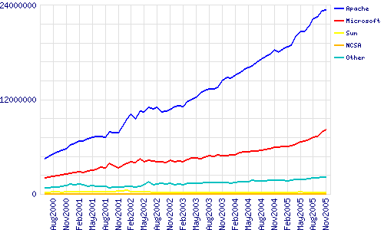
Linux Popularity
Source: http://www.dwheeler.com/oss_fs_why.html

Slide 7
Some Common Terms
X-Windows: (X11 or X) a toolkit and protocol for developing
desktop window environments (modern desktops are built using
X)
KDE: a free desktop environment, originally developed by
Matthias Ettrich in 1996
Gnome: another free desktop environment, originally developed
by Miguel de Icaza and Federico Mena in 1997 in response to
KDE
Directory: is another term for a folder

Slide 8
Some Common Terms
Login account: Every Linux user has their own login name and
password. When you login, all your files will be stored in your
personal home directory
Shell: also called the terminal, the command line, the console, or
the prompt. This is the program where you type in your
commands. It looks like DOS
Bash: is a type of shell and stands for the Bourne Again Shell
Binary: an executable program. Similar to an .exe file on
Windows

Slide 9
Some Common Terms
GUI: is the Graphical User Interface, which is your Desktop with
all its windows and icons
Kernel: is the main part of the operating system. It looks after the
hardware, memory, and sharing of resources, etc.
Root: is the most powerful user on the system, and is similar to the
Windows administrator. Linux users do not user their root account
all the time, only when installing new software, hardware, or
configuring
Script: a series of shell commands stored in a file which can be run
like a program in order to automate a task
Widget: a component belonging to the graphical environment, e.g.
a scrollbar, button, etc.

Slide 10
Linux Philosophy
Linux exists due to an open and accepting philosophy for learning and
exploring
This philosophy encompasses new users as well as experienced users
Every user and developer is welcome
The more users the better, so your problems and experiences are valued
Make use of the helpful online forums, mailing lists, irc channels
Chances are that somebody else had a similar problem to you and it is
already documented
A great resource is “The Linux Documentation Project” at
http://www.tldp.org

