Slide 1
Spark 介绍

Slide 2
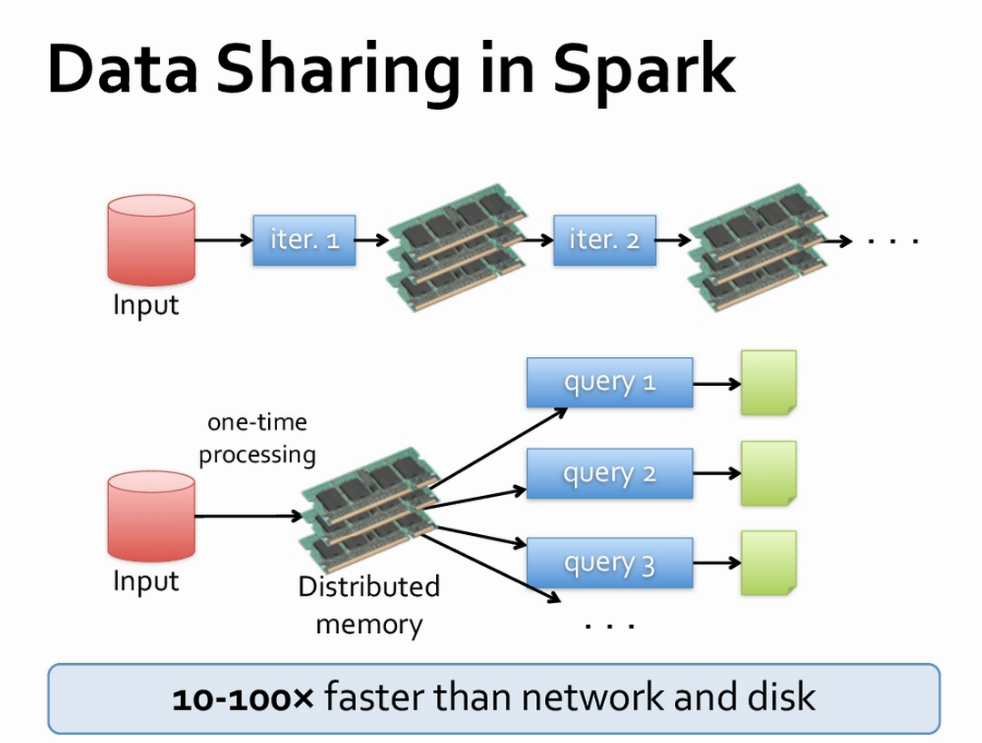

Slide 3
Components
Appliction(Scala/Java/Python
SparkContext
Local Thread
Spark Master
Other resouces
Spark Worker
Spark Worker
HDFS or Local file

Slide 4
RDD
resilient distributed datasets
弹性分布式数据集

Slide 5
RDD
A list of partitions
A function for computing each split
A list of dependencies on other RDDs
Optionally, a Partitioner for key-value RDDs (e.g. to say that the RDD is hash-partitioned)
Optionally, a list of preferred locations to compute each split on (e.g. block locations for
an HDFS file)

Slide 6
RDD
immutable collections of objects spread across a cluster
build through parallel transformations
automatically rebuild on failure
different storage level （memory management）

Slide 7
RDD API
map(func)
Return a new distributed dataset formed by passing each element of the source through a functionfunc.
filter(func)
Return a new dataset formed by selecting those elements of the source on which func returns true.
flatMap(func)
Similar to map, but each input item can be mapped to 0 or more output items (so func should return a Seq rather than a single item).
union(otherDataset)
Return a new dataset that contains the union of the elements in the source dataset and the argument.
reduceByKey(func, [numTasks])
When called on a dataset of (K, V) pairs, returns a dataset of (K, V) pairs where the values for each key are aggregated using the given reduce function. Like in groupByKey, the number of reduce tasks is configurable through an optional second argument.

Slide 8
RDD API
reduce(func)
Aggregate the elements of the dataset using a function func (which takes two arguments and returns one). The function should be commutative and associative so that it can be computed correctly in parallel.
count()
Return the number of elements in the dataset.
saveAsTextFile(path)
Write the elements of the dataset as a text file (or set of text files) in a given directory in the local filesystem, HDFS or any other Hadoop-supported file system. Spark will call toString on each element to convert it to a line of text in the file.
foreach(func)
Run a function func on each element of the dataset. This is usually done for side effects such as updating an accumulator variable (see below) or interacting with external storage systems.

Slide 9
RDD Storage Level
MEMORY_ONLY
Store RDD as deserialized Java objects in the JVM. If the RDD does not fit in memory, some partitions will not be cached and will be recomputed on the fly each time they're needed. This is the default level.
MEMORY_AND_DISK
Store RDD as deserialized Java objects in the JVM. If the RDD does not fit in memory, store the partitions that don't fit on disk, and read them from there when they're needed.
MEMORY_ONLY_SER
Store RDD as serialized Java objects (one byte array per partition). This is generally more space-efficient than deserialized objects, especially when using a fast serializer, but more CPU-intensive to read.
MEMORY_AND_DISK_SER
Similar to MEMORY_ONLY_SER, but spill partitions that don't fit in memory to disk instead of recomputing them on the fly each time they're needed.
DISK_ONLY
Store the RDD partitions only on disk.
MEMORY_ONLY_2, MEMORY_AND_DISK_2, etc.
Same as the levels above, but replicate each partition on two cluster nodes.

Slide 10
Fault Tolerance
RDD track the series of transformations used to build them ( the lineage) to recompute lost data.
val message=sc.textFile().filter(_.contains(“error”)).map(_.split(“ “)(2))
HadoopRDD
Path=hdfs://
FilteredRDD
Contains()
MappedRDD
Split()

Slide 11
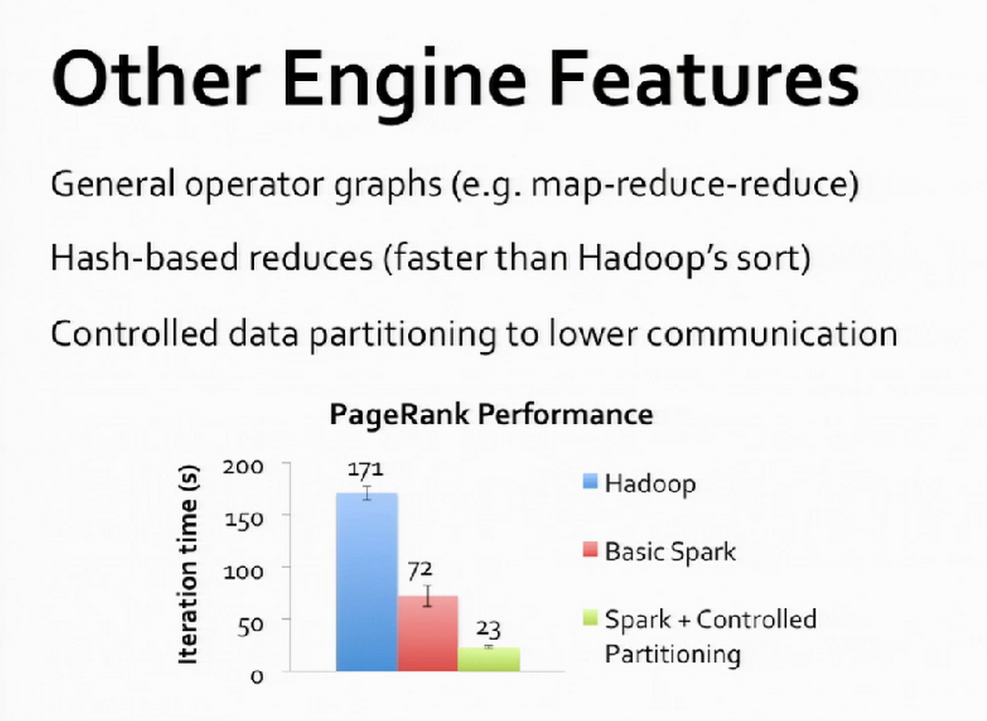

Slide 12
Demo & QA

