Slide 1
Jinni
Compare choices using separate sources
and your priorities
Team 39: Theo and Wahab
Do You Have the GUTS? 2026
BlackRock challenge
Notes:
Hi, we are Theo and Wahab from Team 39. This is Jinni. It brings separate sources into one decision workspace. You set the conditions, compare the choices, and check the evidence. Our built-in examples use fictional data.
Repository evidence:
- README.md
- docs/GENERAL_DECISIONS.md
- web/icon.svg

Slide 2
Maya's journey choice
One journey within £25 and three hours
Input | What it contributes
Option catalog | The choices and their identities
Measurement feed | Cost, journey time and emissions
Your conditions | Budget, hard limits and priorities
Jinni joins the sources and explains what fits
Notes:
Meet Maya, our fictional user. She needs one journey within twenty-five pounds and three hours. The catalog names the choices. A separate feed adds their measurements. Neither feed alone gives a complete comparison. Jinni joins them and applies Maya's conditions.
Repository evidence:
- data/decisions/travel-options.json
- data/decisions/travel-metrics.json
- app/comparison/adapters.py

Slide 3
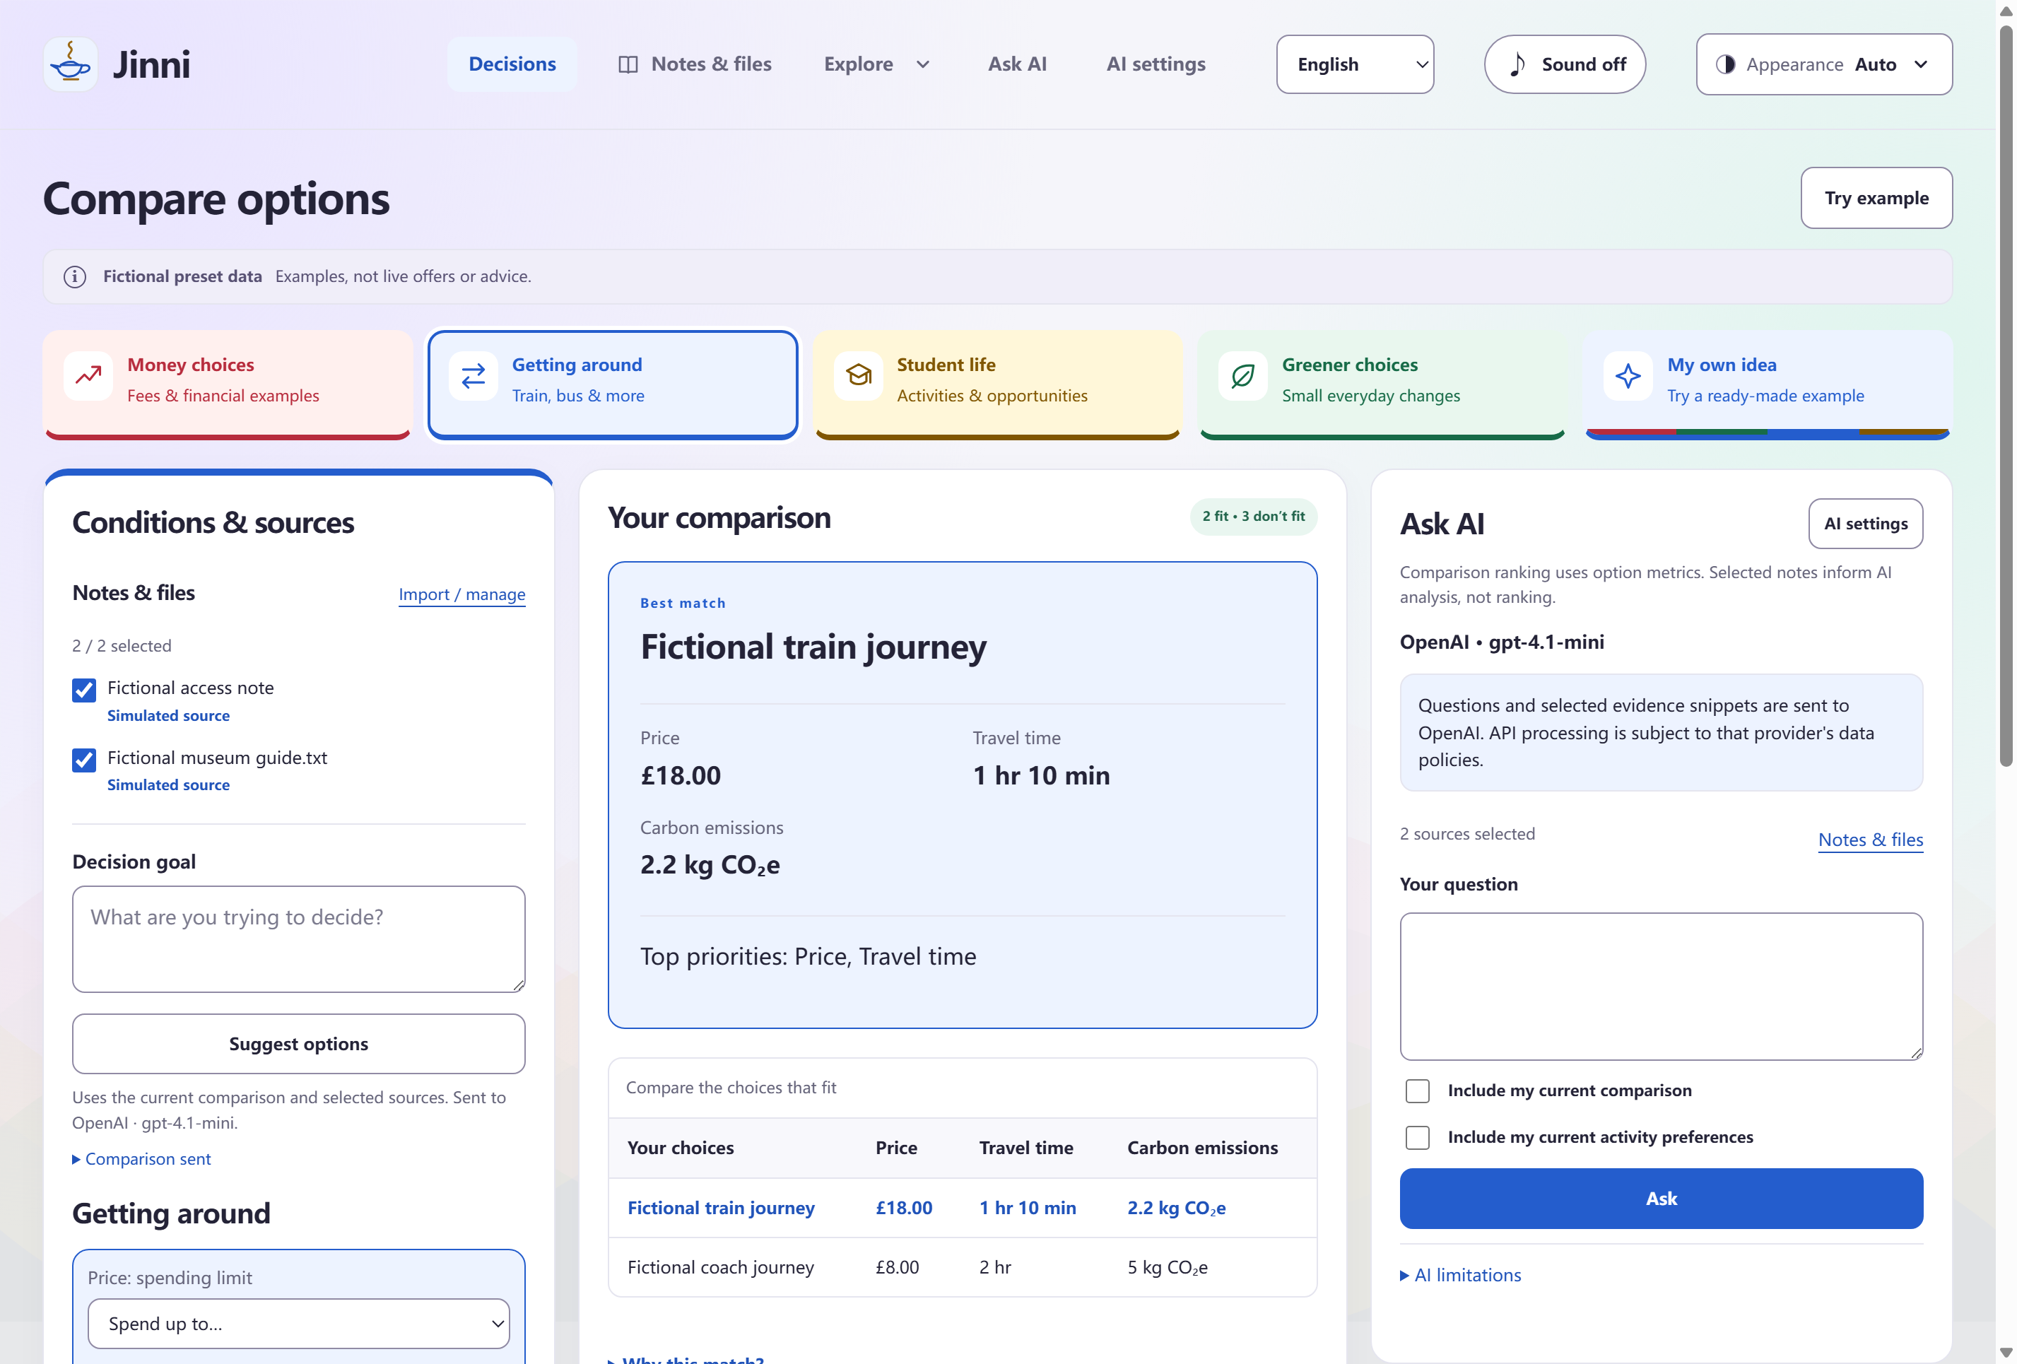
A workspace for the whole decision
1
Set conditions
2
Compare choices
3
Check evidence
Fictional preset data. This screenshot makes no live AI request claim.
Notes:
Here is the shared workspace. Conditions and selected sources sit on the left. The comparison stays in the middle. Ask AI stays beside it in the desktop app. We keep the calculated result separate from AI suggestions.
Repository evidence:
- web/index.html
- web/decision-app.mjs
- web/desktop-ai.mjs
- docs/AI_OPTIONS.md
- docs/presentation/assets/pitch-comparison.png

Slide 4
Maya's feasible journeys
Budget £25 Journey limit 180 minutes
Choice | Cost | Time | Emissions | Hard limits
Train | £18 | 70 min | 2.2 kg CO2e | Fits
Coach | £8 | 120 min | 5 kg CO2e | Fits
Flight | £70 | 45 min | 60 kg CO2e | Over budget
Taxi | £45 | 60 min | 18 kg CO2e | Over budget
Cycle | £0 | 240 min | 0.3 kg CO2e | Over time
Hard limits filter first. Your priorities rank what remains.
Simulated journeys and emissions. Scores measure relative preference fit.
Notes:
Maya's budget is twenty-five pounds and her time limit is three hours. Train and coach fit. Flight and taxi cost too much. Cycling takes too long. We then score the feasible choices using Maya's priorities. No API key is needed.
Repository evidence:
- data/decisions/travel-options.json
- data/decisions/travel-metrics.json
- app/comparison/engine.py

Slide 5
AI with a source you can open
“The fictional museum opens at 11:00. The entrance has a ramp.”
Your selected evidence
Ask a question or request options.
Open the exact quote in its original context.
Fictional museum guide
Mocked-provider example
Quote validation checks source membership. People still judge the answer.
Notes:
You can import notes or a text PDF and select the evidence. Then ask a question or request new options. Each supported result has source quotations you can open. We check the quote against the selected passage. This does not prove every AI claim is true.
Repository evidence:
- docs/AI_EXTENSION.md
- docs/AI_OPTIONS.md
- tests/desktop/options-ui.cjs

Slide 6
One interface, two editions
 | Browser | Electron desktop
Interface | Shared web interface | Shared web interface
Calculation | Equivalent JavaScript | Local Python API
Source library | Local IndexedDB | Local SQLite
Evidence help | Original passage search | Optional cited cloud AI
The desktop identifies the selected AI recipient. Keys are encrypted on this device.
Calculated comparisons stay available when AI fails.
Theo: backend Wahab: frontend and desktop interface
Notes:
Browser and desktop use the same interface files. Desktop calls our local Python API. Browser uses matching JavaScript rules. AI names the selected provider. Keys are encrypted on this device, with an explicit delete control. Comparisons still work if AI fails. Theo handles the backend. Wahab handles the frontend and desktop interface.
Repository evidence:
- docs/ARCHITECTURE.md
- docs/BROWSER.md
- web/platform.mjs
- docs/AI_PROVIDERS.md
- Team 39 role and encrypted-key storage confirmation, 2026-10-18

Slide 7
Maya's choice and its trade-offs
Train: £18, 70 minutes, 2.2 kg CO2e
Coach: £8, 120 minutes, 5 kg CO2e
Her hard limits make both feasible.
Her priorities decide the ranking.
The same core supports market, student, sustainability
and custom examples.
Next: verified live data adapters and user testing
github.com/wahab-linux/my-jinni
Prototype with fictional presets
Notes:
Maya can see the trade-off. The train is faster and has lower simulated emissions. The coach is cheaper. Her limits make both feasible, and her priorities decide the ranking. The same core also supports other scenarios and custom criteria. Next, we want verified live data adapters and user testing. Thank you.
Repository evidence:
- docs/GENERAL_DECISIONS.md
- docs/AI_OPTIONS.md
- docs/REQUIREMENTS.md
- data/decisions/travel-metrics.json

Slide 8
Implementation and scoring
Shared interface Pure decision core Source adapters
1 Check availability and hard limits
2 Normalize feasible options and apply weights
score = 100 × Σ(weight × normalized value) / Σ(weight)
Unknown required data excludes a choice. Ties use stable IDs.
Notes and AI proposals do not silently rewrite measurements or scores.
OpenAPI contract. Tests for boundaries, ranking, both sources and failures.
Backup
Notes:
The layers are experience, pure decision logic and data integration. OpenAPI documents request and response models. Tests cover boundaries, ranking, both sources and failures. Hard limits come first. We normalize feasible options and apply weights. Unknown required data excludes a choice. AI proposals do not silently change measurements or scores.
Repository evidence:
- app/comparison/engine.py
- docs/GENERAL_DECISIONS.md
- docs/AI_OPTIONS.md
- docs/openapi.json
- docs/ARCHITECTURE.md

Slide 9
Questions we expect
Why use AI?
To discuss selected evidence and propose options.
The score stays deterministic.
Are the numbers live?
No. The preset data is explicitly fictional.
What leaves the device?
The question, selected snippets and explicitly requested
calculated context go to the chosen provider.
What did AI help build?
Codex helped with planning, code, tests and this deck.
The team reviewed code and records human decisions.
Live DeepSeek API checks passed for cited answers and option proposals.
Backup
Notes:
These are short answers for questions. Our numbers are fictional. AI discusses evidence and proposes choices, while the calculation stays deterministic. Only explicit questions, selected snippets and requested context go to the selected provider. Codex was our development tool. The team reviewed code. The coordinator verified two real DeepSeek API requests: a cited answer and two cited options. That does not verify live desktop use or real-world data.
Repository evidence:
- AGENTS.md
- docs/AI_EXTENSION.md
- docs/AI_OPTIONS.md
- docs/AI_USAGE.md
- Team 39 role/tool/review confirmation and live DeepSeek verification report, 2026-10-18

