Slide 1
Redux

Slide 2
Intro
Redux are use to store the data whole application which we pass the data of a componet

Slide 3
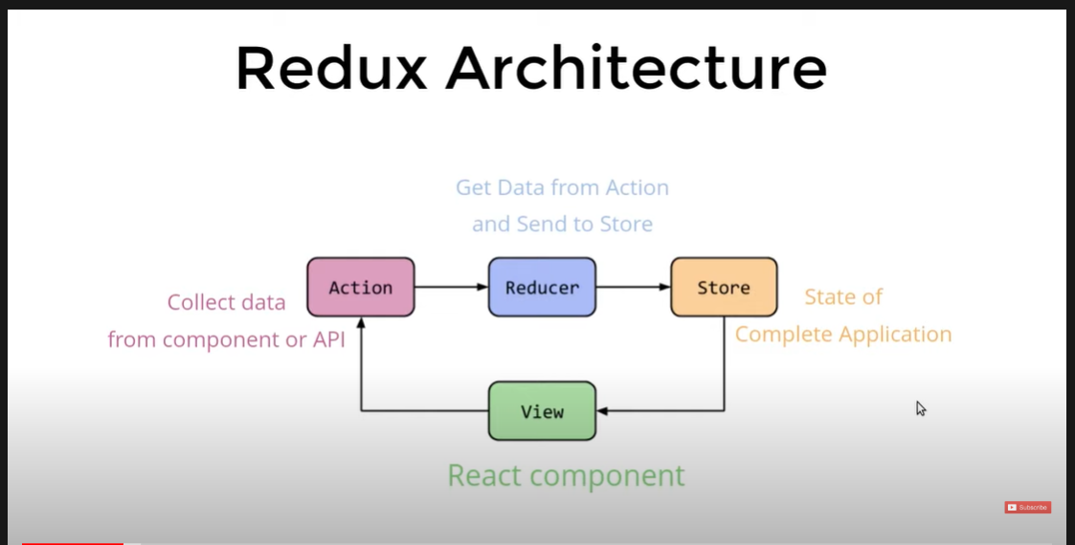
Redux Architecture

Slide 4
Important Point
In Redux data is a uni direction.
Redux one application has only one store.

