Slide 1
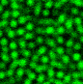
TrackPy
(TP)
Particle Positions
U-net
Labels
TrackPy (TP)
Particle Positions
U-net
Labels
Laplacian Of Gaussian (LOG)
Particle Positions
Attention U-net
Labels
Laplacian Of Gaussian (LOG)
Particle Positions

