Slide 1

RevPay: Secure Digital Payments
A full-stack monolithic financial web application for personal and business users.

Slide 2
Table of Contents
01
02
03
Introduction & Objective
Application Overview
Personal Account Features
04
05
06
Business Account Features
Standard Functional Scope
Definition of Done
07
Conclusion

Slide 3

Introduction & Objective
RevPay is a full-stack monolithic financial web application designed for secure digital payments and money management. It caters to both personal and business users, offering tailored functionalities to streamline financial operations and enhance user experience.

Slide 4
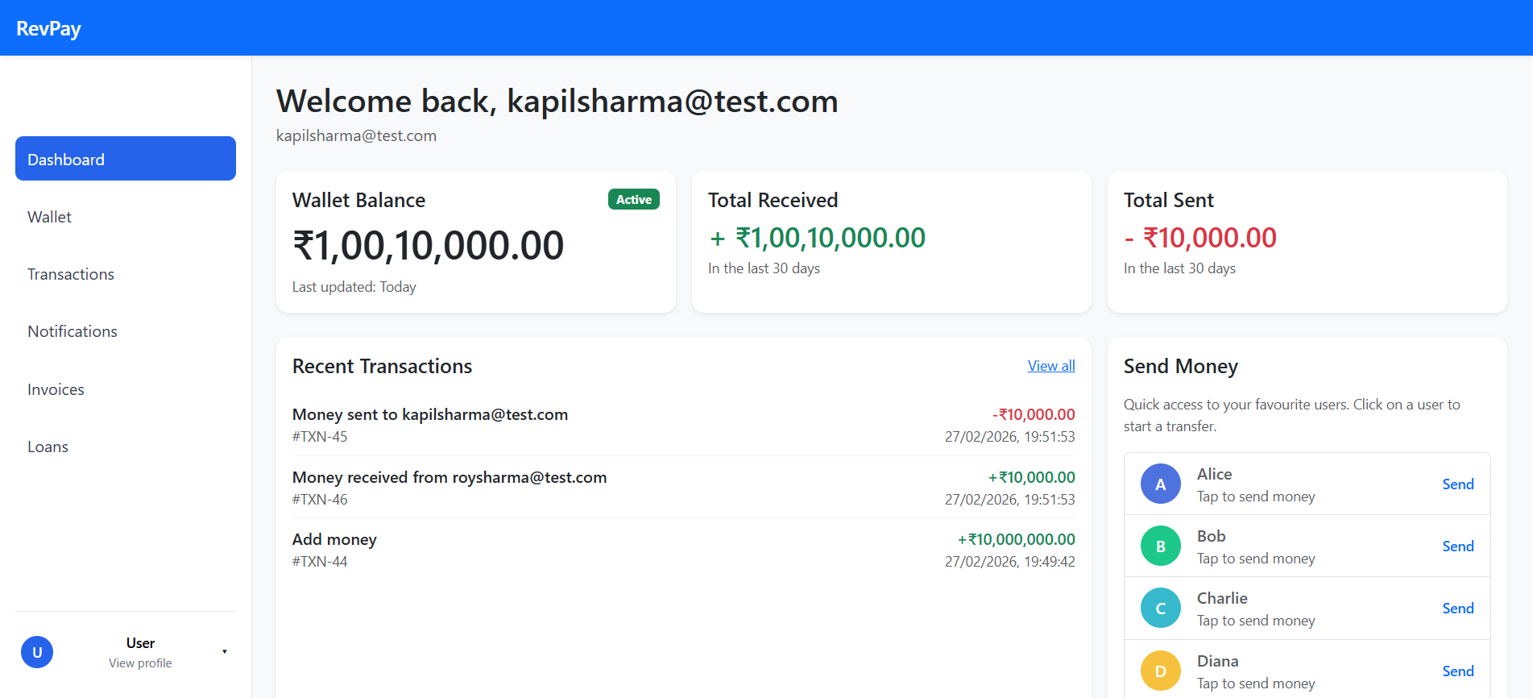
Application Overview
RevPay is a monolithic financial web application enabling secure digital payments and money management. It serves both personal and business users with distinct features.
Key aspects include robust security, role-based access, real-time processing, and comprehensive notifications.

Slide 5


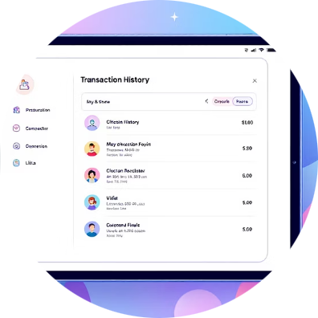

Personal Account Features
Send/Request Money
Manage Payment Methods
Track Transactions
Notifications & Profile
Seamlessly send or request funds from other users.
Add, edit, delete, and set default credit/debit cards.
View and filter comprehensive transaction history.
Receive in-app alerts and manage profile information.

Slide 6
Business Account Features
Business accounts include all personal features, plus:
1
2
Payment Acceptance
Invoice Management
Generate requests and process incoming payments.
Create, send, and track invoices with payment terms.
3
4
Loan Applications
Business Analytics
Apply for business loans and track their status.
Dashboard with key metrics, reports, and payment trends.

Slide 7

Standard Functional Scope
Authentication & Security
Notification System
Transaction Management
Security Implementation
User Interface & Experience
Data Management

Slide 8
Challenges & Learnings
Challenges Faced
Key Learnings
Ensuring robust security for financial data.
Managing complex monolithic architecture.
Integrating diverse payment methods.
Importance of modular design within monoliths.
Prioritizing user experience in financial apps.
Continuous security auditing and updates.

Slide 9
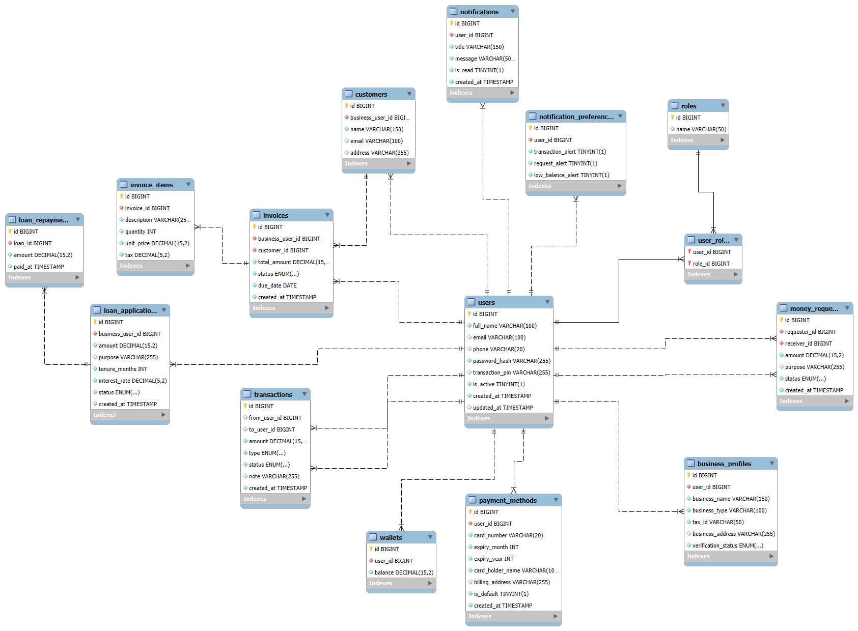
ER DIAGRAM

Slide 10
Future Scope of RevPay
1 )Real Payment Gateway Integration :Integrate Razor pay / Stripe / PayPal
2)Advanced Business Analytics :Revenue charts (daily/weekly/monthly)
3) Credit & Loan Enhancement : Credit score Calculation , EMI calculator

Slide 11
Conclusion
RevPay provides a secure, efficient, and comprehensive platform for digital payments and money management. Its dual functionality for personal and business users, coupled with robust features, positions it as a versatile solution in the financial technology landscape.

