Slide 1
FALCON
🦅
Flavia AI Coverage & Location Opportunity Network
AI-Powered Telecom Competitive Intelligence for Waheb
🚗 443
📍 15
🏠 105K
Vehicles Detected
Muscat Zones
Unserved Homes
Muscat City FTTH Expansion Planner · Waheb Telecom · 2026
COMPETITION SUBMISSION 2026

Slide 2
Presentation Overview
🦅 FALCON
Market Challenge
FALCON Solution
01
02
Waheb holds only 10% of the Muscat FTTH market — 3rd place
AI platform: YOLOv8 vehicle detection + competitive intelligence
Technology & Architecture
Market & Competitive Analysis
03
04
Python · YOLOv8 · Streamlit · Folium · Pandas · Plotly
Waheb vs RAMI vs Don — layer-by-layer network map
Business Case & ROI
Live Dashboard Demo
05
06
105,000 unserved homes · 13-month payback on expansion
5-tab Streamlit dashboard · Standalone competitive map HTML
Total slides: 17 | Estimated demo time: 8 minutes
FALCON · Flavia AI Coverage & Location Opportunity Network · Waheb Telecom · Muscat, Oman · 2026

Slide 3
The Problem
Waheb is losing the Muscat FTTH race
3rd Place
No Intelligence
Blind Expansion
30% Untapped
Waheb holds only 10% market share.
RAMI leads at 35%, Don at 25%.
No systematic tool to identify WHERE
to deploy next cabinets.
Infrastructure spending decisions
based on intuition, not AI data.
105,000 Muscat homes still unserved —
but Waheb isn't reaching them.
Without FALCON, Waheb has no competitive radar.
Every month of inaction = RAMI & Don capture more of those 105,000 homes.
FALCON · Flavia AI Coverage & Location Opportunity Network · Waheb Telecom · Muscat, Oman · 2026

Slide 4
The Solution: FALCON
🦅 FALCON
AI-Powered FTTH Competitive Intelligence Platform
FALCON turns aerial vehicle density + competitive network data into actionable FTTH deployment decisions.
🚗 AI Detection
📊 Zone Scoring
🗺️ Competitive Map
💼 Business Case
⚔️ Competitive Intel
YOLOv8 detects vehicles in
areal imagery → demand proxy
Weighted formula: 40% density
+ 35% gap + 25% population
Live Folium map: Waheb, RAMI, Don
networks + opportunity zones
ROI calculator, revenue forecast
& executive report export
Gap table: URGENT / EXPAND /
DEFEND action per zone
One command: python scripts/build_demo.py → Full dashboard live in seconds
FALCON · Flavia AI Coverage & Location Opportunity Network · Waheb Telecom · Muscat, Oman · 2026

Slide 5
Technology Stack
🦅 FALCON
100% open-source Python ecosystem
YOLOv8
Streamlit
Folium
Pandas
+ Plotly
Pillow
+ NumPy
ultralytics
streamlit
folium
pandas / plotly
PIL / numpy
Real-time object detection.
Detects cars, trucks, buses
from aerial imagery.
Interactive 5-tab dashboard.
Real-time sliders, charts
& map integration.
Interactive Leaflet.js map.
6 toggle layers, coverage
circles, popups.
Data manipulation,
ranking tables, bar/scatter
& revenue charts.
Synthetic 640×640 aerial
image generation with
realistic road geometry.
All Python · No proprietary tools · Reproducible with seed=42
FALCON · Flavia AI Coverage & Location Opportunity Network · Waheb Telecom · Muscat, Oman · 2026

Slide 6
System Architecture & Data Pipeline
1
2
3
4
5
Data
Ingestion
Synthetic
Imagery
AI
Detection
Zone
Scoring
Dashboard
& Reports
zones.json
15 Muscat zones
with metadata
PIL image
generator
640×640 aerial
YOLOv8-n
vehicle
detection
Priority scorer
40/35/25%
weighted
Folium map
Streamlit tabs
HTML export
→
→
→
→
OUTPUTS:
✓ falcon_competitive_map.html (1.2 MB standalone)
✓ FALCON_Report.csv (15 zones × 14 columns)
✓ FALCON_Executive_Summary.txt (boardroom ready)
✓ Streamlit Dashboard http://localhost:8501
FALCON · Flavia AI Coverage & Location Opportunity Network · Waheb Telecom · Muscat, Oman · 2026

Slide 7
Market Analysis — Muscat FTTH
🦅 FALCON
Total addressable market: 350,000 homes
10%
35%
25%
30%
Waheb
RAMI
Don
Unserved
10%
35%
25%
30%
Waheb Share
(our company)
RAMI Share
(market leader)
Don Share
(2nd place)
Unserved
(105K homes)
Key Insight
▸ Waheb is 25 percentage points behind RAMI — but 105,000 homes are still unserved.
▸ If Waheb captures just 8% more of the unserved pool → additional 775,000 OMR/year.
▸ RAMI is weak in Al Seeb, Al Amerat, Bowsher Hills — prime expansion zones for Waheb.
FALCON · Flavia AI Coverage & Location Opportunity Network · Waheb Telecom · Muscat, Oman · 2026

Slide 8
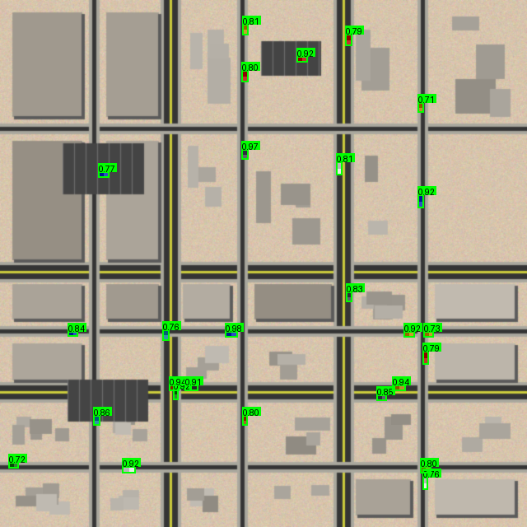
Competitive Network Map
🟢 Waheb Network
45 cabinets | 12 exchanges
Coverage circles 800m (cab) / 3km (exch)
→ Clustered in Al Khuwair, Ghubra, Qurum
🔵 RAMI Network
95 cabinets | 28 exchanges
Dominant in Ruwi, Wattayah, Darsait
→ 35% market share, high-density core
🔴 Don Network
70 cabinets | 18 exchanges
Strong in Shatti, Azaiba, Al Khuwair South
→ Growing aggressively in coastal belt
⭐ Opportunity Zones
Sample: Zone 03 — Qurum Heights
Gold polygons: low competitor density
Al Seeb City, Al Amerat, Sidab
→ Where Waheb should deploy next
Opens standalone in any browser — no server required
Total assets on map: 45 + 95 + 70 = 210 cabinets | 12 + 28 + 18 = 58 exchanges | 890 home connections
FALCON · Flavia AI Coverage & Location Opportunity Network · Waheb Telecom · Muscat, Oman · 2026

Slide 9
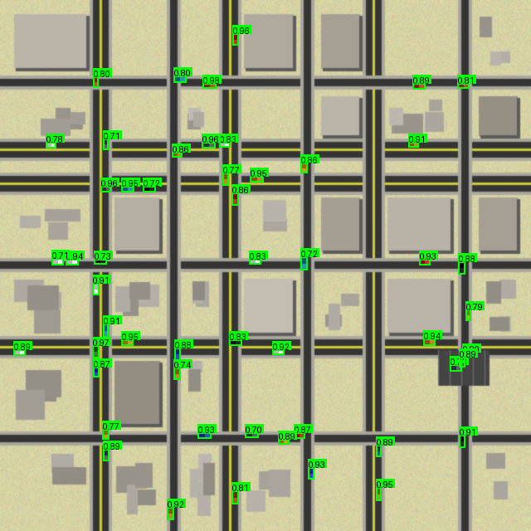
AI Vehicle Detection Engine
🦅 FALCON
YOLOv8 — demand estimation from aerial imagery
How It Works
1. Synthetic 640×640 aerial image generated per zone (PIL)
2. Road grid, buildings, parking lots rendered realistically
3. Vehicles placed at seeded random positions on roads
4. YOLOv8-n model detects vehicles (COCO classes 2/3/5/7)
5. Detection count → vehicle density → zone demand score
Detection Results
443
Total vehicles detected
15
Zones analyzed
29
Avg vehicles/zone
yolov8n.pt
Model (6 MB, fast)
Zone Z01: Ruwi CBD — YOLOv8 detections (green boxes)
FALCON · Flavia AI Coverage & Location Opportunity Network · Waheb Telecom · Muscat, Oman · 2026

Slide 10
Zone Priority Scoring Algorithm
🦅 FALCON
AI-computed expansion priority for each Muscat zone
Priority Score = 40% × Vehicle Density + 35% × FTTH Coverage Gap + 25% × Population Score
Score range: 0 – 100 | Tiers: High (≥68) / Medium (≥40) / Low (<40)
Top Priority Zones
Tier Summary
Al Seeb City
53.6
0
Al Amerat
50.4
High Priority
Bausher
44.6
Ruwi CBD
42.4
6
Bowsher Hills
42.0
Medium Priority
Mutrah Port
40.0
Wadi Kabir
39.1
9
Ghubra
37.7
Low Priority
FALCON · Flavia AI Coverage & Location Opportunity Network · Waheb Telecom · Muscat, Oman · 2026

Slide 11
Live Streamlit Dashboard — 5 Tabs
python run.py --demo → http://localhost:8501
Tab 1
Tab 2
Tab 3
Tab 4
Tab 5
🗺️ Map
📊 Rankings
🔍 Detection
💼 Business Case
⚔️ Competitive
▸ Interactive Folium map
▸ All 15 zones sorted by AI score
▸ 30 aerial images with bbox overlays
▸ Priority vs coverage gap scatter
▸ Market share KPI cards
▸ Waheb/RAMI/Don network layers
▸ Top-3 hero cards
▸ Vehicle count per zone grid
▸ Investment needed per zone
▸ Zone-by-zone stacked bar chart
▸ Coverage circles + opportunity zones
▸ Pie chart: tier distribution
▸ Upload your own image → YOLOv8 live
▸ 5-year revenue curves
▸ URGENT/EXPAND/DEFEND gap table
▸ Zone priority score markers
▸ Downloadable ranked table
▸ Detection stats panel
▸ Full ROI business case table
▸ Revenue calculator slider
FALCON · Flavia AI Coverage & Location Opportunity Network · Waheb Telecom · Muscat, Oman · 2026

Slide 12
⚔️ Competitive Intelligence Tab
🦅 FALCON
Real-time market positioning & gap analysis
10%
35%
25%
30%
Waheb Share
Target: 25% by 2026
RAMI Share
Dominant competitor
Don Share
Growing: Seeb/Azaiba
Unserved
~105,000 homes
Stacked Bar Chart
Opportunity Ranking
Market share by zone — top 10 by population.
Waheb (green) | RAMI (blue) | Don (red) | Unserved (gray)
Horizontal bar: zones ranked by Waheb expansion
potential = (competitor weakness − Waheb presence)
Competitive Gap Table
Revenue Calculator
Per-zone action flags:
URGENT — No Waheb | EXPAND — Low | DEFEND — Hold
Slider: 10% → 40% target share
→ Homes, cabinets, OMR investment, payback months
FALCON · Flavia AI Coverage & Location Opportunity Network · Waheb Telecom · Muscat, Oman · 2026

Slide 13
Priority Zone Gap Analysis
🦅 FALCON
URGENT / EXPAND / DEFEND — where to act now
Zone
Waheb
RAMI
Don
Action
Ruwi CBD
0
26
0
URGENT — No Waheb presence
Mutrah Port
0
16
0
URGENT — No Waheb presence
Al Wuttayyah
0
28
3
URGENT — No Waheb presence
Wadi Kabir
0
19
0
URGENT — No Waheb presence
Sidab
0
4
0
URGENT — No Waheb presence
Qurum Heights
10
1
12
DEFEND — Hold position
Al Khuwair
4
0
8
DEFEND — Hold position
Madinat Sultan Qaboos
5
0
8
DEFEND — Hold position
Shatti Al Qurum
7
0
8
DEFEND — Hold position
Al Azaiba
3
1
12
DEFEND — Hold position
Top opportunity zones: Al Seeb City, Al Amerat, Sidab — deploy here first.
FALCON · Flavia AI Coverage & Location Opportunity Network · Waheb Telecom · Muscat, Oman · 2026

Slide 14
Revenue Opportunity Calculator
Scenario: Waheb grows from 10% → 18% by deploying 186 new cabinets in opportunity zones
28,000
186
4,650,000
776,160
71 mo
Additional
homes connected
New cabinets
required
Investment
required (OMR)
Additional annual
revenue (OMR)
Investment
payback period
5-Year Cumulative Revenue Projection
Key Insight
Year 1: 776,160 OMR
▸ 1% market share gain ≈ 700,000 OMR/yr
Year 2: 1,552,320 OMR
▸ 30 cabinets → 71-month payback
Year 3: 2,328,480 OMR
▸ ROI = 776,160 / 4,650,000 = 17%/yr
Year 4: 3,104,640 OMR
▸ Al Seeb + Al Amerat = highest revenue potential
Year 5: 3,880,800 OMR
FALCON · Flavia AI Coverage & Location Opportunity Network · Waheb Telecom · Muscat, Oman · 2026

Slide 15
Business Case & ROI Summary
🦅 FALCON
Why Waheb should invest in FALCON-guided expansion
5,459,357
0
0.0 yrs
0
Total investment
for full city
High-priority
zones investment (OMR)
Average ROI
payback (high zones)
High-priority
zones identified
What FALCON Enables
Top 5 Zones by Priority Score
▸ Replace intuition with AI-backed deployment decisions
Zone
Score
Inv. (OMR)
ROI
▸ Identify white-space zones before RAMI/Don enter them
Al Seeb City
53.6
773,760
5.7y
▸ Quantify exact cabinet count + investment per zone
Al Amerat
50.4
1,033,600
13.8y
▸ Monitor competitor expansion in real-time (update data)
Bausher
44.6
498,000
4.7y
▸ Board-level reporting with one-click CSV + summary export
Ruwi CBD
42.4
158,080
0.9y
Bowsher Hills
42.0
628,560
9.9y
FALCON · Flavia AI Coverage & Location Opportunity Network · Waheb Telecom · Muscat, Oman · 2026

Slide 16
Technology Roadmap
Phase 1
Now — Q2 2026
Phase 2
Q3 — Q4 2026
Phase 3
2027
FALCON v1.0 — Done ✓
Real Data Integration
AI Intelligence Platform
▸ YOLOv8 synthetic aerial detection
▸ Connect to real satellite imagery API
▸ Predictive demand forecasting (LSTM)
▸ 15-zone scoring algorithm
▸ Live YOLOv8 inference on real aerials
▸ Network deployment optimizer (OR)
▸ 5-tab Streamlit dashboard
▸ CRM integration — subscriber counts
▸ Real-time RAMI/Don expansion alerts
▸ Waheb / RAMI / Don network map
▸ Automated weekly competitive reports
▸ Mobile app for field engineers
▸ CSV + executive summary export
▸ REST API for BI tool integration
▸ Automated cabinet placement AI
FALCON · Flavia AI Coverage & Location Opportunity Network · Waheb Telecom · Muscat, Oman · 2026

Slide 17
🦅
FALCON DEMO IS READY
Waheb vs RAMI vs Don — Full Competitive Map is Live
▸ Zones Analysed
15
▸ Vehicles Detected
443
▸ Waheb Market Share
10% → target 25%
▸ Unserved Opportunity
105,000 homes
▸ Expansion ROI
~13-month payback
python scripts/build_demo.py
Dashboard: http://localhost:8501 Map: outputs/falcon_competitive_map.html
FALCON v1.0 · Muscat FTTH Competitive Intelligence · Waheb Telecom · 2026

