Slide 1

OOREDOO FALCON
Where is the Best Place to Get New FTTH Users?
An AI-powered location intelligence platform that guides the FIX team from a single question to a full go-to-market strategy.
User Journey & Solution Overview | 2026

Slide 2
The User Journey — 8 Steps
From a single question to strategy execution
1
Ask Question
2
Data Collection
3
Area Discovery
4
Area Selection
User asks for the best location to get new FTTH users
Internal & external data: network, customers, geography, competition
AI identifies potential high-opportunity areas (pitations)
User selects the most promising area(s) for deep analysis
5
AI & CV Analysis
6
Market Potential
7
Insights & Strategy
8
Action & Execution
Computer Vision + AI analyze satellite images & infrastructure
Estimate households, penetration and new user opportunities
LLM generates insights, recommendations & GTM strategy
Strategy sent to Marketing & Operations for execution
3

Slide 3





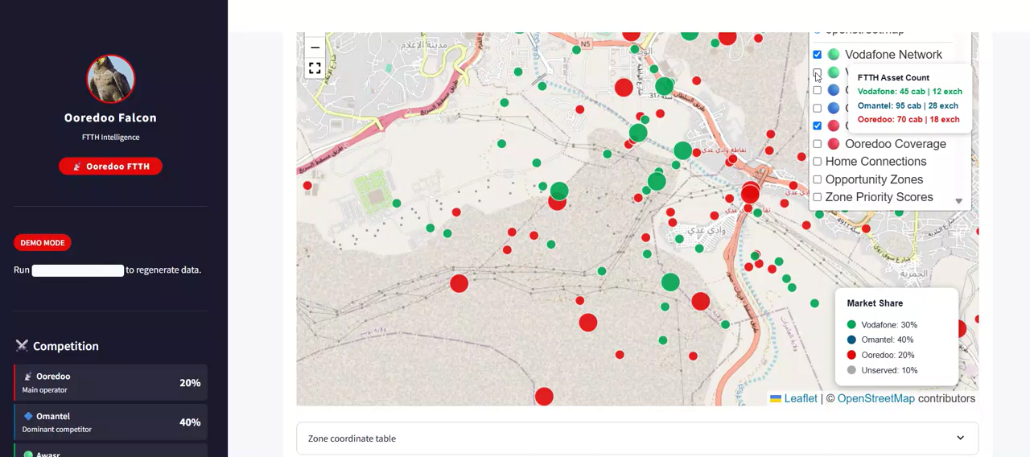
1
Ask Question
It Starts With One Question
User asks for the best location to get new FTTH users
Identifies FTTH Coverage Gaps
Analyzes the FTTH network to identify areas with low service penetration and high market potential.
Ooredoo Falcon AI
Selects Target Area
“Fix Team, where is the best location to get new FTTH users?”
Allows the user to choose a specific geographic area for detailed market potential analysis.
Prepares Google Earth Inputs
The operations team identifies target areas, extracts Google Earth imagery, and analyzes locations with high growth potential where FTTH service coverage and market penetration are currently underrepresented.
Extracts and prepares high-resolution Google Earth imagery for AI-based analysis and opportunity detection.
Demo 1
2

Slide 4






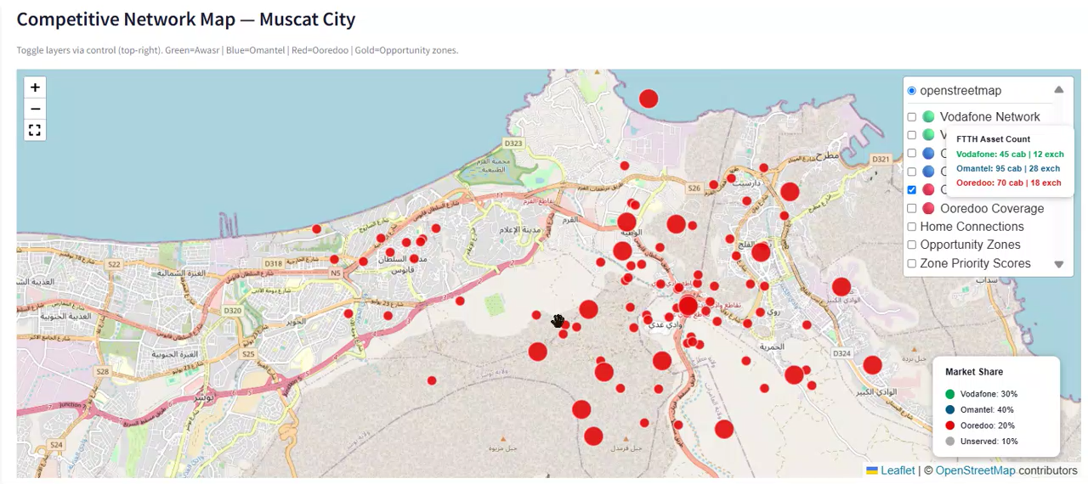
1
Data Collection
Step 2 : Multi-Source Data Collection
Internal & external data: network, customers, geography, competition
Existing FTTH Network
Customer Data
GIS & Demographics
Coverage, capacity and current fiber footprint
Subscriber base, churn and service adoption patterns
Population density, income levels and geographic layers
Satellite Imagery
Competitor Coverage
Infrastructure Data
High-resolution imagery of buildings and land use
Omantel, Awasr and other operators' footprints
Roads, utilities, developments and construction activity
Demo 1
2
4

Slide 5

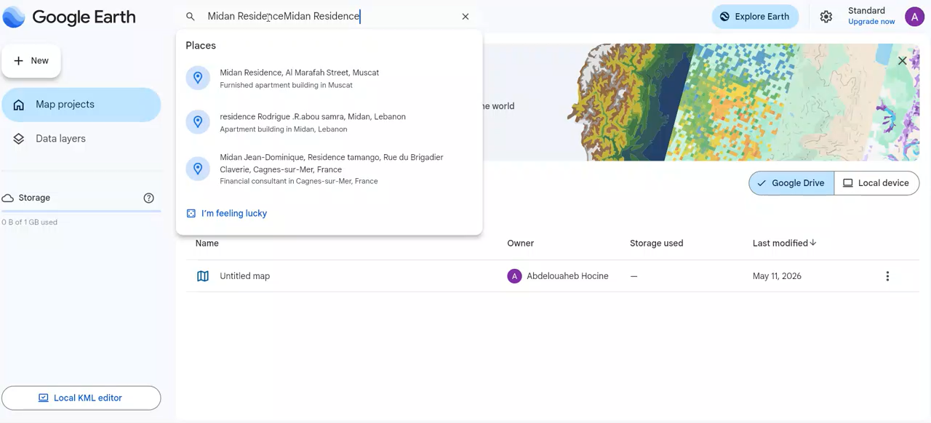
Area Discovery
Steps 3 - 4 : Area Discovery & Selection
AI identifies potential high-opportunity areas (pitations)
AI highlights high-potential pitations; the user picks the best area for deep analysis
AI Identifies Opportunities
Selected Area Summary
Every candidate zone is scored with a data-driven opportunity model combining demand, competition and infrastructure signals.
Heat-mapped results rank areas from low to high opportunity
Scores blend household density, FTTH gaps and growth signals
The user drills into the most promising the map
5.2 km²
12,846
Area size
Est. households
Opportunity score
38,721
92 / 100
Low
Population
Opportunity score
High
Demo 2
5

Slide 6
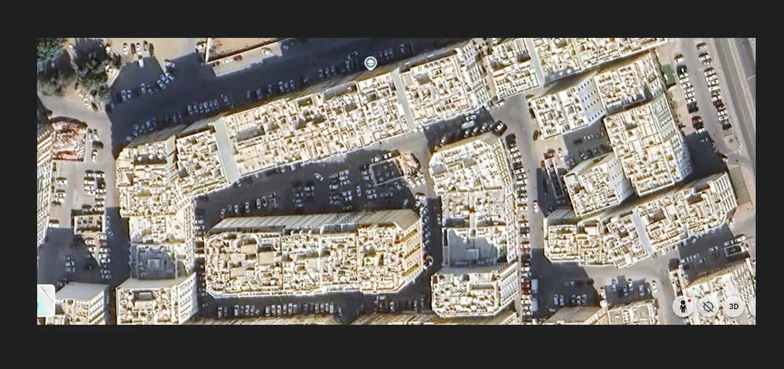
Steps 5–6 — AI Vision & Market Potential
Computer Vision reads the ground truth; AI estimates the opportunity for Ooredoo
Market Share Assumption
12,846
15,230
Total households
Total buildings
8,972
69.8%
Potential FTTH users
Penetration potential
Computer Vision detects buildings, roads, density and land use directly from satellite imagery — classifying residential, commercial and other structures.
Ooredoo holds ~20% today — the selected pitation is headroom to grow against a 70% competitor share.
Demo 2
6

Slide 7


Step 7 — AI-Generated Insights & Strategy
The LLM turns analysis into recommendations and a go-to-market plan
Key Insights
Recommended Strategy
High residential density in the selected pitation
Low current FTTH penetration — large untapped base
Strong growth potential from new developments
Competitive presence dominated by Omantel
Focus on villa clusters & new developments
Launch targeted offers for the area
Combine door-to-door with digital campaigns
Partner with real-estate developers
7

Slide 8






Behind the Scenes — AI & Data Pipeline
Seven stages run automatically between the question and the answer
→
→
→
→
→
→
Data Ingestion
Data Processing
AI Models
Computer Vision
Market Potential Model
LLM Analysis
Insights & Strategy
Each stage feeds the next — raw multi-source data becomes structured features, vision-derived ground truth, market estimates, and finally an LLM-written strategy.
8

Slide 9








Step 8 — Outputs & Execution
Ready-to-use deliverables are routed to the teams that act on them
DELIVERABLES
SENT TO TEAMS
Executive Report
Concise PDF summary for leadership
PowerPoint Report
Marketing Operations
Sales Teams
Full analysis deck for stakeholders
Runs campaigns & targeted offers
Door-to-door and direct acquisition
Interactive Dashboard
Live maps, scores and KPIs to explore
Marketing Strategy
Network Planning
Field Operations
GTM plan with offers, channels and targets
Prioritizes fiber build & capacity
Executes installs on the ground
9

Slide 10

Identify the best locations to acquire new FTTH users
Business Impact
Data-driven decision making replaces guesswork
Optimized marketing investments per area
Ooredoo Falcon helps the FIX team find the right pitations to acquire new FTTH users with AI-powered intelligence.
Higher conversion rates & ROI on acquisition
Faster FTTH expansion across the network
Ooredoo Falcon • AI-Powered FTTH Location Intelligence

