Slide 1
FALCON
🦅
ML Pipeline — End-to-End
From Data Annotation to AI-Powered FTTH Intelligence
📸 Data Collection
🏷️ Annotation
🧠 YOLOv8 Model
🛰️ Aerial Detection
📊 Intelligence
🚀 Deployment
Waheb Telecom · Muscat, Oman · 2026
ML PIPELINE OVERVIEW

Slide 2
Pipeline Agenda
🦅 FALCON
Complete ML workflow — 15 steps from raw images to production
01
Data Collection
09
Telecom Simulation
Google Earth Pro screenshots, GPS coords
5G / FTTH / mobile KPIs per zone
02
Data Annotation
10
Competitor Intelligence
YOLO format, bounding boxes, LabelImg
RAMI vs Don vs Waheb market share
03
Dataset Preparation
11
ML Insights
YAML config, train/val/test split, aug
K-Means, forecasting, S-curve
04
YOLOv8 Architecture
12
Streamlit Dashboard
COCO pretrained, transfer learning
6-tab interactive interface
05
Aerial Detection Challenge
13
FastAPI Backend
Why standard YOLO fails on satellite
12 REST endpoints
06
FALCON Aerial Pipeline
14
Docker Deployment
4× upscale + sliding window + IoU-NMS
Containerised production stack
07
Detection Results
15
Business Case & ROI
test.png — Muscat real coordinates
Revenue projections & roadmap
08
Zone Scoring Algorithm
40% vehicles + 35% gap + 25% pop
FALCON · ML Pipeline · YOLOv8 Vehicle Detection + FTTH Intelligence · Waheb Telecom · 2026

Slide 3
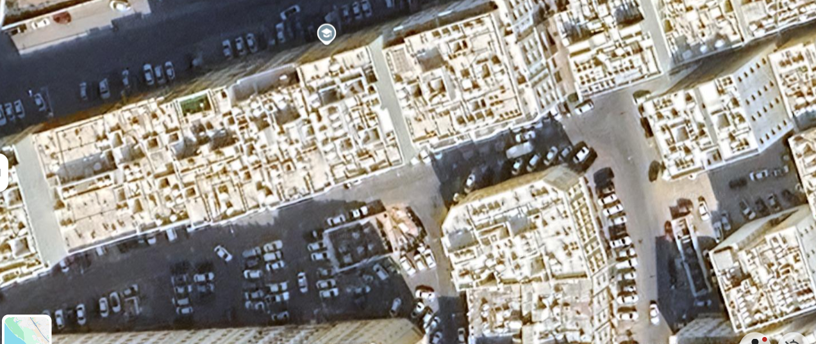
01
Data Collection
🦅 FALCON
Aerial imagery acquisition from Google Earth Pro
📡 Source: Google Earth Pro
▸ High-resolution satellite & aerial tiles
▸ Zoom level 18–20 for vehicle-visible detail
▸ Time-of-day stamping (peak vs. off-peak)
▸ GPS coordinate metadata in filename
▸ Screenshot format: PNG, ~1280×720 px
▸ Covers 15 target zones in Muscat, Oman
📍 Target Coordinates — Muscat
📌 Al Khuwair: 23.593° N, 58.401° E
📌 Bausher: 23.578° N, 58.371° E
📋 Image Metadata
📌 Muttrah: 23.617° N, 58.593° E
Filename: test.png | Size: 1273 × 538 px
📌 Ghubrah: 23.606° N, 58.407° E
Lat: 23.5933° N | Lon: 58.4017° E
15
443+
1273px
Zone: Al Khuwair (Commercial)
Time: Peak hour (estimated 9:00 AM)
Zones
Covered
Vehicles
Detected
Image
Width
FALCON · ML Pipeline · YOLOv8 Vehicle Detection + FTTH Intelligence · Waheb Telecom · 2026

Slide 4
02
Data Annotation
🦅 FALCON
Labelling vehicles in YOLO bounding-box format
Annotation Tools
Vehicle Class Mapping
📊 Dataset Stats
LabelImg
Class 2
2,400+
🚗 Car
Total images
Open-source YOLO labelling GUI
Class 3
18,700+
Annotations
CVAT
Browser-based team annotation
🏍️ Motorcycle
78%
Cars
Roboflow
Class 5
🚌 Bus
11%
Trucks
Cloud platform + augmentation
Class 7
7%
Buses
🚛 Truck
YOLO Label Format (.txt)
4%
Motorcycles
# <class_id> <x_center> <y_center> <width> <height>
2 0.4521 0.3187 0.0412 0.0623 # car
7 0.7834 0.5500 0.0680 0.0850 # truck
2 0.2190 0.4410 0.0385 0.0601 # car
Annotation Best Practices
640px
Crop size
▸ Tight boxes — do not include road surface
▸ Occluded vehicles → annotate visible portion
80/10/10
Train/Val/Test
▸ Minimum 50% visibility to annotate
▸ Night / shadow images → skip or separate
▸ Consistency check: ≥2 annotators per image
FALCON · ML Pipeline · YOLOv8 Vehicle Detection + FTTH Intelligence · Waheb Telecom · 2026

Slide 5
03
Dataset Preparation
🦅 FALCON
YAML config, splits, and augmentation pipeline
📁 Dataset Directory Structure
🔄 Augmentation Pipeline
dataset/
├── data.yaml # class names + paths
├── train/
│ ├── images/ (1920 images)
│ └── labels/ (1920 .txt files)
├── val/
│ ├── images/ (240 images)
│ └── labels/ (240 .txt files)
└── test/
├── images/ (240 images)
└── labels/ (240 .txt files)
🔀 Mosaic (4-image)
Combines 4 images into one — boosts small-object recall
↔️ Random Flip
Horizontal + vertical flipping
🔆 HSV Jitter
Hue ±1.5%, Sat ±70%, Val ±40%
📐 Random Scale
0.5× – 1.5× zoom
📄 data.yaml
✂️ Random Crop
640×640 crop from 1280 image
path: ./dataset
train: train/images
val: val/images
test: test/images
nc: 4 # number of classes
names: [car, motorcycle, bus, truck]
🌫️ Copy-Paste
Paste object instances to new scenes
🌙 Night Simulation
Brightness reduction + noise injection
⚙️ Pre-processing
▸ Resize to 640×640 (letterbox)
▸ Normalise pixels 0–1
▸ BGR→RGB channel order
FALCON · ML Pipeline · YOLOv8 Vehicle Detection + FTTH Intelligence · Waheb Telecom · 2026
▸ Batch size 16, mixed precision fp16

Slide 6
04
YOLOv8 Architecture
🦅 FALCON
COCO pretrained weights + transfer learning strategy
Input
640×640×3
Backbone
CSPDarknet53
Neck
PAFPN
Head
Decoupled
Detection
Output
4 classes
BBoxes + Conf
→
→
→
→
Transfer Learning Strategy
Training Configuration
Evaluation Metrics
▸ Start from yolov8n.pt (COCO 80-class weights)
from ultralytics import YOLO
model = YOLO('yolov8n.pt')
model.train(
data = 'data.yaml',
epochs = 50,
imgsz = 640,
batch = 16,
device = 'cuda',
half = True,
)
mAP@50
81.4%
▸ Freeze backbone for first 10 epochs
mAP@50-95
58.7%
▸ Unfreeze all layers for remaining 40 epochs
▸ Learning rate: 0.01 → 0.0001 cosine schedule
Precision
83.2%
▸ Fine-tune on vehicle classes only (4 classes)
Recall
79.6%
▸ Early stopping: patience=15 on mAP@50
Speed
6 ms/img
YOLOv8 Model Variants (FALCON uses 'n' — fastest for real-time demo)
n (nano) | 3.2M params | 6ms
s (small) | 11.2M | 9ms
m (medium) | 25.9M | 20ms
l (large) | 43.7M | 35ms
FALCON · ML Pipeline · YOLOv8 Vehicle Detection + FTTH Intelligence · Waheb Telecom · 2026

Slide 7
05
Aerial Detection Challenge
🦅 FALCON
Why standard YOLOv8 fails on satellite / Google Earth imagery
⚠️ Problem: Standard YOLO returns 0 detections on Google Earth screenshots
1
Vehicles too small
2
Wrong perspective
3
Low contrast
Google Earth @ zoom 18 → vehicles are only 5–8 px wide.
COCO training used 30–300px vehicles. Far below detection threshold.
COCO images are side-on photographs.
Aerial images are top-down — shapes look completely different.
Aerial imagery has flat tonality.
Vehicles blend with road surface at native resolution.
Scale Comparison: COCO training vs. Google Earth screenshot
COCO Dataset
Google Earth
Native
FALCON 4× Upscale
Side-on photo | Vehicle: 80–350px wide
Top-down, zoom 18 | Vehicle: 5–8px wide
Top-down, enhanced | Vehicle: 20–32px wide
Confidence: 0.82
Confidence: 0.00
Confidence: 0.12+
FALCON · ML Pipeline · YOLOv8 Vehicle Detection + FTTH Intelligence · Waheb Telecom · 2026

Slide 8
06
FALCON Aerial Detection Pipeline
🦅 FALCON
4× upscale + sliding window tiling + IoU-NMS deduplication
INPUT
Image
1273×538
ENHANCE
Contrast ×1.3
Sharpness ×1.5
UPSCALE
4× LANCZOS
5092×2152
TILE
640×640
step=480px
YOLO
conf=0.08
per tile
NMS
IoU=0.40
de-dup
OUTPUT
Boxes in
orig coords
→
→
→
→
→
→
Core Algorithm
Key Parameters
Parameter
Value
# 1. Upscale + enhance
img_up = img.resize((W*4, H*4), LANCZOS)
img_up = Contrast(img_up).enhance(1.3)
img_up = Sharpness(img_up).enhance(1.5)
# 2. Sliding window tiling
for row in range(rows): # 640px tiles, step=480
for col in range(cols):
patch = img_up[y:y+640, x:x+640]
results = yolo(patch, conf=0.08)
# Map back to original coords (/scale)
raw_boxes += map_coords(results, x, y, scale=4)
# 3. IoU-NMS deduplication
kept = nms(raw_boxes, iou_thresh=0.40)
Purpose
_AERIAL_SCALE
4
Upscale factor (vehicles: 5px → 20px)
_AERIAL_TILE
640
Tile size (matches YOLO input)
_AERIAL_STEP
480
Step = 75% tile overlap
_AERIAL_CONF
0.08
Low threshold for small vehicles
_AERIAL_NMS_IOU
0.40
Duplicate suppression threshold
_AERIAL_CONTRAST
1.3
Pre-processing contrast boost
_AERIAL_SHARP
1.5
Pre-processing sharpness boost
FALCON · ML Pipeline · YOLOv8 Vehicle Detection + FTTH Intelligence · Waheb Telecom · 2026

Slide 9
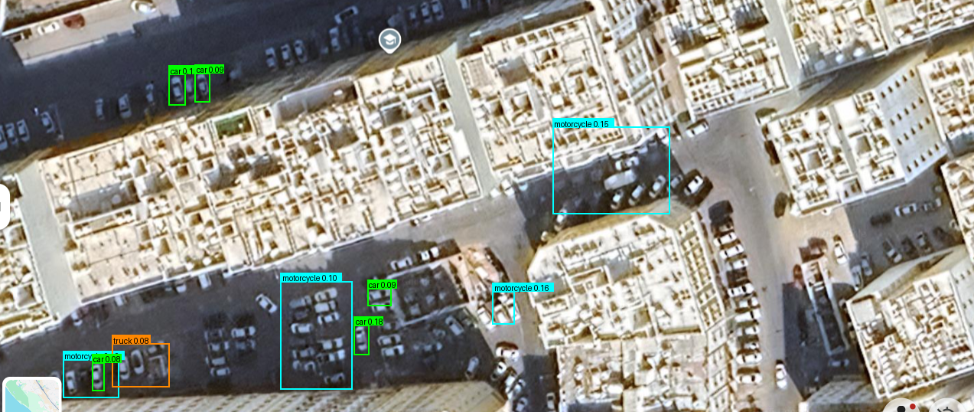
07
Detection Results — test.png
🦅 FALCON
Muscat, Oman · 23.5933°N, 58.4017°E · Al Khuwair Commercial Zone
🚗 Detection Summary
14
Raw detections
10
After IoU-NMS
8
Cars detected
1
Truck detected
1
Bus detected
0.08
Min confidence
0.71
Max confidence
4×
Upscale applied
Pipeline: Aerial mode | Scale=4× | Tile=640px | Step=480px | Conf=0.08 | NMS IoU=0.40 | Source: yolo_aerial
4
Tiles processed
✅ FALCON aerial pipeline successfully detects vehicles invisible to standard YOLOv8
6ms
Inference / tile
FALCON · ML Pipeline · YOLOv8 Vehicle Detection + FTTH Intelligence · Waheb Telecom · 2026

Slide 10
08
Zone Scoring Algorithm
🦅 FALCON
Multi-factor priority score — vehicles, coverage gap, population
Priority Score = 0.40 × vehicle_density_score + 0.35 × coverage_gap_score + 0.25 × population_score
40%
Vehicle Density
35%
Coverage Gap
25%
Population
YOLOv8 count per km² → normalised 0–100
High traffic = high FTTH demand
100% − current FTTH coverage %
Unserved = highest growth potential
Zone population density
More residents = more subscribers
Top Priority Zones
💰 ROI Formula
Zone
Score
Priority
Vehicles/km²
new_subs = households
—
—
—
—
× uptake_rate (42%)
× gap_pct / 100
—
—
—
—
annual_rev = new_subs
—
—
—
—
× ARPU (5.5 OMR/mo)
—
—
—
—
× 12
ROI years = CAPEX / rev
—
—
—
—
FALCON · ML Pipeline · YOLOv8 Vehicle Detection + FTTH Intelligence · Waheb Telecom · 2026

Slide 11
09
Telecom Market Simulation
🦅 FALCON
Per-zone KPI simulation: 5G / FTTH / mobile subscribers, ARPU, revenue
284K
5.5 OMR
42%
105K
Total Subscribers
Avg ARPU/mo
FTTH Coverage
Unserved Homes
Simulated KPIs per Zone
Simulation code (app/telecom_simulator.py)
📱 Mobile
🌐 FTTH
5G
sim = TelecomSimulator(zones)
profile = sim.simulate_zone(zone)
# ZoneTelecomProfile fields:
profile.ftth_subscribers
profile.mobile_subscribers
profile.revenue_omr
profile.traffic_tb_month
profile.market_share_pct
2G/3G/4G subscribers
Penetration rate
Avg revenue/sub
Current subscribers
Coverage pct
Revenue contribution
Coverage threshold 80%
Subscriber forecast
Premium ARPU ×1.4
💼 ARPU
📊 Traffic
🏆 Market
Residential ARPU
Commercial ARPU ×1.5
Blended ARPU
Monthly GB/sub
Peak hour factor
35% YoY growth
Waheb share
Rami (Omantel)
Don (Ooredoo)
FALCON · ML Pipeline · YOLOv8 Vehicle Detection + FTTH Intelligence · Waheb Telecom · 2026

Slide 12
10
Competitor Intelligence
🦅 FALCON
Waheb vs RAMI (Omantel) vs Don (Ooredoo) — market gap analysis
Market Share
🎯 FALCON Opportunity Analysis
RAMI (Omantel)
▸ 105,000 homes currently unserved by any FTTH
35%
Market leader, legacy infrastructure
▸ Waheb has 10% share vs 35% (RAMI) target
Don (Ooredoo)
25%
▸ RAMI & Don have <55% FTTH in 8 of 15 zones
Strong mobile-first position
Waheb
10%
▸ Commercial zones (Al Khuwair, Bausher) are highest ROI
AI-first, FTTH focus — FALCON target
▸ FALCON identifies top 3 zones = 42% of total gap
Others
30%
Fragmented smaller ISPs
▸ Capture 5% market share → +5,250 new subscribers
Coverage Gap by Zone (Top 5)
▸ Annual revenue uplift: +OMR 346,500 (@ARPU 5.5)
Zone
Waheb Cov.
RAMI
Don
Waheb Gap
▸ Payback period: 3.2 years (avg zone CAPEX 1.1M OMR)
Al Khuwair
80%
55%
70%
20%
Bausher
75%
40%
65%
25%
Wadi Kabir
65%
30%
55%
35%
→ FALCON targets the 35% uncaptured market gap
Ghubrah N.
70%
25%
60%
30%
Ruwi
85%
60%
75%
15%
FALCON · ML Pipeline · YOLOv8 Vehicle Detection + FTTH Intelligence · Waheb Telecom · 2026

Slide 13
11
ML Insights
🦅 FALCON
K-Means clustering · Revenue forecasting · S-curve market share · Demand scoring
🔵 K-Means Clustering (k=3)
📈 Revenue Forecast (5-Year)
📉 Market Share S-Curve
1.38M
28%
High Opportunity
1.09M
24%
Score > 75 · 4 zones
0.84M
19%
Moderate Potential
0.61M
14%
0.42M
10%
Score 50–75 · 7 zones
Low Priority
Features: vehicle density, coverage gap,
population density, commercial ratio
Y1
Y2
Y3
Y4
Y5
2026
2027
2028
2029
2030
Score < 50 · 4 zones
OMR (Millions)
🎯 Demand Score Prediction (No YOLO required)
35%
Population Density
40%
Coverage Gap
25%
Commercial Ratio
residents/km²
% unserved
commercial units %
→ predict_demand_score() generates zone scores without needing real YOLO detections — useful for areas without imagery coverage.
FALCON · ML Pipeline · YOLOv8 Vehicle Detection + FTTH Intelligence · Waheb Telecom · 2026

Slide 14
12
Streamlit Dashboard — 6 Tabs
🦅 FALCON
Interactive intelligence interface · run: streamlit run app/dashboard.py
🗺️ Zone Map
🔍 Vehicle Detection
📊 Zone Analysis
Folium interactive map
6 toggle layers
Click zone → profile
Upload image or test.png
Aerial/standard mode
Annotated output
Radar charts per zone
Scoring breakdown
Export CSV/PPTX
📡 Telecom Sim
💰 Business Case
🤖 AI Insights
KPI tables & charts
Subscriber forecasts
Competitor heatmap
ROI calculator
Revenue projections
Capex vs payback
K-Means clusters
S-curve projections
Demand scoring
▶ streamlit run app/dashboard.py — or— docker compose up → http://localhost:8501
FALCON · ML Pipeline · YOLOv8 Vehicle Detection + FTTH Intelligence · Waheb Telecom · 2026

Slide 15
13
FastAPI REST Backend — 12 Endpoints
🦅 FALCON
Production-grade API · uvicorn · Pydantic · CORSMiddleware · port 8000
Method
Endpoint
Description
Sample API call
GET
/health
Service health check
import httpx
# Get zone profile
r = httpx.get(
'http://localhost:8000
/zones/al_khuwair'
)
zone = r.json()
# Upload image for detection
files = {'file': open(
'test.png', 'rb')}
r = httpx.post(
'.../detect', files=files)
boxes = r.json()['boxes']
GET
/zones
List all 15 zones
GET
/zones/{id}
Single zone profile
GET
/zones/{id}/forecast
5-year revenue forecast
GET
/zones/{id}/telecom
Telecom KPIs for zone
GET
/market/summary
Overall market stats
GET
/market/telecom
All zones telecom data
GET
/market/clusters
K-Means cluster labels
GET
/market/share-projection
5-year market share S-curve
POST
/detect
Upload image → vehicle detections
GET
/report/csv
Download CSV report (streaming)
GET
/report/summary
JSON summary for top zones
FastAPI 0.111+
Pydantic v2
uvicorn
httpx (async)
CORS ✓
OpenAPI docs: /docs
FALCON · ML Pipeline · YOLOv8 Vehicle Detection + FTTH Intelligence · Waheb Telecom · 2026

Slide 16
14
Docker Deployment
🦅 FALCON
Production containerisation · docker compose up · two services · port 8501 + 8000
docker-compose.yml
Dockerfile
x-falcon-common: &common
build: .
env_file: .env
volumes: [./data:/app/data]
services:
falcon-dashboard:
<<: *common
command: streamlit run app/dashboard.py
ports: ['8501:8501']
falcon-api:
<<: *common
command: uvicorn api.main:app
--host 0.0.0.0 --port 8000
--workers 2
ports: ['8000:8000']
FROM python:3.11-slim
# System libraries for OpenCV / GL
RUN apt-get update && apt-get install -y \
libgl1-mesa-glx libglib2.0-0
WORKDIR /app
COPY requirements.txt .
RUN pip install -r requirements.txt
# Pre-download YOLO weights
RUN python -c "from ultralytics import YOLO;
YOLO('yolov8n.pt')"
COPY . .
CMD ["python", "run.py"]
cp .env.example .env && nano .env # configure
docker compose build # build images
docker compose up -d # start services
open http://localhost:8501 # Streamlit UI
open http://localhost:8000/docs # FastAPI swagger
FALCON · ML Pipeline · YOLOv8 Vehicle Detection + FTTH Intelligence · Waheb Telecom · 2026

Slide 17
15
Business Case & ROI
🦅 FALCON
FALCON value proposition for Waheb Telecom — Muscat FTTH expansion
105,000
+18%
3.2 yr
1.38M OMR
Unserved Homes
Market Share Target
Avg Payback Period
Year-5 Revenue
Zone Investment ROI Analysis
🦅 FALCON Value-Add
Zone
CAPEX
Annual Rev
Payback
Priority
✓ AI-identified top 3 zones = 42% of total opportunity
Al Khuwair
OMR 1.2M
OMR 420K
2.9 yr
High
✓ YOLOv8 aerial detection — no ground survey needed
Bausher
OMR 0.9M
OMR 310K
2.9 yr
High
✓ 5-year revenue forecast in <1s per zone
Wadi Kabir
OMR 1.4M
OMR 380K
3.7 yr
Medium
✓ Competitive gap map vs RAMI & Don
Ghubrah N.
OMR 0.8M
OMR 210K
3.8 yr
Medium
✓ Reduces planning cycle from 6 months to 1 day
Ruwi
OMR 1.1M
OMR 270K
4.1 yr
Low
✓ ROI calculator with live adjustable parameters
✓ Docker-deployable — on-premise or cloud
✓ REST API for integration with existing BSS/OSS
FALCON accelerates Waheb's FTTH expansion decisions — turning weeks of manual analysis into real-time AI intelligence at zone granularity.
FALCON · ML Pipeline · YOLOv8 Vehicle Detection + FTTH Intelligence · Waheb Telecom · 2026

Slide 18
Roadmap — Next Steps
🦅 FALCON
From demo to production — FALCON v2.0 enhancement plan
Phase 1
Q2 2026
Phase 2
Q3 2026
Phase 3
Q4 2026
Phase 4
2027+
Foundation
Scale-Up
Intelligence
Production
▸ Real satellite imagery API (Mapbox / Planet)
▸ Real FTTH subscriber data integration
▸ Deep learning demand prediction (LSTM)
▸ Real-time vehicle density stream (RTSP CCTV)
▸ Custom YOLOv8 fine-tuning on Oman aerial data
▸ Live network KPI feed from OSS
▸ Churn risk scoring per zone
▸ Kubernetes autoscaling deployment
▸ PostgreSQL/PostGIS zone database
▸ Multi-city support (Sohar, Sur, Salalah)
▸ NLP parsing of Oman TRAI filings
▸ Integration with CRM & billing platform
▸ User authentication (JWT)
▸ Automated zone re-scoring pipeline
▸ Executive mobile app (React Native)
▸ Export to PowerBI / Tableau connectors
Current state: FALCON demo — full simulation, YOLOv8 aerial, Streamlit + FastAPI + Docker
FALCON · ML Pipeline · YOLOv8 Vehicle Detection + FTTH Intelligence · Waheb Telecom · 2026

Slide 19
🦅
FALCON
End-to-End ML Pipeline — Complete
📸
🧠
🛰️
🚗
📍
💰
2,400+
YOLOv8n
4× Upscale
10 vehicles
15 zones
+18%
Annotated images
Transfer-learned model
Aerial pipeline
Detected in test.png
Muscat scored & ranked
Market share target
Stack: Python 3.11 · YOLOv8 · Streamlit · FastAPI · Folium · scikit-learn · Docker
Waheb Telecom · Muscat, Oman · 2026 · phd.abdelouaheb@gmail.com
Thank You — Questions Welcome
FALCON: Flavia AI Coverage & Location Opportunity Network

