Slide 1
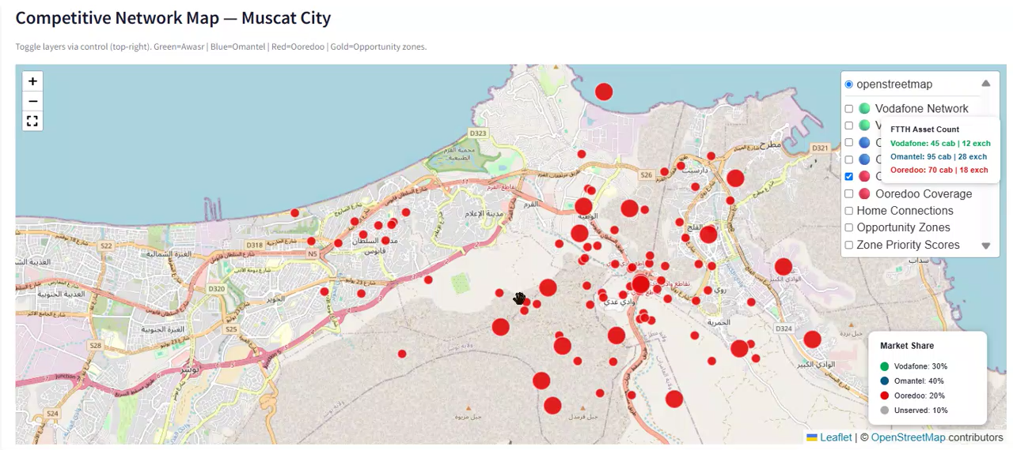
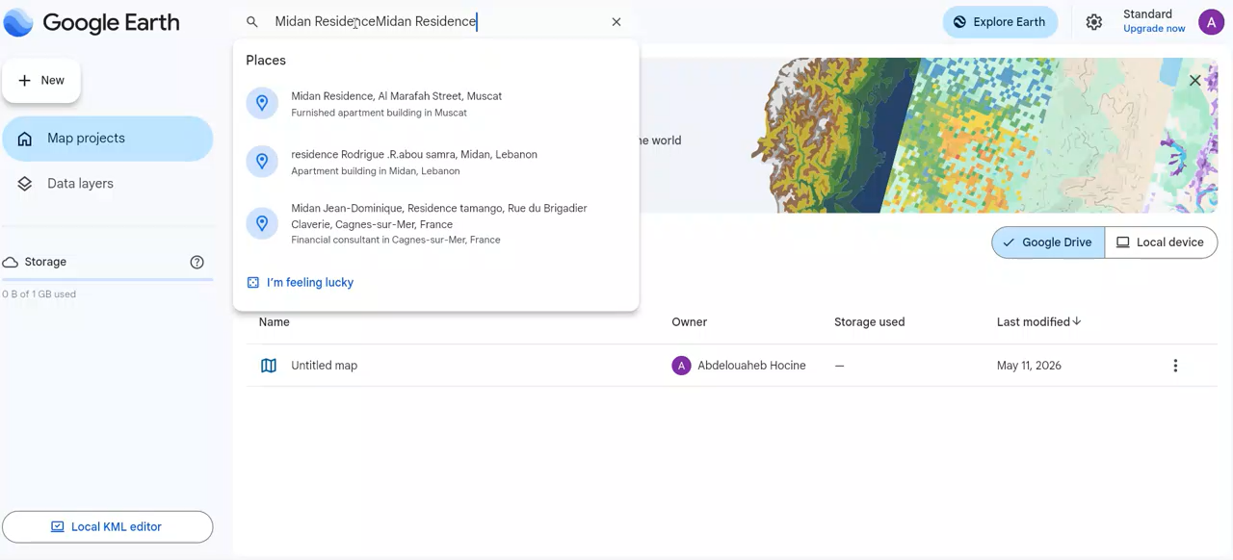
Step 2,3 & 4 : Data Collection & Area Discovery
DATA SIGNALS
RANKED HOTSPOTS
AI OPPORTUNITY ENGINE
Existing FTTH Network
Zone A – Al Marafah
FTTH Opportunity Index
Opportunity Score
94
/ 100
Coverage, capacity & Ooredoo fiber footprint
#1
Households: 4,200
Customer Data
Population: 11,800
1
Demand Signal
Area size: 5.4 km²
Subscribers, churn & service adoption patterns
Household density + growth trends
Zone B – East Suburbs
GIS & Demographics
FTTH Gap Score
Opportunity Score
87
/ 100
2
#2
Population density, income & geographic layers
Uncovered areas + low-penetration zones
Households: 3,100
Population: 8,400
Competition Index
Area size: 9.8 km²
Satellite Imagery
3
High-resolution building imagery & land use analysis
Competitor coverage & market share
Zone C – Industrial West
Opportunity Score
71
/ 100
Competitor Coverage
4
Infrastructure Score
#3
Households: 1,900
Omantel, Awasr and other operators’ footprints
Fiber deployment readiness in area
Population: 5,200
Area size: 7.1 km²
Infrastructure
User selects hotspot
Heat-mapped output ranks all areas
Demo 1
for deep-dive AI analysis
Roads, utilities, developments & construction activity
Low Opportunity Medium High Opportunity
4

