Slide 1
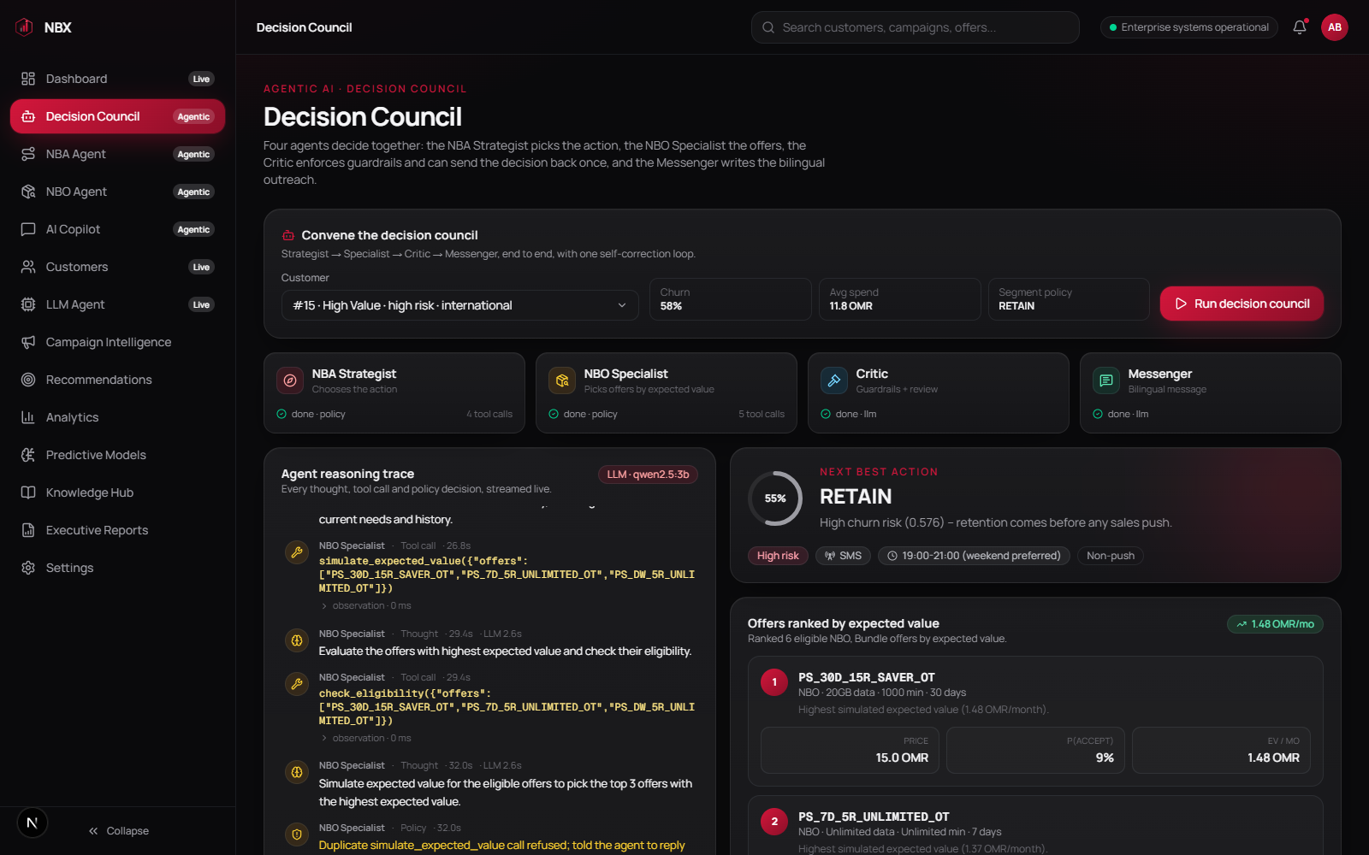
Agentic Next Best Action & Next Best Offer
AGENTIC AI · OOREDOO OMAN
A council of AI agents that investigates each customer with real tools, checks itself against business guardrails, and writes the outreach in Arabic and English.
Live run in the Ooredoo UI: four agents decide for customer #15, every step streamed.
4
10
35
cooperating agents
tools over live data
automated tests
Notes:
We replaced the fixed NBO and NBA pipelines with a decision council of four agents. Each agent chooses which evidence to gather through tools, the critic enforces business guardrails, and the messenger writes a bilingual message. Everything shown in this deck runs today on a laptop GPU with a local 3B model; the same code moves to the company GPU server with vLLM by changing one setting.

Slide 2
From a fixed pipeline to a decision council
WHY AGENTIC
Before: fixed pipeline
Now: agentic council
Same four steps for every customer, whatever the case
LLM re-ranks offers retrieved by text similarity
One blended score; nobody reviews the decision
Business rules only reorder the final list
No trace of why an offer was chosen
Agents decide which evidence to gather, and when they have enough
Offers chosen on expected value: P(accept) × revenue + retention value
A critic enforces hard guardrails and can send the decision back once
Compliant bilingual SMS and call script, checked in code
Every thought and tool call streamed live and auditable
The bandit, collaborative filtering and cohort graph are still here, now as tools the agents call, not as fixed steps.
Notes:
The old pipelines ran the same steps for everyone and the LLM only re-ranked a list. In the council, the specialists pick their own tools, offers are compared on simulated expected value, and a critic reviews the joint decision. Hard guardrails such as never pushing a sale to a high churn-risk customer are enforced by code, not by the prompt, so they cannot be talked around.

Slide 3
How the platform fits together
ARCHITECTURE
Ooredoo UI
FastAPI
Decision council
LLM server
Next.js
Dashboard
Customer 360
Decision Council
NBA / NBO agents
AI Copilot
SSE + REST
/agentic/stream
/agentic/decide
/copilot/chat
/portfolio/summary
/customers
events
ReAct loop, policy enforced in code:
required evidence
schema validation
loop guard
1 critic revision
deterministic fallback
OpenAI API
Laptop:
llama.cpp +
Qwen2.5-3B
GPU server:
vLLM + 7B
1 NBA Strategist
2 NBO Specialist
3 Critic
4 Messenger
TOOLS (facts only, no LLM)
Risk scores
Usage trends
VW contextual bandit
Contact policy
Cohort graph
BPR collab. filtering
Eligibility rules
EV simulator
DATA subscribers · churn / appetency / fragility propensities · weekly + monthly revenue · purchase history · offer catalog
Notes:
The UI talks to FastAPI, which streams every agent event to the browser over Server-Sent Events. The council runs a policy-enforced ReAct loop: the model chooses each step, but code checks required evidence, validates answers, stops loops and falls back deterministically if the LLM fails. Tools wrap the models we already had: the Vowpal Wabbit bandit, the cohort graph, BPR collaborative filtering and the production business rules, plus a new expected-value simulator. The LLM sits behind an OpenAI-compatible API: llama.cpp on a laptop today, vLLM on the GPU server in production.

Slide 4
The strategist overruled the bandit, with evidence
ONE REAL DECISION · CUSTOMER #15
1
Bandit prior
The contextual bandit proposes UPSELL with p = 0.83
2
NBA Strategist
Reads churn 58% and a falling revenue trend, then chooses RETAIN
3
NBO Specialist
Checks eligibility, simulates expected value: the 30-day saver pack leads at 1.48 OMR/month
4
Critic
Hard guardrails pass: no sales push to an at-risk customer, eligibility, contact cooldown
5
Messenger
English + Arabic SMS and a call script; currency verified as OMR in code
Bandit said sell. The evidence said keep. The council kept the customer, then still found the offer with the best expected value.
Notes:
This is a real run, not a mock-up. The Vowpal Wabbit bandit wanted to upsell customer 15 with 83% probability. The NBA strategist looked at the churn propensity of 58% and the falling revenue trend and chose RETAIN, explaining why. The NBO specialist then ranked eligible retention-friendly packs by simulated expected value. The expected-value model is a documented heuristic today; replacing it with an uptake model trained on campaign history is a next step.

Slide 5
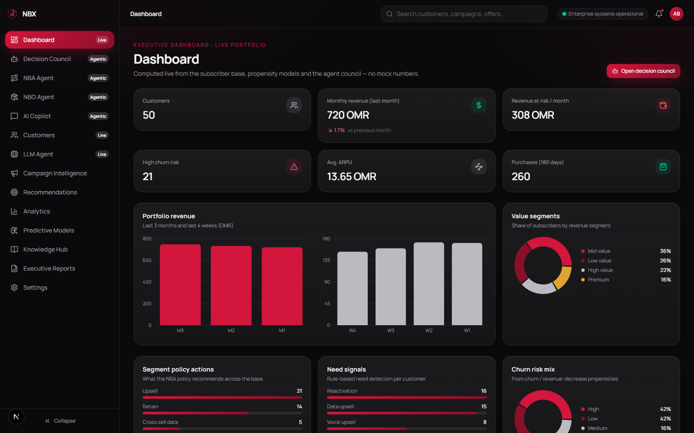
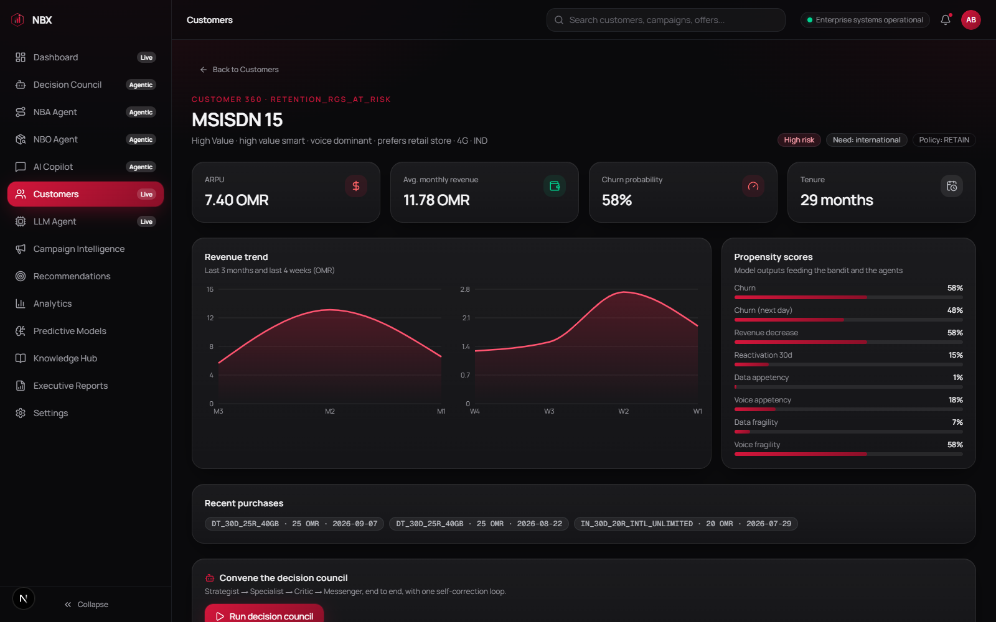
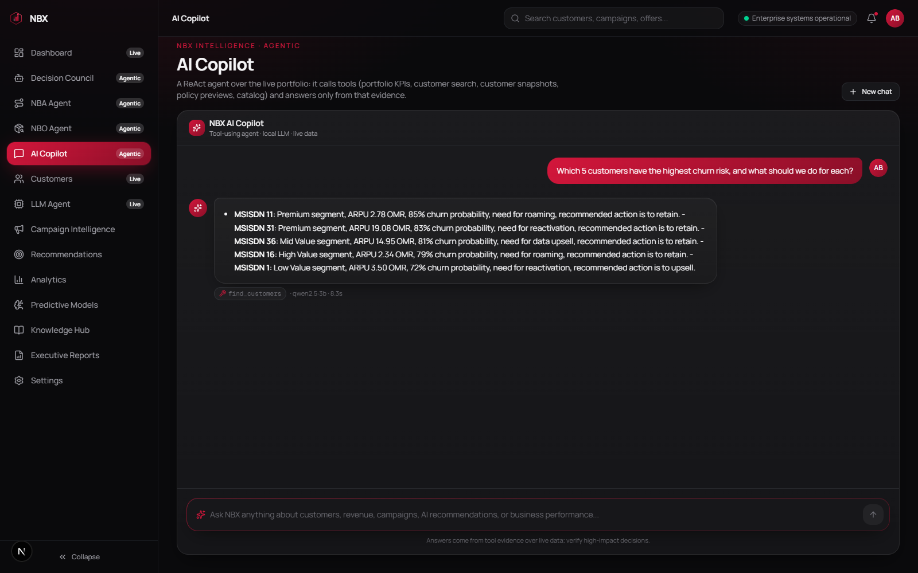
Live on real data, not mock-ups
THE OOREDOO EXPERIENCE
Executive dashboard
Customer 360
AI Copilot
Revenue, revenue at risk, segment and action mix, computed live.
Propensity scores and revenue trend; run the council for this customer.
A tool-using agent; answers quote tool evidence, units preformatted.
Also live: Decision Council, NBA Agent and NBO Agent pages stream each agent's reasoning as it happens. Deep links such as /ooredoo/council?msisdn=15&run=1 start a run for a customer.
Notes:
The Ooredoo edition is now the main app. Dashboard, Customers, Customer 360 and the Copilot were mock pages; they now read the live portfolio from the backend. The NBA and NBO pages run the agents and show their reasoning as it happens. The Copilot answers from tool calls only; tool outputs carry preformatted units because small models tend to mis-convert percentages and currencies.

Slide 6
Working today; one switch to production
RESULTS · NEXT STEPS
~30 s
0
Next steps
1
Deploy on the company GPU with vLLM and a 7B model (GPU_SETUP.md)
full council per customer: Qwen2.5-3B on a 4 GB laptop GPU
hard-guardrail violations shipped: enforced in code, tested on 20 customers
2
Train an uptake model on campaign history to replace the heuristic EV simulator
35
1
3
Feed real contact-history and consent data into the contact policy
automated tests, including policy, loop guard and fallback
setting, LLM_BACKEND=vllm, moves the LLM to the GPU server
4
Pilot: A/B test the council against current NBA on one segment; measure take-rate and churn
Caveat: the 3B laptop model often needs the controller's loop guard to finish; a 7B model on the GPU server should finish on its own more often.
Notes:
Numbers are measured on this laptop: about 30 seconds for the full council with a 3B model on a 4 GB GPU. Hard guardrails are enforced by code and covered by tests, so a violating decision cannot ship even if the model or the LLM critic gets it wrong. Moving to production is a configuration change: point LLM_BACKEND at vLLM on the GPU server. The real business proof is the pilot: an A/B test against the current NBA on one segment.

