Slide 1
assignment week 10
waheeb Algabri and Farhana Akther

Slide 2
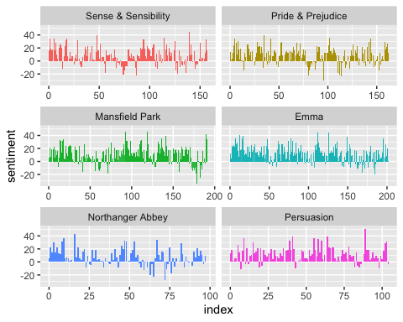
Introduction
Chapter 2 of Text Mining with R focuses on Sentiment Analysis. Our task for this assignment is to first obtain the main example code from the chapter and ensure it works in an R Markdown document, with a citation to the original code. Then, we are required to expand the code in two ways:
Using a different corpus of our choice. Adding at least one extra sentiment lexicon, which we can discover through research, potentially from another R package.
Loading required Libraries
## ── Attaching core tidyverse packages ──────────────────────── tidyverse 2.0.0 ── ## ✔ dplyr 1.1.0 ✔ readr 2.1.4 ## ✔ forcats 1.0.0 ✔ stringr 1.5.0 ## ✔ ggplot2 3.4.1 ✔ tibble 3.1.8 ## ✔ lubridate 1.9.2 ✔ tidyr 1.3.0 ## ✔ purrr 1.0.1 ## ── Conflicts ────────────────────────────────────────── tidyverse_conflicts() ── ## ✖ dplyr::filter() masks stats::filter() ## ✖ dplyr::lag() masks stats::lag() ## ℹ Use the ]8;;http://conflicted.r-lib.org/conflicted package]8;; to force all conflicts to become errors ## Loading required package: RColorBrewer ## ## ## Attaching package: 'reshape2' ## ## ## The following object is masked from 'package:tidyr': ## ## smiths
The sentiments datasets
Obtain sentiment lexicons from three different sources: AFINN, Bing, and NRC.
afinn<- get_sentiments("afinn") bing<- get_sentiments("bing") nrc<-get_sentiments("nrc")
Sentiment analysis with inner join
We use the austen_books() function from the janeaustenr package to extract text from Jane Austen’s novels and prepare it for analysis by splitting it into individual words using the unnest_tokens() function.
We filter the NRC sentiment lexicon to include only words with a “joy” sentiment, then use the inner_join() function to merge this lexicon with the tidy text data frame. The resulting data frame is then filtered to include only words from “Emma” and is counted using count() to show the frequency of words with a “joy” sentiment.
## Joining with `by = join_by(word)`
## # A tibble: 301 × 2 ## word n ## <chr> <int> ## 1 good 359 ## 2 friend 166 ## 3 hope 143 ## 4 happy 125 ## 5 love 117 ## 6 deal 92 ## 7 found 92 ## 8 present 89 ## 9 kind 82 ## 10 happiness 76 ## # … with 291 more rows
We join the tidy text data frame with the Bing sentiment lexicon using inner_join(). We then use count() and pivot_wider() functions to count the number of positive and negative words in each book, grouped by sections of 80 lines. Finally, the ggplot() function is used to create a bar chart that shows the sentiment score over the plot trajectory of each novel. The chart is facet-wrapped by book, and the sentiment score is calculated as the difference between the number of positive and negative words.
## Joining with `by = join_by(word)`
## Warning in inner_join(., get_sentiments("bing")): Each row in `x` is expected to match at most 1 row in `y`. ## ℹ Row 435434 of `x` matches multiple rows. ## ℹ If multiple matches are expected, set `multiple = "all"` to silence this ## warning.

Slide 3
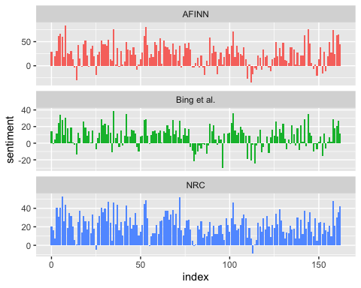
Comparing the three sentiment dictionaries
Filter Data
Calculate Sentiment Scores
## Joining with `by = join_by(word)` ## Joining with `by = join_by(word)` ## Joining with `by = join_by(word)`
## Warning in inner_join(., get_sentiments("nrc") %>% filter(sentiment %in% : Each row in `x` is expected to match at most 1 row in `y`. ## ℹ Row 215 of `x` matches multiple rows. ## ℹ If multiple matches are expected, set `multiple = "all"` to silence this ## warning.
Visualize Sentiment Scores

Slide 4
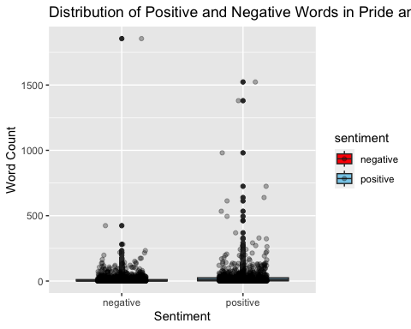
Most common positive and negative words
Counts the frequency of words in a text dataset categorized by sentiment using the Bing lexicon
## Joining with `by = join_by(word)`
## Warning in inner_join(., get_sentiments("bing")): Each row in `x` is expected to match at most 1 row in `y`. ## ℹ Row 435434 of `x` matches multiple rows. ## ℹ If multiple matches are expected, set `multiple = "all"` to silence this ## warning.
Visualizes the top 10 positive and negative words using the Bing lexicon in a bar plot.

Slide 5
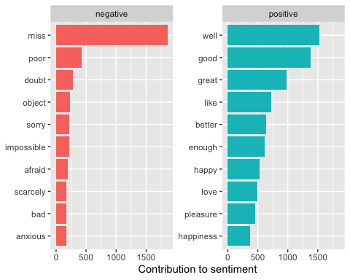

Slide 6
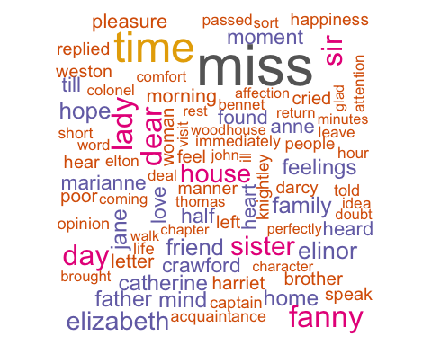
Creates a custom list of stop words that includes the words “well”, ““, and”miss” by binding together a tibble of these words with the standard list of stop words.
Wordclouds
## Joining with `by = join_by(word)`
## Warning in wordcloud(word, n, max.words = 100, color = colors): mother could ## not be fit on page. It will not be plotted.
## Warning in wordcloud(word, n, max.words = 100, color = colors): subject could ## not be fit on page. It will not be plotted.
## Warning in wordcloud(word, n, max.words = 100, color = colors): edmund could ## not be fit on page. It will not be plotted.
## Warning in wordcloud(word, n, max.words = 100, color = colors): happy could not ## be fit on page. It will not be plotted.
## Warning in wordcloud(word, n, max.words = 100, color = colors): party could not ## be fit on page. It will not be plotted.
## Warning in wordcloud(word, n, max.words = 100, color = colors): looked could ## not be fit on page. It will not be plotted.
## Warning in wordcloud(word, n, max.words = 100, color = colors): obliged could ## not be fit on page. It will not be plotted.
## Warning in wordcloud(word, n, max.words = 100, color = colors): answer could ## not be fit on page. It will not be plotted.
## Warning in wordcloud(word, n, max.words = 100, color = colors): emma could not ## be fit on page. It will not be plotted.
## Warning in wordcloud(word, n, max.words = 100, color = colors): eyes could not ## be fit on page. It will not be plotted.
## Warning in wordcloud(word, n, max.words = 100, color = colors): friends could ## not be fit on page. It will not be plotted.
## Warning in wordcloud(word, n, max.words = 100, color = colors): world could not ## be fit on page. It will not be plotted.
## Warning in wordcloud(word, n, max.words = 100, color = colors): suppose could ## not be fit on page. It will not be plotted.
## Warning in wordcloud(word, n, max.words = 100, color = colors): spirits could ## not be fit on page. It will not be plotted.
## Warning in wordcloud(word, n, max.words = 100, color = colors): evening could ## not be fit on page. It will not be plotted.

Slide 7
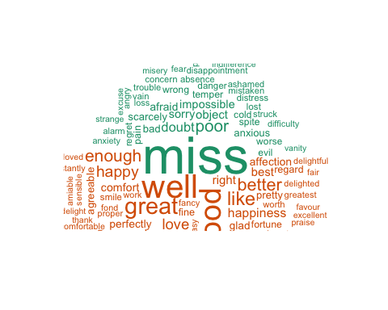
## Joining with `by = join_by(word)`
## Warning in inner_join(., get_sentiments("bing")): Each row in `x` is expected to match at most 1 row in `y`. ## ℹ Row 435434 of `x` matches multiple rows. ## ℹ If multiple matches are expected, set `multiple = "all"` to silence this ## warning.

Slide 8
Looking at units beyond just words
p_and_p_sentences <- tibble(text = prideprejudice) %>% unnest_tokens(sentence, text, token = "sentences") p_and_p_sentences$sentence[2]
## [1] "by jane austen"
austen_chapters <- austen_books() %>% group_by(book) %>% unnest_tokens(chapter, text, token = "regex", pattern = "Chapter|CHAPTER [\\dIVXLC]") %>% ungroup() austen_chapters %>% group_by(book) %>% summarise(chapters = n())
## # A tibble: 6 × 2 ## book chapters ## <fct> <int> ## 1 Sense & Sensibility 51 ## 2 Pride & Prejudice 62 ## 3 Mansfield Park 49 ## 4 Emma 56 ## 5 Northanger Abbey 32 ## 6 Persuasion 25
bingnegative <- get_sentiments("bing") %>% filter(sentiment == "negative") wordcounts <- tidy_books %>% group_by(book, chapter) %>% summarize(words = n())
## `summarise()` has grouped output by 'book'. You can override using the ## `.groups` argument.
tidy_books %>% semi_join(bingnegative) %>% group_by(book, chapter) %>% summarize(negativewords = n()) %>% left_join(wordcounts, by = c("book", "chapter")) %>% mutate(ratio = negativewords/words) %>% filter(chapter != 0) %>% slice_max(ratio, n = 1) %>% ungroup()
## Joining with `by = join_by(word)` ## `summarise()` has grouped output by 'book'. You can override using the ## `.groups` argument.
## # A tibble: 6 × 5 ## book chapter negativewords words ratio ## <fct> <int> <int> <int> <dbl> ## 1 Sense & Sensibility 43 161 3405 0.0473 ## 2 Pride & Prejudice 34 111 2104 0.0528 ## 3 Mansfield Park 46 173 3685 0.0469 ## 4 Emma 15 151 3340 0.0452 ## 5 Northanger Abbey 21 149 2982 0.0500 ## 6 Persuasion 4 62 1807 0.0343

Slide 9
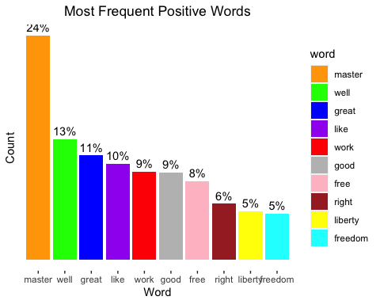
Extension
My Bondage and My Freedom by Frederick Douglass
we will analyze text My Bondage and My Freedom by Frederick Douglass. and we will use the gutenbergr library to search and download it.
The sentiments datasets
bondage_count <- gutenberg_download(202)
## Determining mirror for Project Gutenberg from https://www.gutenberg.org/robot/harvest
## Using mirror http://aleph.gutenberg.org
bondage_count
## # A tibble: 12,324 × 2 ## gutenberg_id text ## <int> <chr> ## 1 202 "MY BONDAGE and MY FREEDOM" ## 2 202 "" ## 3 202 "By Frederick Douglass" ## 4 202 "" ## 5 202 "" ## 6 202 "By a principle essential to Christianity, a PERSON is eternall… ## 7 202 "differenced from a THING; so that the idea of a HUMAN BEING," ## 8 202 "necessarily excludes the idea of PROPERTY IN THAT BEING. —COLE… ## 9 202 "" ## 10 202 "Entered according to Act of Congress in 1855 by Frederick Doug… ## # … with 12,314 more rows
Tidy the data
#removing the first 763 rows of text which are table of contents bondage_count <- bondage_count[c(763:nrow(bondage_count)),] #using unnest_tokens to have each line be broken into indidual rows. bondage <- bondage_count %>% unnest_tokens(word, text) bondage
## # A tibble: 129,096 × 2 ## gutenberg_id word ## <int> <chr> ## 1 202 chapter ## 2 202 i ## 3 202 _childhood_ ## 4 202 place ## 5 202 of ## 6 202 birth ## 7 202 character ## 8 202 of ## 9 202 the ## 10 202 district ## # … with 129,086 more rows
bondage_index <- bondage_count %>% filter(text != "") %>% mutate(linenumber = row_number(), chapter = cumsum(str_detect(text, regex("(?<=Chapter )([\\dII]{1,3})", ignore_case = TRUE)))) bondage_index
## # A tibble: 10,716 × 4 ## gutenberg_id text linen…¹ chapter ## <int> <chr> <int> <int> ## 1 202 CHAPTER I. _Childhood_ 1 1 ## 2 202 PLACE OF BIRTH—CHARACTER OF THE DISTRICT—TUCKAH… 2 1 ## 3 202 NAME—CHOPTANK RIVER—TIME OF BIRTH—GENEALOGICAL … 3 1 ## 4 202 TIME—NAMES OF GRANDPARENTS—THEIR POSITION—GRAND… 4 1 ## 5 202 ESTEEMED—“BORN TO GOOD LUCK”—SWEET POTATOES—SUP… 5 1 ## 6 202 CABIN—ITS CHARMS—SEPARATING CHILDREN—MY AUNTS—T… 6 1 ## 7 202 KNOWLEDGE OF BEING A SLAVE—OLD MASTER—GRIEFS AN… 7 1 ## 8 202 CHILDHOOD—COMPARATIVE HAPPINESS OF THE SLAVE-BO… 8 1 ## 9 202 SLAVEHOLDER. 9 1 ## 10 202 In Talbot county, Eastern Shore, Maryland, near… 10 1 ## # … with 10,706 more rows, and abbreviated variable name ¹​linenumber
Most frequent postive words
## Joining with `by = join_by(word)`
## Warning in inner_join(., get_sentiments("bing")): Each row in `x` is expected to match at most 1 row in `y`. ## ℹ Row 5334 of `x` matches multiple rows. ## ℹ If multiple matches are expected, set `multiple = "all"` to silence this ## warning.
## Selecting by n

Slide 10
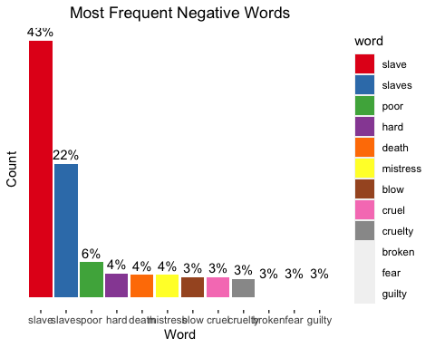
Most frequent negative words
## Joining with `by = join_by(word)`
## Warning in inner_join(., get_sentiments("bing")): Each row in `x` is expected to match at most 1 row in `y`. ## ℹ Row 5334 of `x` matches multiple rows. ## ℹ If multiple matches are expected, set `multiple = "all"` to silence this ## warning.
## Selecting by n
## Warning in RColorBrewer::brewer.pal(n, pal): n too large, allowed maximum for palette Set1 is 9 ## Returning the palette you asked for with that many colors

Slide 11
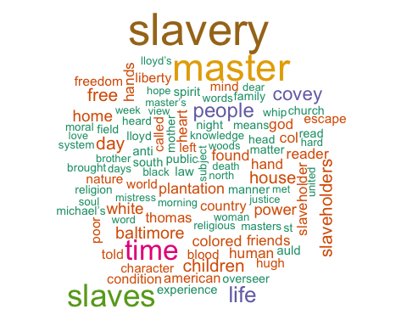
Wordclouds
## Joining with `by = join_by(word)`
## Warning in wordcloud(word, n, max.words = 100, color = colors): slave could not ## be fit on page. It will not be plotted.

Slide 12
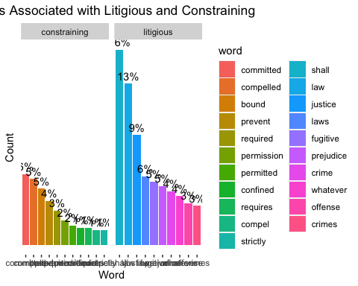
Loughran Lexicon
Here , we will use loughran lexicon instead of one of the lexicons used in the sample code.
## [1] "negative" "positive" "uncertainty" "litigious" "constraining" ## [6] "superfluous"
## Joining with `by = join_by(word)`
## Warning in inner_join(., get_sentiments("loughran")): Each row in `x` is expected to match at most 1 row in `y`. ## ℹ Row 881 of `x` matches multiple rows. ## ℹ If multiple matches are expected, set `multiple = "all"` to silence this ## warning.
## Selecting by n

Slide 13
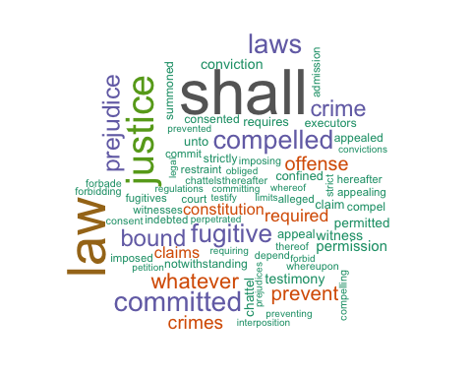
Wordclouds
## Joining with `by = join_by(word)`
## Warning in inner_join(., get_sentiments("loughran")): Each row in `x` is expected to match at most 1 row in `y`. ## ℹ Row 881 of `x` matches multiple rows. ## ℹ If multiple matches are expected, set `multiple = "all"` to silence this ## warning.

Slide 14
Conclusion
In conclusion, this assignment has allowed us to explore the topic of sentiment analysis. We have successfully implemented and expanded upon the main example code from chapter 2 of the Text Mining with R book. We have used three different sentiment lexicons - AFINN, Bing, and NRC.to analyze the sentiment of Jane Austen’s novels. We have also visualized the sentiment scores over the plot trajectory of each novel and compared the sentiment scores obtained from the different sentiment lexicons. Furthermore, we have identified the most common positive and negative words in the novels using the Bing lexicon. Then we extended using My Bondage and My Freedom” by Frederick Douglass using the gutenbergr library

