Slide 1
Multilingual author profiling on Facebook
Mehwish Fatima, Komal Hasan, Saba Anwar, Rao Muhammad Adeel Nawab
Journal: Information Processing and Management, Elsevier

Slide 2
Outline
Introduction
Related Work
Corpus Generation Process
Experimental Setup
Results and Analysis
Future Work

Slide 3

Introduction
Author Profiling
To identify an author’s traits by analyzing his written text.
Traits:
Age, gender, native language, etc.
New Document
Text Document
Features
Vectors
Feature
Vector
Author Profiling
Machine Learning Algorithm
Predictive Model
Predicted Gender
Gender

Slide 4
Introduction
Multilingualism
Roman Urdu
Congruence of Urdu and English
Urdu written in English alphabets.
Popular for digital communication in Pakistan.
Monolingual text (English)
Wait for me. I am coming.
Multilingual text (Roman Urdu + English)
Mera intazar kro. I am coming.

Slide 5

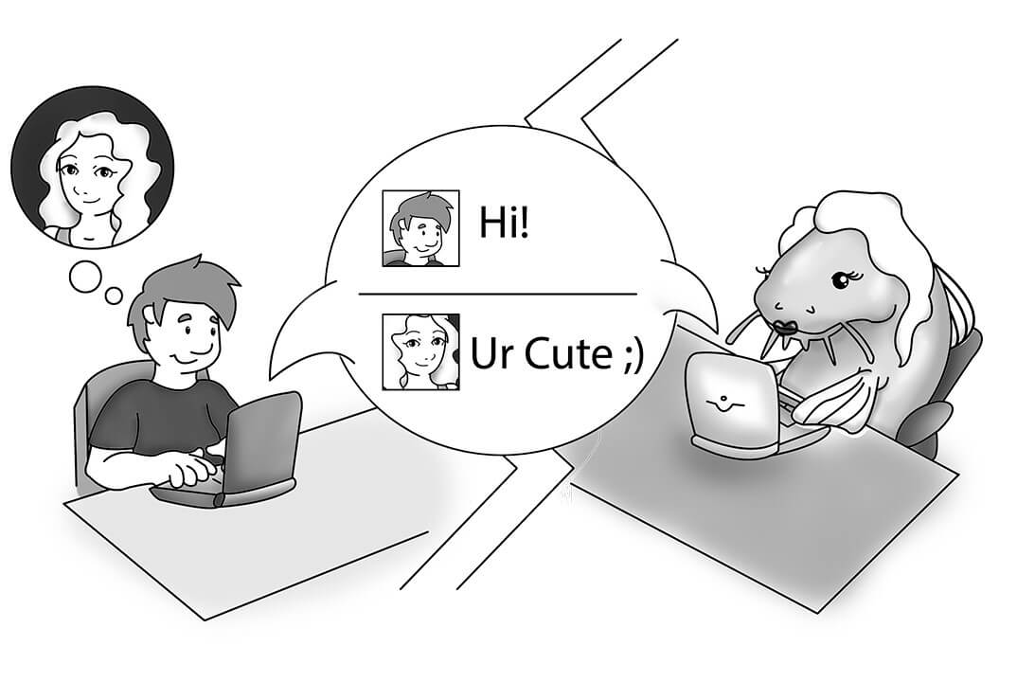
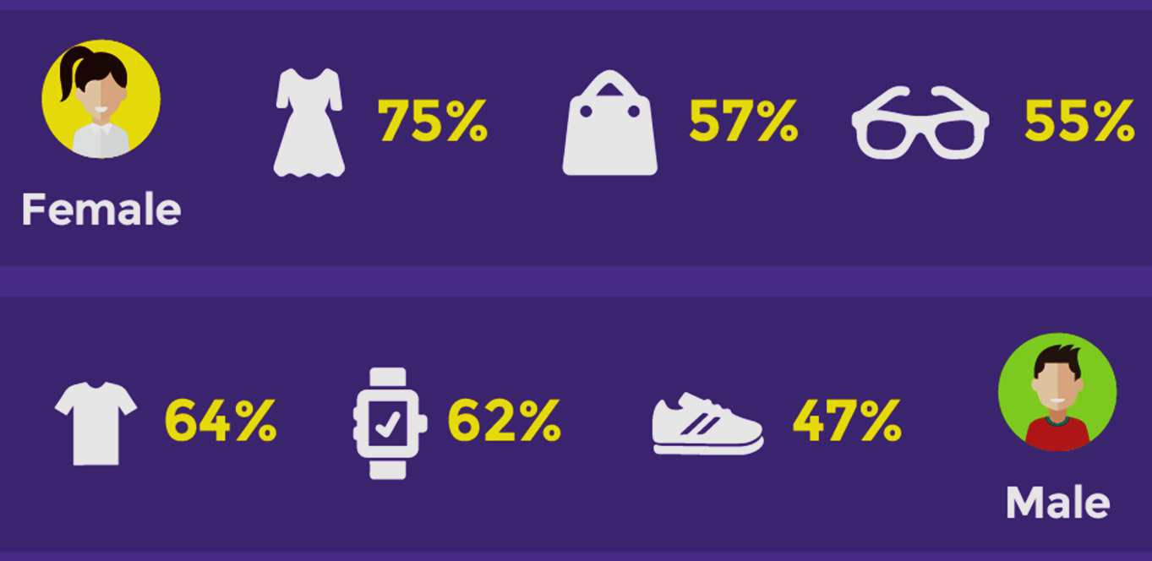
Applications
Forensics linguistics.
Fake profile detection.
Marketing.
Ref: https://www.quickanddirtytips.com/education/grammar/forensic-linguistics
Ref: https://heimdalsecurity.com/blog/fake-facebook-scams/
Ref: https://blog.jakpat.net/lets-online-shopping-female-vs-male-toward-fashion-product/

Slide 6
Related Work
Related work consists of work done in PAN competition series and work done on other corpora
Genres:
Hotel Reviews, Tweets, Social Media, Documents (BNC) and Blog
Languages:
English, Spanish, Italian, Dutch, Vietnamese, Greek, French, German, Catalan, Portuguese, Indonesian, Malay, Chinese, Japanese, Swedish, Filipino
Traits:
Age and gender identification on same genre and cross genre, other traits identification and correlation of emotions with gender

Slide 7
Related Work
Limitations of existing corpora:
Monolingual corpora or sub-corpora which contains either
European language
English
Any other regional language such as Japanese or Chinese
Public posts of Facebook

Slide 8
Research Focus
Author Profiling
Genre
Language
Gender identification
Facebook
Roman Urdu and English
Age identification
Public and private posts and comments
Multilingual at document level

Slide 9
Objectives
Corpus Generation
Translation
Author Profiling
Evaluation
Developing a multilingual corpus
Manual building of a bilingual dictionary for translation.
Modeling the author profiling techniques for age and gender identification on multilingual and translated corpora.
Evaluating and comparing the behavior of techniques on multilingual and translated corpora

Slide 10
Corpus Generation Process
Preprocessing
Unique identification
Demographics as truth file
Profiles as text files
Representatives
Garbage removal
Duplication removal
Incomplete profiles removal
Facebook
Self written posts and comments
Consent
Data and demographics via email
Friends and family
Students
Colleagues
Source
Data Collection
Finalization

Slide 11
Proposed Corpus (RUEN–AP–17 )
Corpus statistics
Top 10 most frequent words
Sr. | Word | Frequency | Language | Meaning
1 | bhai | 2757 | RU | Brother
2 | main | 2450 | EN / RU | EN: Primary, RU: I
3 | Allah | 2366 | RU | God
4 | yar | 2130 | RU | Buddy
5 | happy | 2074 | EN | Glad
6 | nice | 1881 | EN | Pleasant
7 | han | 1814 | RU | Yes
8 | day | 1618 | EN / RU | EN: Day, RU: Give
9 | time | 1544 | EN | Time
10 | love | 1528 | EN | Affection
Corpus Statistics
No. of profiles | 479
No. of words (tokens) | 1,032,899
No. of word types (unique tokens) | 453,986
No. of average token per profile | 2156
Demographic traits | 7

Slide 12
Proposed Corpus (RUEN–AP–17 )
Corpus distribution
Trait | Class | #of Profiles | % of Class
Gender | Male | 328 | 68%
 | Female | 151 | 32%
Age | xx – 19 | 170 | 35%
 | 20 – 24 | 218 | 46%
 | 25 – xx | 91 | 19%
Native Language | Urdu | 157 | 33%
 | Punjabi | 269 | 56%
 | Pashto | 26 | 5%
 | Others | 27 | 6%
Trait | Class | #of Profiles | % of Class
Native Area | Punjab | 433 | 90%
 | KPK | 33 | 7%
 | Sindh | 13 | 3%
Qualification | College | 99 | 21%
 | Under graduation | 297 | 62%
 | Post graduation | 83 | 17%
Personality | Introvert | 157 | 33%
 | Extrovert | 322 | 67%
Occupation | Student | 416 | 87%
 | Other | 63 | 13%

Slide 13
Proposed Corpus (RUEN–AP–17 )
Sr. | Word | Frequency
1 | No | 20041
2 | You | 16491
3 | Okay | 9919
4 | I | 9204
5 | Come | 8009
6 | Be | 7443
7 | Do | 7241
8 | Surprise | 6670
9 | Yes | 6320
10 | Her | 6300
Bilingual dictionary
Source: RUEN-AP-17
Total # of unique words: 84,000.
Grouping of spelling variants of Roman Urdu words.
Mapping of 7749 most frequent Roman Urdu words into English.

Slide 14
Experimental Setup
Datasets
Multilingual
Translated
RUEN-AP-17
479 profiles
Targeted traits: Gender and Age
Age groups
Gender
xx – 19 (170 profiles)
20 – 24 (218 profiles)
25 – xx (91 profiles)
Male (328 profiles)
Female (151 profiles)

Slide 15
Experimental Setup
Author profiling methods
Stylometry based methods
Content based methods
Individual: (64 features)
11 word based features
47 character based features
6 vocabulary richness features
Group of word, character, vocabulary richness and all.
Word N-grams (N = 1 – 3)
Character N-grams (N = 2 – 10)
Feature selection methods
Information gain
Gain ratio
Chi square

Slide 16
Experimental Setup
Classifiers
Naïve Bayes
Support Vector Machine
Based on Bayes probability
Good for text classification
Based on linear hyperplane
Doesn’t overfit on training data
J48
Random Forest
Based on decision tree
Robust to errors
Based on bagging to create several decision trees
Less overfitting, robust to errors, implicit feature selection

Slide 17
Experimental Setup
Evaluation methodology
Supervised document classification task
Binary classification
Multi-classification
Gender: Male | Female
Age: xx – 19 | 20 – 24 | 25 – xx
10-fold cross validation
Systematically creates "K=10" train/test splits
Better estimate of out-of-sample performance

Slide 18
Experimental Setup
Evaluation measures
Baseline Approach
MCC (Most common category) or Null accuracy
Accuracy
Area under Roc (AUC)
How often is the classifier correct?
Easiest classification metrics
Single number summary of classifier performance
Higher the value better the classifier

Slide 19
Results: Stylometry based methods
 | Gender |  |  |  |  |  | Age
 | Multilingual |  |  | Translated |  |  | Multilingual |  |  | Translated
Group | CLF | ACC | AUC | CLF | ACC | AUC | CLF | ACC | AUC | CLF | ACC | AUC
 | MCC | 0.680 |  | MCC | 0.680 |  | MCC | 0.460 |  | MCC | 0.460
All | RF | 0.813 | 0.782 | NB | 0.750 | 0.656 | RF | 0.646 | 0.826 | RF | 0.625 | 0.687
Vocab | RF | 0.750 | 0.589 | RF | 0.688 | 0.517 | RF | 0.511 | 0.665 | RF | 0.625 | 0.681
Word | RF | 0.750 | 0.593 | RF | 0.750 | 0.640 | RF | 0.604 | 0.681 | RF | 0.583 | 0.714
Char | RF | 0.792 | 0.828 | RF | 0.750 | 0.693 | RF | 0.688 | 0.795 | RF | 0.604 | 0.759

Slide 20
Results: Content based methods (Word N-Gram)
 | Gender |  |  |  |  |  | Age
 | Multilingual |  |  | Translated |  |  | Multilingual |  |  | Translated
Feature | CLF/FSM | ACC | AUC | CLF/FSM | ACC | AUC | CLF/FSM | ACC | AUC | CLF/FSM | ACC | AUC
 | MCC | 0.680 |  | MCC | 0.680 |  | MCC | 0.460 |  | MCC | 0.460
1gram | IG/RF | 0.875 | 0.847 | CS, GR, IG/ SVM | 0.729 | 0.639 | IG/RF | 0.688 | 0.762 | CS, GR, IG/ SVM, J48 | 0.583 | 0.689
2gram | CS, GR, IG/RF, SVM | 0.813 | 0.736 | CS, GR, IG/ NB | 0.750 | 0.729 | CS, GR, IG/ NB | 0.708 | 0.747 | CS, GR, IG/ NB | 0.750 | 0.809
3gram | CS, GR, IG/ SVM | 0.854 | 0.785 | CS, GR/ SVM | 0.813 | 0.700 | GR/RF | 0.625 | 0.699 | CS, IG/ RF | 0.625 | 0.717

Slide 21
Results: Content based methods (Character N-gram)
 | Gender |  |  |  |  |  | Age
 | Multilingual |  |  | Translated |  |  | Multilingual |  |  | Translated
Feature | CLF/FSM | ACC | AUC | CLF/FSM | ACC | AUC | CLF/FSM | ACC | AUC | CLF/FSM | ACC | AUC
2gram | IG/RF | 0.833 | 0.729 | CS, GR, IG/ RF, J48 | 0.708 | 0.54 | IG/RF | 0.620 | 0.778 | CS, GR, IG/ NB, J48, RF | 0.521 | 0.559
3gram | GR/RF | 0.875 | 0.799 | GR/RF | 0.745 | 0.779 | CS, GR, IG/RF | 0.646 | 0.816 | CS, GR, IG/ SVM | 0.563 | 0.608
4gram | CS, GR, IG/ RF, J48 | 0.833 | 0.810 | CS/RF | 0.708 | 0.627 | GR/RF | 0.708 | 0.817 | CS, GR, IG/ J48 | 0.563 | 0.666
5gram | CS, GR, IG/RF | 0.854 | 0.806 | GR/RF | 0.750 | 0.635 | CS, GR, IG/ NB, RF | 0.688 | 0.734 | CS, GR, IG/ NB, RF | 0.625 | 0.622
6gram | CS, IG/RF | 0.854 | 0.802 | CS, GR, IG/ NB, SVM | 0.729 | 0.682 | IG/RF | 0.729 | 0.789 | CS, GR, IG/ NB, SVM, RF | 0.542 | 0.662
7gram | CS, GR, IG/RF, J48 | 0.854 | 0.818 | CS, GR, IG/RF, SVM | 0.723 | 0.708 | CS/RF | 0.708 | 0.845 | CS, GR, IG/ SVM | 0.604 | 0.657
8gram | GR/RF | 0.875 | 0.862 | CS, IG/J48 | 0.729 | 0.641 | IG, GR/ RF | 0.688 | 0.788 | GR/SVM | 0.542 | 0.678
9gram | CS, GR, IG/RF, SVM | 0.854 | 0.803 | CS, GR, IG/ NB | 0.729 | 0.733 | IG/RF | 0.708 | 0.824 | CS, GR, IG/ NB, J48 | 0.563 | 0.623
10gram | GR/RF | 0.833 | 0.824 | CS, IG/J48 | 0.771 | 0.622 | GR/RF | 0.708 | 0.834 | CS, GR, IG/ SVM | 0.479 | 0.512

Slide 22
Discussion and Conclusion
Comparison of Datasets
Performance got down due to translation, particularly in gender.
Translated dataset showed outdoing performance only for word 2-gram.
Multilingual dataset is better than the translated.
Comparison of Approaches
All approaches outperformed the MCC.
Content based approach outperformed stylometry based approach.

Slide 23
Discussion and Conclusion
Comparison of Classifiers
Random Forest performed robustly on both of datasets and approaches.
Comparison of Feature Selection Methods
Almost all feature selection methods performed well for age identification.
Chi Square and Gain Ratio performed well for gender identification.
Best results on both Corpora
Gender: Word 1-gram and Character 3 & 8-gram (multilingual dataset).
Age: Character 6-gram (multilingual dataset) and word 2-gram (translated dataset).

Slide 24
Contributions and Future Work
Exploring the behavior of language dependent features (e.g: Part Of Speech),
Increasing the size of bilingual dictionary,
Identification of author traits other than age and gender.
Multilingual Corpus
Bilingual Dictionary
Modelled Author Profiling
Evaluation & Comparison
Availability of corpora:
mehwish.Fatima@ciitlahore.edu.pk

Slide 25
References
Alowibdi, J. S. , Buy, U. A. , & Yu, P. (2013). Language independent gender classification on twitter. In Proceedings of the 2013 IEEE/ACM international conference on advances in social networks analysis and mining (ASONAM’13) (pp. 739–743). Niagara Falls, Canada: ACM .
Argamon, S. , Koppel, M. , Fine, J. , & Shimoni, A. R. (2003). Gender, genre, and writing style in formal written texts. Text, 23 (3), 321–346 .
Burger, J. D. , Henderson, J. , Kim, G. , & Zarrella, G. (2011). Discriminating gender on Twitter. In Proceedings of the conference on empirical methods in natural language processing (EMNLP) (pp. 1301–1309). Edinburgh, United Kingdom: Association for Computational Linguistics . Caplan, J. (2013). Social media and politics: Twitter use in the second congressional district of virginia. Elon Journal of Undergraduate Research in Communi- cations, 4 (1), 5–14 .
Ciot, M. , Sonderegger, M. , & Ruths, D. (2013). Gender inference of Twitter users in non-english contexts. In Proceedings of the 2013 conference on empirical methods in natural language processing (EMNLP) (pp. 1136–1145). Seattle, USA: Association for Computational Linguistics .
Duong, D. T. , Pham, S. B. , & Tan, H. (2016). Using content-based features for author profiling of Vietnamese forum posts. In Recent developments in intelligent information and database systems (pp. 287–296). Springer .
Koppel, M. , Argamon, S. , & Shimoni, A. R. (2002). Automatically categorizing written texts by author gender. Literary and Linguistic Computing, 17 (4), 401–412 . Lin, J. (2007). Automatic author profiling of online chat logs . Naval Postgraduate School, Monterey, California mathesis .
Mikros, G. K. (2012). Authorship attribution and gender identification in Greek blogs. In Methods and applications of quantitative linguistics (pp. 21–32). University of Belgrade, Serbia .
Nguyen, D. , Gravel, R. , Trieschnigg, D. , & Meder, T. (2013). “How old do you think I am?”A study of language and age in Twitter. In Proceedings of the seventh international AAAI conference on weblogs and social media (ICWSM’13) (pp. 439–448). Cambridge, Massachusetts, USA: AAAI Press .
Park, G. , Schwartz, H. A. , Eichstaedt, J. C. , Kern, M. L. , Kosinski, M. , Stillwell, D. J. , et al. (2015). Automatic personality assessment through social media language. Journal of Personality and Social Psychology, 108 (6), 934–952 .
Pham, D. D. , Tran, G. B. , & Pham, S. B. (2009). Author profiling for Vietnamese blogs. In 2009 International conference on asian language processing (IALP) (pp. 190–194). Singapore: IEEE Computer Society .
Rangel, F. (2013). Author profile in social media: Identifying information about gender , age , emotions and beyond. In Fifth BCS-IRSG symposium on future directions in information access (FDIA 2013), Granada, Spain (pp. 58–60) .
Rangel, F. (2013). Author profile in social media: Identifying information about gender , age , emotions and beyond. In Fifth BCS-IRSG symposium on future directions in information access (FDIA 2013), Granada, Spain (pp. 58–60) .
Rangel, F. , & Rosso, P. (2013). On the identification of emotions and authors’ gender in Facebook comments on the basis of their writing style. In Proceedings of the first international workshop on emotion and sentiment in social and expressive media: Approaches and perspectives from AI (ESSEM 2013): 1096 (pp. 34–46). Turin, Italy: CEUR Workshop Proceedings .
Rangel, F. , Rosso, P. , Moshe Koppel, M. , Stamatatos, E. , & Inches, G. (2013). Overview of the author profiling task at PAN 2013. Clef 2013 evaluation labs and workshop –Working notes papers. Valencia, Spain .
Rangel, F. , Rosso, P. , Potthast, M. , Stein, B. , & Daelemans, W. (2015). Overview of the 3rd author profiling task at PAN 2015. Clef 2015 evaluation labs and workshop –Working notes papers . Toulouse, France: CEUR-WS.org .
Rangel, F. , Rosso, P. , Potthast, M. , Trenkmann, M. , Stein, B. , Verhoeven, B. , et al. (2014). Overview of the 2nd author profiling task at PAN 2014. Clef 2014 evaluation labs and workshop –Working notes papers . Sheffield, UK: CEUR-WS.org .
Rosenthal, S. , & McKeown, K. (2011). Age prediction in blogs: A study of style, content, and online behavior in pre-and post-social media generations. In Proceedings of the 49th annual meeting of the association for computational linguistics: Human language technologies (pp. 763–772). Portland, Oregon: Association for Computational Linguistics .
Sap, M. , Park, G. , Eichstaedt, J. C. , Kern, M. L. , Stillwell, D. , Kosinski, M. , et al. (2014). Developing age and gender predictive lexica over social media. In Pro- ceedings of the 2014 conference on empirical methods in natural language processing (EMNLP) (pp. 1146–1151). Doha, Qatar: Association for Computational Linguistics .
Schler, J. , Koppel, M. , Argamon, S. , & Pennebaker, J. W. (2006). Effects of age and gender on blogging. In AAAI spring symposium on computational approaches to analyzing weblogs: 6 (pp. 199–205). Palo Alto, California: AAAI Press .
Schwartz, H. A. , Eichstaedt, J. C. , Kern, M. L. , Dziurzynski, L. , Ramones, S. M. , Agrawal, M. , et al. (2013). Personality, gender, and age in the language of social media: The open-vocabulary approach. PLOS ONE, 8 (9), e73791 .
Shrestha, P. , Rey-Villamizar, N. , Sadeque, F. , Pedersen, T. , Bethard, S. , & Solorio, T. (2016). Age and gender prediction on health forum data. In Proceedings of the tenth international conference on language resources and evaluation (LREC 2016) . Portoro, Slovenia: European Language Resources Association (ELRA) .
Verhoeven, B. , Daelemans, W. , & Plank, B. (2016). TwiSty: A multilingual Twitter stylometry corpus for gender and personality profiling. In Proceedings of the tenth international conference on language resources and evaluation (LREC 2016) . Portoro, Slovenia: European Language Resources Association (ELRA) .
Volkova, S. , & Yarowsky, D. (2014). Improving gender prediction of social media users via weighted annotator rationales. NIPS 2014 workshop on personal- ization: Methods and applications. Montreal, Canada .
Wanner, L. (2015). Multiple language gender identification for blog posts. In Proceedings of the 37th annual meeting of the cognitive science society, Pasadena, California (pp. 2248–2251) .

