Slide 1
Languages

Slide 2
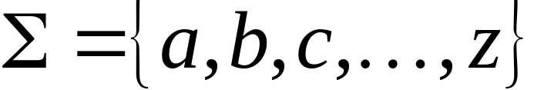
Language: a set of strings
String: a sequence of symbols
from some alphabet
Example:
Strings: cat, dog, house
Language: {cat, dog, house}
Alphabet:

Slide 3
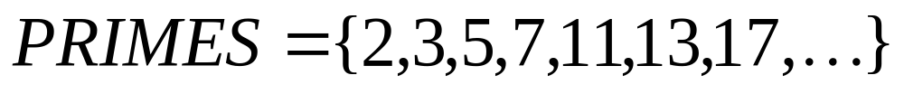

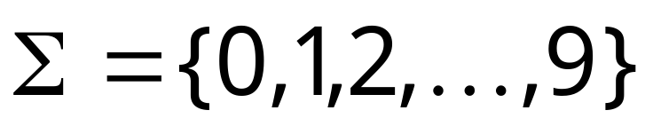
Languages are used to describe
computation problems:
Alphabet:

Slide 4

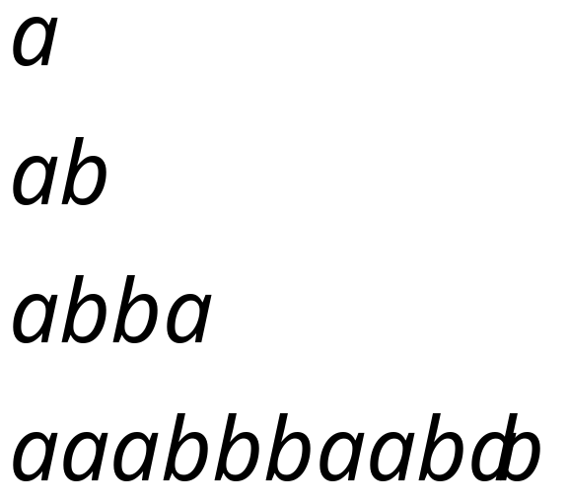
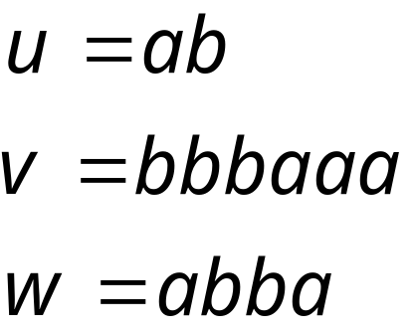
Alphabets and Strings
An alphabet is a set of symbols
Example Alphabet:
A string is a sequence of
symbols from the alphabet
Example Strings

Slide 5
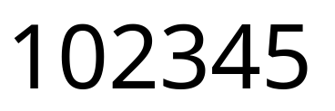
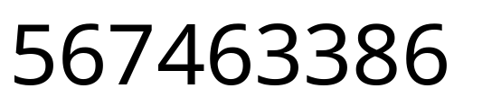
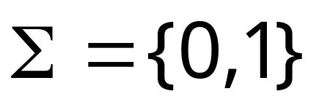


Decimal numbers alphabet
Binary numbers alphabet

Slide 6
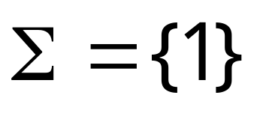

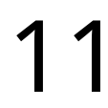
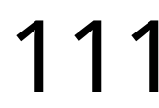
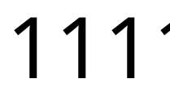
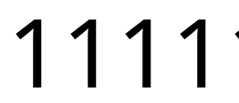




Unary numbers alphabet
Unary number:
Decimal number:

Slide 7
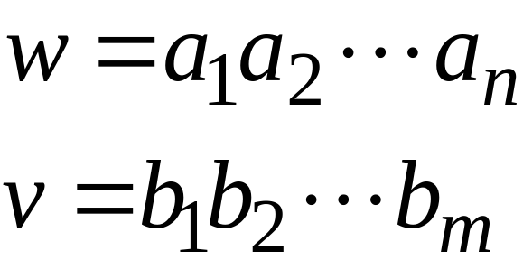
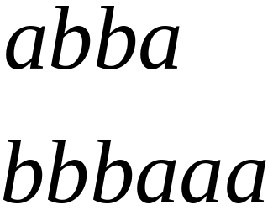
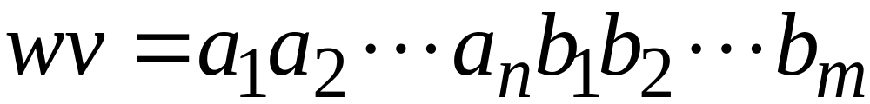

String Operations
Concatenation

Slide 8




Reverse

Slide 9


String Length
Length:
Examples:

Slide 10


Length of Concatenation
Example:

Slide 11
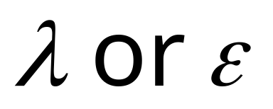
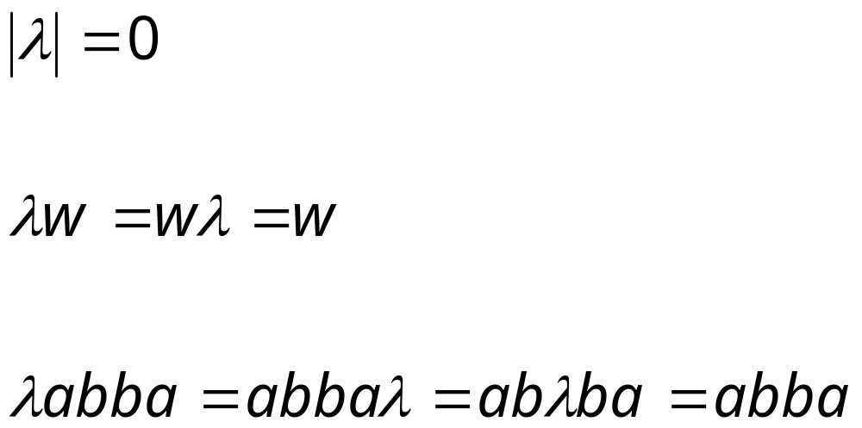
Empty String
A string with no letters is denoted:
Observations:

Slide 12


Substring
Substring of string:
  a subsequence of consecutive characters
String Substring

Slide 13




Prefix and Suffix
Prefixes Suffixes
prefix
suffix

Slide 14




Another Operation
Example:
Definition:

Slide 15



The * Operation
: the set of all possible strings from
alphabet

Slide 16


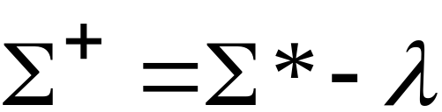
The + Operation
: the set of all possible strings from
alphabet except

Slide 17


Languages
A language over alphabet
is any subset of
Examples:
Language:
Language:
Language:

Slide 18
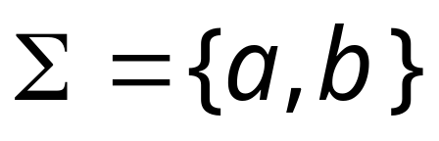




More Language Examples
An infinite language
Alphabet

Slide 19
Prime numbers
Alphabet
Language:

Slide 20
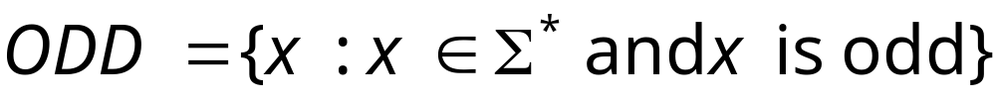
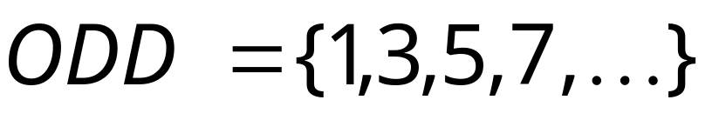
Even and odd numbers
Alphabet

Slide 21
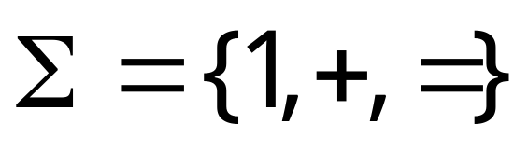
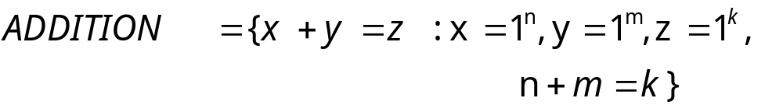
Unary Addition
Alphabet:
Language:

Slide 22
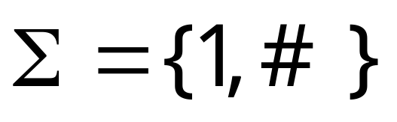
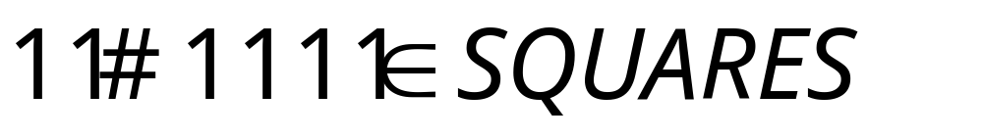
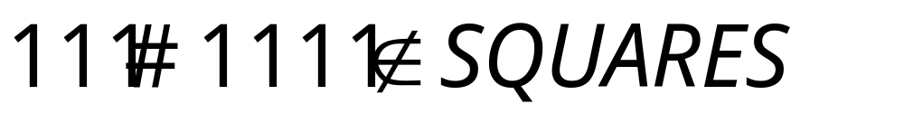
Squares
Alphabet:
Language:

Slide 23
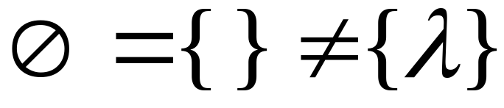



Note that:
Sets
Set size
Set size
String length

Slide 24


Operations on Languages
The usual set operations
Complement:

Slide 25



Reverse
Definition:
Examples:

Slide 26


Concatenation
Definition:
Example:

Slide 27



Another Operation
Definition:
Special case:

Slide 28




Slide 29



Star-Closure (Kleene *)
All strings that can be constructed from
Definition:
Example:

Slide 30
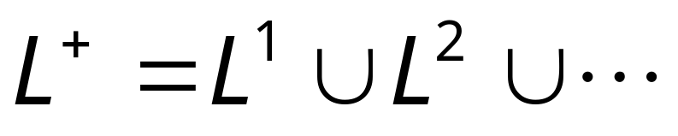
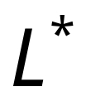


Positive Closure
Definition:
Same with but without the

