Slide 1
Mathematical Preliminaries

Slide 2
Mathematical Preliminaries
Sets
Functions
Relations
Graphs
Proof Techniques

Slide 3
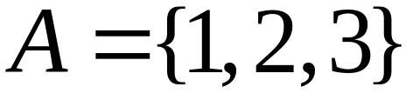

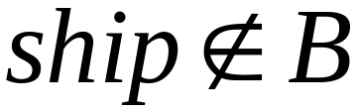
SETS
A set is a collection of elements
We write

Slide 4
Set Representations
  C = { a, b, c, d, e, f, g, h, i, j, k }
  C = { a, b, …, k }
  S = { 2, 4, 6, … }
  S = { j : j > 0, and j = 2k for some k>0 }
  S = { j : j is nonnegative and even }
finite set
infinite set

Slide 5
A = { 1, 2, 3, 4, 5 }
U
6
A
2
8
1
3
7
4
5
9
10
Universal Set: all possible elements
    U = { 1 , … , 10 }

Slide 6
Set Operations
A = { 1, 2, 3 } B = { 2, 3, 4, 5}
Union
A U B = { 1, 2, 3, 4, 5 }
Intersection
    A B = { 2, 3 }
Difference
    A - B = { 1 }
    B - A = { 4, 5 }
A
B
2
4
1
3
5
U
2
3
1
Venn diagrams

Slide 7
Complement
      Universal set = {1, …, 7}
      A = { 1, 2, 3 } A = { 4, 5, 6, 7}
4
A
A
6
1
3
2
5
7
A = A

Slide 8
{ even integers } = { odd integers }
Integers
1
odd
0
5
even
2
6
4
3
7

Slide 9
DeMorgan’s Laws
A U B = A B
U
A B = A U B
U

Slide 10
Empty, Null Set:
= { }
S U = S
S =
S - = S
- S =
U
= Universal Set

Slide 11
Subset
A = { 1, 2, 3} B = { 1, 2, 3, 4, 5 }
U
A B
Proper Subset:
U
A B
B
A

Slide 12
Disjoint Sets
A = { 1, 2, 3 } B = { 5, 6}
A B =
U
A
B

Slide 13
Set Cardinality
For finite sets
A = { 2, 5, 7 }
|A| = 3
(set size)

Slide 14
Powersets
A powerset is a set of sets
S = { a, b, c }
Powerset of S = the set of all the subsets of S
2^{S} = { , {a}, {b}, {c}, {a, b}, {a, c}, {b, c}, {a, b, c} }
Observation: | 2^{S} | = 2^{|S|} ( 8 = 2³ )

Slide 15
FUNCTIONS
domain
range
4
A
B
f(1) = a
1
a
2
b
3
c
5
f : A -> B
If A = domain
then f is a total function
otherwise f is a partial function

Slide 16
GRAPHS
A directed graph
e
b
node
a
d
edge
c
Nodes (Vertices)
V = { a, b, c, d, e }
Edges
E = { (a,b), (b,c), (b,e),(c,a), (c,e), (d,c), (e,b), (e,d) }

Slide 17
Labeled Graph
2
6
e
2
b
1
3
a
d
6
5
c

Slide 18
Walk
e
b
a
d
c
Walk is a sequence of adjacent edges
(e, d), (d, c), (c, a)

Slide 19
Path
e
b
a
d
c
Path is a walk where no edge is repeated
Simple path: no node is repeated

Slide 20
Cycle
e
base
b
3
1
d
a
2
c
Cycle: a walk from a node (base) to itself
Simple cycle: only the base node is repeated

Slide 21
root
Level 0
Level 1
leaf
Height 3
Level 2
Level 3

Slide 22
Binary Trees

Slide 23
PROOF TECHNIQUES
Proof by induction
Proof by contradiction

Slide 24
Example
Theorem: A binary tree of height n
has at most 2^{n} leaves.
Proof by induction:
let L(i) be the maximum number of
leaves of any subtree at height i

Slide 25
We want to show: L(i) <= 2^{i}
Inductive basis
      L(0) = 1 (the root node)
Inductive hypothesis
      Let’s assume L(i) <= 2^{i} for all i = 0, 1, …, k
Induction step
      we need to show that L(k + 1) <= 2^{k+1}

Slide 26
Induction Step
height
k
k+1
From Inductive hypothesis: L(k) <= 2^{k}

Slide 27
Induction Step
height
L(k) <= 2^{k}
k
k+1
L(k+1) <= 2 * L(k) <= 2 * 2^{k} = 2^{k+1}
(we add at most two nodes for every leaf of level k)

Slide 28
Remark
Recursion is another thing
Example of recursive function:
    f(n) = f(n-1) + f(n-2)
    f(0) = 1, f(1) = 1

Slide 29
Proof by Contradiction
We want to prove that a statement P is true
    we assume that P is false
    then we arrive at an incorrect conclusion
    therefore, statement P must be true

Slide 30
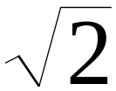
Example
Theorem: is not rational
Proof:
    Assume by contradiction that it is rational
    = n/m
    n and m have no common factors
    We will show that this is impossible

Slide 31
= n/m 2 m² = n²
n is even
n = 2 k
Therefore, n² is even
m is even
m = 2 p
2 m² = 4k²
m² = 2k²
Thus, m and n have common factor 2
Contradiction!

Slide 32
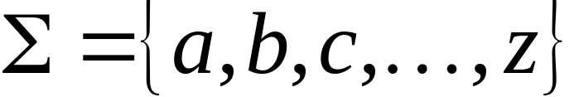
A language is a set of strings
String: A sequence of letters
  Examples: “cat”, “dog”, “house”, …
  Defined over an alphabet:

Slide 33

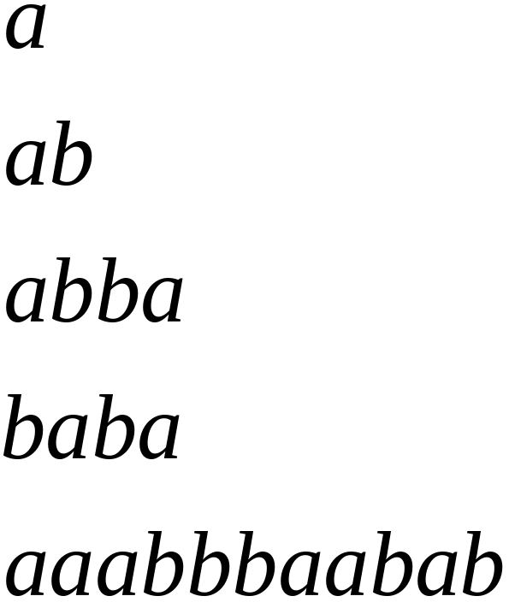
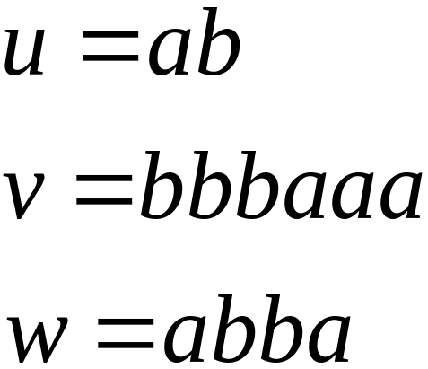
Alphabets and Strings
We will use small alphabets:
Strings

Slide 34
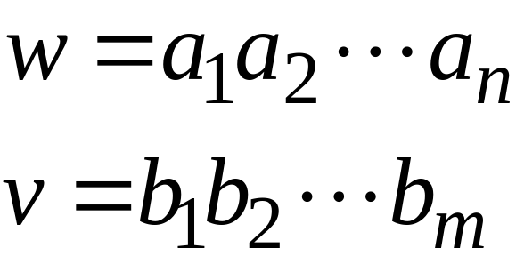
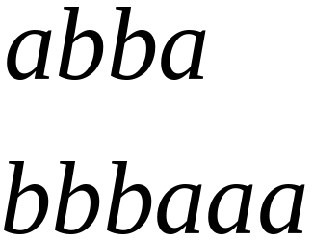
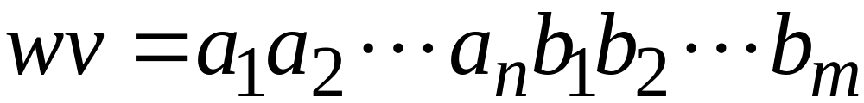

String Operations
Concatenation

Slide 35




Reverse

Slide 36


String Length
Length:
Examples:

Slide 37
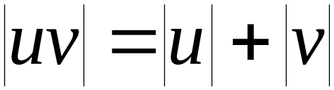

Length of Concatenation
Example:

Slide 38

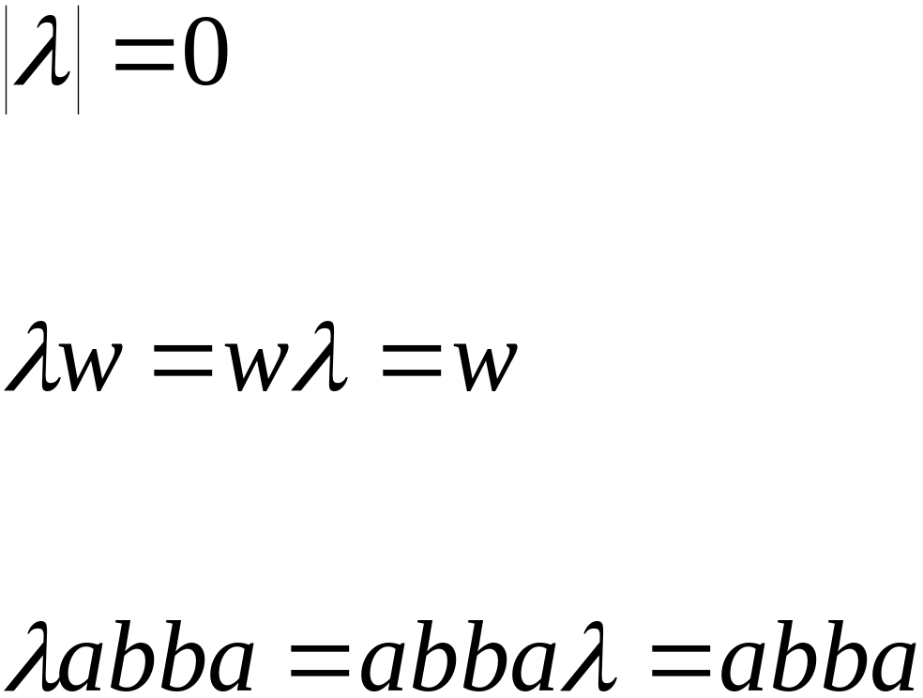
Empty String
A string with no letters:
Observations:

Slide 39


Substring
Substring of string:
  a subsequence of consecutive characters
String Substring

Slide 40




Prefix and Suffix
Prefixes Suffixes
prefix
suffix

Slide 41




Another Operation
Example:
Definition:

Slide 42



The * Operation
: the set of all possible strings from
alphabet

Slide 43

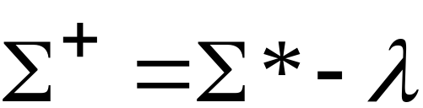
The + Operation
: the set of all possible strings from
alphabet except

Slide 44
Languages

Slide 45


Languages
A language is any subset of
Example:
Languages:

Slide 46
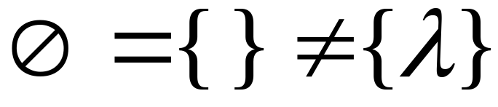



Note that:
Sets
Set size
Set size
String length

Slide 47




Another Example
An infinite language

Slide 48


Operations on Languages
The usual set operations
Complement:

Slide 49



Reverse
Definition:
Examples:

Slide 50


Concatenation
Definition:
Example:

Slide 51



Another Operation
Definition:
Special case:

Slide 52



More Examples

Slide 53


Star-Closure (Kleene *)
Definition:
Example:

Slide 54
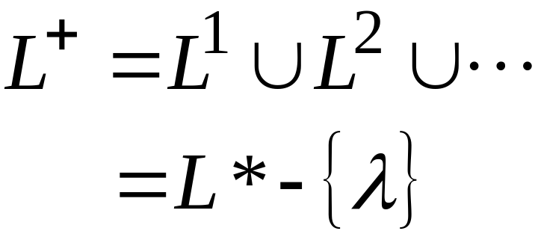

Positive Closure
Definition:

Slide 55
Models of Computation

Slide 56
Church Turing Thesis
Anything that can be computed (in the informal sense) can be computed with a Turing Machine
“A function is effectively computable if and only if it is Turing-computable.” [1]
“A certain procedure constitutes a (discrete) algorithm for computing a given function if and only if it can be implemented as a Turing Machine that computes that given function.” [1]
[1] Ben-Amram, The Church-Turing Thesis and its Look-alikes, ACM SIGACT News (2003) 36: 113-114.

Slide 57
Computation
CPU
memory

Slide 58
temporary memory
input memory
CPU
output memory
Program memory

Slide 59
Automaton
temporary memory
Automaton
input memory
CPU
output memory
Program memory

Slide 60
Different Kinds of Automata
Automata are distinguished by the temporary memory
  Finite Automata: no temporary memory
  Pushdown Automata: stack
  Turing Machines: random access memory

Slide 61
Finite Automaton
temporary memory
input memory
Finite
Automaton
output memory
Example: Vending Machines
(small computing power)

Slide 62
Pushdown Automaton
Stack
Push, Pop
input memory
Pushdown
Automaton
output memory
Example: Compilers for Programming Languages
(medium computing power)

Slide 63
Turing Machine
Random Access Memory
input memory
Turing
Machine
output memory
Examples: Any Algorithm
(highest computing power)

Slide 64
Power of Automata
Finite
Automata
Pushdown
Automata
Turing
Machine
Less power
More power
Solve more
computational problems

Slide 65
The Chomsky Hierarchy
Non Turing-Acceptable
Turing-Acceptable
decidable
Context-sensitive
Context-free
Regular
Fall 2006
Costas Busch - RPI

Slide 66
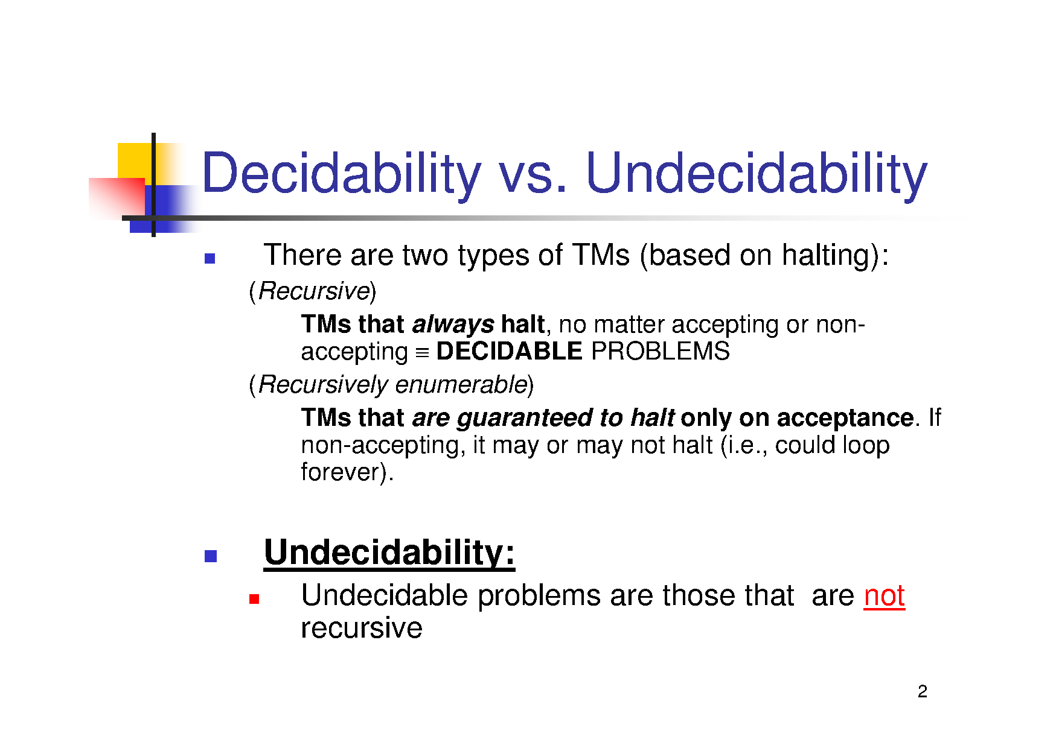

Slide 67
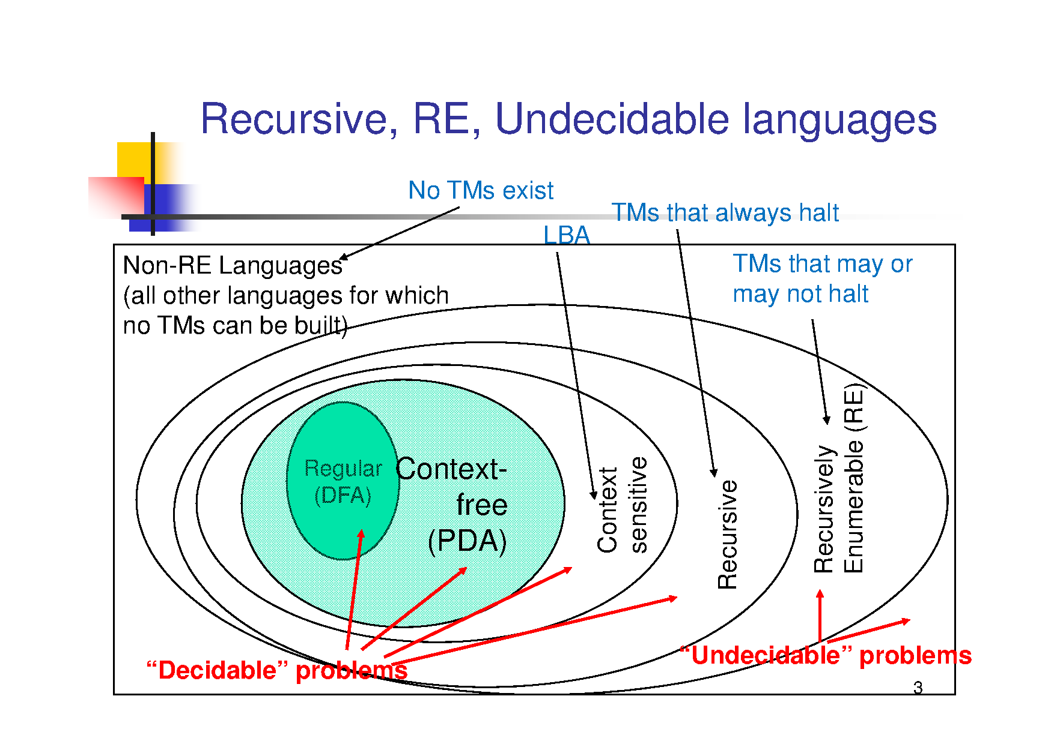

Slide 68
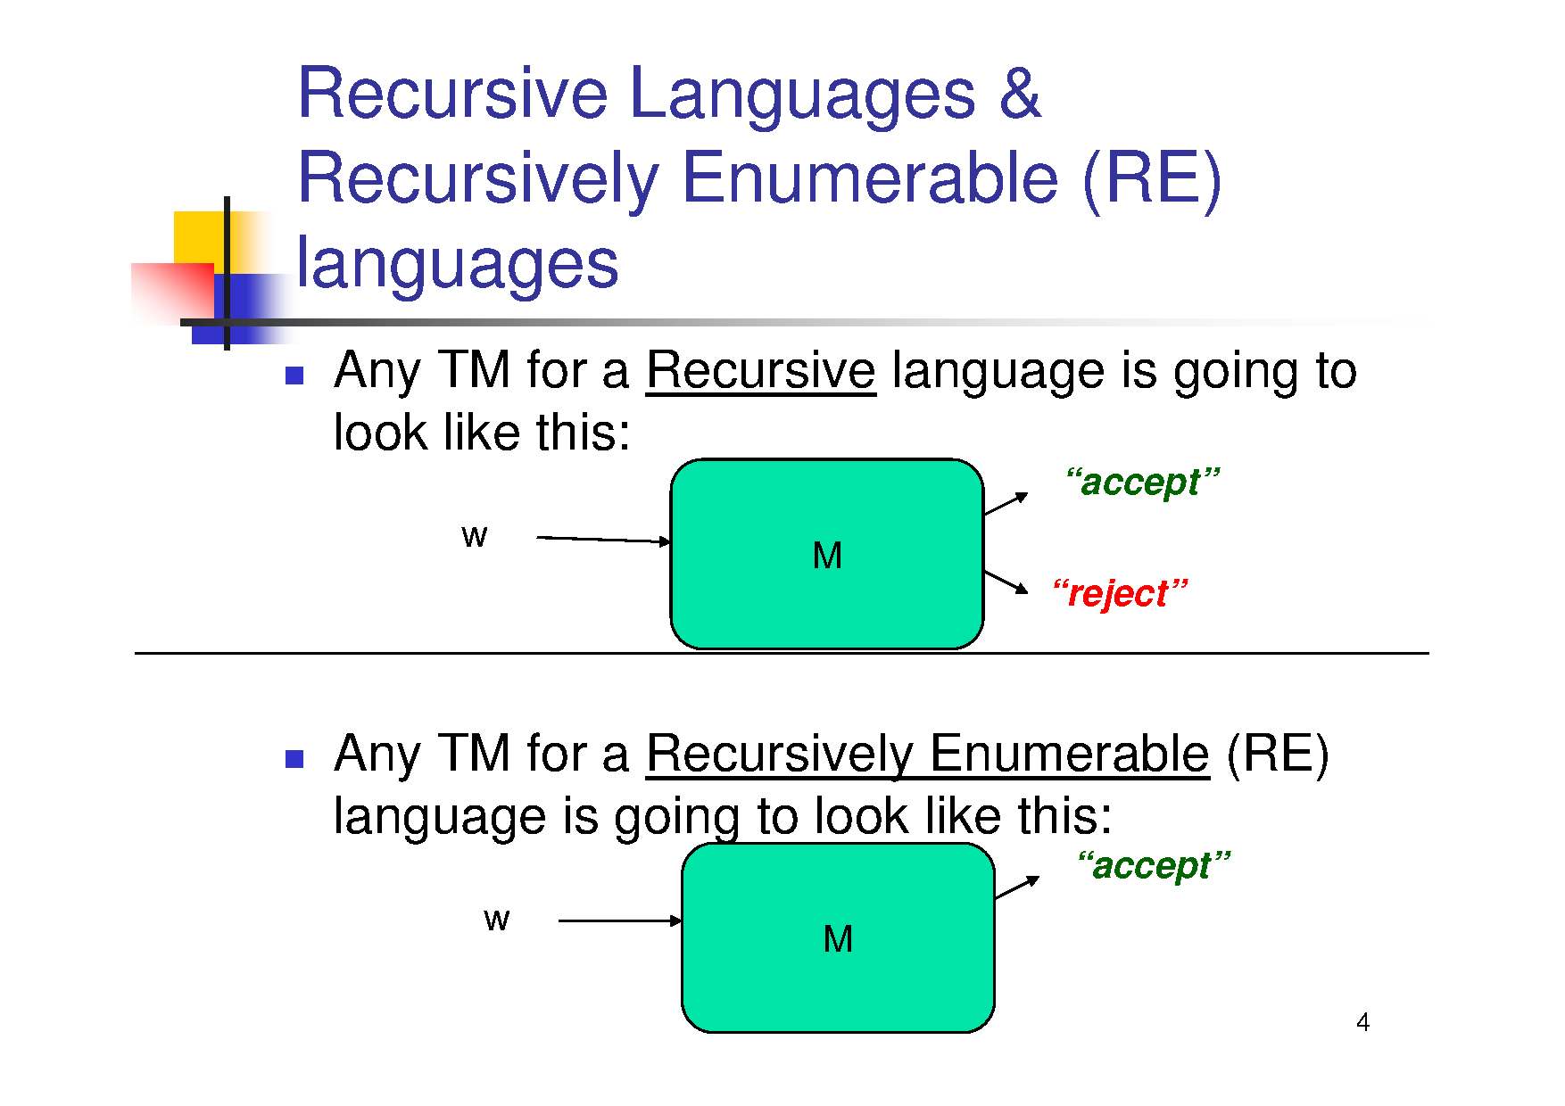

Slide 69
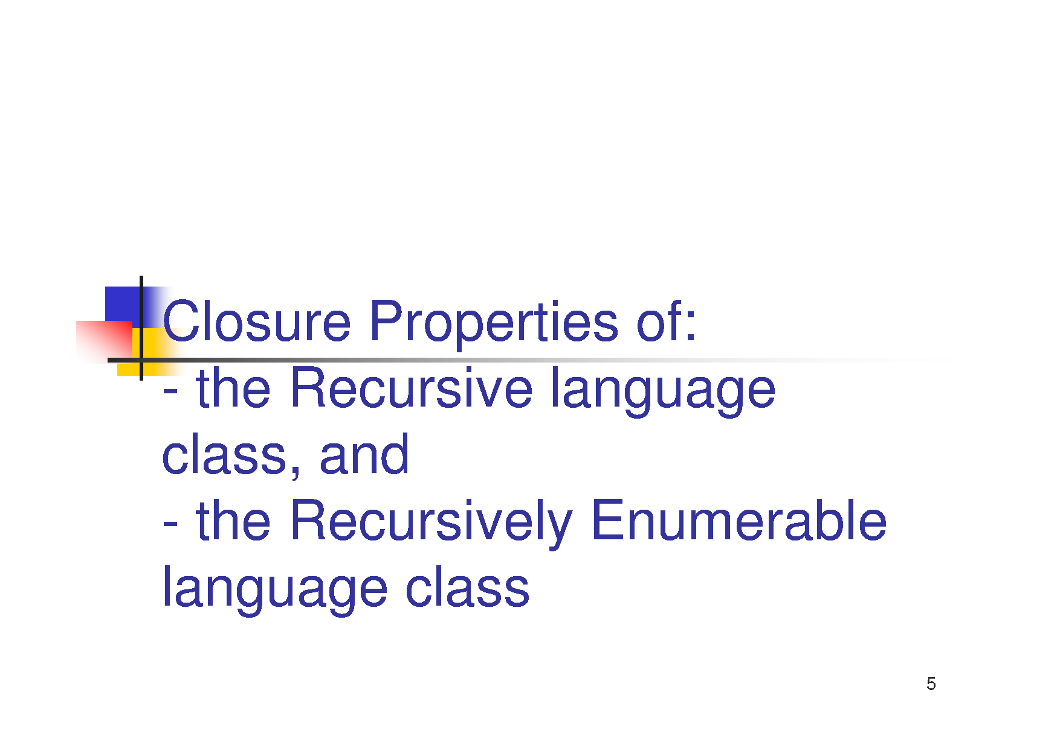

Slide 70
Recursive Enumerable (RE) or Type -0 Language
Accepted or recognized by Turing machine which means it will enter into final state for the strings of language and may or may not enter into rejecting state for the strings which are not part of the language
It means TM can loop forever for the strings which are not a part of the language. RE languages are also called as Turing recognizable languages.

Slide 71
Recursive Language (REC)
A recursive language (subset of RE) can be decided by Turing machine which means it will enter into final state for the strings of language and rejecting state for the strings which are not part of the language. e.g.; L= {a^{n}b^{n}c^{n}|n>=1} is recursive because we can construct a turing machine which will move to final state if the string is of the form a^{n}b^{n}c^{n} else move to non-final state. So the TM will always halt in this case.
REC languages are also called as Turing decidable languages

