Slide 1

Bangkalan,
Hal: Lamaran Kerja
Kepada Yth,
HRD RSUD. Syarifah Ambami
Ditempat
Dengan Hormat,
Sehubungan dengan informasi yang saya peroleh bahwa di perusahaan yang Bapak / Ibu pimpin sedang membutuhkan karyawan, maka untuk itu saya yang bertanda tangan dibawah ini:
Nama | : Wahid Arinanto Nugroho
Tempat/Tgl lahir | : Malang, 8 Januari 1997
Alamat | : Perum Lavender Blok K-3, Mlajah, Bangkalan
Pendidikan | : S1 Teknik Informatika
Telepon | : 087850866665
Email | : wahiid.ari@gmail.com
Dengan ini saya mengajukan permohonan kepada Bapak/Ibu untuk melamar menjadi karyawan di perusahaan ini pada posisi IT Staff. Saya memiliki kondisi kesehatan yang baik, cepat memahami bidang baru yang sedang dipelajari / dikerjakan, dan saya memiliki motivasi tinggi dalam bekerja.
Sebagai bahan pertimbangan Bapak/Ibu pimpinan, bersama ini saya lampirkan berkas-berkas berikut:
CV / Daftar riwayat hidup
Fotocopy Ijazah
Fotocopy transkip nilai akademik
Fotocopy KTP
Fotocopy SIM
Fotocopy SKCK
Pas photo 4x6
Sungguh besar harapan saya agar dapat diterima diperusahaan yang Bapak / Ibu pimpin. Demikianlah permohonan ini, atas perhatiannya saya ucapkan banyak terima kasih.
Hormat Saya
Wahid Arinanto Nugroho

Slide 2
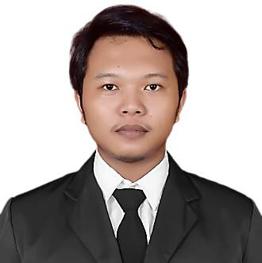




Wahid Arinanto Nugroho
Junior Software Developer | UI Designer
EXPERIENCE
Dispenduk Bangkalan
PROFILE
Web Developer (Magang)
2018
Saya sangat tertarik dengan dunia teknologi, pemrograman dan juga pengembangan aplikasi. Saat ini sedang mempelajari ilmu tentang pengembangan aplikasi berbasis web menggunakan Node JS.
Merancang dan mengembangkan Sistem Pengaduan Masyarakat berbasis web untuk Dinas Kependudukan dan Pencatatan Sipil Kabupaten Bangkalan.
Smart Media Comp Surabaya
IT Support (Magang)
2013
Bertanggung jawab untuk instalasi, evaluasi dan peningkatan terhadap tiga objek utama yaitu komputer, software, dan pengembangan sistem jaringan.
CONTACT
EDUCATION
wahiid.ari@gmail.com
Universitas Trunojoyo
+6287850866665
Teknik Informatika | Sarjana Komputer
2015 - 2020
github.com/wahidari
SMKN 2 Bangkalan
2012 - 2015
linkedin.com/in/wahidari
Teknik Komputer Jaringan
Bangkalan, Jawa Timur
portfolio
PERSONAL SKILLs
Web - Pengaduan - Sistem pengaduan masyarakat berbasis web
Web - SPK HP - Sistem Pendukung Keputusan pemilihan smartphone
Office Apps
Web - Covid Status - Web informasi status terkini pandemi covid-19
Software Development
Web - Football – Web penyedia informasi tentang liga primer Inggris
Database Management
Android - DompetKu - Aplikasi pencatatan pemasukan dan pengeluaran
PROGRAMMING
Android - Pendaki - Aplikasi informasi gunung dan informasi pendakian
Python - Flask
CERTIFICATIONs
Javascript - NodeJS
Dicoding - Membangun Progressive Web Apps
CSS - Bootstrap
Dicoding - Fundamental Front-End Web Development
SQL - MariaDB
Dicoding - Dasar Pemrograman Web
FreeCodeCamp - Responsive Web Design
2020
completion
Progate - Path Pengembangan Web (Node.js)
2020
IDCamp Scholarship
Dicoding - Membuat Aplikasi Android untuk Pemula
2020
Digitalent Scholarship
Dicoding - Memulai Pemrograman Dengan Kotlin
CfDS UGM x Progate
Dicoding - Membangun Aplikasi Android Native Bagian I
2020
Dicoding - Membangun Aplikasi Android Native Bagian II
2016
2019
HacktoberFest
Indonesia Android Kejar - Android Beginner

Slide 3
Wahid Arinanto Nugroho
Junior Web Developer
EXPERIENCE
Dispenduk Bangkalan
PROFILE
Web Developer (Internship)
2018
I am a junior web developer with strong passion to learn new things. Familiar with a few web frameworks. Currently interested and learning about Node JS. I enjoy hiking on my spare time.
Design and develop a web-based public complaints system for Dinas Kependudukan dan Pencatatan Sipil Kabupaten Bangkalan.
Smart Media Comp Surabaya
IT Support (Internship)
2018
Responsible for installation, evaluation and improvement of three main objects, namely computers, software, and network system development.
CONTACT
EDUCATION
wahiid.ari@gmail.com
University of Trunojoyo
+6287850866665
Informatics Engineering | Bachelor of Computer Science
2015 - 2020
github.com/wahidari
SMKN 2 Bangkalan
2012 - 2015
linkedin.com/in/wahidari
Computer and Network Engineering
Bangkalan, Jawa Timur
portfolio
PERSONAL SKILLs
Web - Pengaduan - Web based public complaints system for government
Web - SPK HP - Decision support system for choosing right smartphones
Office Apps
Web - Covid Status - A simple web app to track latest covid-19 status
Web Development
Web - Football - Web that provides information about Premier League
Database Management
Android - DompetKu - Money manager app to track income and expenses
PROGRAMMING
Android - Pendaki - Simple mountain and hiking information application
Python - Flask
CERTIFICATIONs
Javascript - NodeJS
Dicoding - Membangun Progressive Web Apps
CSS - Bootstrap
Dicoding - Fundamental Front-End Web Development
SQL - MariaDB
Dicoding - Dasar Pemrograman Web
FreeCodeCamp - Responsive Web Design
2020
completion
Progate - Path Pengembangan Web (Node.js)
2020
IDCamp Scholarship
Dicoding - Membuat Aplikasi Android untuk Pemula
2020
Digitalent Scholarship
Dicoding - Memulai Pemrograman Dengan Kotlin
CfDS UGM x Progate
Dicoding - Membangun Aplikasi Android Native Bagian I
2020
Dicoding - Membangun Aplikasi Android Native Bagian II
2016
2019
HacktoberFest
Indonesia Android Kejar - Android Beginner

Slide 4
Wahid Arinanto Nugroho
Junior Software Developer
EXPERIENCE
Dispenduk Bangkalan
PROFILE
Web Developer (Internship)
2018
I am a junior software developer with strong passion to learn new things. Familiar with a few web frameworks. Currently interested and learning about Node JS. I enjoy hiking on my spare time.
Design and develop a web-based public complaints system for Dinas Kependudukan dan Pencatatan Sipil Kabupaten Bangkalan.
Smart Media Comp Surabaya
IT Support (Internship)
2018
Responsible for installation, evaluation and improvement of three main objects, namely computers, software, and network system development.
CONTACT
EDUCATION
wahiid.ari@gmail.com
University of Trunojoyo
+6287850866665
Informatics Engineering | Bachelor of Computer Science
2015 - 2020
github.com/wahidari
SMKN 2 Bangkalan
2012 - 2015
linkedin.com/in/wahidari
Computer and Network Engineering
Bangkalan, Jawa Timur
portfolio
PERSONAL SKILLs
Web - Pengaduan - Web based public complaints system for government
Web - SPK HP - Decision support system for choosing right smartphones
Office Apps
Web - Covid Status - A simple web app to track latest covid-19 status
Software Development
Web - Football - Web that provides information about Premier League
Database Management
Android - DompetKu - Money manager app to track income and expenses
PROGRAMMING
Android - Pendaki - Simple mountain and hiking information application
Python - Flask
CERTIFICATIONs
Javascript - NodeJS
Dicoding - Membangun Progressive Web Apps
CSS - Bootstrap
Dicoding - Fundamental Front-End Web Development
SQL - MariaDB
Dicoding - Dasar Pemrograman Web
FreeCodeCamp - Responsive Web Design
2020
completion
Progate - Path Pengembangan Web (Node.js)
2020
IDCamp Scholarship
Dicoding - Membuat Aplikasi Android untuk Pemula
2020
Digitalent Scholarship
Dicoding - Memulai Pemrograman Dengan Kotlin
CfDS UGM x Progate
Dicoding - Membangun Aplikasi Android Native Bagian I
2020
Dicoding - Membangun Aplikasi Android Native Bagian II
2016
2019
HacktoberFest
Indonesia Android Kejar - Android Beginner

Slide 5
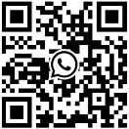
Wahid Arinanto Nugroho
Junior Software Developer
EXPERIENCE
Dispenduk Bangkalan
PROFILE
Web Developer (Internship)
2018
I am a junior software developer with strong passion to learn new things. Familiar with a few web frameworks. Currently interested and learning about Node JS. I enjoy hiking on my spare time.
Design and develop a web-based public complaints system for Dinas Kependudukan dan Pencatatan Sipil Kabupaten Bangkalan.
Smart Media Comp Surabaya
IT Support (Internship)
2018
Responsible for installation, evaluation and improvement of three main objects, namely computers, software, and network system development.
CONTACT
EDUCATION
wahiid.ari@gmail.com
University of Trunojoyo
+6287850866665
Informatics Engineering | Bachelor of Computer Science
2015 - 2020
github.com/wahidari
SMKN 2 Bangkalan
2012 - 2015
linkedin.com/in/wahidari
Computer and Network Engineering
Bangkalan, Jawa Timur
portfolio
PERSONAL SKILLs
Web - Pengaduan - Web based public complaints system for government
Web - SPK HP - Decision support system for choosing right smartphones
Office Apps
Web - Covid Status - A simple web app to track latest covid-19 status
Software Development
Web - Football - Web that provides information about Premier League
Database Management
Android - DompetKu - Money manager app to track income and expenses
PROGRAMMING
Android - Pendaki - Simple mountain and hiking information application
Python - Flask
CERTIFICATIONs
Javascript - NodeJS
Dicoding - Membangun Progressive Web Apps
CSS - Bootstrap
Dicoding - Fundamental Front-End Web Development
SQL - MariaDB
Dicoding - Dasar Pemrograman Web
FreeCodeCamp - Responsive Web Design
2020
completion
Progate - Path Pengembangan Web (Node.js)
2020
IDCamp Scholarship
Dicoding - Membuat Aplikasi Android untuk Pemula
2020
Digitalent Scholarship
Dicoding - Memulai Pemrograman Dengan Kotlin
CfDS UGM x Progate
Dicoding - Membangun Aplikasi Android Native Bagian I
2020
Dicoding - Membangun Aplikasi Android Native Bagian II
2016
2019
HacktoberFest
Indonesia Android Kejar - Android Beginner

Slide 6
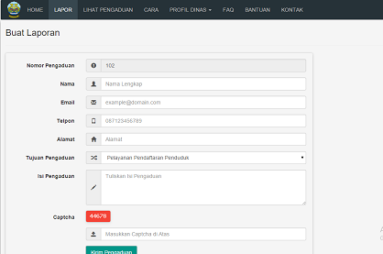
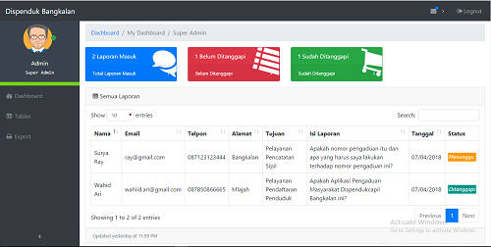
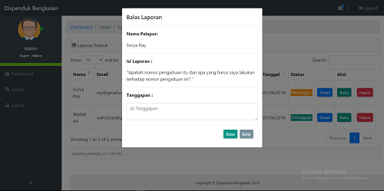
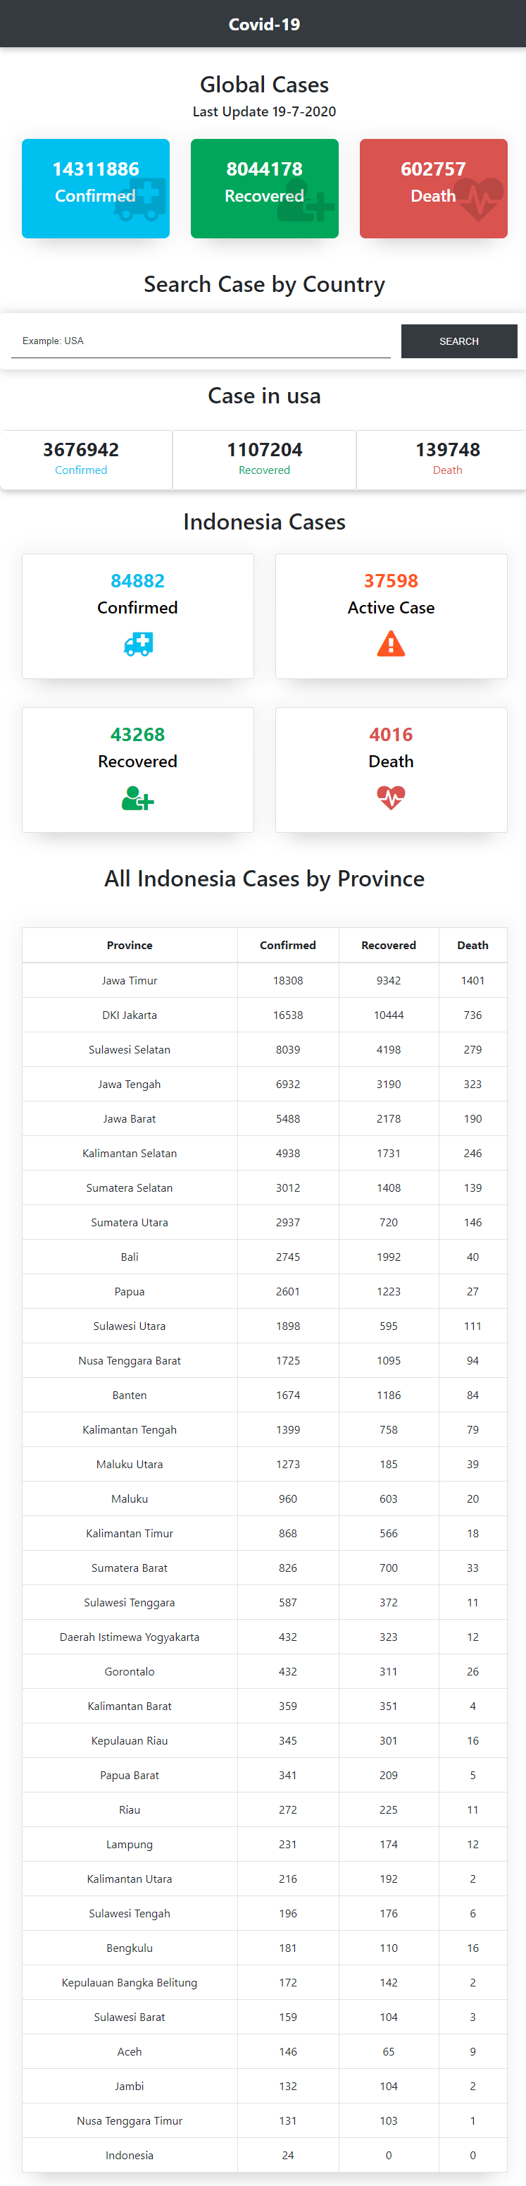
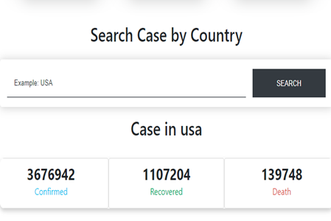
Public Complaints System
Portfolio 1
A web-based Public Complaints System for Dinas Kependudukan dan Pencatatan Sipil Kabupaten Bangkalan.
built with
MySQL
HTML 5
CSS 3
Javascript
PHP
Covid-19 Status
Portfolio 2
A simple web app to monitor latest status of coronavirus (covid-19) cases (confirmed, deaths and recovered).
built with
HTML 5
CSS 3
Javascript
API

Slide 7
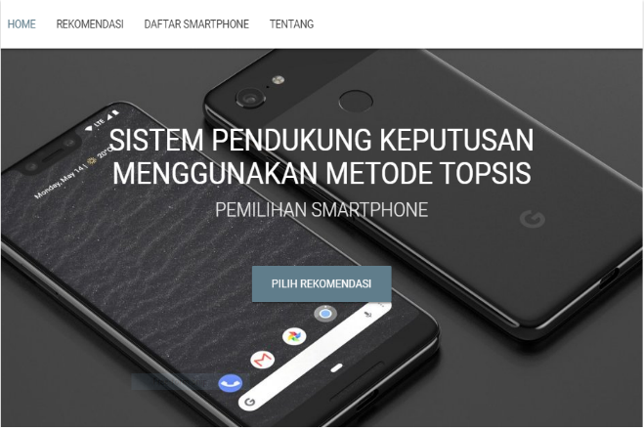
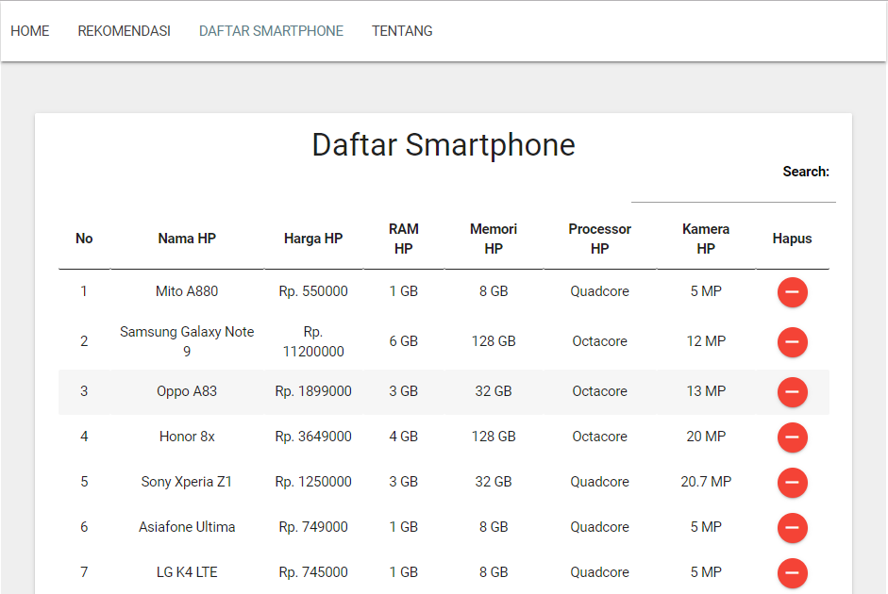
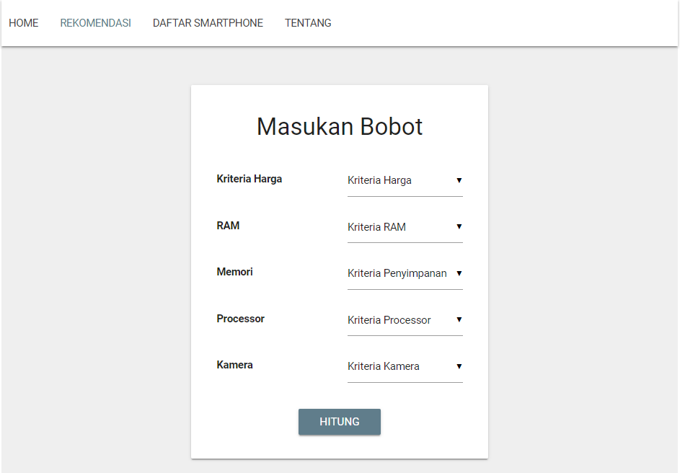
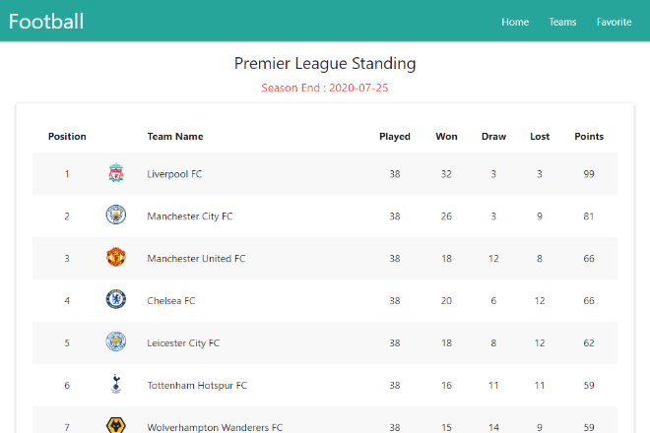
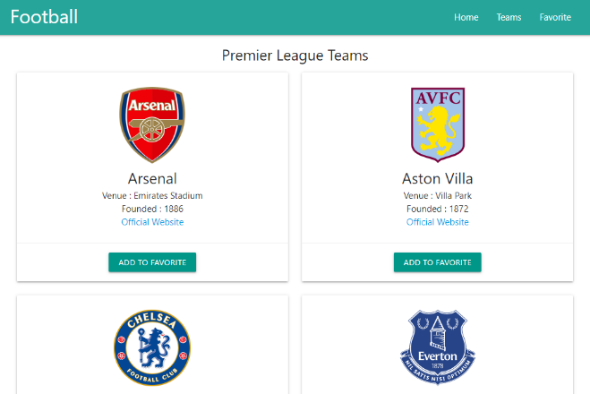
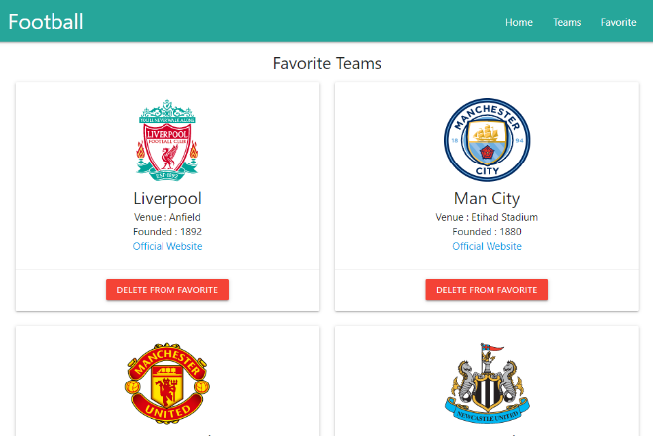
Decision Support System
Portfolio 3
A web-based Decision Support System using TOPSIS method for choosing the best smartphone based on price and specification.
built with
MySQL
HTML 5
CSS 3
Javascript
PHP
Football Web App
Portfolio 4
A platform that provides you a lot of information about English Premier League by utilizing football-data.org API and Workbox as caching strategy.
built with
HTML 5
CSS 3
Javascript
API

Slide 8
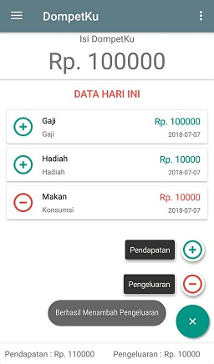
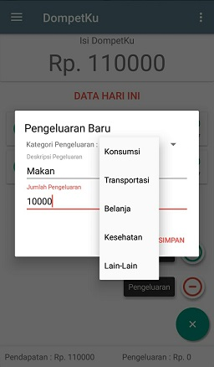
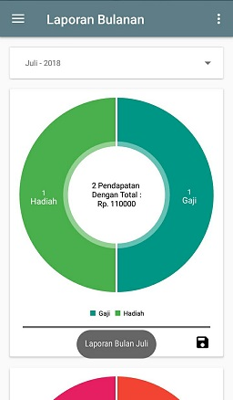
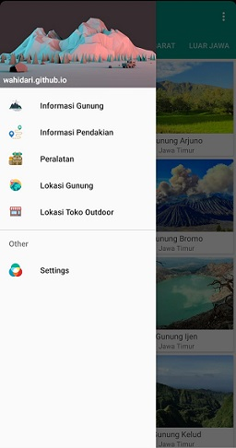
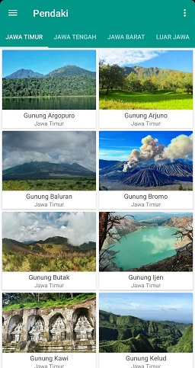
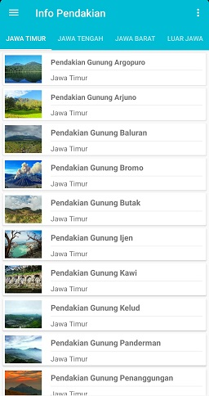
Portfolio 5
DompetKu
built with
An easy and efficient budget app and expense tracker for managing your money built through the Android platform.
XML
Java
SQLite
Portfolio 6
Pendaki
built with
Discover the names, information and locations of mountain and hills around you while hiking, trekking or enjoying your favorite outdoor activity.
XML
Java
SQLite

