Slide 1

IFET COLLEGE OF ENGINEERING
(An Autonomous Institution)
Department of Computer Science and Engineering
Project Phase-I
Unleashing Growth Potential Business With Advanced Analytics And Predictive Modeling
PRESENTED BY
Sathish R
(421121102138)
GUIDED BY
Dr. P. Kanimozhi

Slide 2
ABSTRACT
The project explores how businesses can leverage data analytics and AI to enhance decision-making and innovation.
It demonstrates how AI tools, such as Deep learning, assist in predicting market trends and improving efficiency.
By analyzing current data practices, we highlight strategies for integrating analytics into day-to-day business operations.
The paper also outlines challenges in data adoption, including ethical concerns and the need for skilled professionals.

Slide 3
INTRODUCTION
In today's digital era, businesses generate massive amounts of data that can provide valuable insights.
Data analytics helps businesses understand patterns and predict outcomes for better decision-making.
AI offers advanced capabilities like automation and predictive modeling, transforming traditional business processes.
However, organizations must address challenges such as data privacy, security, and talent shortages.

Slide 4
EXISTING SYSTEM
S.No | Title | Author | Year Published | Drawback
1 | McKinsey's 2023 Report on AI Adoption | McKinsey & Co. | 2023 | Lacks industry-specific insights
2 | AI's Role in Enhancing Customer Experiences | InData Labs | 2023 | Focus on generalized data
3 | AI and Analytics: 30% Improvement in Customer Engagement | Various Researchers | 2023 | Sample size too small
4 | Importance of AI with Big Data for Predictive Analysis | Unknown | 2023 | Overestimates impact in small enterprises

Slide 5
PROPOSED SYSTEM
The project will use Python libraries like pandas for data handling, numpy for computations, and matplotlib for visualizing trends.
The system will focus on automating data processing to predict key business performance indicators.
Integration of AI-driven solutions will help organizations automate decision-making processes based on real-time data.
Ethical data management and privacy considerations will be embedded into the proposed system architecture.

Slide 6
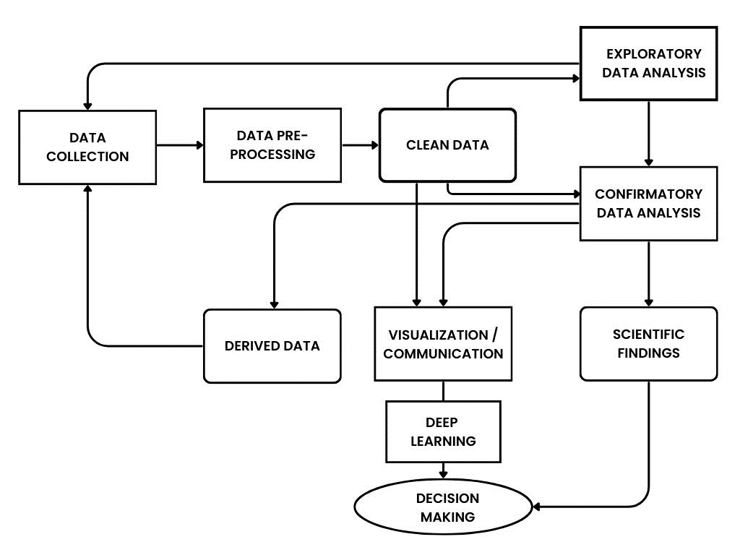
ARCHITECTURE DIAGRAM

