Slide 1

Linear Regression
I - INTRODUCTION
II - Real-life example
III – How it works (The Mathematics Behind It)
IV – Validation in Machine Learning
Presented by :
Ahmed azim
Supervised by :
Mr. Kella

Slide 2

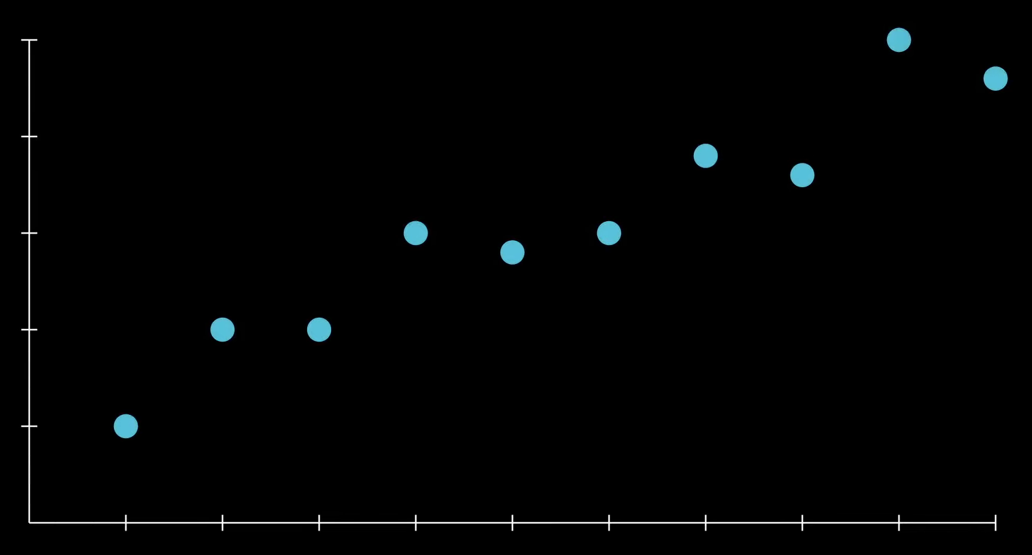
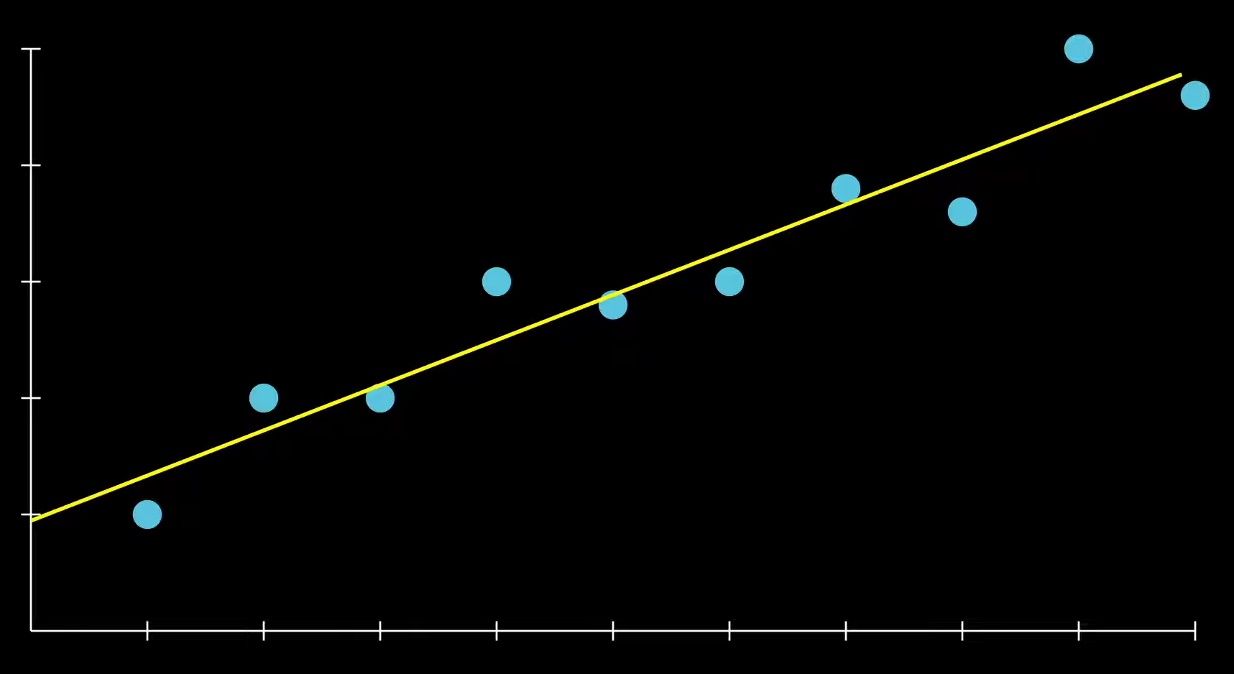


INTRODUCTION
What is linear regression?
In statistics , a linear regression is a regression model that works to establish a linear relationship
between a variable, called the explained variable, and one or more variables, called explanatory variables.
(Variable expliquée)
(Variables explicatives )
=

Slide 3
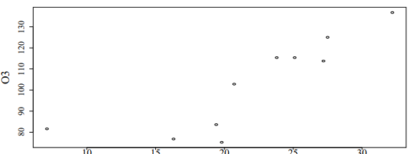
INTRODUCTION
Example
For public health reasons, we are interested in the concentration of ozone (O₃) in the
air (in micrograms per milliliter).
In particular, we want to determine whether it is possible to explain the maximum ozone level of the day using the temperature T12 at noon. The data are as follows:
Outlier :
Is a data point that is far from the general pattern of the data
“Linear regression is sensitive to outliers. One extreme value can slightly change the slope of the regression line.”

Slide 4
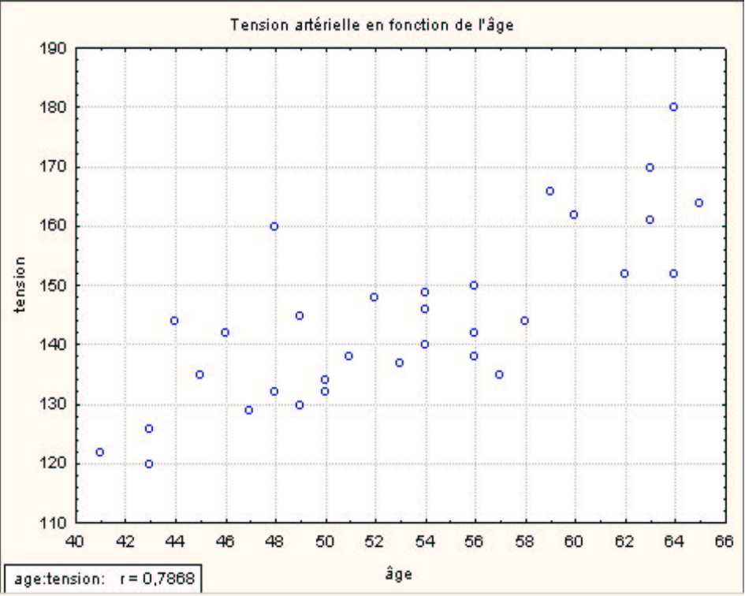
Real-life example
Study of the relationship between blood pressure and an individual’s age
The upward-trending shape of the scatter plot suggests a positive linear relationship between blood pressure and age. The linear correlation observed in the sample is r = 0.7868 .

Slide 5

Real-life example
Study of the relationship between blood pressure and an individual’s age
The upward-trending shape of the scatter plot suggests a positive linear relationship between blood pressure and age. The linear correlation observed in the sample is r = 0.7868 .
The Linear regression model, which expresses the relationship between Y and X using a linear function. Graphically, the relationship is represented by a line with the equation :
The coefficient b1​: the slope of the line; b1 > 0 if the line is increasing, b1= 0 if the line is horizontal , and b1 < 0 if the line is decreasing.
The coefficient b0 ​: the intercept of the line. It represents the value of Y when X = 0

Slide 6
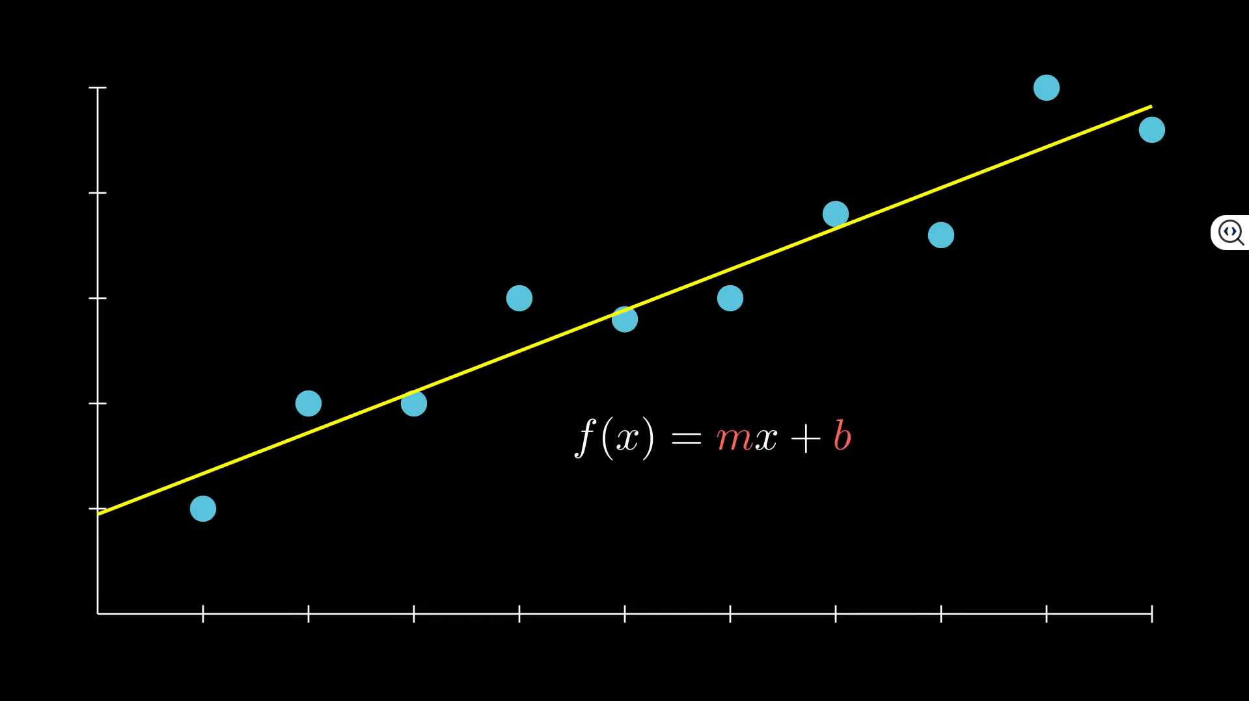
How it works
How does the linear egression work ?
The linear regression tries to find the best fitting straight line that describes the relationship between X and Y .
=

Slide 7
How it works
How does the linear egression work ?
The linear regression tries to find the best fitting straight line that describes the relationship between X and Y .
f (x) : The output variable
x : The input variable
m : The slope of the line , it shows how much Y changes when X increases or decreases (weight)
B : The intercept of the line , it represents the value of Y when X = 0 (bias)

Slide 8
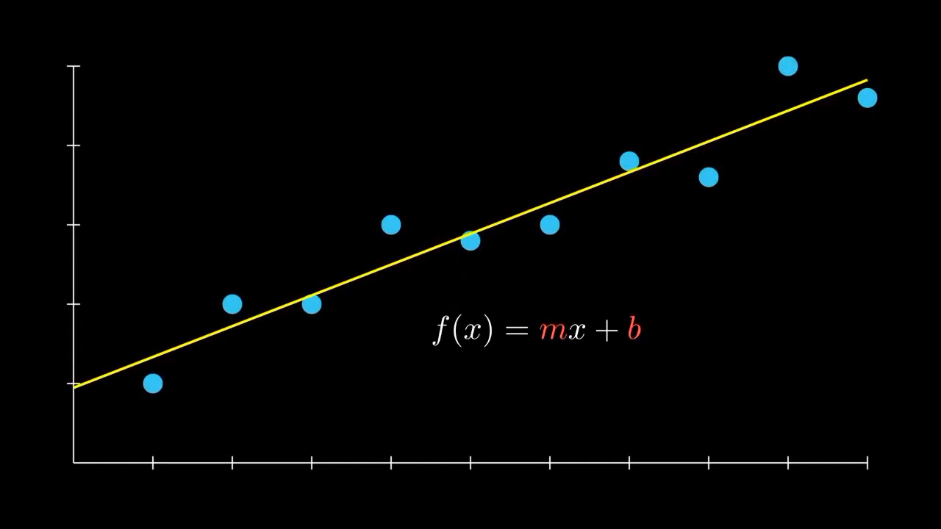
How it works
How does the linear egression work ?
The linear regression tries to find the best fitting straight line that describes the relationship between X and Y .
f (x) : The output variable
x : The input variable
m : The slope of the line , it shows how much Y changes when X increases or decreases (weight)
B : The intercept of the line , it represents the value of Y when X = 0 (bias)

Slide 9
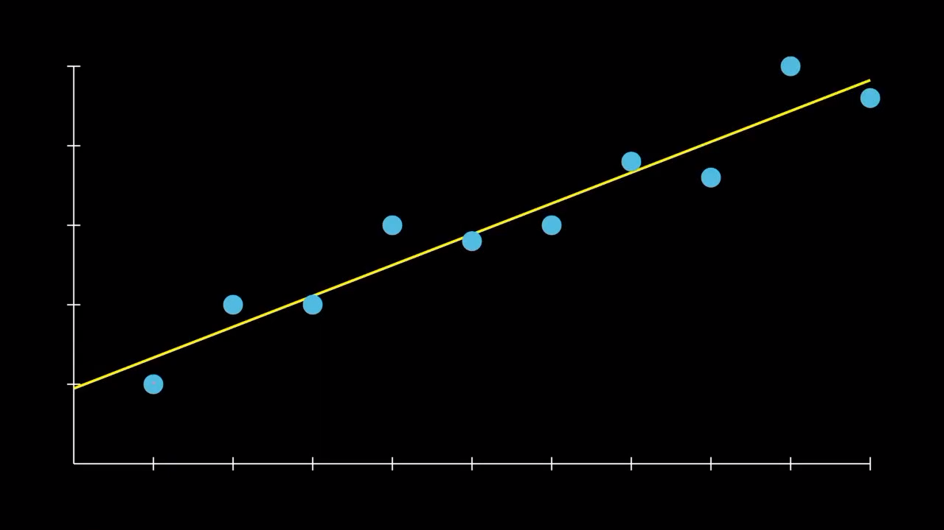
How it works
Fitting the best line
The model does not choose any random line
It chooses the line that minimizes the error between :
The real values ( actual data points )
The predicted values ( values on the line )
The difference called error or residual

Slide 10
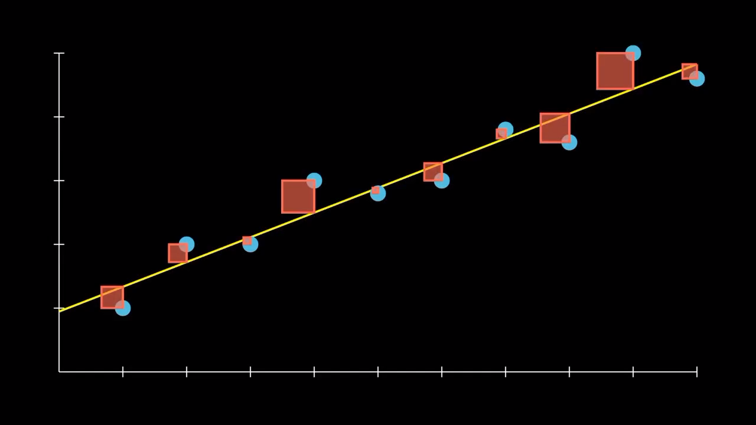
How it works
Minimizing the error
To mesure the error , we use a loss function

Slide 11
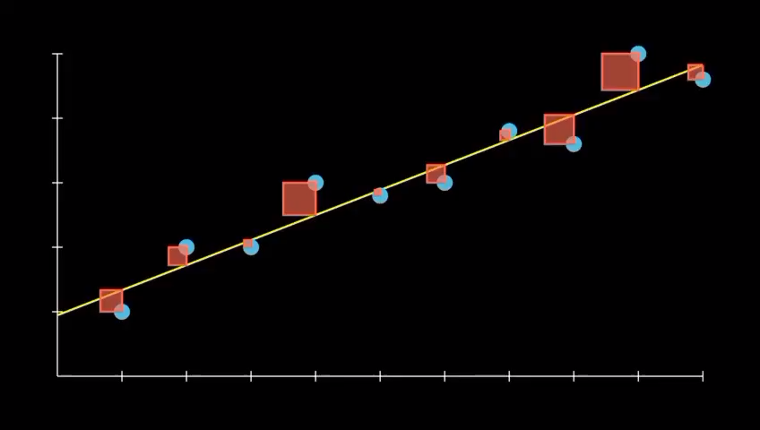
How it works
Minimizing the error
To mesure the error , we use a loss function
The larger the errors are
The more amplified the area of squares are

Slide 12

How it works
Minimizing the error
To mesure the error , we use a loss function
MSE :
- The difference between real and predicted
- Squares them
Takes the average
( mean (SSE) )

Slide 13
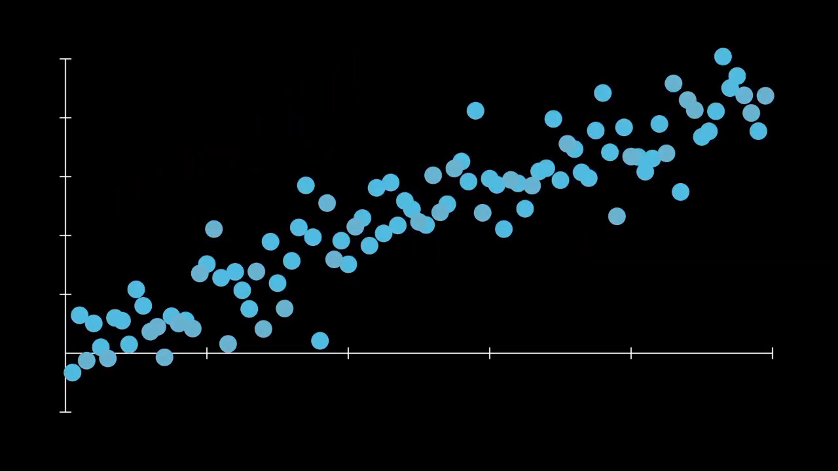
validation
Split the data
We don’t train the model on all the data.
We devide the dataset into : testing set and trainig set

Slide 14
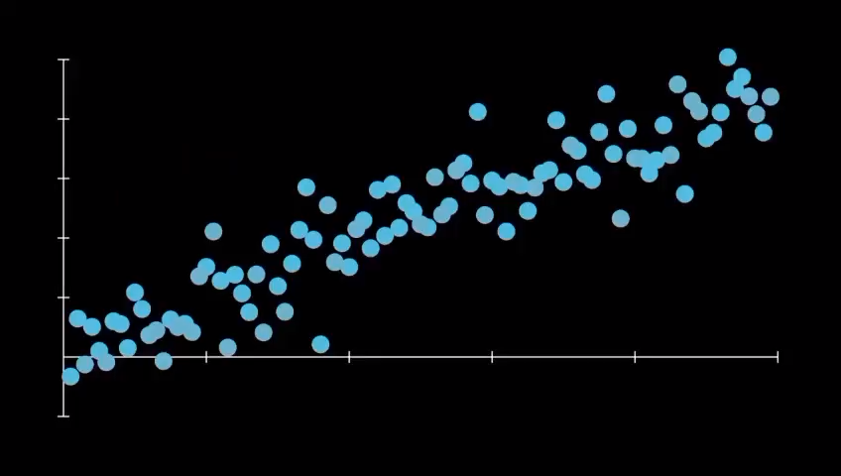
validation
Split the data
We don’t train the model on all the data.
We devide the dataset into : testing set and trainig set

Slide 15
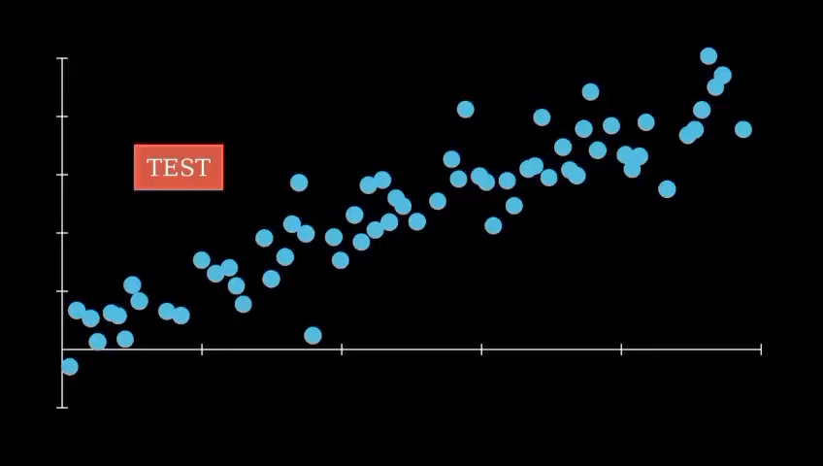
validation
Split the data
We don’t train the model on all the data.
We devide the dataset into : testing set and trainig set

Slide 16
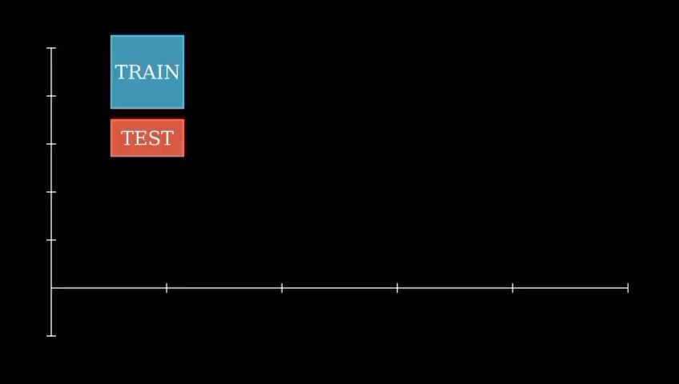
validation
Split the data
The training dataset then will be used to fit the regression line
The testing dataset then will be used to validate its performance on unseen data.

Slide 17
validation
Evaluate Performance
To mesure how good the model is , we use evaliation matrics
Mean squared error (MSE)
Measure avg squared error , smaller MSE means a better model
Root Mean Squared Error (RMSE)
R² (R-squared)
Mesures how mutch of the variation in Y is explained by X , between 0 and 1

Slide 18
Conclusion
Linear regression is a simple and powerful supervised ML alghorithm used to model the realationship between X and Y
It works by finding the best fitting straight line using the equation :
Sources :
An Introduction to statistical Learning (book) , chapter 3

