Slide 1
AUTHORSHIP Identification OF PUNJABI POETRY
Dr. A. Pandian
Stephen Wahid(RA1411003010425)
Yash Tokas (RA1411003010490)

Slide 2
INTRODUCTION
Authorship attribution is the process of determining the writer of a document. It is required to figure out the author of the historical writings whose authors are not known. There were disputes regarding the authorship of old and historical important text so, there was a need to develop a system which can be proficient to recognise the true author of the text. In literature, there are lots of classification techniques conducted in this process. In this project we will explore information retrieval methods such as Rare words, Textual feature, function words, Rhythm feature in authorship attribution. We will perform various experiments with punjabi poems gathered from punjabi-kavita.com.

Slide 3
Present system
The present system of Authorship Attribution is established only for worldwide or nationwide spoken languages.
There are less to almost no resources available to use or even develop Authorship Attribution projects in regional languages.
There are various techniques available to determine the author of the document, but all this work is done mostly on english and arabic languages.

Slide 4
Limitations of present system
Punjabi is an Indo-Aryan language which is 10th most spoken language in the world. It is the native language of about 150 million people moreover, it is very rich language consisting of vast literature but due to lack of awareness of researchers not much work is done on Punjabi language. Although some topic summarisation, topic modelling, name entity recognition systems has been developed for Punjabi language but AA system is not yet developed.

Slide 5
Proposed system
Proposed System will provide a way to identify authors of Punjabi poems.
It will also be helpful in expanding it to a scalable application by iteratively re-training data-sets using SVM, and transform the project into a GUI – based application, that can be commercially used by organisations that deal with Punjabi literature.
The Documentation of this project will give a clear idea in order to later on develop similar applications for other regional languages that have limited or no resources such as these on the internet.

Slide 6
Problem statement
A few punjabi poems that are present in punjabi literature, have their fame due to their unique style and structure, yet their writers/authors remain unknown.
This project aims to identify the authors of those poems, by training the dataset with a few famous poets and identify the style/fingerprint of the un-authored poems to the authored ones.
Each author follows a certain style (like fingerprint or thumb impression),which is based on functional words. By using these functional words and their frequencies, identification of the author is possible [Madigan et al, 2005, Koppel et al 2006, Amir et al 2012].

Slide 7
Architecture diagram
SQL code
Dataset
Feature set
Feature extraction
80 (poems) x 5 (poets) = 400
WordCount, CharCount, etc.
Author Identification
Classification
Feature selection
Linear Regression, Naïve Bayes, etc.
Using decision-tree algorithms (J48)

Slide 8
Literature survey
Authorship Identification for Tamil Classical Poem (Mukkoodar Pallu) using C 4.5 Algorithm, Indian Journal of Science and Technology, Vol 9(46), A. Pandian, V. V. Ramalingam and R. P. VishnuPreet
the author uses a rundown of components for the authorship identification problem. The author uses 800 instances of a tamil dataset for the same. C 4.5 algorithm is used to classify the authors based on their previous work. An accuracy of 84.66 percent is achieved by the author by using the same algorithm.

Slide 9
Literature survey
Towards Author Identification of Arabic Text Articles, 2014 IEEE, 5th International Conference on Information and Communication Systems (ICICS), Ahmed Fawziotoom, Emad E Abdullah, Shifaa Jaafar, Aseer Hamdellh, Dana Amer
the author used 456 arabic instances belonging to 7 authors to perform identi- fication of Arabic text articles. The algorithms used are support vector machine, Neural networks and Markov Chains an iterative procedure to perform classification.

Slide 10
datasets
The poetry corpus is a store having collection of poems related to a particular poet. The poetry of 5 different poets is collected from the website - http://www.punjabi-kavita.com/. The poetry corpus includes 125 poems for training dataset and 125 poems for testing dataset shown in Table on the next slide. This whole process is carried out to train the network using appropriate set of poetry so that if anonymous poem is given as input it can distinguish it correctly.

Slide 11
datasets
S. No. | Name of Poet | No. of Poems for Training Purpose | No. of Poems for Testing Purpose
1. | Baba Bulle Shah | 80 | 20
2. | Bawa Balwant | 80 | 20
3. | Bhai Vir Singh | 80 | 20
4. | Prof. Mohan Singh | 80 | 20
5. | Prof. Puran Singh | 80 | 20

Slide 12
Testing dataset
S. No. | Name of the Poem
1. | ਤਾਰਾ / star
2. | ਨੈਣ / Nine
3. | ਦੁਨੀਆਂ ਦੇ ਪੁਆੜੇ / The world's spell
4. | ਸਾਵੇਂ(ਗੀਤ ਬਿਹਾਗ) / Saave
5. | ਦਿਲ / heart
6. | ਬਹਾਰ ਦਾ ਗੀਤ / song of the spring
7. | ਪਿਆਰੇ ਦੀ ਭਾਲ / looking for love
8. | ਮਾਹੀ ਦੇ ਮੇਹਣੇ / Mahi's taillows
9. | ਪਰੇਮ ਪੇਚੇ / Burman screws
10. | ਮੇਲੇ ਵਿਚ ਜੱਟ / Jatt in fair
This dataset is the corpus of the poetry of Unknown authors.
At the final conclusion of this project, we aim to identify the authors of these poems as one of the authors present in the training dataset.

Slide 13
Feature set

Slide 14
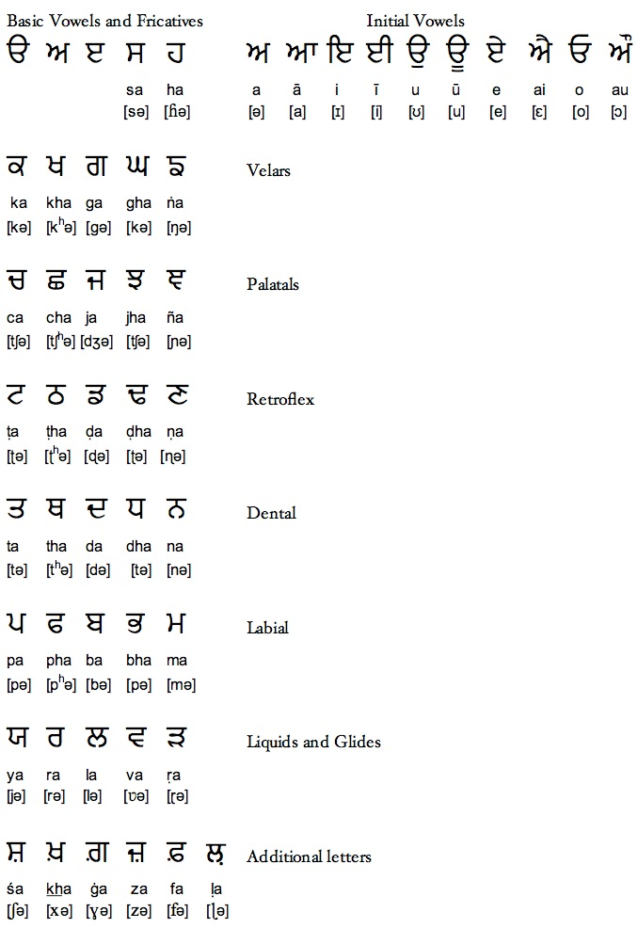

Slide 15
Features type Features
Lexical:
Character-based
Character (Akhar) count (N)
Character-Space Ratio
Character Frequency (35 features)
Vowel count (2 types)
Velar count
Palatel count
Retroflex count
Dental count
Labiel count
LG count
Ending Akhar (A [Aa], N [Na, Ni], L[La, Li])
Lexical:
Word-based
Token/Word count (T)
Average token length
Sentence/Line count
Average sentence length (in terms of N, in terms of T)
Word Frequency
Syntactic:
Punctuation frequency ( | , ? ! : ; ‘ “) (8 features)
Statistical:
Mean
Minimum
Maximum
Sum

Slide 16
Feature Selection

Slide 17
Algorithms used
J 48 Classifier - J48 algorithm is developed by Ross Quinlon. This algorithm will be a development of the ID3 algorithm that might have been being used sooner times. C4.5 algorithm constructs a choice tree. The steps of the algorithm are explained as follows:
Check for base cases.
For each attribute x, find the information gain by splitting on x.
Let x1 be the attribute with highest information gain.
Create a node that splits on x1.
Iterate on the subsets of x1 and add all the nodes as children of x1.

Slide 18
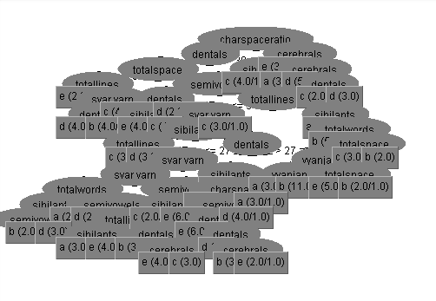
J48 decision tree

Slide 19
results

Slide 20
Best features according to accuracy
Features | Accuracy Percentage
Minimum | 41.33
Palatel Count | 59.67
Avg Sentence length | 63.33
Char Frequency | 69
Mean | 69.67
Line count | 76.67
Vowel count | 81
Word count | 81.67
Labiels | 80
Dentals | 80.33
Avg token length | 82.67
Ending akhar | 83.33

Slide 21
Classifier Algorithm accuracy
S.no | Algorithm Used | Accuracy Achieved
1. | J48 | 86.66%
2. | Random Forest | 73.3%
3. | Bayes Net | 46.6%
4. | Naïve Bayes | 66.66%
5. | KStar | 63.33%
6. | OneR | 10%
7. | Attribute Selected Classifier | 73.33%
8. | Randomizable Filter Classifier | 60%
9. | Sequential Minimal Optimization (SMO) | 76.66%
10. | Locally Weighted Learning (LWL) | 70%
11. | IBK | 83.33%
12. | JRip | 40%
13. | Random Tree | 63.33%
14. | Multilayer Perceptron | 80%
15. | Logit Boost | 70%
16. | Decision Table | 43.33%
17. | Naïve Bayes Multinomial | 66.66%
18. | Bagging | 53.33%
19. | Random Committee | 63.33%
20. | AdaBoost M1 | 6.66%

Slide 22
conclusion
Out of the twenty algorithms considered for classification, the J48 algorithm has performed well and has given an maximum peak accuracy of 86.66% on the dataset. Other algorithms like IBK and Multilayer Perceptron have also provided a decent accuracy ranging from 80% - 83.33%. Algorithms like OneR and AdaBoost M1 have given the least accuracy of 10% and 6.66% respectively. Out of the 20 algorithms used for comparison, the J48 algorithm has performed well with an accuracy of 86.66%.

Slide 23
references
Authorship Identification for Tamil Classical Poem (Mukkoodar Pallu) using C 4.5 Algorithm, Indian Journal of Science and Technology, Vol 9(46), DOI: 10.17485/ijst/2016/v9i46/107910, December 2016, A. Pandian, V. V. Ramalingam and R. P. VishnuPreet
http://sqlitebrowser.org/ - A Browser Interface for SQL Lite
https://www.cs.waikato.ac.nz/ml/weka/index.html - A Guide to use the Weka Toolkit

