Slide 1

Unlocking Workforce Potential: HR Insights and Recommendations
Prepared By OLAWALE .Q ADEREMI

Slide 2

INTORDUCTION
Welcome, everyone! Today,
we're going to uncover the hidden
patterns and insights within our
organization's HR data.
With over 1470 employees, our
company's workforce is its greatest
asset.
But to truly harness this potential,
we need to understand
who's ready for growth, who's
nearing retirement,
and how we can prepare
for the future.
Let's dive into the data
and
discover opportunities
to drive success!

Slide 3

Objective
To leverage HR data and analytics to pinpoint employees ripe for advancement, concurrently identifying those approaching retirement, thereby informing targeted development initiatives, seamless knowledge transfer, and a robust succession strategy.

Slide 4
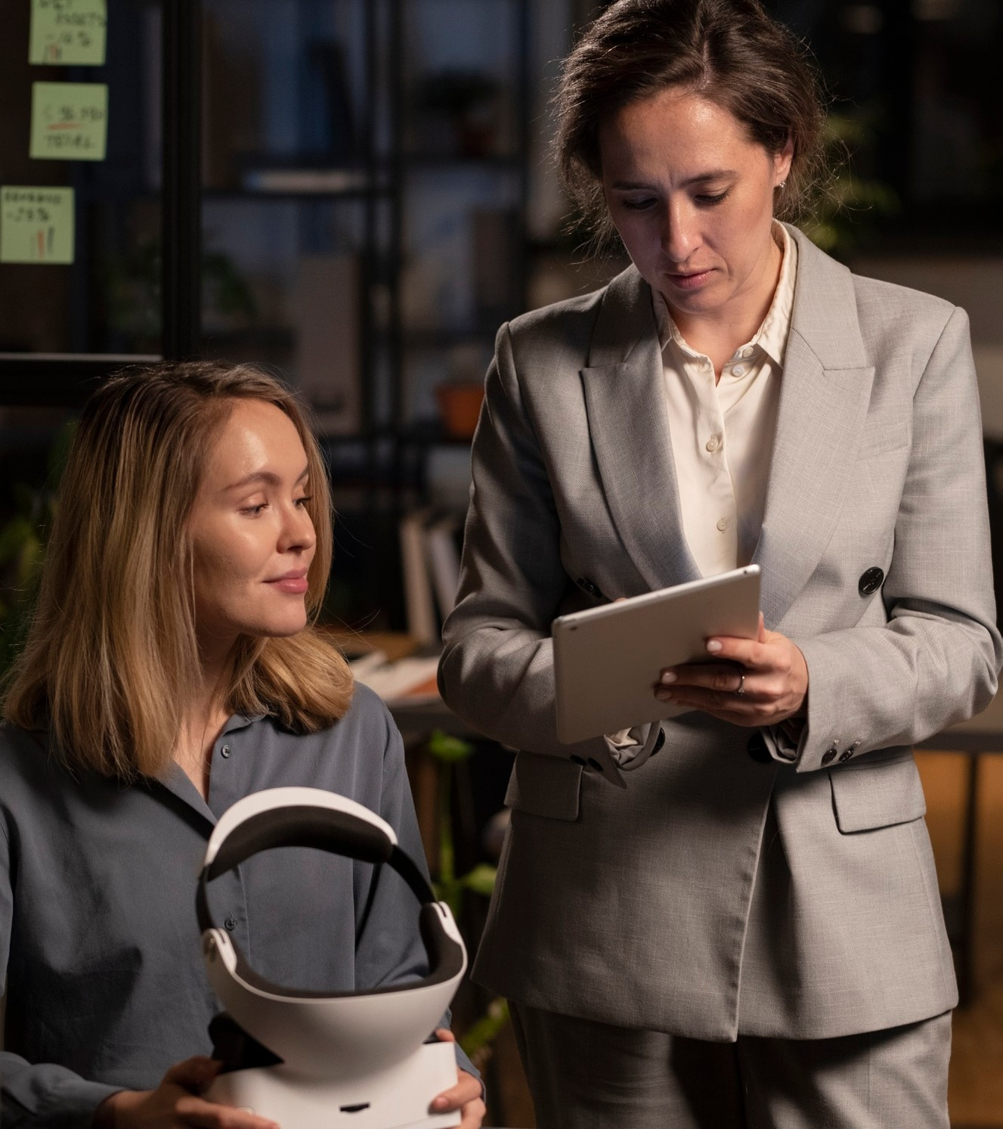
Importance of HR Analytics
KEY FINDING
Total Employee Distribution: Overview of the organization's workforce, detailing the total number of employees across various departments.
Promotion Readiness:
Due for Promotion: Employees prepared for career advancement due to exceptional performance.
Not Due for Promotion: Employees who need further development or haven't met promotion criteria.
Retirement and Succession Planning:
Due for Retrenchment: Employees nearing retirement age, facilitating proactive succession planning and talent management.

Slide 5
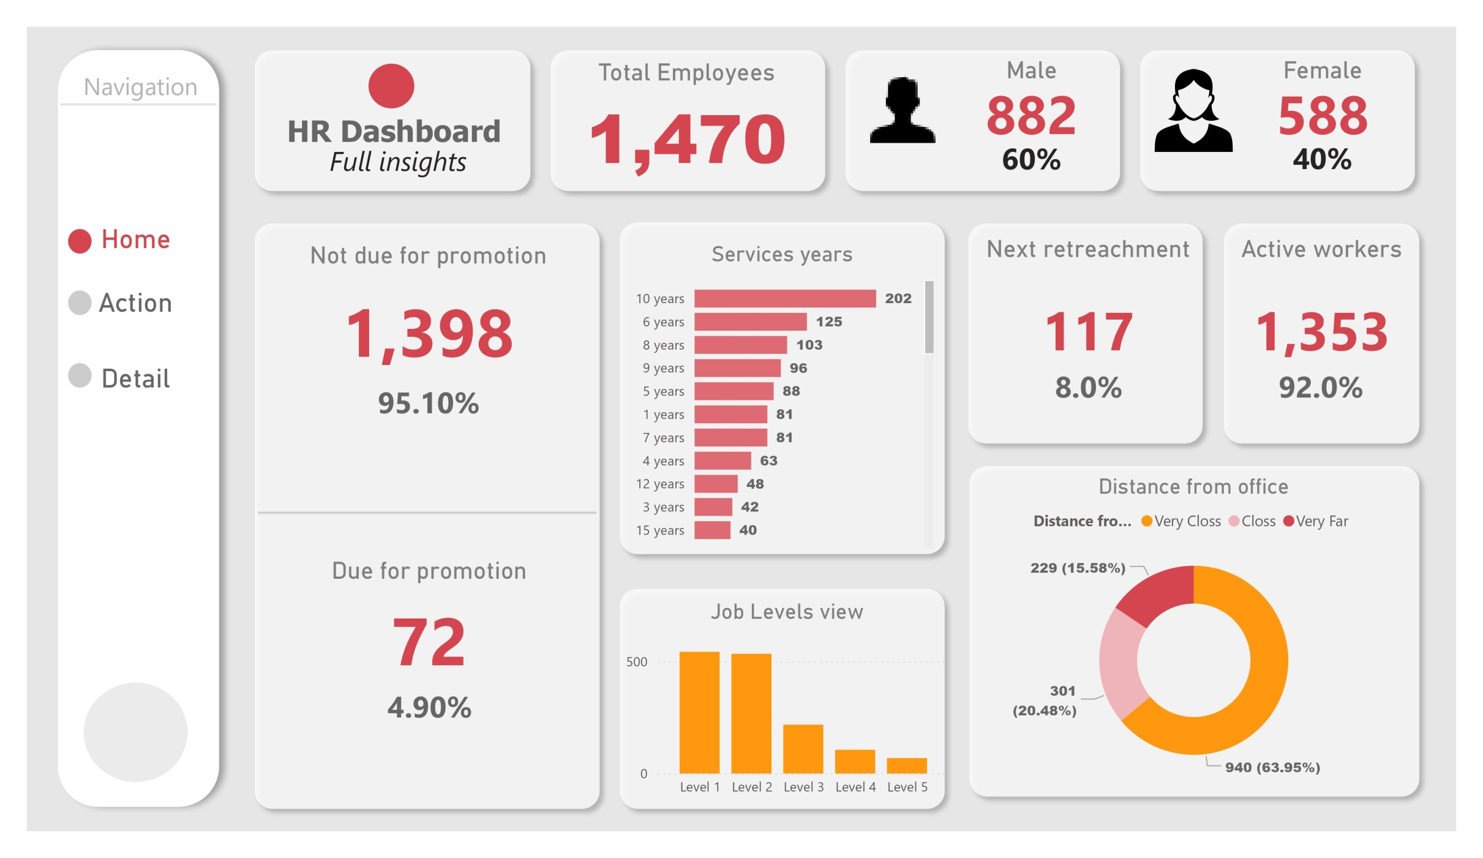
Key Metrics to

Slide 6
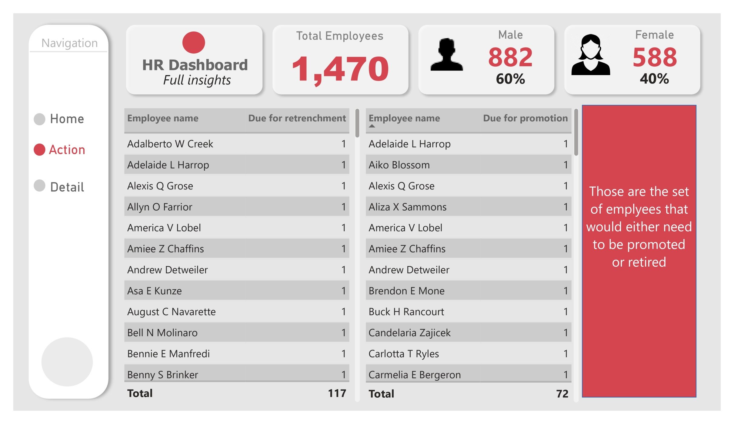

Slide 7
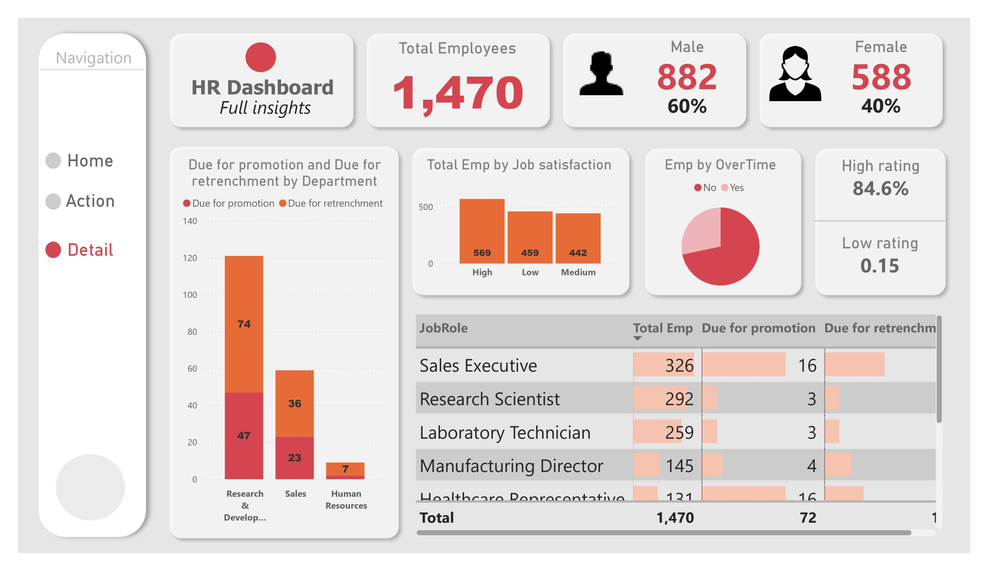

Slide 8
Promotion Readiness Targeted Training: Develop programs for employees "Not Due for Promotion" to enhance skills. Clear Promotion Criteria: Establish and communicate promotion expectations. Recognize High Performers: Reward employees "Due for Promotion" with timely advancement opportunities. Retirement and Succession Planning Succession Planning: Implement processes for seamless knowledge transfer. Retirement Resources: Provide support for employees "Due for Retrenchment". Future Leaders Development: Identify and cultivate potential leaders for critical roles. Departmental Insights Workshops: Conduct specific sessions to tackle departmental challenges. Tailored HR Initiatives: Adapt initiatives to meet unique departmental needs. Collaboration: Encourage knowledge sharing among departments for organizational success. Strategic Workforce Planning Review Workforce Plans: Regularly update plans to align with organizational goals. Data Analytics: Use analytics to forecast talent needs and address gaps. Culture of Learning: Promote continuous learning and development to enhance growth and retention
Recommendation
THANK YOU.

