Slide 1
Aviation Risk Analysis
Ann Wahu July 27, 2025

Slide 2
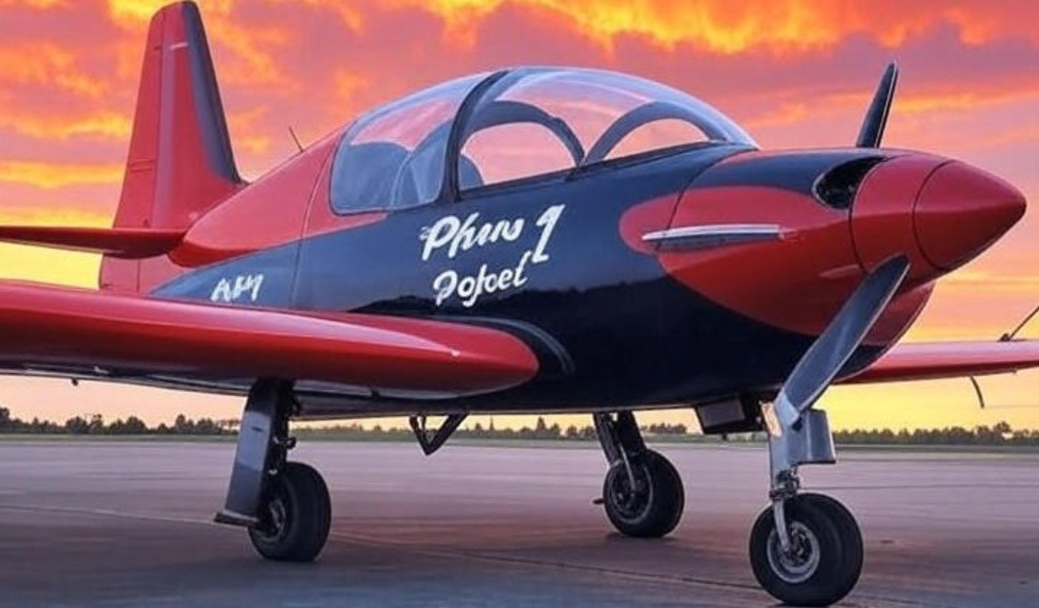
Summary
Descriptive analysis of Aviation Accident data reveals potential risks of purchasing and operating airplanes for commercial and private enterprises:
Purchase of Cessna, Piper, Beech, Boeing and Mooney airplanes accounts for an average accident of 88.2%.
Operation of airplanes during IMC weather condition accounts for a risk score of 43.5% while in VMC condition it 16.8%.
The average risk has been reducing over the years.

Slide 3
Outline
Business Understanding
Data Understanding
Data Analysis
Recommendations
Next
Thank You

Slide 4

Business Problem
Make and Model to Purchase
Best Operational Conditions
Risk trend over the years

Slide 5
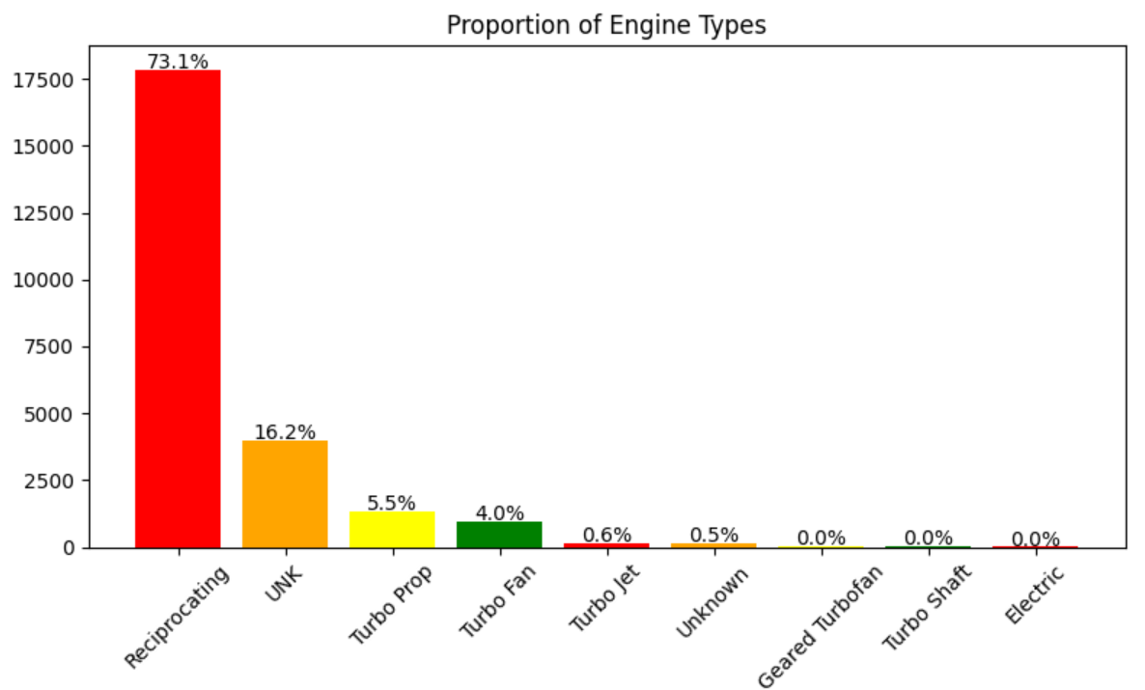
Data & Methods
The dataset comprises 90,348 entries reduced to 32,287 entries after filtering out non-airplane categories and non-amateur values from 1962 to 2023.
Includes accident details with a description of the airplanes such as make, model, weather condition, engine type .…

Slide 6
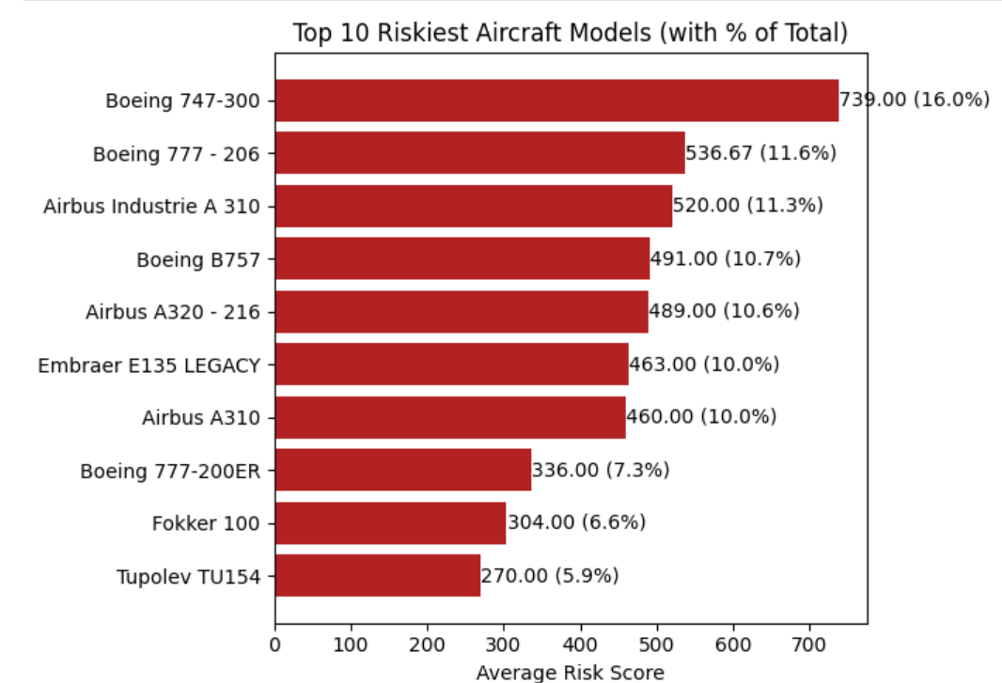
Results
Riskiest make/model is Boeing 747-300, with an average risk of 16%.

Slide 7
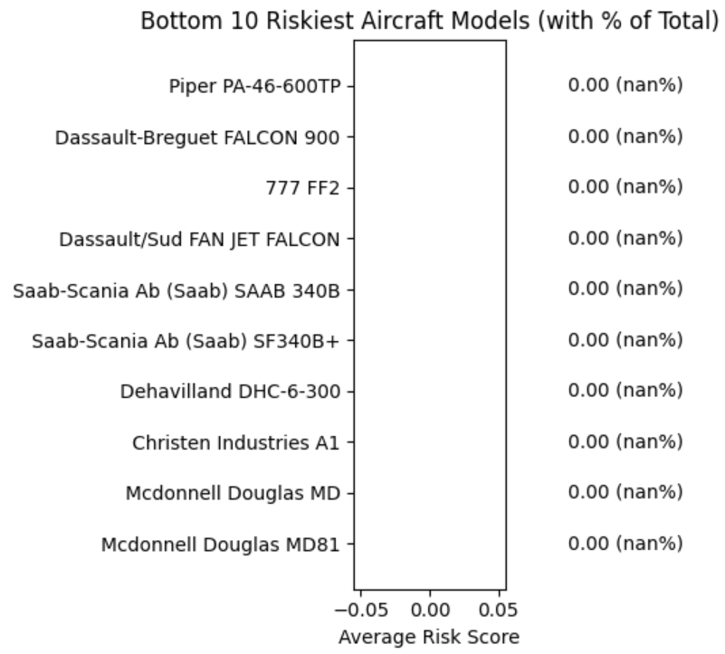
Results
Recommended models are as shown, with Piper, Dassault, Saab-Scania Ab (Saab), Mcdonnell Douglas being safer.

Slide 8
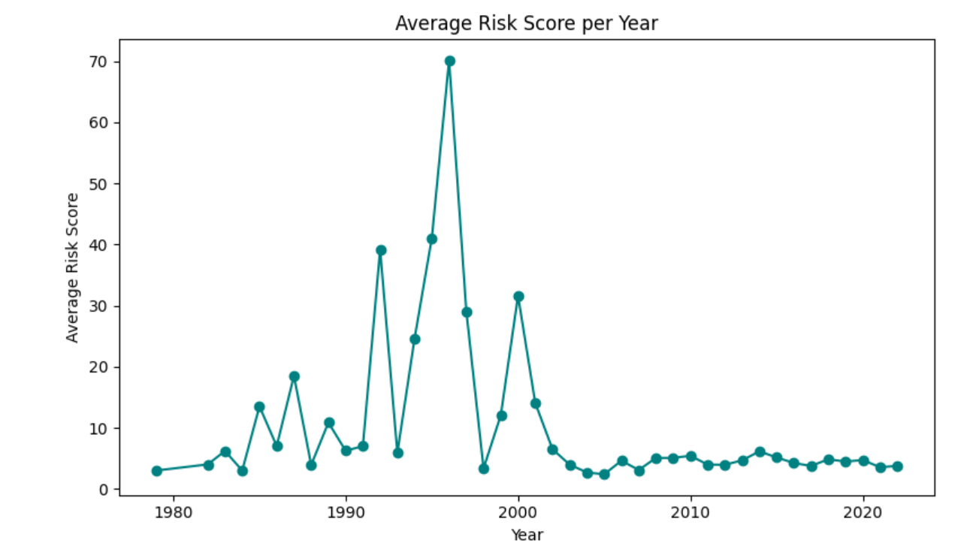
Results
Investment in aviation industry now makes more sense than in the years before because of the advancement in technology and a relatively declining trend.

Slide 9
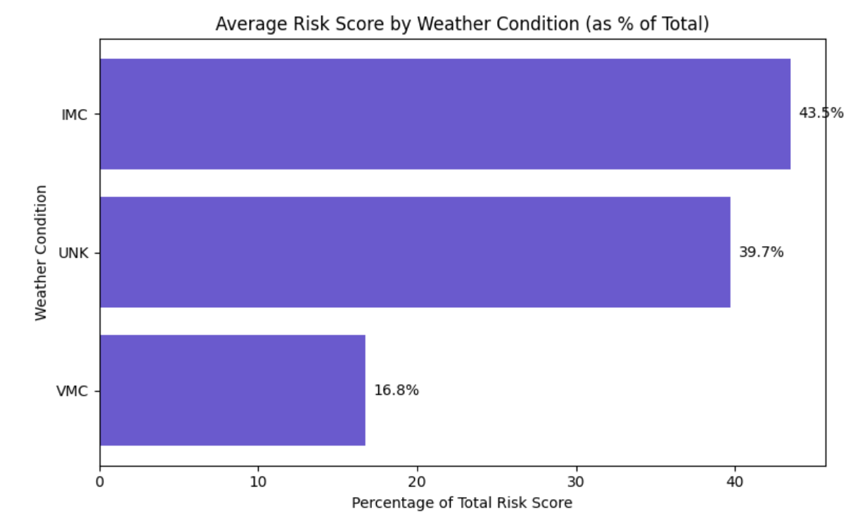
Results
VMC weather condition is the best for operations compared to IMC with a risk score of 16.8%

Slide 10
Conclusions
Purchase the make and models with the least risk score to minimize risk.
Purchase of airplanes with reciprocating engines is largely discouraged, with a whooping risk score of 73%
Encouraged operations are during the VMC weather condition.
Next steps:
Incorporate number of flights to get:
The ratio of accidents to the number of flights
Understand the most preferred airplane and why

Slide 11
Questions
Any Questions?

Slide 12
Thank You!
Email: stacyannewahu@gmail.com
GitHub: https://github.com/wahu-dev/
LinkedIn: https://www.linkedin.com/in/ann-wahu/

