Slide 1







Stack Overflow Developer survey 2019 Analysis
Huaidong(Ben) Wang
April 14, 2024

Slide 2



OUTLINE
Executive Summary
Introduction
Methodology
Results
Visualization – Charts
Dashboard
Discussion
Findings & Implications
Conclusion
Appendix

Slide 3

EXECUTIVE SUMMARY
The survey background and how the data is collected.
The goal of the survey is to find out what is the:
Most desirable language and Databases
Most desirable webframe Platforms
Methodology description.
Data gathering.
Data analysis.
Data visualizations.
Results presentation supported by charts
Discussion of overall findings and implications regarding
Final conclusions of the research.

Slide 4

INTRODUCTION
Stack Overflow‘s annual Developer Survey is one of the largest and most comprehensive surveys of software developers around the world. It gathers insights into programming languages, tools, technologies, job preferences, salary trends, etc.
The purpose of this research is to use this survey data to describe and predict how people are using programming languages, platfromw, database and framworks now and in the future.

Slide 5

METHODOLOGY
Data Source: Stake Overflow Developer Survey 2019
Data collecting
API
Web Scraping
Dedecated liberary
Data cleaning and wrangling with Python.
Exploratory data analysis
Analyzing distribution
Handling outliers
Determine correlations
Data visulation
Using Python languange.
Using IBM Cognos
Final Report

Slide 6
RESULTS
Through the analysis of survey data, we have arrived at clear conclusions regarding several technological trends and current situations in the IT industry. Please follow me to the next slides.

Slide 7
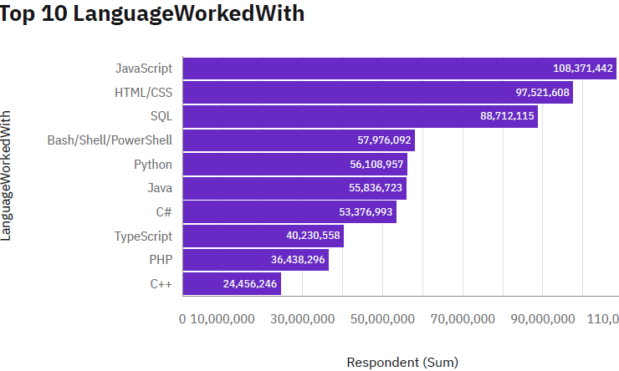
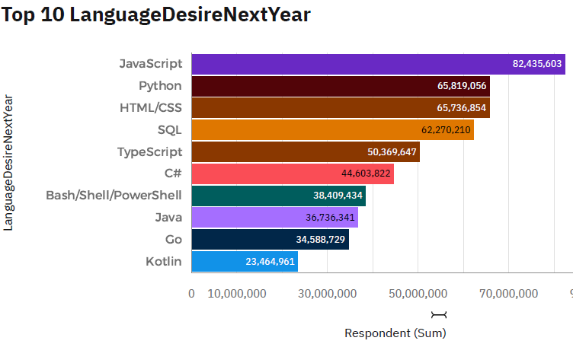
PROGRAMMING LANGUAGE TRENDS
Current Year
Next Year

Slide 8
PROGRAMMING LANGUAGE TRENDS - FINDINGS & IMPLICATIONS
Findings
JavaScript is the most popular programming language in 2019.
HTML/CSS, SQL are second and third in demand language on the job market.
Python, TypeScript might jump up to the front next year.
Implications
Web development and data handling languagea wil keep in high demand in the future.
C++ might fall out of the TOP 10 language next year.
C# will almost keep the same in the next year.

Slide 9
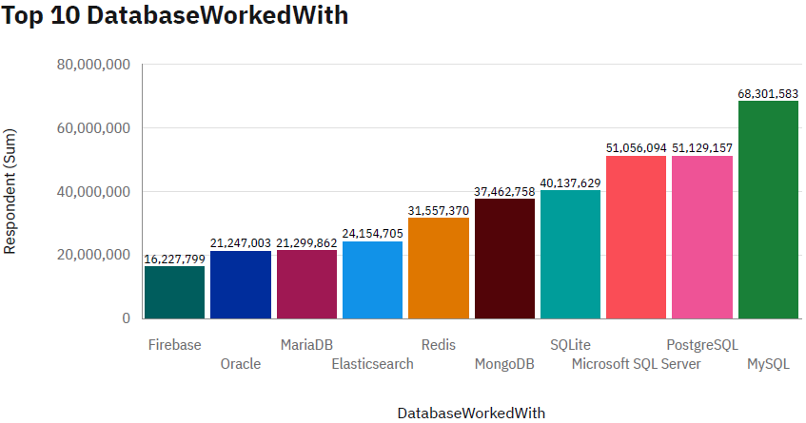
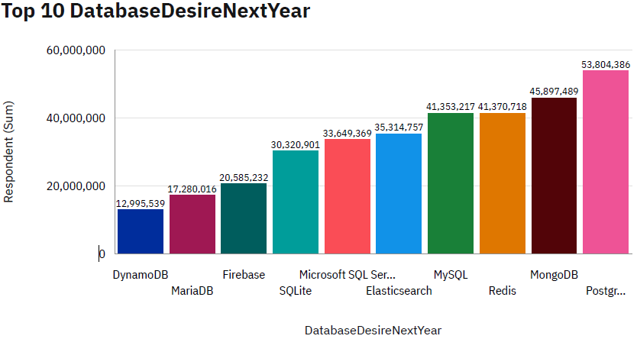
DATABASE TRENDS
Current Year
Next Year
< Bar chart of top 10 databases for the current year goes here >
< Bar chart of top 10 databases for the next year goes here.>

Slide 10
DATABASE TRENDS - FINDINGS & IMPLICATIONS
Findings
MySQL and PostgreSQL are the #1 and #2 Database in the market
MS SQL and Sqlite are the less in demand.
MongoDB as a non SQL database become more interesting to people
Implications
PostgreSQL might become the most popular DMMS next year
MongDB may surpass MS SQL and MySQL to become the second-ranked DBMS. Means people are more interested in non SQL DBMS

Slide 11

DASHBOARD
https://github.com/wahudong/IBM-Data-Analyst/blob/main/IBM%20Capstone%20Project%20Dashboard.pdf

Slide 12
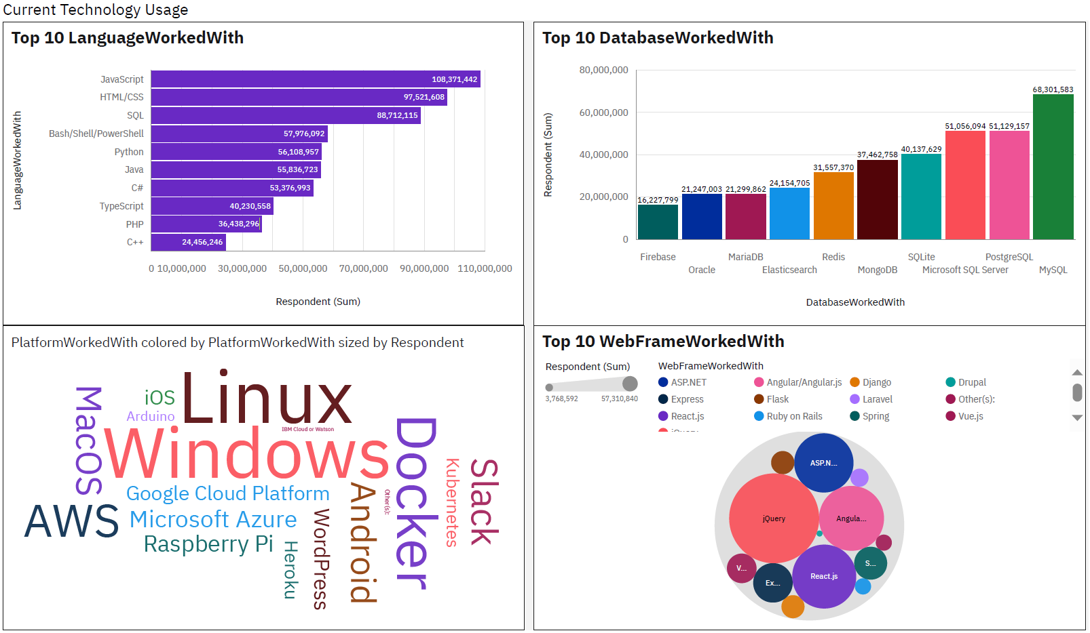
DASHBOARD TAB 1

Slide 13
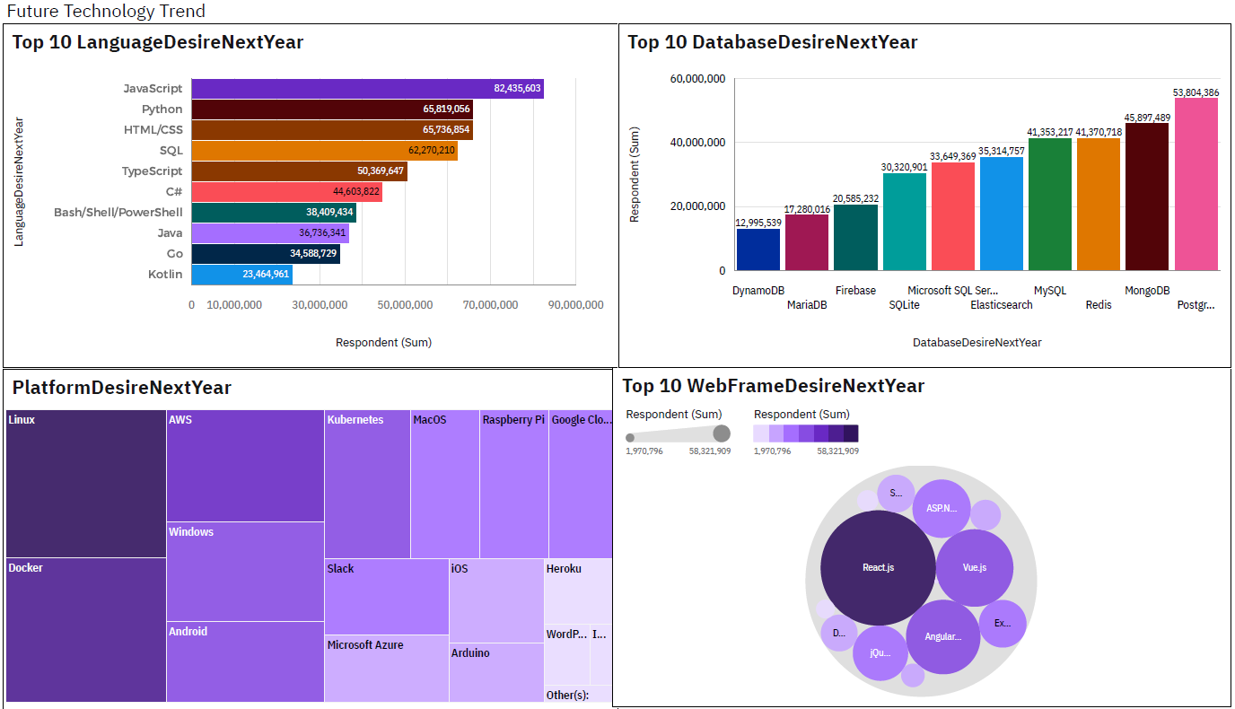
DASHBOARD TAB 2
Screenshot of dashboard tab 2 goes here

Slide 14
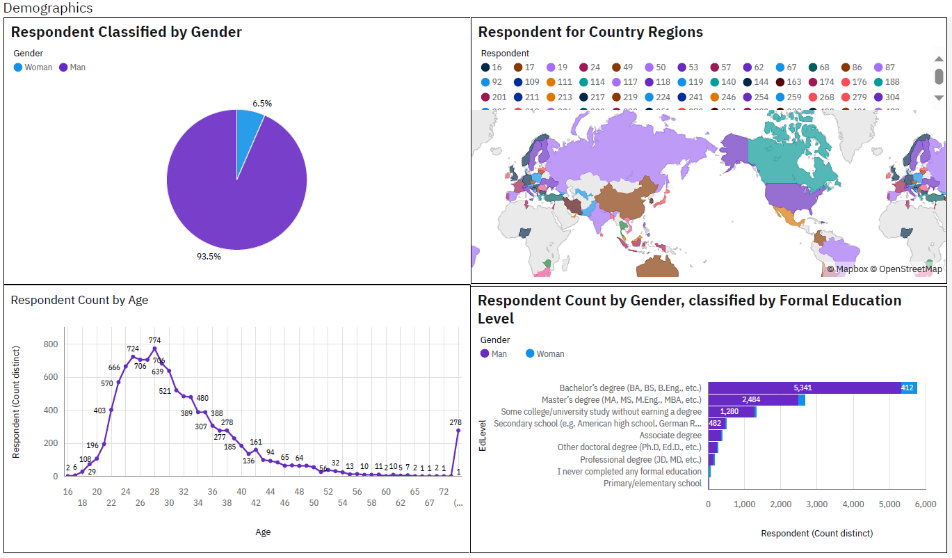
DASHBOARD TAB 3
Screenshot of dashboard tab 3 goes here

Slide 15
DISCUSSION
Technologies evolve rapidly.
Keeping our knowledge updated is crucial to avoid being left behind
Open source product become more popular in recent years.

Slide 16
OVERALL FINDINGS & IMPLICATIONS
Findings
Javascript and Python will become most popular language.
PostgreSQL and MongoDB will stay in the highest demand.
React will gos up to the #1 web framework position. Vue, Angular will be the less demand.
In software development industry, 93.5% people are male while 6.5% people are female
Implications
Get ready for the Non-SQL database.
Software developers in undeveloped country.
Help female more easy to get into software development industry

Slide 17

CONCLUSION
The trends in IT industry is keep changing over time.
People need to keep learning new technologies to avoid being left behind.
More and more people are interested in non-SQL database.
Open source cross platform language will be more popular.

Slide 18

APPENDIX

Slide 19
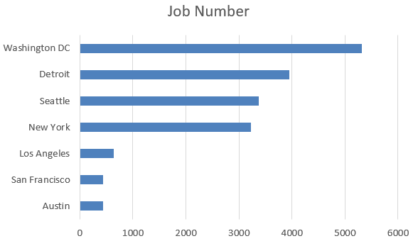
JOB POSTINGS
In Module 1 you have collected the job posting data using Job API in a file named “job-postings.xlsx”. Present that data using a bar chart here. Order the bar chart in the descending order of the number of job postings.

Slide 20
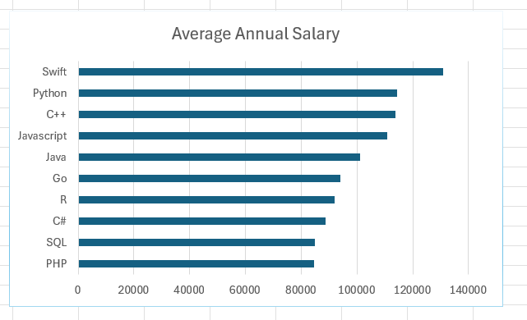
POPULAR LANGUAGES
In Module 1 you have collected the job postings data using web scraping in a file named “popular-languages.csv”. Present that data using a bar chart here. Order the bar chart in the descending order of salary.

