Slide 1
Progress Final Project
Cross-Dataset Evaluation of IoT/IIoT Intrusion Detection Model Generalization on CIC IIoT 2025
Lecturer Advisor
Dr. Ferry Astika Saputra, S.T., M.Sc..
197708232001121002
Dr Tita Karlita S.Kom., M.Kom
197910142002122002
Wahyu Ikbal Maulana
3323600056

Slide 2
Research Background - 5 Why
Why 1
New Dataset:
CIC IIoT 2025
Why 2
Expanding IoT
Threat Landscape
Why 3
CIC IoT 2023
Is Outdated
Why 4
Dataset for
ML Prediction
Why 5
Cross-Dataset
Evaluation
CIC IIoT 2025 offers a realistic IIoT environment, synchronized sensor time-series and network traffic, covering 50 attack types in 7 categories.
ORDR reports ~820,000 IoT attacks per day (+46% YoY). The growing IoT ecosystem demands more up-to-date representative data.
Studies show severe class imbalance in CICIoT2023 (attack traffic ~97.7%), making high accuracy scores misleading for real-world performance.
CIC IIoT 2025 is designed as a real-world IIoT anomaly detection benchmark. Challenge: imbalanced, multi-class data with lower performance.
Models can overfit to a single dataset. Cross-dataset evaluation tests whether a model learns general attack patterns vs. memorizing training data.

Slide 3
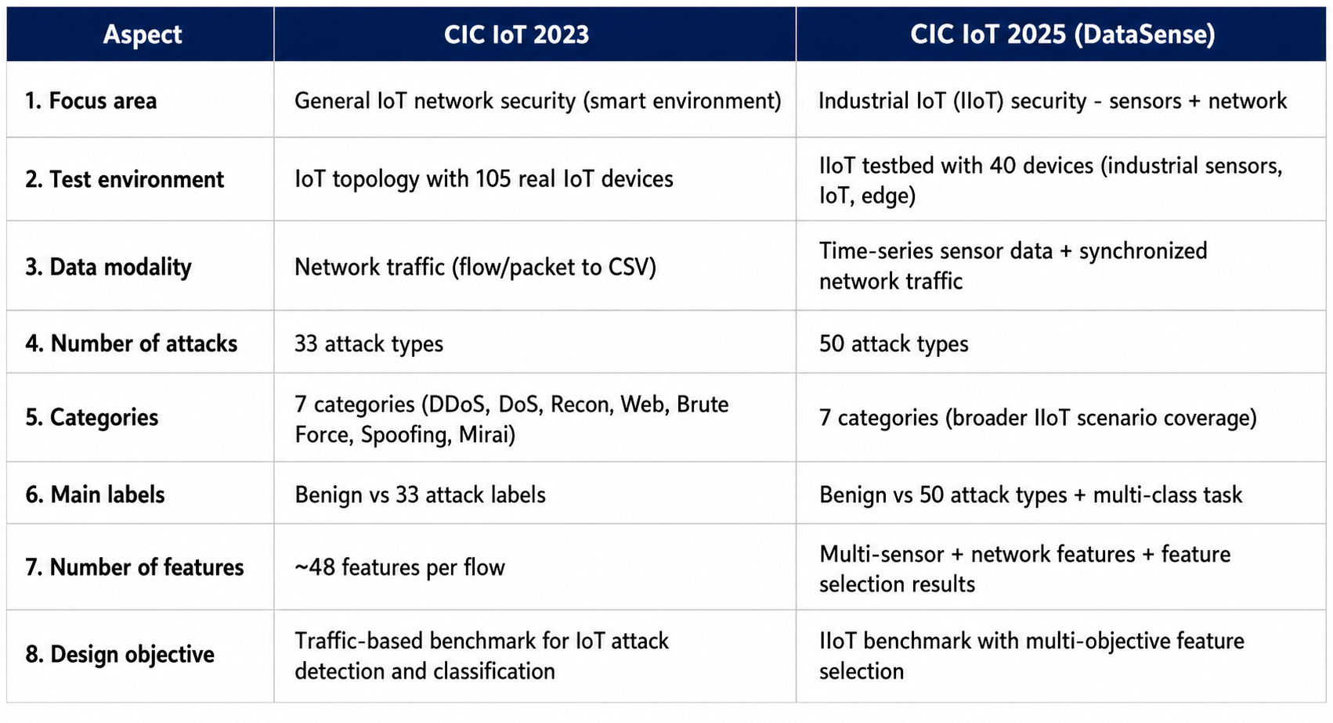
Perbandingan Dataset

Slide 4
CIC IIoT Dataset 2025 (DataSense)
Canadian Institute for Cybersecurity (CIC), UNB — unb.ca/cic/datasets/iiot-dataset-2025.html
Attack Categories (50 total)
40
Devices
50
Attack Types
7
Categories
5
Testbed Layers
Category
Sub-types
Scale
DDoS
14 types
1.14B packets
Realistic IIoT testbed — Not simulated — 40 real interconnected devices across 5 layers (IoT/IIoT, Network, Edge, Cloud, Attacker).
DoS
14 types
537.5M packets
MITM
3 types
125.7M packets
Dual-stream data — Synchronized time-series sensor data (Arduino + industrial sensors) and network traffic captured simultaneously.
Recon
9 types
15.8M packets
Novel feature selection — Multi-objective method balancing detection accuracy and resource efficiency — closer to practical IIoT deployment.
Malware
2 types
1.47M packets
ML/DL benchmark — Supports real-time attack detection and classification experiments. Benign baseline: 12 hours, 259K packets.
Web
5 types
590K packets
Bruteforce
2 types
127K packets

Slide 5
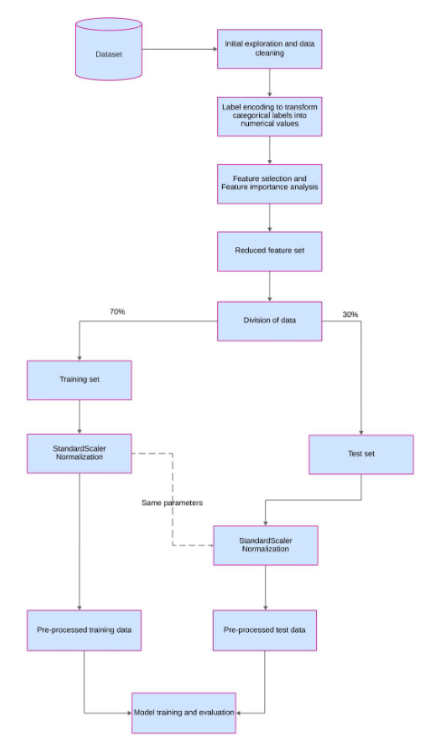
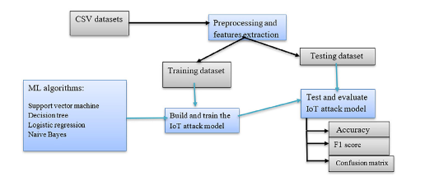
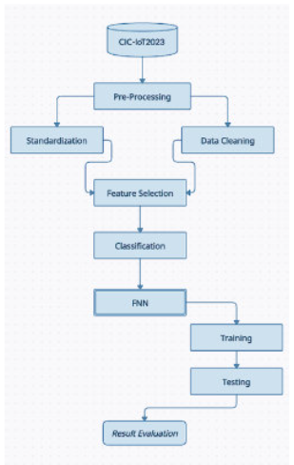
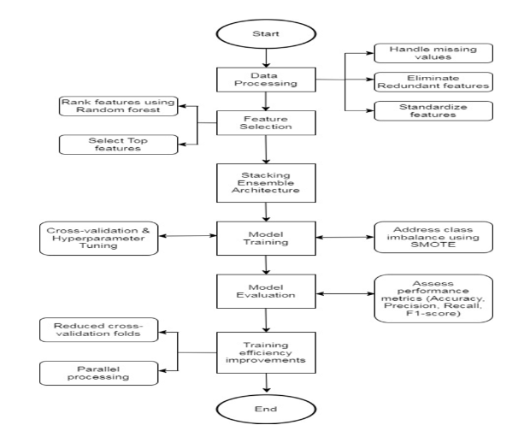
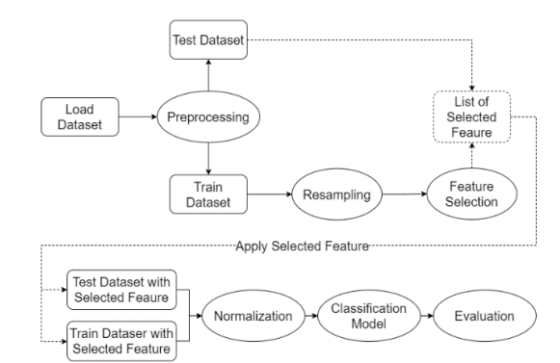
Proposed Workflow cic iot 2023 - related research
Workflow awal yang digunakan sebagai baseline

Slide 6
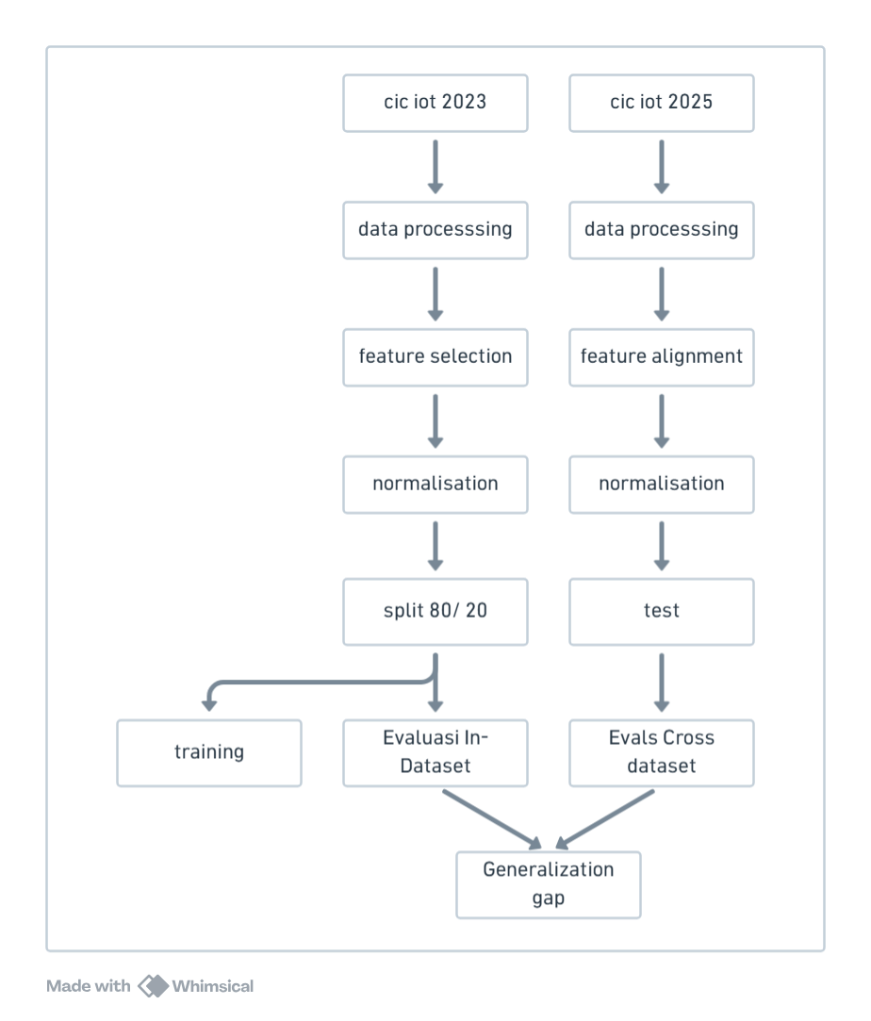
Diagram system

Slide 7
In progressing

Slide 8
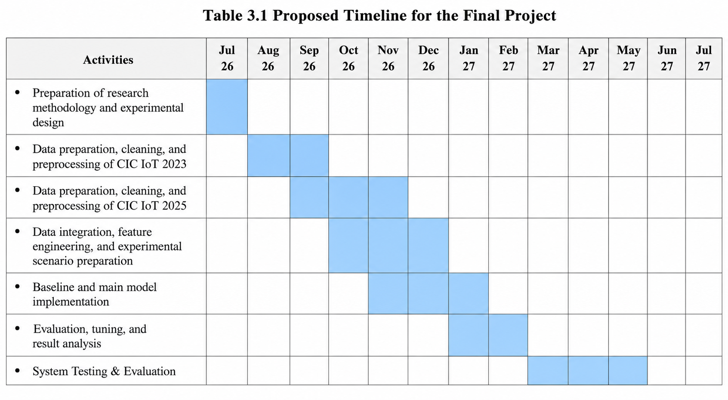
Timeline

Slide 9
Thank You

Slide 10
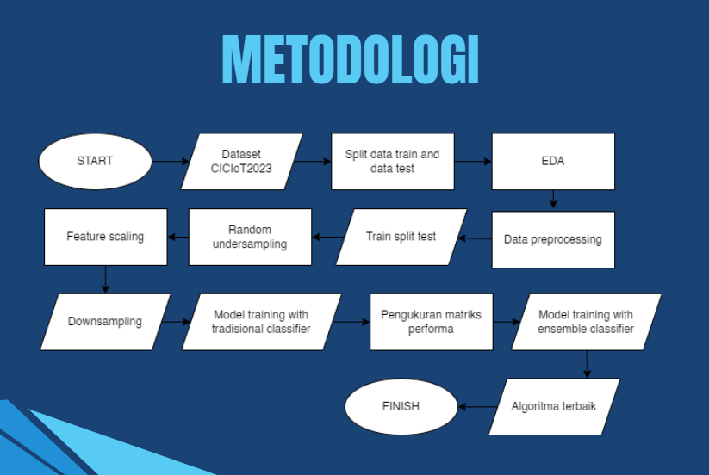
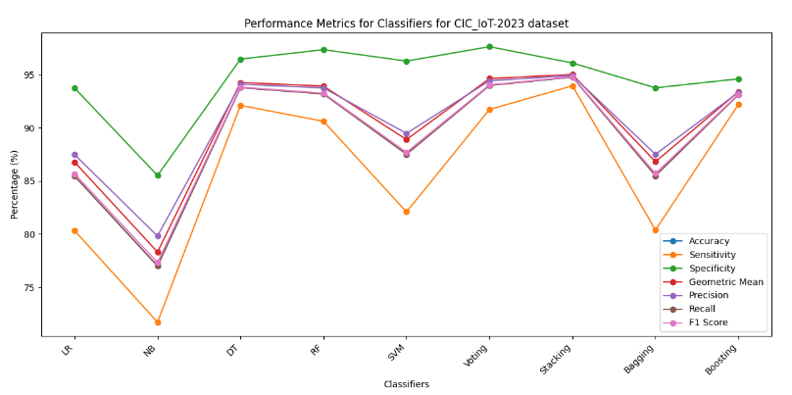
researcher's own previous work
https://github.com/wahyudesu/malware-detection

