Slide 1
Recap

Slide 2
builtin types
byte, sbyte, short, ushort, int, uint, long, ulong, char
float, double, decimal
bool
N.B all these types are actually shorthand for a type like System.Int32 (int) (which are structs)
string is a class (System.String) (which is a class)
var (type deduction, but it's still static typing, not like const in JS)

Slide 3
Source Code Structure
namespace
{
interface class record struct delegate
{
field property method event nested types
{
anonymous types var z=new{x,y} tuples void (int,float)Method {return (1,2.3)}
}
}
}
New style C# allows you to have Main()as a top level function but this is just syntactic sugar
for static class Program { static void Main() {…}}

Slide 4
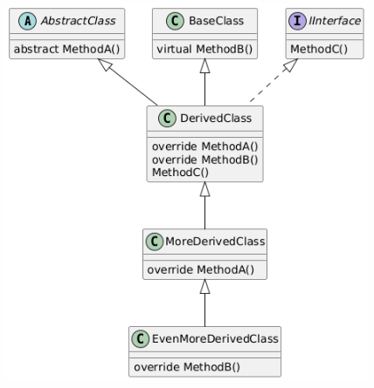
abstract -> class, method
virtual -> method
override -> method
new - > method
static class
static method
static field/property
Example of using static class would be where you only want one resource, like a file handle or db connection, or a single pool of a fixed number of resources.
The downside is you need to deal with race conditions, using locking or Lazy<> initialisation.

Slide 5
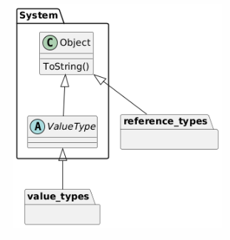
Reference Types – class, record
ValueTypes – primitive, struct

Slide 6
Boxing
Puts a ValueType instance inside a reference counted Object.
It allows to choose between the extra memory requirements of having unnecessary copies of a ValueObject and the extra performance hit of the repeated Box’ing and UnBox’ing operations.
List<MyClass> l; // elements are references (addresses)
//The following can be a problem. Every element is copied when I Add or Get.
List<MyValueType> m; // elements are whole objects of MyValueType
List n; // List of Objects
n.Add( v (a MyValueType)) // boxing
struct MyValueType {
}
MyValueType x;
Object a = x; // Boxing. a is a handle to an object on the heap. And x has been copied into that object.
Method(a, x);

Slide 7
Generics
class GenericClass<T,U,…> where T: constraint
{
}
public class Class {
public T GenericMethod<T>(T arg);
}
class Contravariant<in U>
{
public void Method(U arg);
}
Contravariant<Base> baseType = new();
Contravariant<Derived> derivedType = baseType; // ok
Derived arg = new Derived();
derivedType.Method(arg);
class Covariant<out T>
{
public T Method();
}
Covariant<Derived> derivedType = new();
Covariant<Base> baseType = derivedType; // ok
Base ret = baseType.Method();

Slide 8
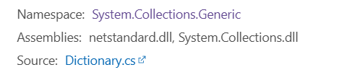
namespace: every type has a fully qualified name which is namespace + type name
assembly: where the executable code is stored (like npm packages and pip packages)
two different things, but often with the same/similar name structure

