Slide 1
672 hours since we last met
224 hours of sleep ?
224 hours of job/housework/chores ?
112 hours of fun/hobbies/social/self-care ?
What happened to the other 112 hours?

Slide 2
Programming in C#:
Not interesting
Too hard
Wrong language
The teacher:
Boring
Not good at teaching
Too hard
Too easy
The projects:
Boring
Not relevant to a real project
Want a change?
Follow a book?

Slide 3
It really doesn’t matter what programming language you learn at this stage
Programming is development
You have to enjoy development
Creating a solution to your client’s problem
You learn through practice
You do not learn by following instructions, reading or watching someone else do it
You can learn about design principles and patterns, unit testing techniques, all you like:
But they will not mean anything to you until you have experience of lots of coding.
Effort is the Algorithm
Veritasium: What Everyone Gets Wrong About AI and Learning – Derek Muller Explains

Slide 4
Which Skill? (Let’s bust a myth)
Language A advertises 1000 vacancies and there are 5000 candidates applying
Language B advertises 100 vacancies and there are 200 candidates applying
Both are popular in the industry and likely to be around forever
As a student, which skill would you choose?
So why are the job sites (and CYF) so f***ing obsessed about which languages have the most jobs or are trending?
(Because it’s the easiest way to make it look as though they are doing their job)

Slide 5
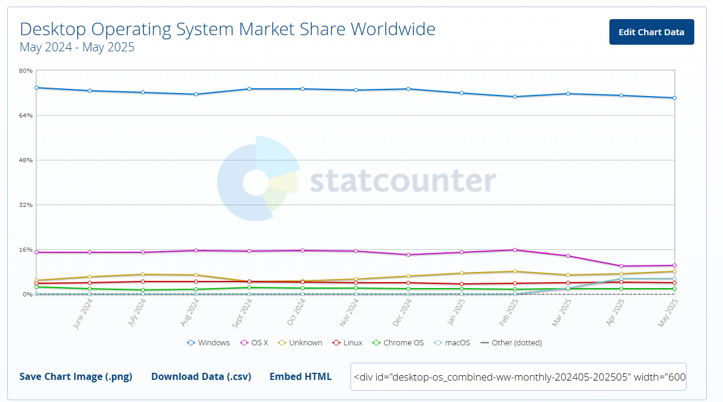

Slide 6
