Slide 1
.Where( word => word[6] == ‘S’ )
.Where( word => word.Count(c=> c==‘E’) >= 1 )
.Where( word => word.Count(c=> c==‘S’) >= 1 )
.Where( word => word.Count(c=> c==‘T’) >= 1 )
.Where( word => !word.Contains(‘A’) )
.Where( word => !word.Contains(‘B’) )
.Where( word => !word.Contains(‘D’) )
**** **S*
E,S,T >= 1
A,B,D = 0
DATA BASE
LONG TUSK
.Where( word => word[4] == ‘T’ )
.Where( word => word[6] == ‘S’ )
.Where( word => word.Count(c=> c==‘N’) >= 1 )
.Where( word => word.Count(c=> c==‘U’) >= 1 )
.Where( word => !word.Contains(‘A’) )
.Where( word => !word.Contains(‘B’) )
.Where( word => !word.Contains(‘D’) )
**** T*S*
E,N,S,T,U >= 1
A,B,D,G,K,L,O = 0
UNDO TEST
UN** TEST
E,N,S,U >= 1; T>=2
A,B,D,G,K,L,O = 0
.Where( word => word[0] == ‘U’ )
.Where( word => word[1] == ‘N’ )
.Where( word => word[4] == ‘T’ )
.Where( word => word[5] == ‘E’ )
.Where( word => word[6] == ‘S’ )
.Where( word => word[7] == ‘T’ )
.Where( word => !word.Contains(‘D’) )
.Where( word => !word.Contains(‘O’) )
Find a way to document your algorithm!

Slide 2
And create Unit Tests!
Help you in writing code, e.g. testing endpoints of external apis, testing database clients
Make sure you know as soon as you break something (it takes a long longer to fix a bug that was introduced a long time ago)
Force you to write modular code (so that your components have single responsibility)
Try writing the unit test first. You might be surprised at how well it works.

Slide 3
Design for Change
Designing something concrete, like a building or a car, is about designing something that is stable – it doesn’t change.
1
Designing for software is about designing something that supports change.
2

Slide 4
What is a Dependency
A dependency is something that enables a change to have an impact on your software (it might break it, or require it to change) but it’s necessary otherwise your software can’t do anything useful.
var db = new PostgresDatabase("connectionStringAndPassordForPostgres");
db.DoSomethingSpecificToPostgres();
var data = db.LoadData("select * from table");
This code depends on Postgres, and the methods that the Postgres libraries require you to call.
If the methods change, your code must change
If you change to another type of database your code must change
But your code is not interested in what the database is. It only cares about the data object

Slide 5
Dependency
depends
If this end changes,
A dependency on a type happens every time the type’s name is used:
Inheritance
Interface Implementation
Variable declaration
Function call
This end has to change or be recompiled

Slide 6
SOLID principles
Single Responsibility
Open for externsion / Closed for modification
Liskov Substitution Principle
Interface Segregation
Dependency Inversion Principle

Slide 7
Single Responsibility
Classes and functions should have single responsibility
public void ProcessData()
{
Data data;
if (usePostgres){
var db = new PostgresDatabase("connectionStringAndPassordForPostgres");
db.DoSomethingSpecificToPostgres();
data = db.LoadData("select * from table");
}
else{
var db = new SqlServerDatabase("connectionStringAndPassordForSqlServer");
db.DoSomethingSpecificToSqlServer();
data = db.LoadDataButInASqlServerKindOfWay(“select ….”);
}
// do something with data
switch (reportType)
{
case ReportType.Pdf:
data.ToPdf();
break;
case ReportType.Excel:
…
}
}
It should just do this
public void ProcessData(
Database db,
ReportGenerator repgen
)
{
data = db.LoadData();
repgen.CreateReport(data);
}
This will only need to change if the Database and ReportGenerator class methods (not the implementations) change

Slide 8
Open for extension/Closed for modification
Ideally code shouldn’t change once it’s written into a class
If it doesn’t change, it’s dependents can’t break
Options for adding new functionality include:
Inheritance
implementation of interfaces
Decorator Pattern
C# extension methods
public abstract class Database
{
// this doesn't change ever again (ish)
public abstract void LoadData();
}
public class PostgresDatabaseAdapter : Database
{
public override void LoadData()
{
// Do Postgres stuff in here
}
}
public class SqlServerDatabaseAdapter : Database
{
public override void LoadData()
{
// Do SqlServer stuff in here
}
}
// + can easily add new subclasses later

Slide 9
Liskov Substition Principle
You should be able to use a derived class everywhere a base class is required.
How?
If you override a method, make sure it does pretty much the same thing
C# prevents you from reducing the visibility of base methods.
public void ProcessData(
Database db, // base class
ReportGenerator reportGenerator // base class
)
{
// Liskow substitution principle says that
// anything that inherits from Database
// and ReportGenerator can be used here
Data data = db.LoadData();
reportGenerator.GenerateReport(data);
}
ProcessData(new SqlServerDataBaseAdapter(), // derived
new ExcelReportGenerator()); // derived
ProcessData(new PostgresDataBaseAdapter(), // derived
new PdfReportGenerator()); // derived

Slide 10
Interface Segregation
// Not Segregated
public interface IDataprocessingResourceProvider
{
Database getDatabase();
ReportGenerator getReportGenerator();
}
// Segregated
public interface IDatabaseResourceProvider
{
Database getDatabase();
}
public interface IReportGeneratorResourceProvider
{
ReportGenerator getReportGenerator();
}
The methods on an interface should belong together
Don’t put unrelated methods on the same interface
Interfaces require their methods to have implementations, so a large interface forces a class to implement pointless code.

Slide 11
Dependency Inversion Principle
DataProcessor contains all its dependencies and even dependencies it might not end up using (e.g. both Postgres and SqlServer databases). If any of them changes, DataProcessors needs to change and be tested
var dataProcessor = new DataProcessor();
dataProcessor.ProcessData();
DIDataProcessor only depends on the base class Database, which contains no code only a method signature. It’s not likely to change. The main program chooses whether it wants to use a PostgresDatabase or SqlServerDatabase, and does not need to recode DIDataProcessor when it changes its mind
var reportGeneratorDI = new OnlyDoReports().getReportGenerator();
var databaseDI = new OnlyDoPostgresDatabses().getDatabase();
var dataProcessorDI = new DIDataProcessor(databaseDI, reportGeneratorDI);
dataProcessorDI.ProcessData();

Slide 12
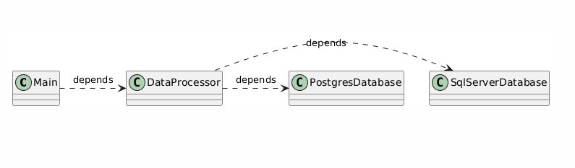
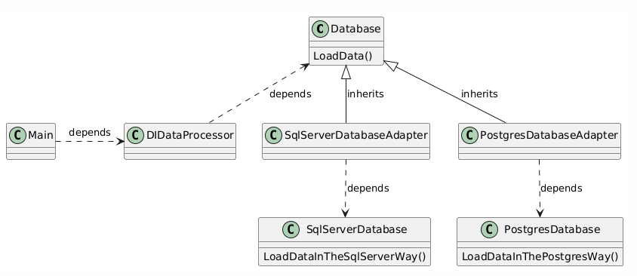
Dependency Inversion Principle UML

