Slide 1













Thinking about Caching
Computer
$0.5×{10}^{−9}$ s
LAN
$1×{10}^{−6}$ s
$100×{10}^{−3}$ s
L1 Cache
$1×{10}^{−3}$ s
WAN /
Cloud
$1.0×{10}^{−9}$ s
IPC
RAM
$50×{10}^{−9}$ s
$100×{10}^{−6}$ s
$10×{10}^{−3}$ s
SSD
HDD

Slide 2
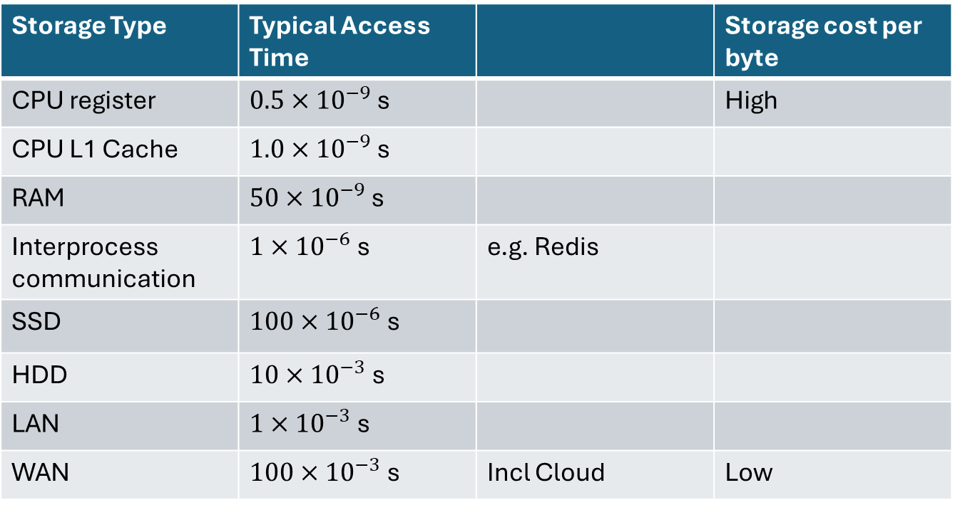
The motivation for caching comes from the different speeds of different types of memory
Generally, the only place that data can be manipulated is in a CPU, so the hardware design places the fastest memory there. But it’s expensive so caching is all about taking advantage of the low cost of large amounts of memory, while making sure you get the best performance out of it.
Storage Type | Typical Access Time |  | Storage cost per byte
CPU register | $0.5×{10}^{−9}$ s |  | High
CPU L1 Cache | $1.0×{10}^{−9}$ s
RAM | $50×{10}^{−9}$ s
Interprocess communication | $1×{10}^{−6}$ s | e.g. Redis
SSD | $100×{10}^{−6}$ s
HDD | $10×{10}^{−3}$ s
LAN | $1×{10}^{−3}$ s
WAN | $100×{10}^{−3}$ s | Incl Cloud | Low

Slide 3
Code should do things once only, if possible
internal class CachingDataSource() : IDataSource
{
// use an async style SemaphoreSlim to allow async methods to be called in a thread-safe manner
// otherwise can use lock
private readonly SemaphoreSlim semaphore = new SemaphoreSlim(1, 1);
private string? cachedData = null;
private readonly IDataSource dataSource = new DataSource(); // use a real data source
public async Task<string> GetDataAsync()
{
await semaphore.WaitAsync(); // if the semaphore is in use, task will wait until it is free
try {
cachedData ??= await dataSource.GetDataAsync(); // ??= only calls GetDataS
return cachedData;
}
finally
{
// always called before returning from the method
semaphore.Release();
}
}
}

Slide 4
Cache Design Principles
Caching applies to anything that takes a while:
Computation
Don’t do anything you don’t need to:
Deferred computation
Don’t fill the cache until you know it’s needed

Slide 5
ASP.NET Service Lifetime rules
 | Services method | Lifetime | Number of Instances
Singleton | AddSingleton<> | As long as the server is running | Exactly one
Scoped | AddScoped<> AddControllers() | From receiving a request to sending the response | One for each request
Transient | AddTransient<> AddHttpClient() | For as long as it is in use
Long lived
Short lived
If a short lived service is injected into a longer lived service, it will have its lifetime increased to the longer lifetime,

Slide 6
How do you decide which Lifetime?
Look at the fields in the class
Decide how long the values stored in them need to remain valid
If the values are valid for all users (like a cache of valid Tube Stations) then it should be a singleton
If the values are used to process one request (like a pair of Start/destination Tube stations for a route query) then it should be scoped.
If it has no state it should probably be transient.
NB. This is about fields, not local variables in methods.
Session is a lifetime that is supported using HttpSession.

Slide 7
C# static
A static field or property is one that has only one instance in the whole program. New instances are not created when the class is instantiated.
A static method is one that does not have an implicit this variable, so it does not run in the context of an instance of a class
A static class is one that cannot be instantiated. Any fields, properties and methods are static

Slide 8
C# Scope and Lifetime
Scope means “where can I see a variable or type”
Accessibility is about whether I can access a type I can see (is it public, protected, private)
Generally all classes in a Project are in scope for the rest of the Project (but may not be accessible)
Local variables are scoped to the block (between the {…}) in which they are declared.
Lifetime means “how long does this variable or object live for”
Local variable live as long as the block in which they are declared and are stored on the stack
Static variables are stored in a fixed section of memory usually called Data
Class instances live as long as there is a reference to them and are stored on the heap when new() called.

Slide 9
Namespaces and Assemblies
An Assembly is the physical store of the compiled code (as files):
A Nuget Package is like an npm package
A Nuget Package contains one or more Assemblies
A project (.csproj) builds one Assembly (.dll or .exe)
When you work on a .csproj you need to define it’s dependencies in terms of Nuget packages (as you do with package.json in npm) or other .csproj projects
A Namespace defines the fully qualified name of types. All types have a unique namespace+type.
The using keyword simply declares the namespace root as a potential prefix for types referenced in the .cs file.
Unlike javascript import it doesn’t tell it where the package is.

