Slide 1
Algorithms
Sorting

Slide 2

A Bootcamper’s dream…
Interviewer:
How do you sort this array of numbers?
Let myArray = [34, 939, 30, -3, 32, -920, 344, 344, 12…];
Bootcamper:
Easy!
Call mArray.sort()
Time for MY questions now:
What’s my starting salary?
How many days holiday?

Slide 3

…dream turns into nightmare…
Interviewer:
Not so fast!
What if my array contains a million zillion elements?
…and I only want the first 50?
What if the possible element values are a fixed set? Like days of the week?
…
Bootcamper:
Pahh! What if you shoved your job up your (*”&(“!

Slide 4

…a more constructive answer might be…
Bootcamper:
I’d investigate how Array.sort() works internally and analyse whether it is suitable for my purposes
I’d implement code that is optimal for my requirement
Either way:
You have to understand something about sorting algorithms

Slide 5
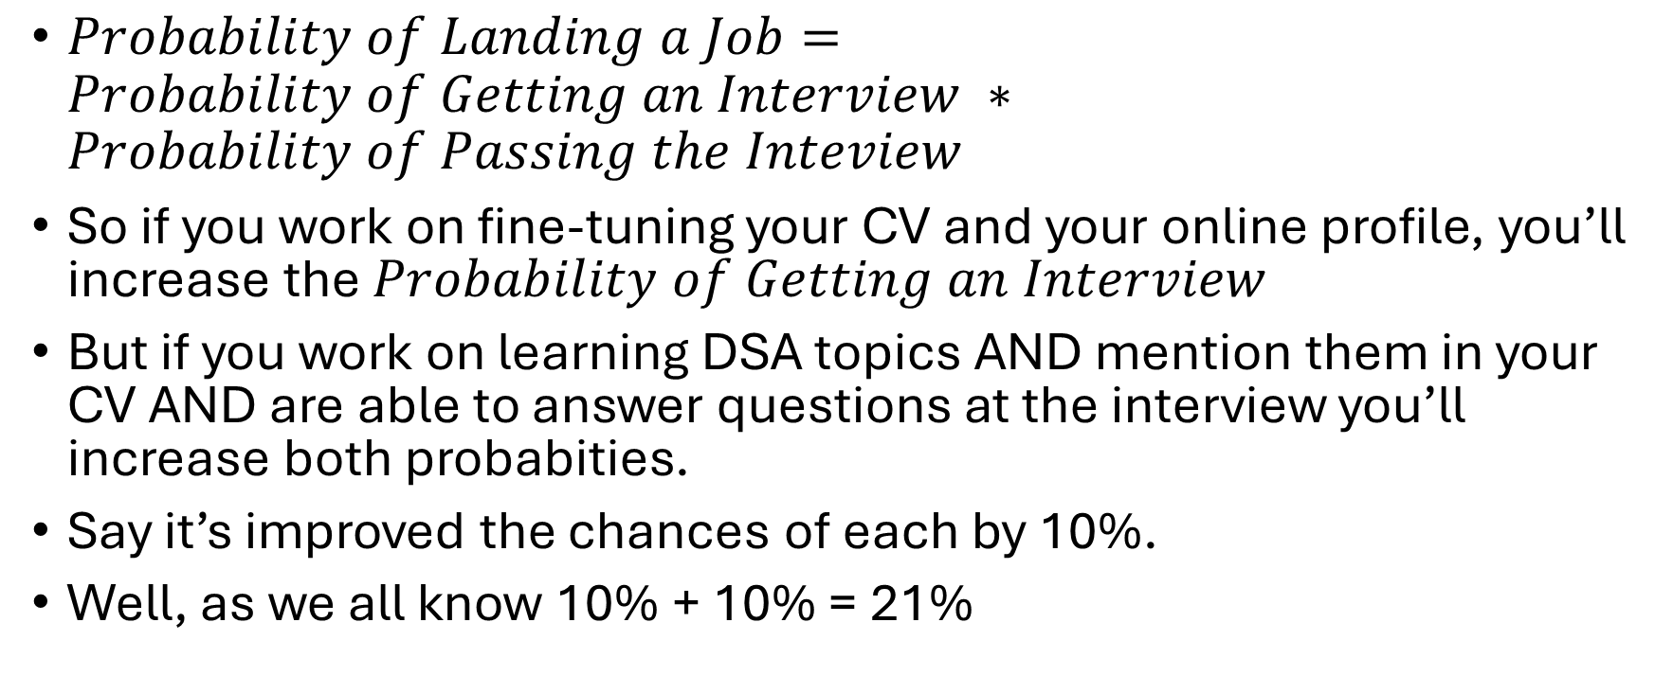
A Quant might look at it like this…
$Probability of Landing a Job=Probability of Getting an Interview ∗Probability of Passing the Inteview$
So if you work on fine-tuning your CV and your online profile, you’ll increase the $Probability of Getting an Interview$
But if you work on learning DSA topics AND mention them in your CV AND are able to answer questions at the interview you’ll increase both probabities.
Say it’s improved the chances of each by 10%.
Well, as we all know 10% + 10% = 21%

