Slide 1
Starline Co.– Technical Presentation
Date: 03/13/2020
Presenter:Prahlad Lama

Slide 2
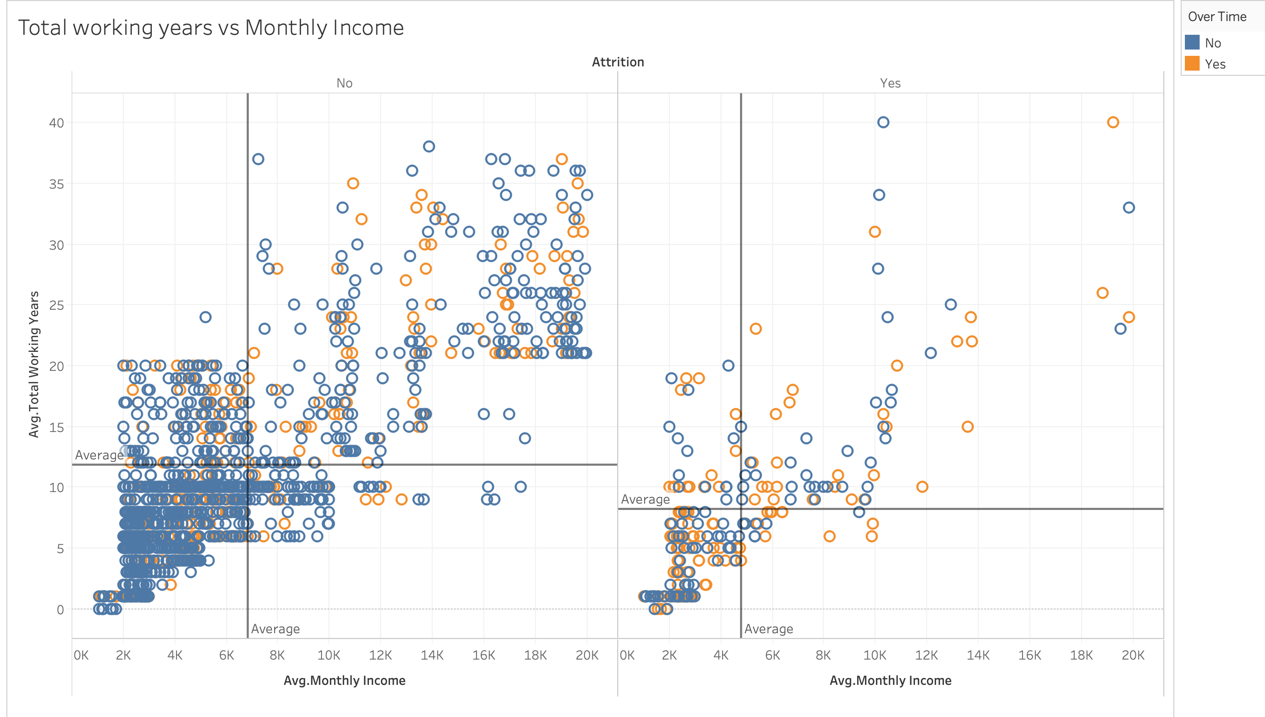
Employees who are subject to continuous overtime with low income lead the way with respect to Churn, with Monthly Income, Overtime & Total working Years being the leading contributors to Churn. .
Avg.Monthly Income:$6.8k
Avg.Totalworkingyrs:11.8 yrs
Avg.MonthlyIncome:$4.7K
Avg.Totalworking years:8.2 yrs
Key Insights
Overtime : Employees who work overtime (30.5%)¹ are highly likely to leave the company than who don’t (10.4%)¹
Monthly Income: Employees who make less than $4.7K (46.8%)²on average are likely to Churn than those making $6.8 k or higher monthly income.
Total working Years: Employees who works less than 8.2 years(42.5%)² on average are highly likely to leave the company than those working 11.8 years or more.
Source: Star line Co.Statistical Records
1.Refer to Slide 8 barplots where Leavers % Over Time (30.5%)
2.Refer to cap_2 python HR

Slide 3
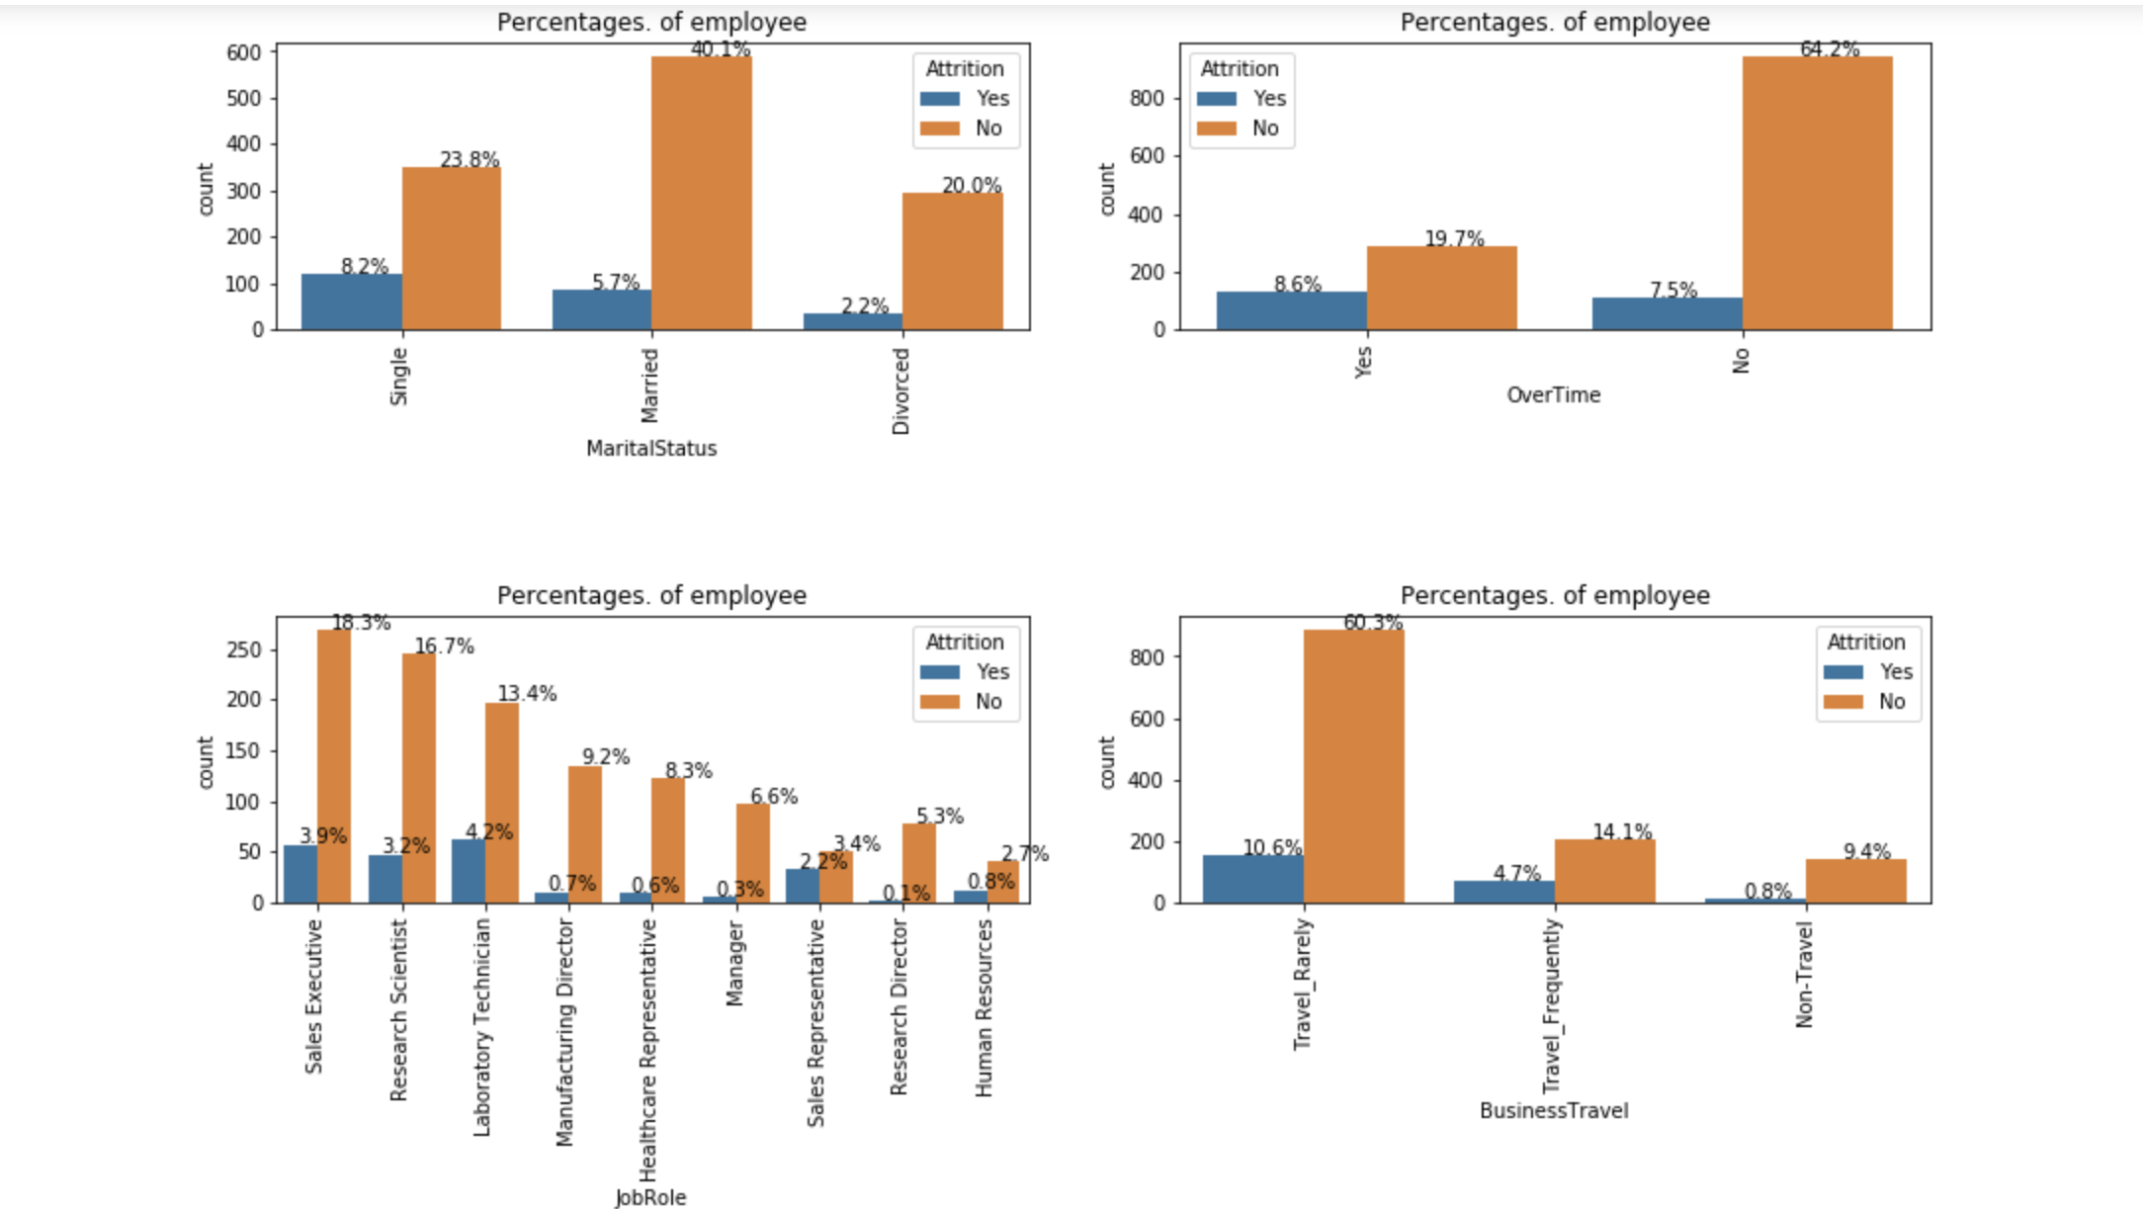
From Count plot Chart ,we see that Employees working Overtime, who are Single, as Lab Technician and who Travel Rarely constitute the highest percentages of employees who left the company.
Key Insights
Job Role: Sales Representative and Lab Technician together make up 6.4% of total Churn and are highly prone to leaving as they have high disproportionate Attrition rate within¹.
Single employees make up the highest churn %(8.2%) and are likely to leave
Over-timers are more prone to (8.6%) Churn than non-overtimers(7.5%)
Employees who travel rarely make up biggest chunk of Leavers but within subgroup who Travel Frequently are more likely to Churn²
Count plots with Percentage of Employees
1:Rerer to Slide 7 barplots where Leavers %,Sales Rep(39%) and Lab Technician(23%)
2:Refer to Slide 8 barplots where Leavers % Business_travel_frequently (24.91%)

Slide 4
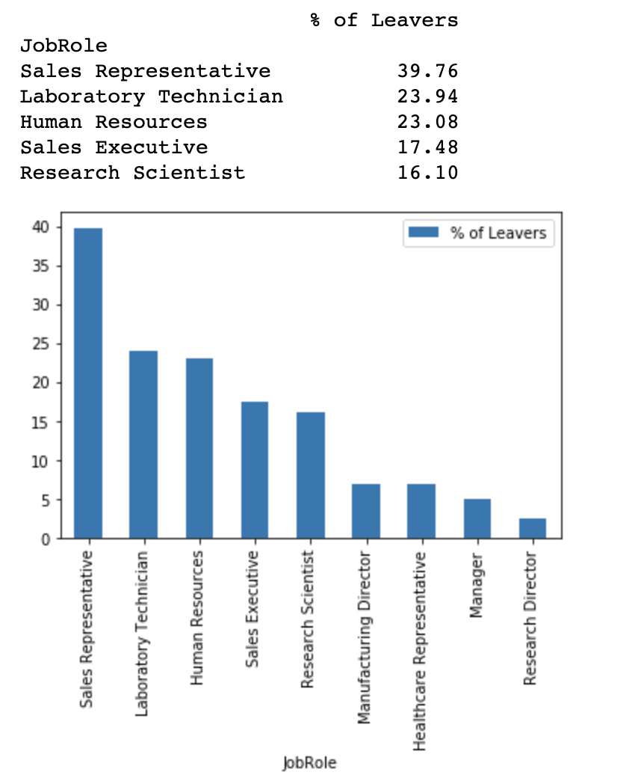
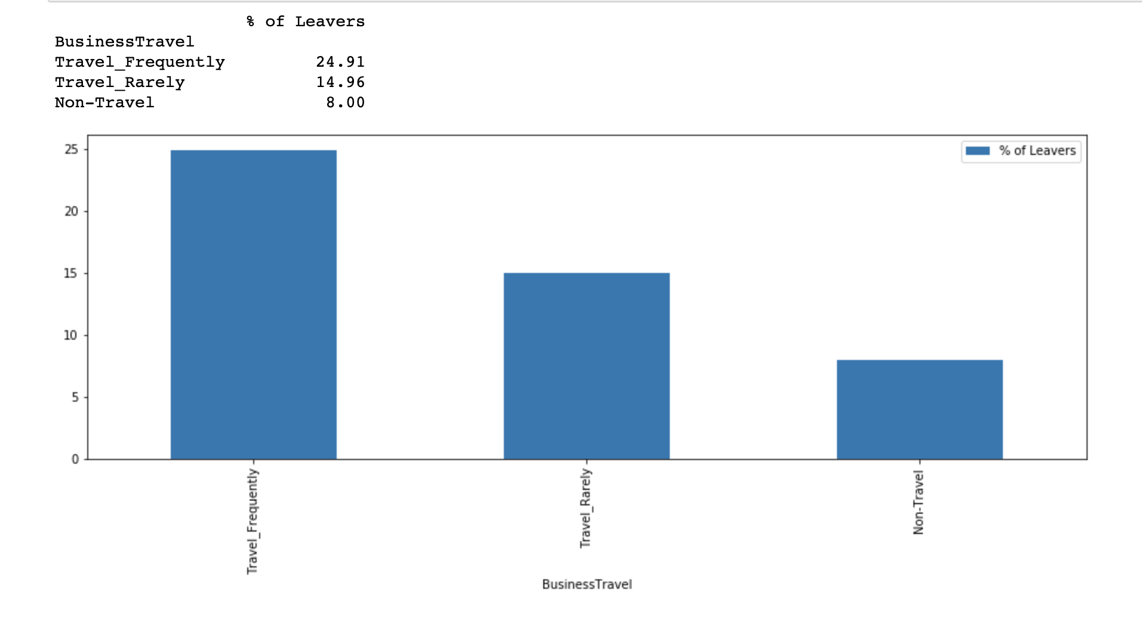
From bar Chart viz, Majority of Company leavers are :Sales Rep & Lab Technician within all Job Roles in the company and Travel frequently
Key Insights
Sales Representative have the highest (39%) Churn followed by Laboratory Technician and Human Resources
Together Sales Rep & Lab Technician make 22% of total Employees count.
Employees who Travel Frequently (25%)are likely to Churn than those who don’t.

Slide 5
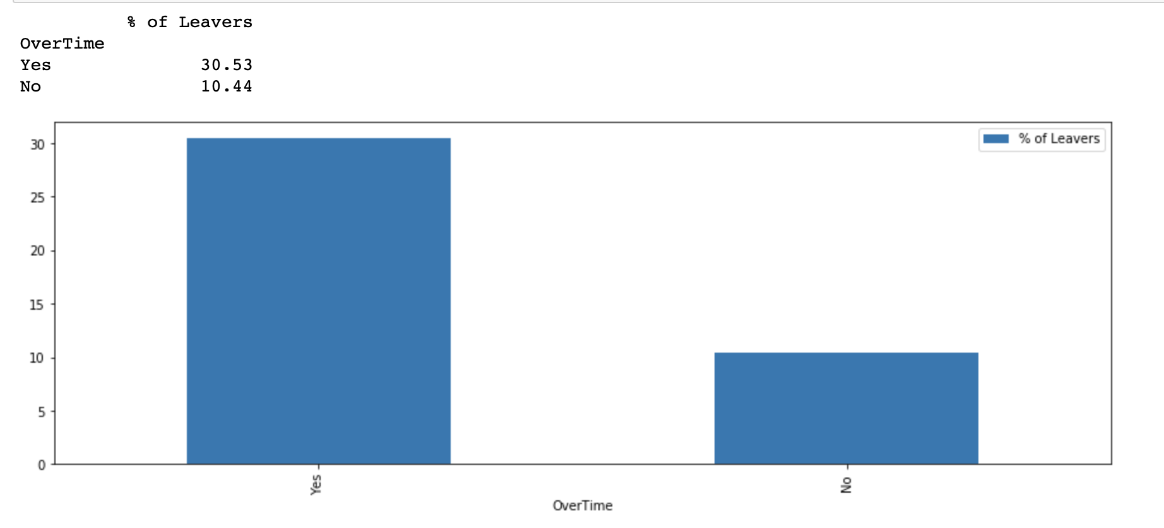
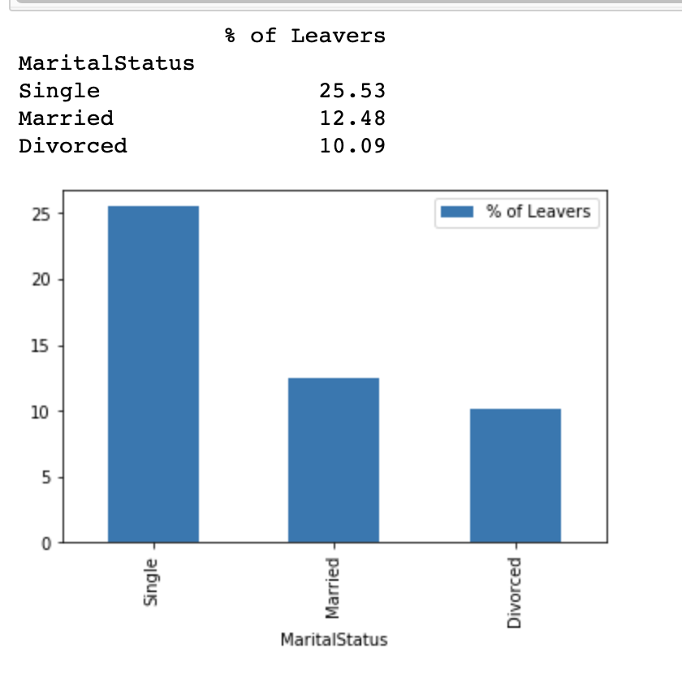
From visualization of Overtime & Marital Status, Employees who work overtime & Single are most likely to leave the company than who don’t.
Key Insights
Employees who work overtime(30%) of them left than those who didn’t account for only 10%.
Employees who work overtime out of all employees is 28.3%.
Employees who are Single (25%) are likely to leave than who are married (12%) or divorced(10%)

Slide 6
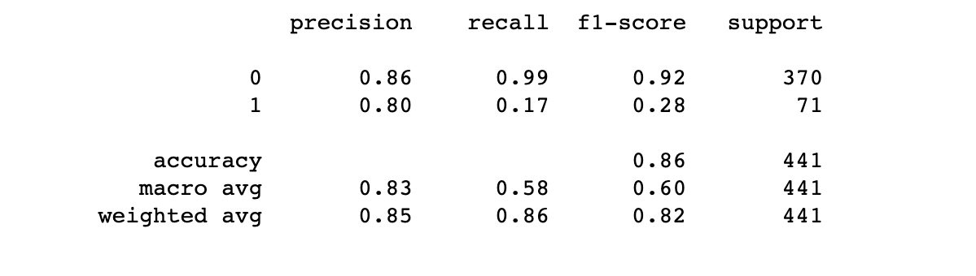
Employing fine tuned Random Forest model, we improved our prediction accuracy of Churn at 86% and can precisely predict the churn 80% of the time.
Final Classification report of RF model
Key Insights
A better Precision(0.80) for employee who Churned shows that our model can better predict true positive i.e. employees that left and labeled as churn from the false positive i.e employees who didn’t actually churned but was labeled as churned.
Our Regression model accuracy is 86%,and could be improved, if data was more balanced.

Slide 7
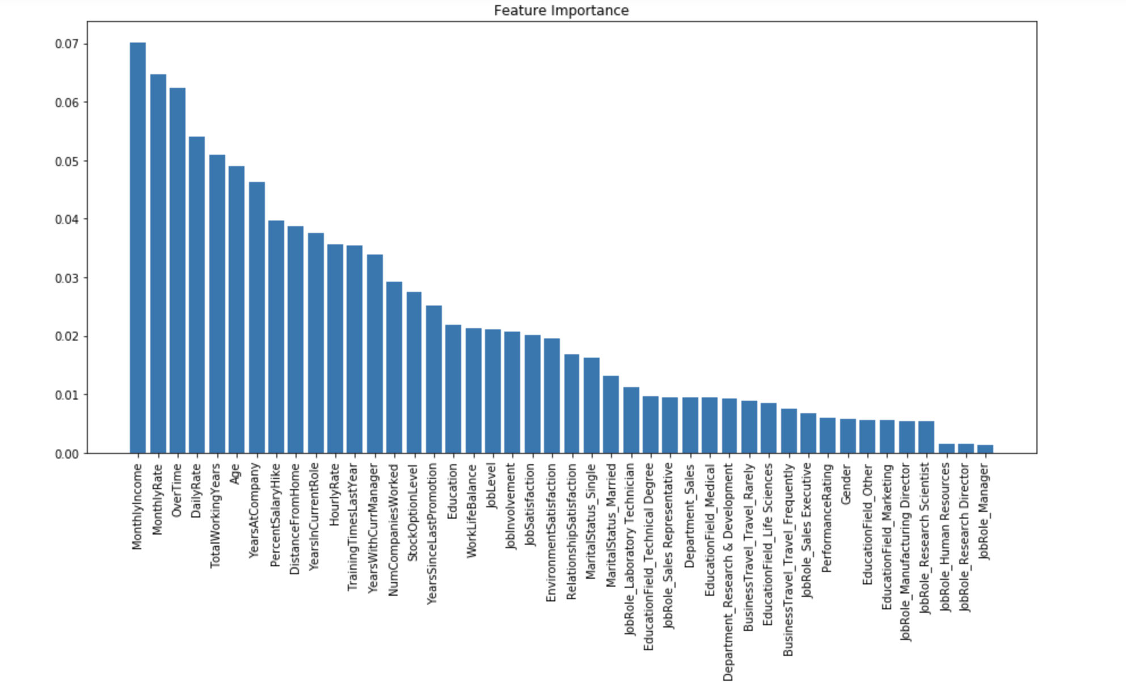
The top 5 core features of fine-tuned Random Forest model, based on their feature importance coefficient are: Monthly Income, Monthly Rate, Overtime, Daily Rate & Total working Years
Key Insights
The feature importance of LR model shows that Monthly Income, Monthly Rate, Overtime, Daily Rate and Total working Years are top features predicting Churn
Out of these features Monthly Income, Over Time & Total working years also matches with variables that showed strongest correlation with target variable Attrition¹.
1:Rerer to Slide 5

