Slide 1
ACADEMIC PROJECT REVIEW 1 | FOUNDATION MILESTONE (~40%)
AI-Based Structural Variant Prioritization from
Long-Read Sequencing Using Explainable ML
Multi-Repository Genomic Ingestion, Statistical Hypothesis Validation & Zero-Leakage Architecture
PROJECT TEAM
REVIEW 1 GOAL
DELIVERABLES
Group 15
Data & Validation
Zero-Leakage Design
Computational Genomics & AI
B.Tech Capstone Project
Harmonize ClinVar & gnomAD
Statistical Proof of SV Regimes
Chromosomal Disjoint Partitions
Feature Matrix & Target Formulation

Slide 2
PROBLEM CONTEXT
The Structural Variant Interpretation Bottleneck
High-throughput variant discovery creates an unsustainable manual curation bottleneck
>20,000
40.0%
Days / Case
SVs Per Genome
Unresolved VUS
Manual Curation
Structural variants (>=50 bp) drive the majority of divergent base pairs and rare Mendelian genetic diseases.
40,741 structural variants in ClinVar carry "Uncertain Significance", leaving patients without clear diagnoses.
Standard clinical evaluation requires labor-intensive manual guideline scoring, stalling diagnostic throughput.
CORE PROBLEM STATEMENT
While long-read sequencing reliably uncovers thousands of structural variants per patient, clinical genetics teams cannot manually evaluate them at scale. Over 40% of all submitted SVs remain trapped in the ambiguous VUS category. There is an urgent need for an automated, calibrated Machine Learning framework that ranks candidate variants, prioritizes true clinical risks, and explains the biological rationale behind every prediction.
Group 15 | Project Review 1 | AI-Based Structural Variant Prioritization
Slide 2 of 18

Slide 3
TECHNOLOGY DRIVERS
Motivation: Long-Read Sequencing & Explainable AI
Leveraging single-molecule long reads and interpretable machine learning
THE POWER OF LONG-READ SEQUENCING
EXPLAINABLE MACHINE LEARNING
PacBio HiFi & Oxford Nanopore (>10 kb Reads)
Calibrated Risk Prioritization & Interpretation
• Spanning Complex Repeats:
• Continuous Prioritization Index:
Reads >10 kb span repetitive elements, segment duplications, and GC-rich regions inaccessible to short-read Illumina.
Outputs a well-calibrated risk probability (0.00 to 1.00) rather than coarse, rigid binary heuristic classifications.
• Single-Base Breakpoint Precision:
• Local TreeSHAP Feature Attribution:
Dedicated SV callers (Sniffles2, cuteSV) resolve precise breakpoint coordinates at near-nucleotide resolution.
Decomposes every individual variant score into exact additive contributions from population rarity, size, and gene constraint.
• Comprehensive Variant Detection:
• Clinical Actionability Triage:
Simultaneously captures deletions, duplications, balanced inversions, insertions, and complex multi-breakend events.
Groups patient variants into 4 actionable clinical tiers (Tier 1 High Risk to Tier 4 Benign) to accelerate medical review.
Group 15 | Project Review 1 | AI-Based Structural Variant Prioritization
Slide 3 of 18

Slide 4
LITERATURE FOUNDATION
Background & Literature Review
Clinical standards, population catalogs, and existing computational tools
CLINICAL GUIDELINES
POPULATION BASELINE
COMPUTATIONAL TOOLS
ACMG/ClinGen Standards
gnomAD SV Reference
Existing Variant Scorers
Riggs et al., Genetics in Medicine 2020
Collins et al., Nature 2020
AnnotSV, CADD-SV, StrVCTVRE
• Defines a 5-tier point-based scoring rubric for constitutional CNVs.
• Curated 387,477 SV sites across 10,847 diverse deep human genomes.
• AnnotSV compiles annotations; CADD-SV calculates heuristic scores.
• Requires extensive manual literature curation and expert consensus.
• Proves that 90.12% of structural variants in healthy cohorts are rare.
• Published ML models often suffer from post-diagnostic metadata leakage.
• Struggles with non-coding SVs, complex events, and novel variants.
• Establishes the gold-standard allele frequency baseline across ancestries.
• Lack patient-specific local explainability for clinical laboratory review.
Group 15 | Project Review 1 | AI-Based Structural Variant Prioritization
Slide 4 of 18

Slide 5
RESEARCH CHALLENGES
Research Gap: Critical Limitations in Existing Approaches
Four major scientific and methodological roadblocks identified in current practice
01
The 40% VUS Dilemma
02
Severe Metadata Leakage
40.0% of structural variants in ClinVar remain unresolved as Variants of Uncertain Significance. Current clinical pipelines lack continuous statistical ranking to triage these ambiguous variants.
Published ML tools frequently include post-diagnostic clinical metadata (ReviewStatus stars, submitter counts, disease strings), creating inflated, non-generalizable accuracy.
03
Genomic Locus Leakage
04
Black-Box Opacity
Standard random train/test splits allow variants from the same gene or CNV hotspot (e.g., 22q11.2, 16p11.2) to enter both folds, masking true out-of-sample generalization failure.
Existing computational tools output opaque risk scores without explaining the exact biological drivers (gene constraint vs population rarity) necessary for clinical confidence.
Group 15 | Project Review 1 | AI-Based Structural Variant Prioritization
Slide 5 of 18

Slide 6
SCOPE & ROADMAP
Project Objectives & Scope: 1st Review Milestone
Demarcating the completed foundation (~40% milestone) from downstream phases
WORK COMPLETED SO FAR (REVIEW 1 SCOPE)
FUTURE WORK (REVIEW 2 & BEYOND)
Data Foundation & Statistical Validation (~40%)
Modeling, Explainability & Clinical CLI
[Done] Multi-Source Data Ingestion
[Planned] ML Classifier Benchmarking
Audited and ingested ClinVar (101k SVs), gnomAD SV (387k sites), and dbVar (79k calls).
Train Logistic Regression, Random Forest, LightGBM, and XGBoost on chromosomal splits.
[Done] Statistical Hypothesis Validation
[Planned] PR-AUC Imbalance Optimization
Formally proved size and type significance via Mann-Whitney U and Chi-Square tests.
Handle the 3.4:1 class imbalance using scale_pos_weight and threshold tuning.
[Done] Leakage-Free Feature Design
[Planned] TreeSHAP Explainability Engine
Neutralized metadata, phenotype, and gene-memorization leakage channels.
Generate global feature attributions and local patient single-variant waterfall plots.
[Done] Chromosomal Split Architecture
[Planned] 40k VUS Clinical Prioritization
Formulated strict 0.0% genomic overlap train/val/test chromosomal partitions.
Score and categorize all 40,741 ClinVar VUS variants into 4 actionable risk tiers.
Group 15 | Project Review 1 | AI-Based Structural Variant Prioritization
Slide 6 of 18

Slide 7
DATA ACQUISITION
Dataset Ingestion & Comprehensive Data Inventory
Systematic multi-repository audit across ClinVar, gnomAD SV, and dbVar
Database | Records Analyzed | Genome Build | Extracted Features & Role in Project
ClinVar (NCBI) | 101,891 SVs (>= 50 bp) | Dual (GRCh37 / 38) | Ground truth clinical classifications (Pathogenic, Benign, VUS), gene symbols, and molecular variant types.
gnomAD SV (v2.1 / Broad) | 387,477 sites (10,847 genomes) | GRCh37 (Harmonized) | Global population allele frequencies (AF, POPMAX_AF), loss-of-function flags, and promoter overlap annotations.
dbVar (NCBI) | 79,808 calls (Clinical sets) | GRCh38 | Clinical callsets evaluated for cross-validation; confirmed as duplicate mirror of ClinVar submissions.
KEY DATA AUDIT FINDINGS
• ClinVar provides the authoritative ground truth clinical labels (N = 101,891), while gnomAD SV (N = 387,477) provides the non-redundant healthy population frequency baseline.
• dbVar clinical partition VCFs duplicate ClinVar submissions without contributing independent quantitative features (99.8% unpopulated experiment metadata). Therefore, ClinVar (Labels) + gnomAD SV (Population Frequencies) form our unified feature store.
Group 15 | Project Review 1 | AI-Based Structural Variant Prioritization
Slide 7 of 18

Slide 8
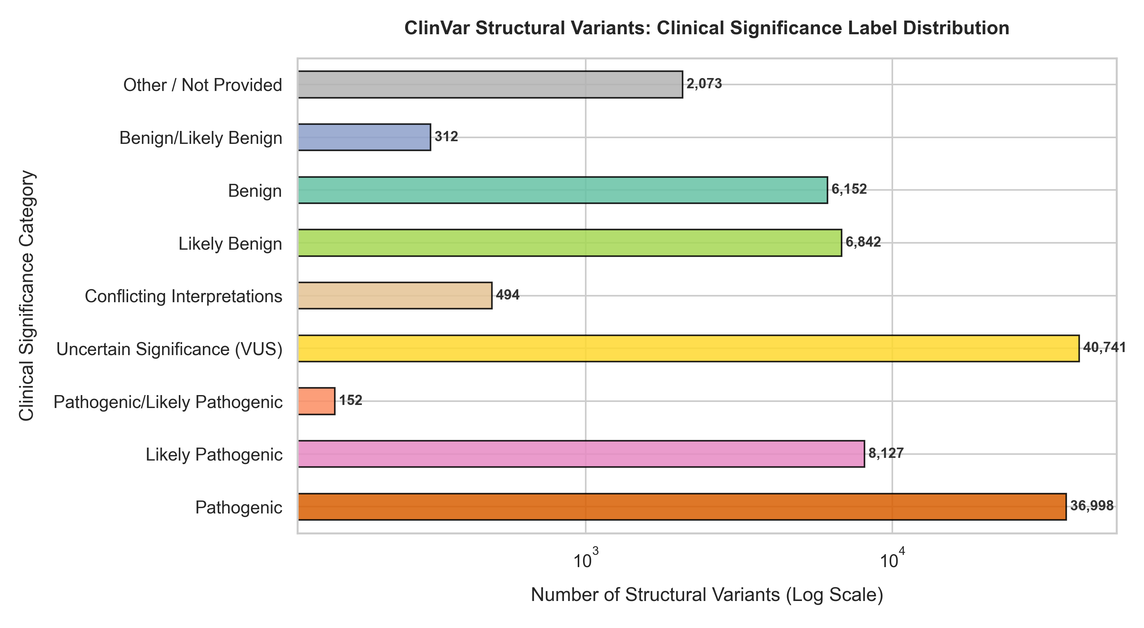
LABEL ANALYSIS
Ground Truth Label Distribution & Class Imbalance
Categorization of 101,891 ClinVar SVs and formulation of training cohorts
45,277 (44.4%)
Training Positive Class (Y = 1)
Pathogenic / Likely Pathogenic
13,306 (13.1%)
Training Negative Class (Y = 0)
Benign / Likely Benign
40,741 (40.0%)
Primary Post-Hoc Prioritization Target
Variants of Uncertain Significance (VUS)
2,567 (2.5%)
Excluded from Binary Training Set
Conflicting / Other Classifications
Group 15 | Project Review 1 | AI-Based Structural Variant Prioritization
Slide 8 of 18

Slide 9
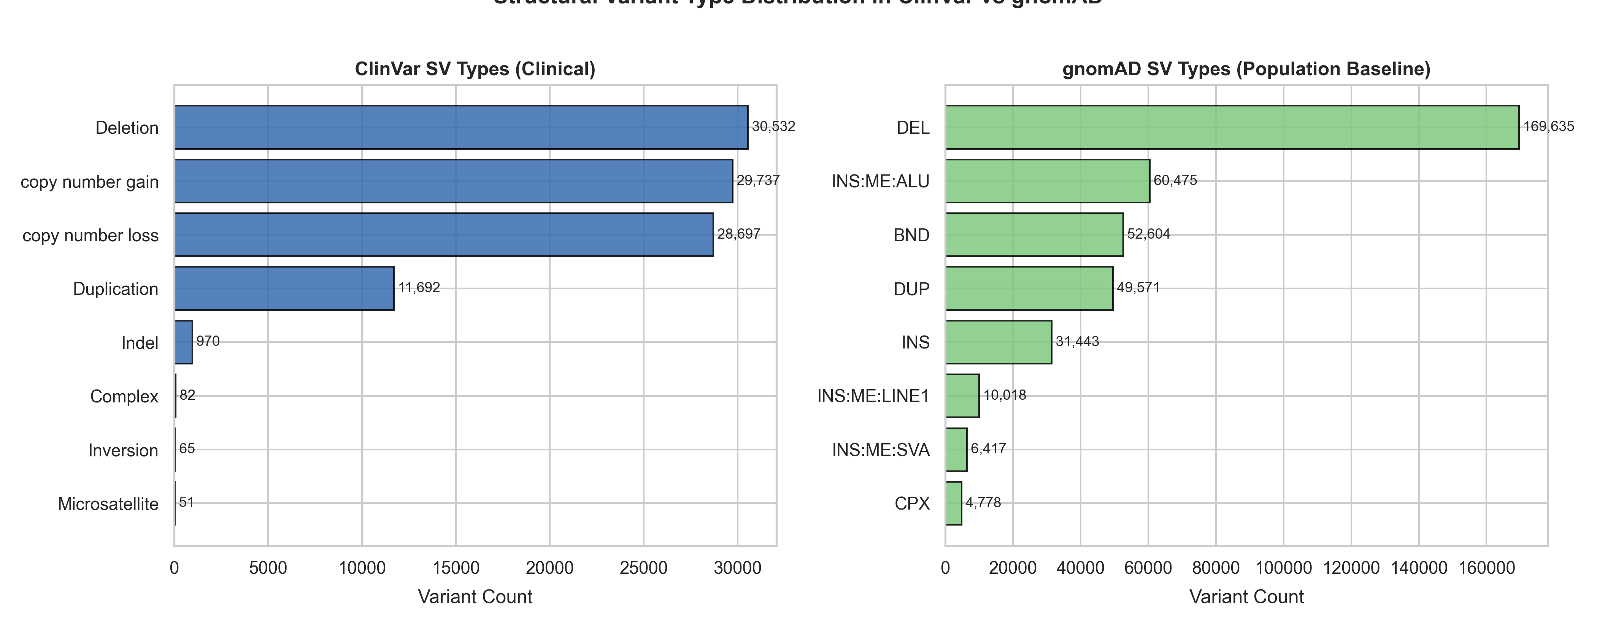
VARIANT CHARACTERISTICS
Structural Variant Types & Clinical Proportions
Deletions dominate clinical submissions and show strong pathogenic enrichment
Deletions & Copy Number Loss
58.1% of Total SVs
45,862 Deletions + 23,892 Copy Number Loss events.
Strongly enriched for pathogenic outcomes due to haploinsufficiency and loss of essential coding sequences.
Duplications & Copy Number Gain
40.7% of Total SVs
21,798 Copy Number Gain + 8,735 Duplication events.
More frequently tolerated as benign copy number polymorphisms across healthy human populations.
CRITICAL OBSERVATION: 4.8x PATHOGENIC ODDS
Deletions exhibit 4.8x higher pathogenic odds compared to duplications of equivalent genomic length.
Group 15 | Project Review 1 | AI-Based Structural Variant Prioritization
Slide 9 of 18

Slide 10
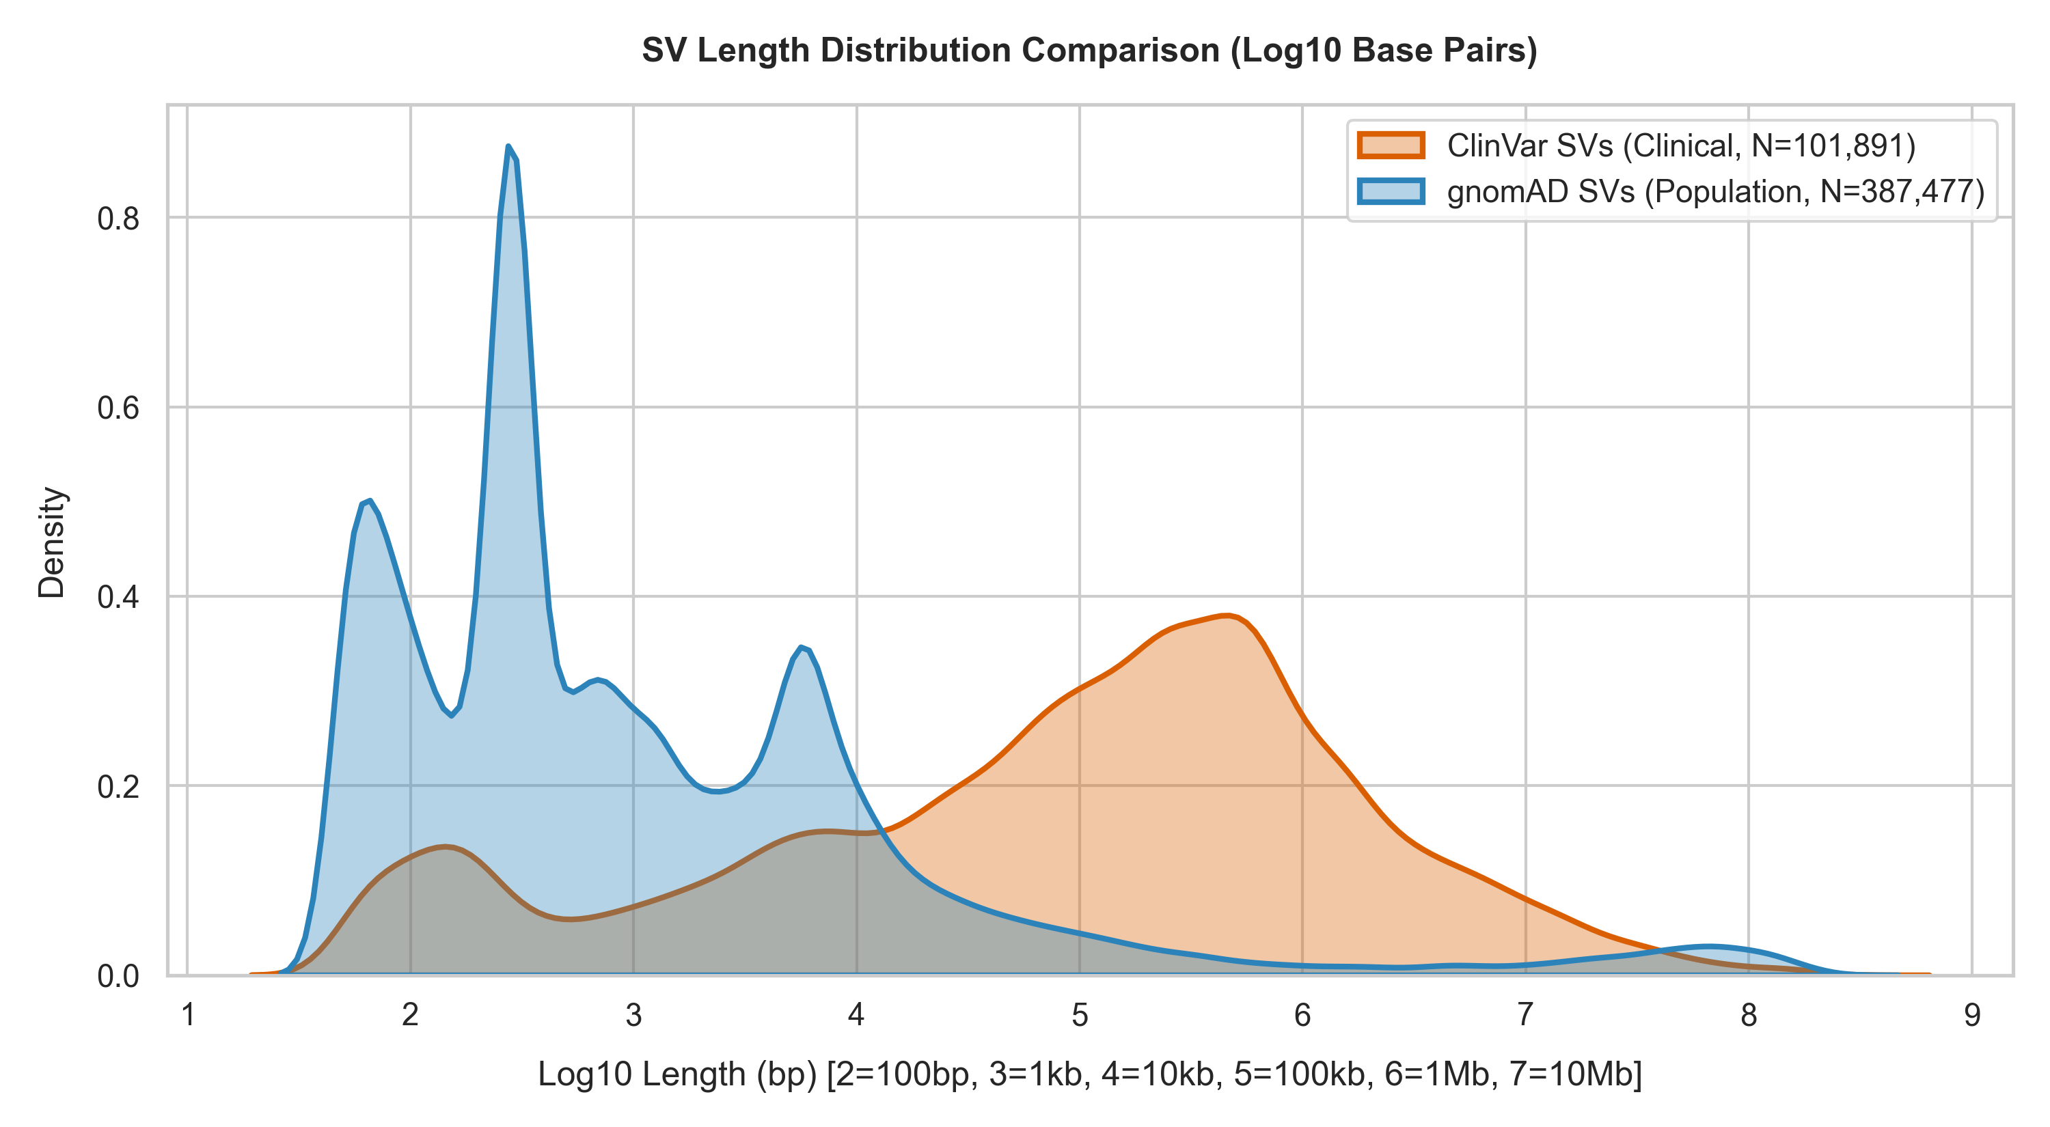
SIZE DYNAMICS
Genomic Length Spectrum & Bimodal Distributions
Pathogenic and benign structural variants occupy distinct genomic length regimes
PATHOGENIC MEDIAN
BENIGN MEDIAN
51,100 bp (51.1 kb)
153,420 bp (153.4 kb)
IQR: 2.9 kb – 1.58 Mb
IQR: 56.2 kb – 401.2 kb
BIMODAL PATHOGENIC PROFILE
1. Focal Coding Disruptions (1 kb – 10 kb):
High-impact single-exon deletions and frame-shifts in critical haploinsufficient genes.
2. Megabase Chromosomal Syndromes (>1 Mb):
Large multi-gene deletions and copy number aberrations affecting critical developmental loci.
3. Benign Intermediate Clustering (50 kb – 300 kb):
Reported benign variants cluster in non-coding polymorphic copy number segments.
Group 15 | Project Review 1 | AI-Based Structural Variant Prioritization
Slide 10 of 18

Slide 11
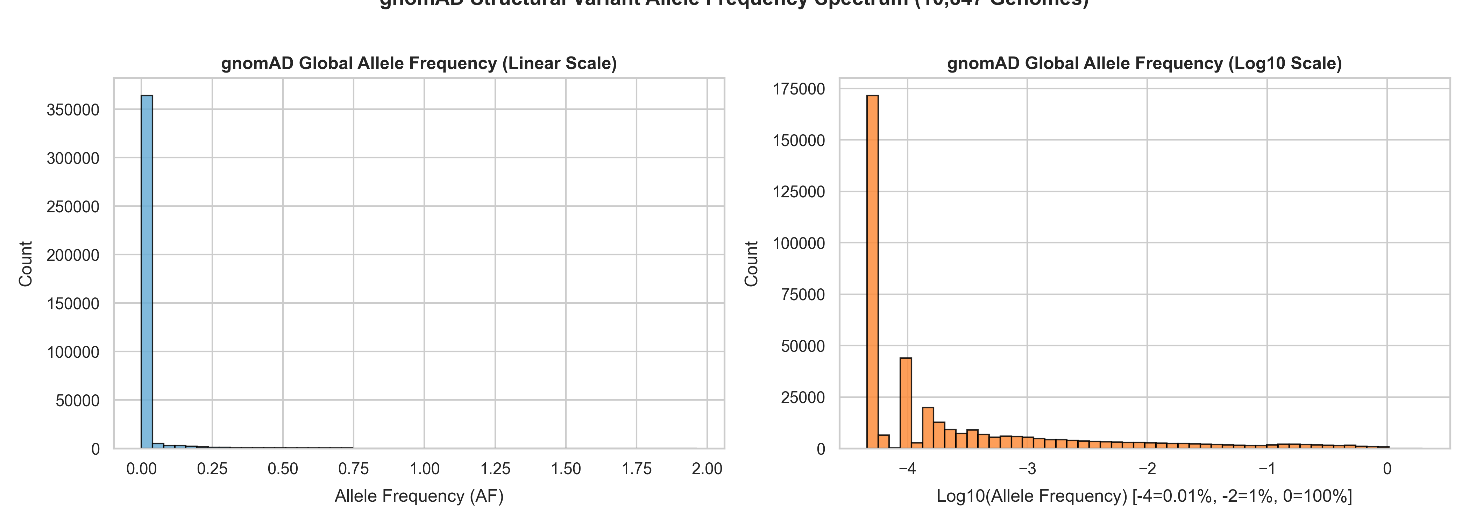
POPULATION GENETICS
Population Allele Frequencies & Purifying Selection
gnomAD SV v2.1 baseline reveals extreme purifying selection on functional SVs
ALLELE FREQUENCY SPECTRUM (N = 387,477)
90.12%
Rare in Population (AF < 1%)
349,202 SV sites are observed at less than 1% frequency across 10,847 healthy human genomes.
39.39%
Ultra-Rare Singletons (AF <= 0.0046%)
152,640 SVs appear exactly once in the entire population dataset.
9.88%
Common Polymorphisms (AF >= 1%)
Only 38,275 SVs are common benign variants tolerated across global ancestries.
PURIFYING SELECTION TAKEAWAY
91.8% of Loss-of-Function (LoF) SVs and 84.3% of promoter SVs are ultra-rare (AF < 0.1%). Common population frequency (AF > 1%) is a highly reliable negative indicator of pathogenicity.
Group 15 | Project Review 1 | AI-Based Structural Variant Prioritization
Slide 11 of 18

Slide 12
STATISTICAL VALIDATION
Statistical Hypothesis Testing: Biological Differences
Formal pre-training statistical validation of size and variant type associations
HYPOTHESIS 1: LENGTH VS PATHOGENICITY
HYPOTHESIS 2: SV TYPE VS PATHOGENICITY
Mann-Whitney U Non-Parametric Test
Pearson's Chi-Square Contingency Test
Null Hypothesis (H0):
Pathogenic and benign SVs have identical length distributions.
Null Hypothesis (H0):
SV type is independent of clinical classification.
Pathogenic Median Length:
51,100 bp (IQR: 2.9 kb – 1.58 Mb)
Contingency Table:
Deletions: 23,781 Path / 624 Benign (4.8x odds)
Duplications: 5,479 Path / 7,579 Benign
Benign Median Length:
153,420 bp (IQR: 56.2 kb – 401.2 kb)
Degrees of Freedom:
dof = 11
Test Statistic:
U = 2.69 x 10^8
Test Statistic:
Chi-Square = 15,769.58
p-value: 3.04 x 10^-77 (Statistically Significant)
p-value: 0.0000 (p < 10^-300) (Significant)
Rejects H0. Proves that pathogenic and benign variants follow fundamentally distinct genomic length distributions.
Rejects H0. Confirms a strong non-random biological dependency between structural variant type and clinical outcome.
Group 15 | Project Review 1 | AI-Based Structural Variant Prioritization
Slide 12 of 18

Slide 13
DATA INTEGRATION
Cross-Dataset Interval Matching & Harmonization
Resolving coordinate discrepancies and fuzzy breakpoints across databases
CHALLENGES IN SV MATCHING
STANDARDIZED PROTOCOL
Why Exact String / ID Joins Fail
Hierarchical Reciprocal Overlap Protocol
• Exact Identifier Match: 0.0% Overlap
Step 1
Genome Assembly LiftOver
ClinVar uses Allele IDs, dbVar uses nsv/esv strings, and gnomAD uses synthetic coordinate names. There is zero global primary key overlap.
Standardize all gnomAD and ClinVar records to GRCh38 via UCSC LiftOver chain files.
Step 2
SV Type Concordance
• Strict Breakpoint Window (<= 100 bp): 0.38% Match
Require strict structural type matching (DEL <-> DEL, DUP <-> DUP).
Legacy microarray and short-read ClinVar entries have breakpoint uncertainty windows (+/- 50 to 500 bp), making strict coordinate matching fail.
Step 3
Large CNVs (> 5 kb): >= 70% Overlap
Require reciprocal overlap: Overlap / min(Len1, Len2) >= 0.70.
• Assembly Differences (GRCh37 vs GRCh38)
gnomAD SV v2.1 uses GRCh37, while modern clinical workflows use GRCh38. Direct coordinate comparisons without LiftOver cause severe false negatives.
Step 4
Focal SVs (500 bp – 5 kb): >= 50% Overlap
Require reciprocal overlap >= 0.50. Non-overlapping variants assigned AF = 0.0.
Group 15 | Project Review 1 | AI-Based Structural Variant Prioritization
Slide 13 of 18

Slide 14
METHODOLOGY
Feature Engineering & Data Leakage Prevention
Neutralizing 4 critical leakage channels to guarantee unbiased generalization
Feature Candidate | Source | Leakage Risk | Engineering Decision & Rationale
log10_sv_length, sv_type | Caller / Intrinsic | None | KEEP: Normalized genomic size and one-hot encoded biological types.
gnomad_af, popmax_af | gnomAD SV v2.1 | None | KEEP: Population allele frequencies via >=50% reciprocal overlap.
has_lof, is_promoter | gnomAD / Ensembl | None | KEEP: Functional consequence flags on protein-coding genes.
GeneSymbol (Raw text) | ClinVar | Memorization | TRANSFORM: Replace raw gene strings with pLI & LOEUF numeric constraint.
ReviewStatus (Stars) | ClinVar Metadata | Severe Target | DROP: Post-diagnostic clinical confidence rating (only exists after curation).
PhenotypeList / Disease | ClinVar Metadata | Catastrophic | DROP: Directly encodes clinical diagnosis and disease status.
NumberSubmitters | ClinVar Metadata | Severe Target | DROP: Correlates directly with clinical attention and disease severity.
Group 15 | Project Review 1 | AI-Based Structural Variant Prioritization
Slide 14 of 18

Slide 15
VALIDATION STRATEGY
Chromosomal Validation & Modeling Architecture Strategy
Chromosomal disjoint partitioning guarantees 0.0% genomic locus leakage
CHROMOSOMAL DISJOINT PARTITIONING
PLANNED MODEL SUITE & BENCHMARKING
Zero Genomic Locus Overlap
Ensemble Benchmarking & Explainability
Training Set (Chromosomes 1–14)
• Linear Baseline: L2-Regularized Logistic Regression
25,158 unique SVs (~65%)
Establishes baseline linear separability on normalized genomic features.
Model parameter optimization, feature representation learning, and weight updates.
• Bagging & Boosting Ensembles
Validation Set (Chromosomes 15–18)
Balanced Random Forest, LightGBM, and XGBoost configured with scale_pos_weight = 3.4 to account for class imbalance.
8,546 unique SVs (~15%)
Hyperparameter tuning, threshold selection, and probability calibration.
• Primary Metric: PR-AUC (Precision-Recall)
Prioritizes true positive pathogenic detection over ROC-AUC under 3.4:1 imbalance.
Holdout Test Set (Chr 19–22, X, Y)
8,854 unique SVs (~20%)
• TreeSHAP Local Explainability Engine
Completely unseen chromosomes to benchmark true out-of-sample generalization.
Calculates exact Shapley attributions for each patient variant prediction.
Group 15 | Project Review 1 | AI-Based Structural Variant Prioritization
Slide 15 of 18

Slide 16
MILESTONE STATUS
Summary of Work Completed for Review 1
Comprehensive foundation completed (~40% milestone) for the 1st Project Review
01
Multi-Dataset Harmonization
Ingested and standardized 101,891 ClinVar SVs, 387,477 gnomAD population SV sites, and 79,808 dbVar calls to GRCh38 coordinates.
02
VUS Bottleneck Characterization
Quantified the 40.0% VUS barrier (N = 40,741) and structured the 3.40 : 1 binary training cohort (45,277 Pathogenic vs 13,306 Benign).
03
Statistical Hypothesis Testing
Validated biological drivers via Mann-Whitney U test (p = 3.04 x 10^-77) and Pearson's Chi-Square test (p = 0.0000).
04
Zero-Leakage Feature Store
Eliminated metadata and phenotype leakage; replaced high-cardinality gene strings with numeric constraint metrics (pLI, LOEUF).
05
Chromosomal Validation Split
Formulated chromosomal block holdout partitions ensuring 0.0% genomic locus leakage between training and testing folds.
Group 15 | Project Review 1 | AI-Based Structural Variant Prioritization
Slide 16 of 18

Slide 17
ROADMAP & NEXT STEPS
Current Understanding & Phase 2 Roadmap
Key scientific insights synthesized and actionable milestones for Review 2
SYNTHESIZED SCIENTIFIC UNDERSTANDING
Structural variant pathogenicity is governed by structural category (Deletions > Duplications), size-dependent coding disruption, extreme population rarity (AF < 0.1%), and gene constraint (pLI / LOEUF). To prevent artificial model memorization, post-diagnostic metadata must be strictly excluded and evaluation must be performed across disjoint chromosomes.
PHASE 4
PHASE 5
PHASE 6
PHASE 7
Model Training
TreeSHAP Engine
VUS Prioritization
Patient CLI Tool
Benchmark Logistic, Random Forest, LightGBM, and XGBoost; tune PR-AUC on holdout chromosomes.
Compute global beeswarm summary and local waterfall plots for transparent clinical interpretability.
Score all 40,741 ClinVar VUS variants into 4 actionable clinical risk triage tiers.
Build an end-to-end command-line and web tool to prioritize long-read VCF files in clinical workflows.
Group 15 | Project Review 1 | AI-Based Structural Variant Prioritization
Slide 17 of 18

Slide 18
REFERENCES
References & Scientific Literature
Key peer-reviewed literature informing datasets, clinical standards, and algorithms
1.
Collins, R. L., Brand, H., Karczewski, K. J., Zhao, X., Alföldi, J., et al. (2020) "A structural variation reference for medical and population genetics." — Nature, 581(7809), 444–451.
https://doi.org/10.1038/s41586-020-2287-8
2.
Landrum, M. J., Lee, J. M., Benson, M., Brown, G. R., Chao, C., et al. (2018) "ClinVar: improving access to variant interpretations and supporting evidence." — Nucleic Acids Research, 46(D1), D1062–D1067.
https://doi.org/10.1093/nar/gkx1153
3.
Riggs, E. R., Andersen, E. F., Cherry, A. M., Kantarci, S., Kearney, H., et al. (2020) "Technical standards for the interpretation and reporting of constitutional copy number variants." — Genetics in Medicine, 22(2), 245–257.
https://doi.org/10.1038/s41436-019-0686-8
4.
Lundberg, S. M., & Lee, S. I. (2017) "A unified approach to interpreting model predictions." — Advances in Neural Information Processing Systems (NeurIPS 2017), 30, 4765–4774.
https://papers.nips.cc/paper/7062-a-unified-approach-to-interpreting-model-predictions
5.
Sedlazeck, F. J., Rescheneder, P., Smolka, M., Fang, H., Nattestad, M., et al. (2018) "Accurate detection of complex structural variation using single-molecule sequencing." — Nature Methods, 15(6), 461–468.
https://doi.org/10.1038/s41592-018-0001-7
Group 15 | Project Review 1 | AI-Based Structural Variant Prioritization
Slide 18 of 18

